Slide 1
Seg_595_dynamic

Slide 2
Seg_595_dynamic
In previous chapter, we builded the seg_595_static, six seven-segment-display all display same value because sel[5:0] always 6’b111_111, but if we want to display 0 to 999_999 by sequence, the sel[5:0] shouldn’t be 6’b111_111, sel value should be corresponding display position value.
So, in this chapter we need to build the project for seg_595_dynamic, the sel is corresponding with seg, each seven-segment-display can display different value.
0
0
0
0
0
0
0
0
0
0
0
1
0
0
0
0
0
2
Ignore 2 to 999_996
9
9
9
9
9
9
9
9
9
9
9
8
9
9
9
9
9
7

Slide 3
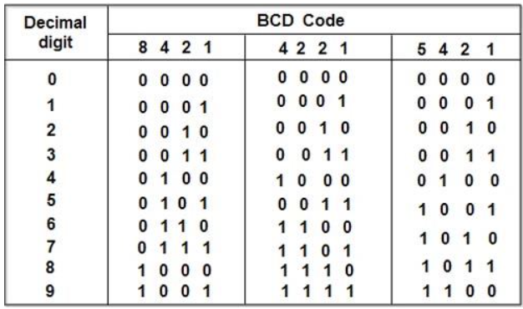
Binary to BCD
If we want to display 0 to 999_999, but the value in binary, can’t align corresponding sel signal.
For example, the value 321 in binary is 1_0100_0001, but in BCD is 0011_0010_0001, we can using sel[0] to present 0001, sel[1] present 0010 and sel[2] present 0011, so we need to translate the data value from binary to BCD.

Slide 4
BCD encode
BCD is using 4 bit width binary to represent 1 decimal number.
So, in this chapter, the max value is decimal 999_999, we need 4x6 = 24 bit width binary.
And the formula is generate 24 bit width array and full of 0, {24’b0}. And define the 4 bit width is 1 section, total 6 sections.
Then we can shift the decimal number to this array, shift 1 bit per time, if either section value bigger than 4, this section need to add 3 first then shift.
Add 3 is due to BCD encode only present 0 to 9, but 4 bit width binary is 0 to 15, if any section value is bigger then 9, needs add 6 carry to next section, so before shift if the value bigger than 4, it means after shift the value will bigger than 9, add 3 then shift = shift then add 6.

Slide 5
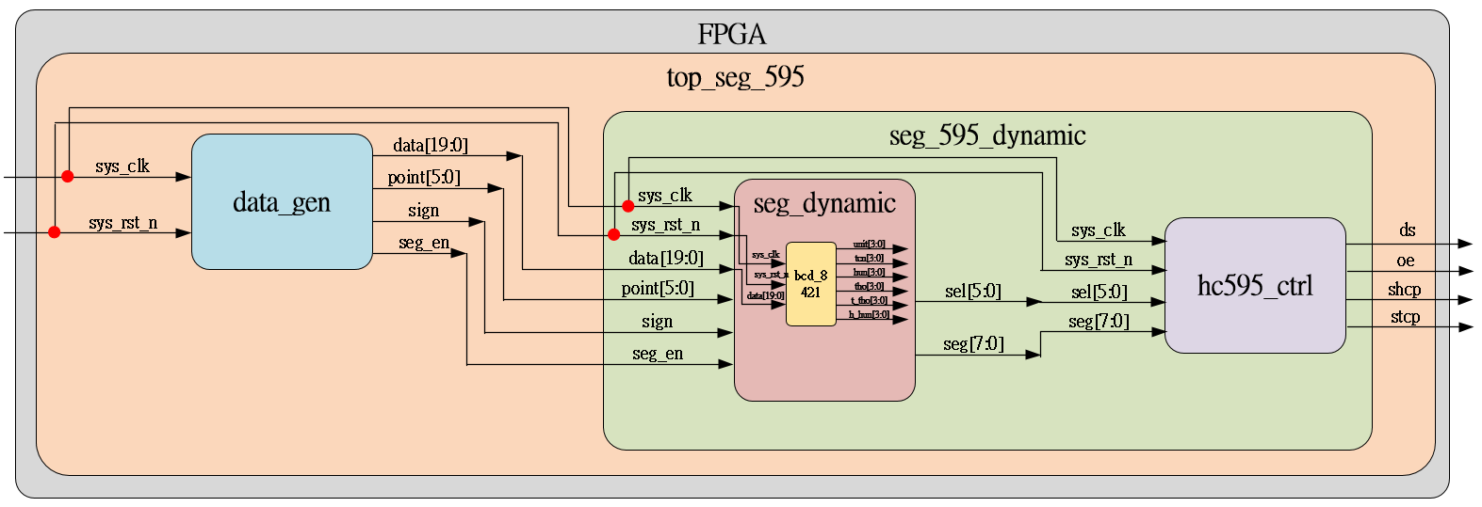
Objective
Using persistence of vision theory, the sel change speed is 1ms and the data changed speed is 100 ms, generate the data 0 to 999_999 by sequence and display by six seven-segment-display.

Slide 6
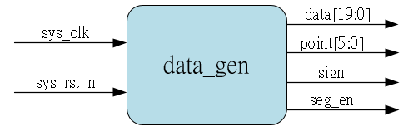
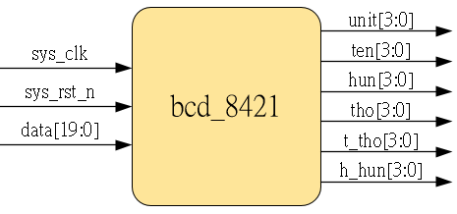
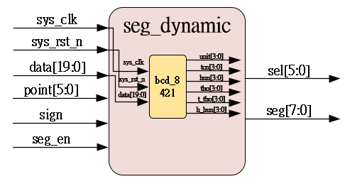
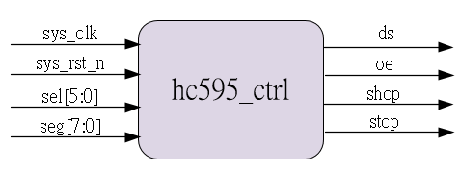
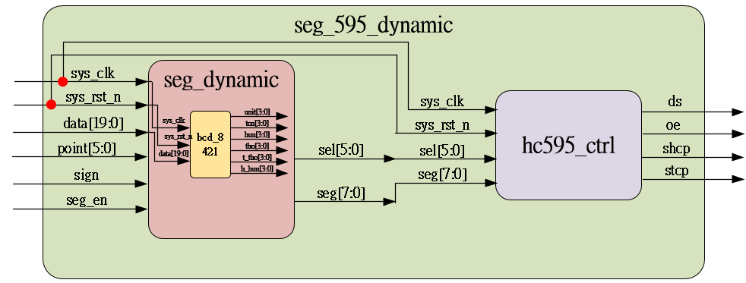
System_sub-module
Using previous

Slide 7
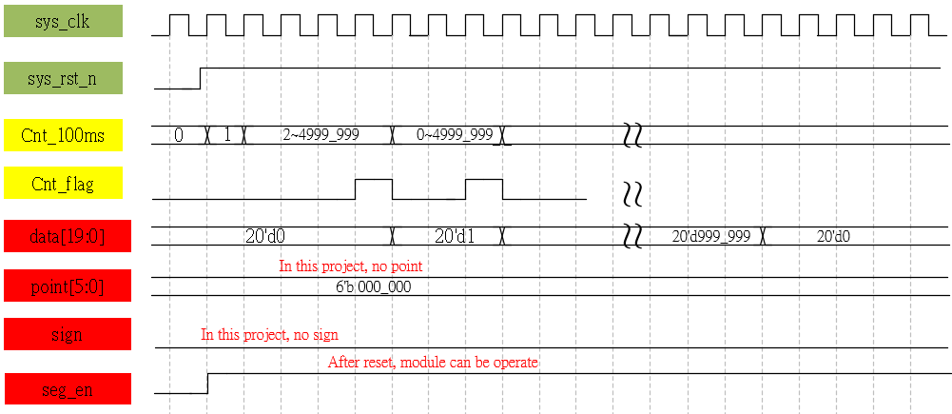
Waveform Graph – data_gen

Slide 8
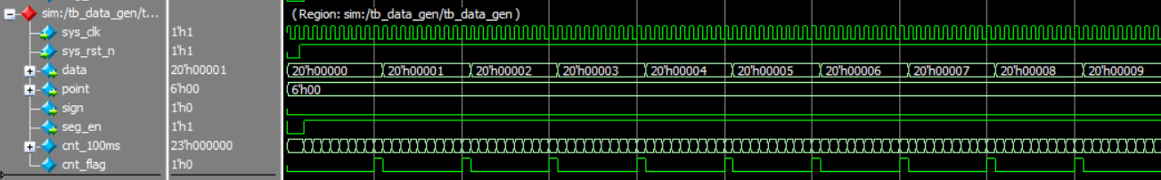
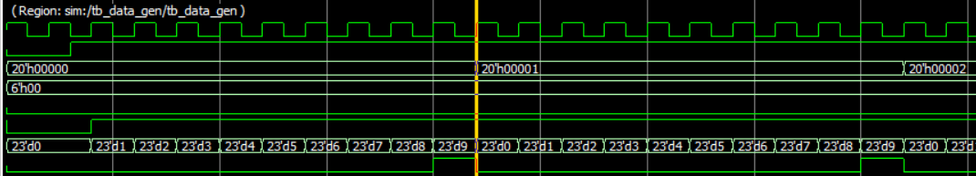
Simulation- data_gen
Test bench set the data_max = 9 & cnt_max = 9, correct.

Slide 9
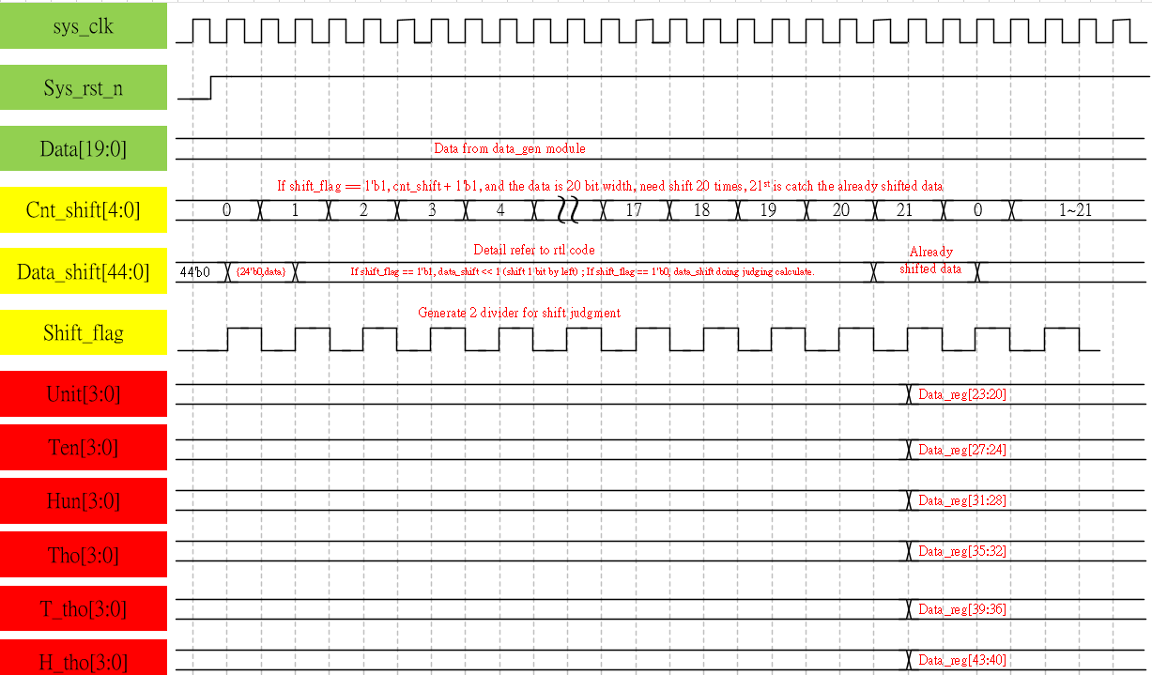
Waveform Graph – bcd_8421

Slide 10
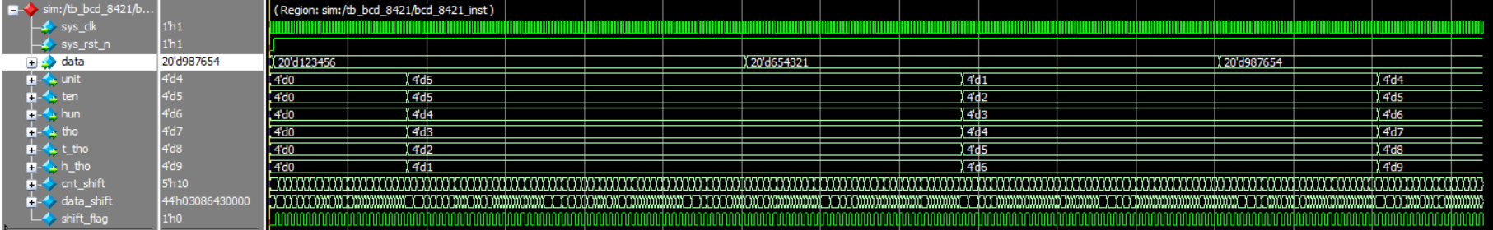
Simulation- bcd_8421
Test bench set the data is 123456 & 654321 & 987654, all translate correct.

Slide 11
Waveform Graph – Seg_dynamic
Attached png file can see high resolution picture.

Slide 12
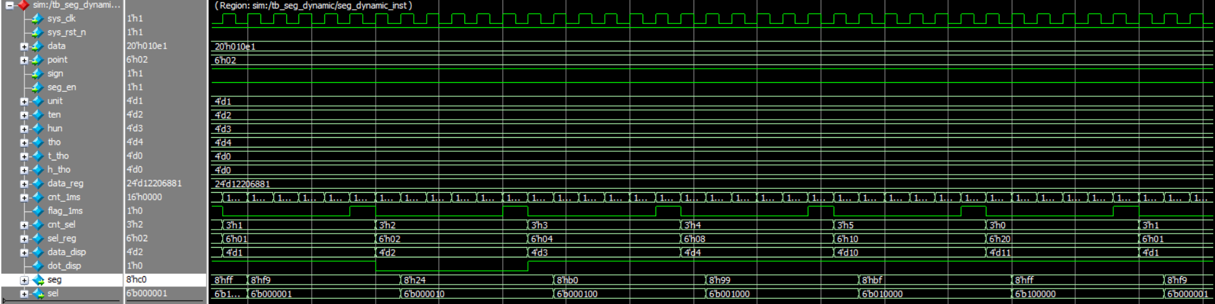
Simulation- Seg_dynamic
The test bench is transfer 0 – 4321 to this module, sel and seg is correct.

