Slide 1
Seg_595_static

Slide 2
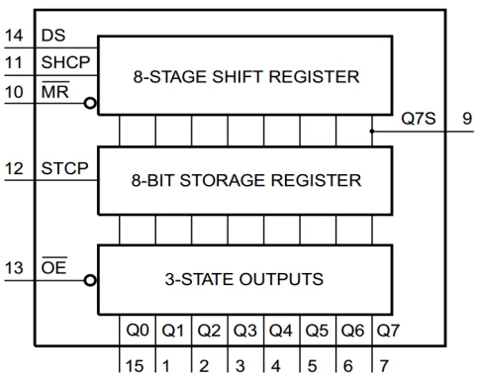
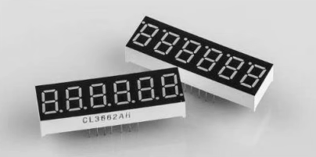
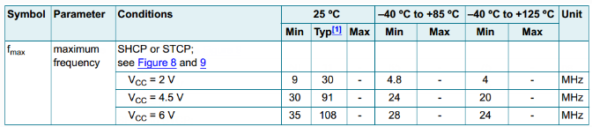
Seg_595_static
In Embedfire Pro FPGA, using two 74HC595PW (shift register) to control the seven-segment-display.
So we need to using FPGA generate the DS, SHCP, STCP and OE signal, and FPGA using 3.3V to 74HC595PW, so we using 12.5 MHz as SHCP working frequency.
And the seven-segment-display needs seg[7:0] and sel [5:0] signal, it’s FPGA generate the serial in signal to DS, and parallel out by 74HC595PW to seven-segment-display.

Slide 3
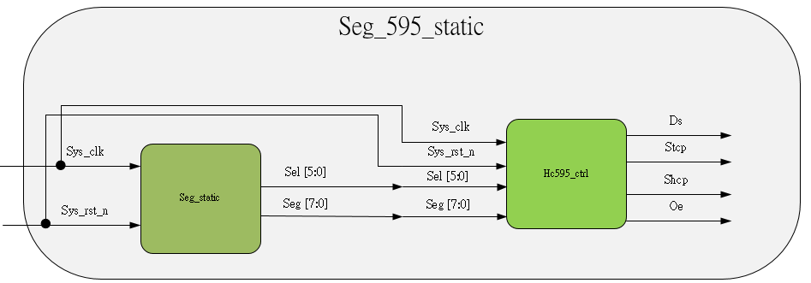
Objective
In this FPGA, seven-segment-display can display six numbers.
We want to display 000000 to FFFFFF by sequence, and interval is 500ms.
For this objective needs 2 modules, seg_static and hc595_ctrl.
Seg_static generate the sel[5:0] & seg[7:0] data to hc595_ctrl, and hc_595_ctrl execute the data then output the ds, stcp, shcp and oe signal.

Slide 4
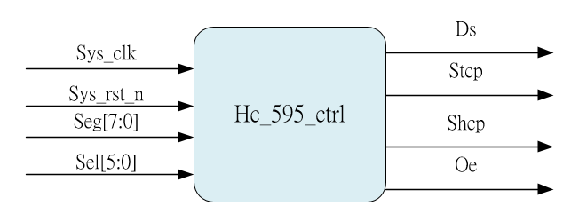
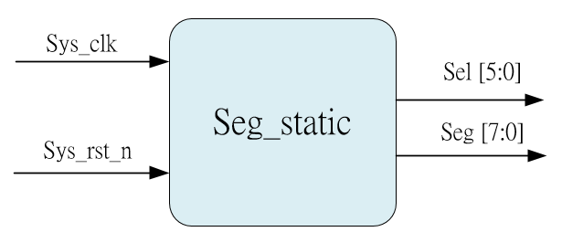
System_sub-module

Slide 5
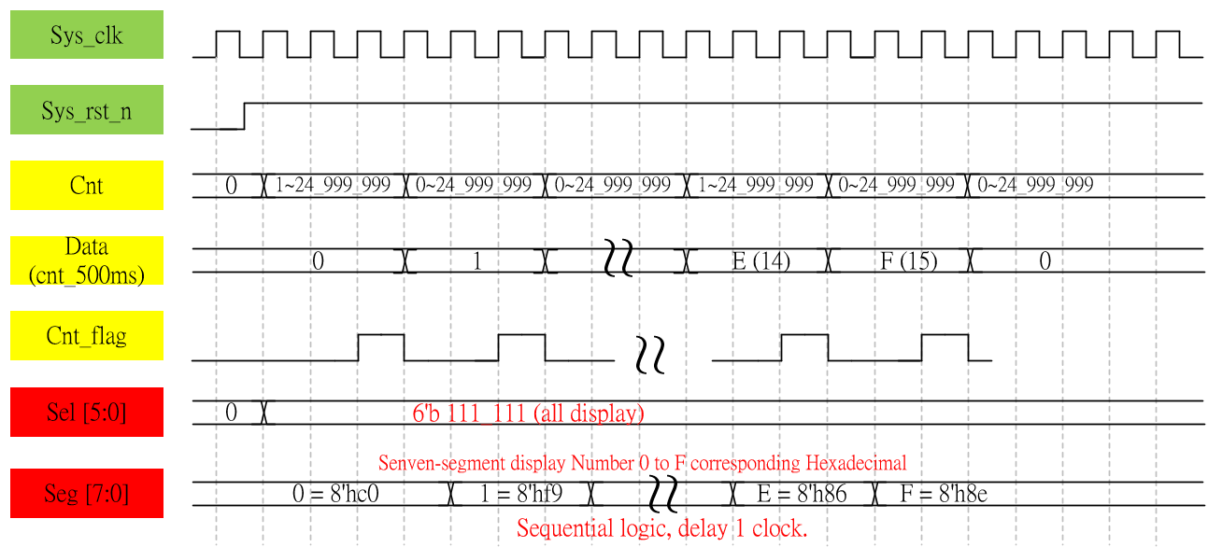
Waveform Graph – seg_static

Slide 6
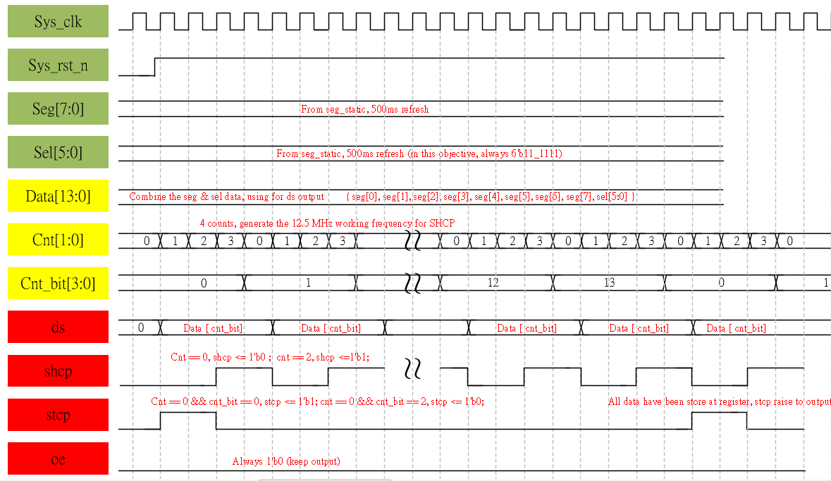
Waveform Graph – hc595_ctrl

Slide 7
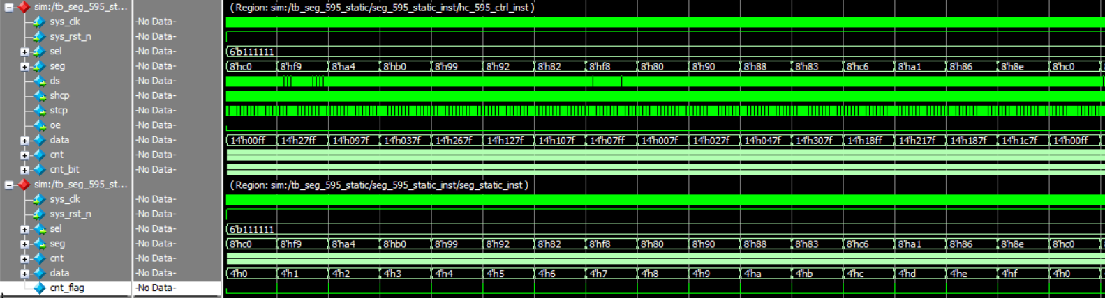
Simulation-hc_595_ctrl
Sel and seg data generate correct, and transfer to hc_595_ctrl is OK.

Slide 8
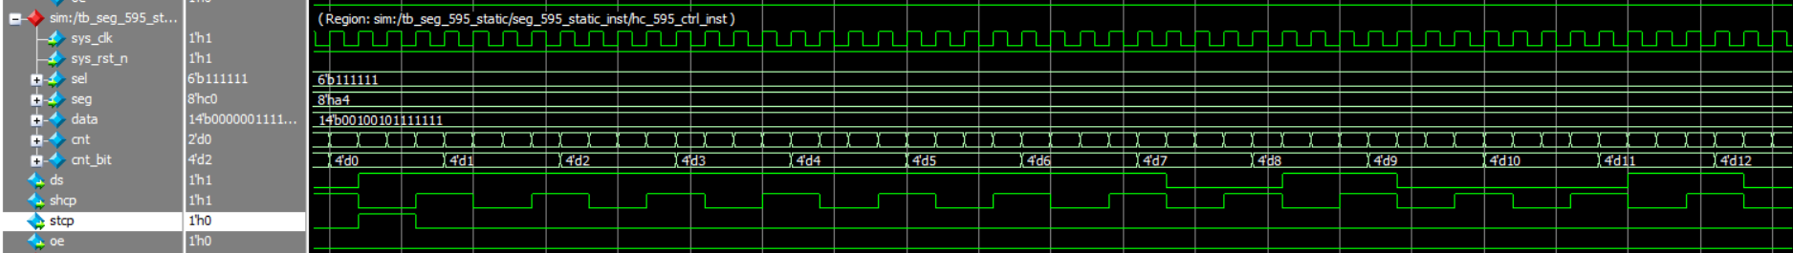
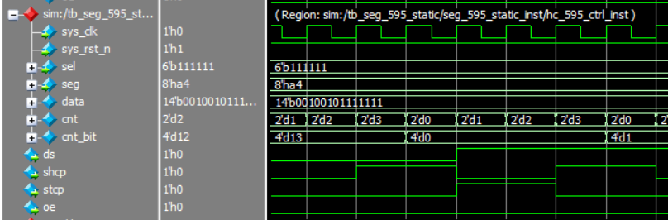
Simulation-seg_595_static
Ds, shcp, stcp and oe signal is ok, align code and waveform

