Slide 1
ip_core_pll

Slide 2
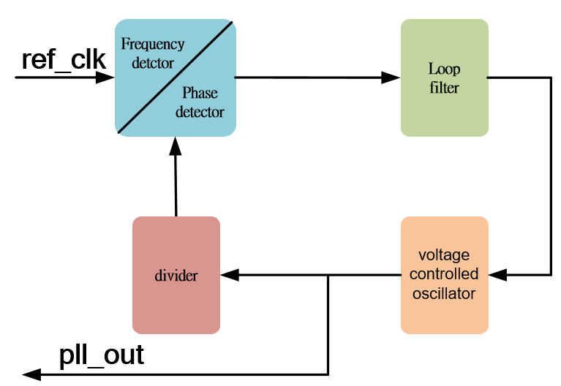
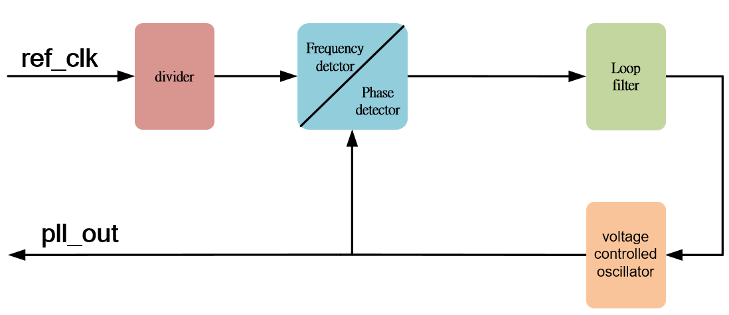
PLL
PLL, Phase Locked Loop, we can using it to make clock divider or multiplier, and duty cycle and phase shift also, and in this chapter, we using quartus_ip_core_pll.
Let’s simple introduce the simple PLL operating principle as below picture.
multiplier
divider
Compare A = B/2
Compare A/2 = B
A 50 MHz
A 50 MHz
Divide by 2
100MHz / 2 = 50 MHz
Divide by 2
B 100 MHz
B 25 MHz
If A ≠ B/2, voltage enhanced or decreased
B 100 MHz
If A ≠ B/2, voltage enhanced or decreased

Slide 3
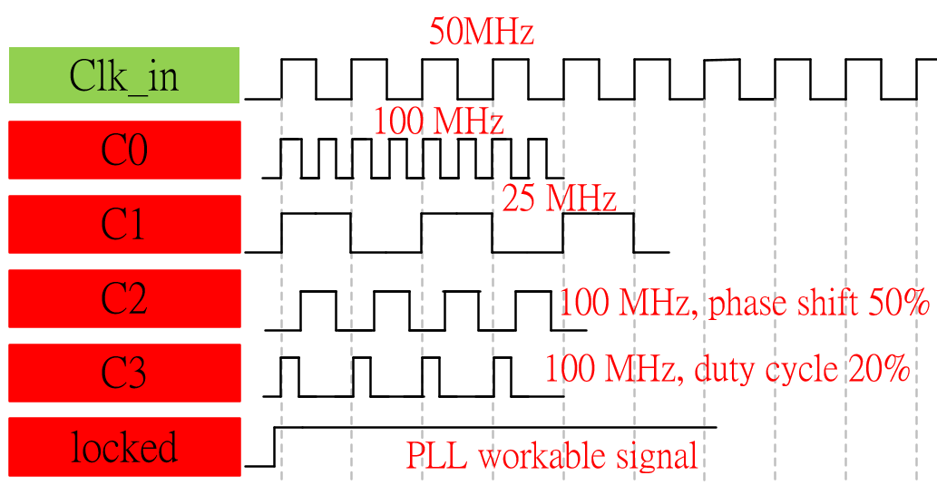
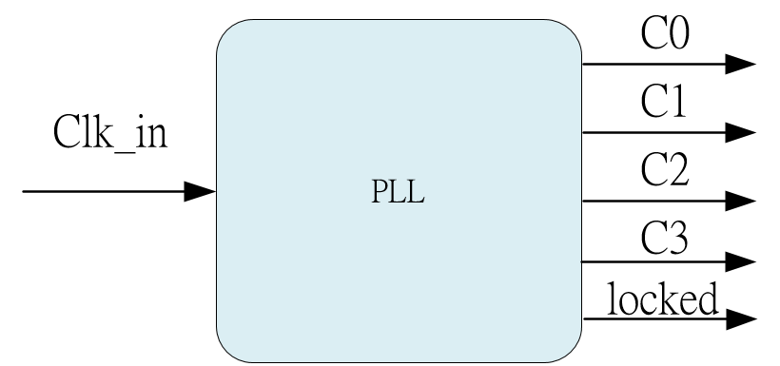
System & Waveform Graph

Slide 4
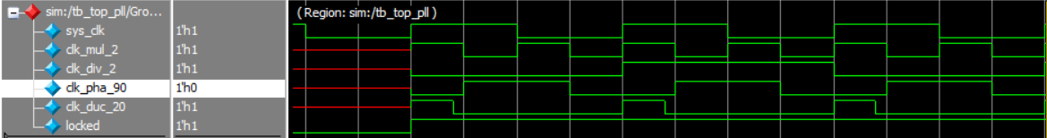
Waveform Graph - Simulation
At first, locked is low-level so that c0 to c3 all are red line, means not workable.

