Slide 1
ip_core_rom

Slide 2
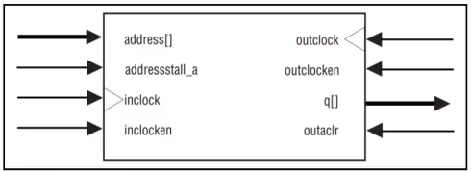
ROM
ROM (Read Only Memory), which only can read the have been stored data, cannot be written.
In this FPGA, we need to provide the address to Rom, then Rom will release the data which stored in this address.
In this chapter, we using the quartus ip_core rom, and initial the rom by 1 mif file.

Slide 3
Objective
Using rom output the data corresponding address 0 to 255 by sequence, and display the data by seven_segment_displly, display 200ms each data.
If press the K1 button, display address 99st data, if press k1 again the data display start at 99st data and sequential added higher. (99, 100, 101 ..….)
If press the K2 button, display address 199s data, if press K2 again the data display start at 199st data and sequential added higher. (199, 200, 201……)
If press the K1 button first data keep 99st,then press K2 button the data changed to 199st, and push K2 button again, start as 199st and sequential added higher.

Slide 4
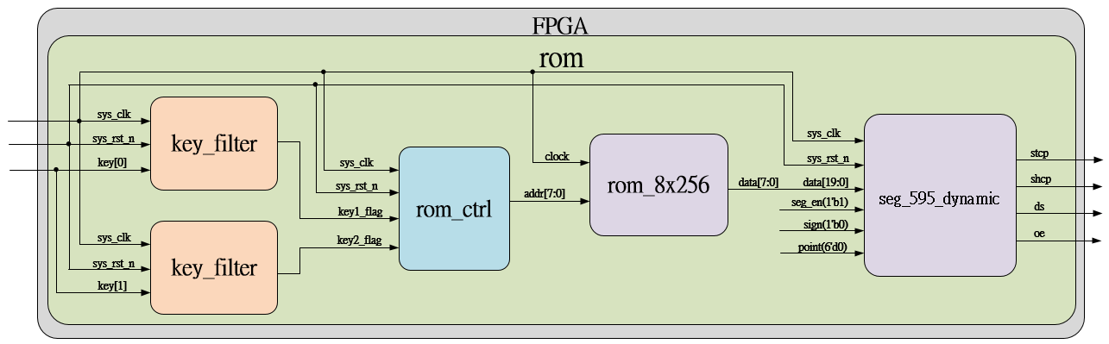
System

Slide 5
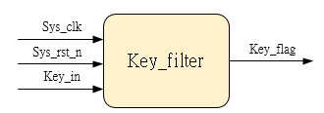
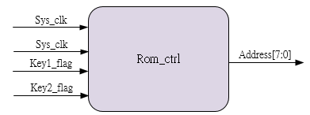
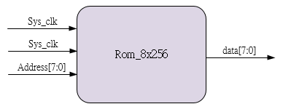
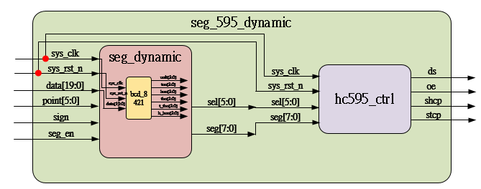
Sub_system
Using previous
Ip_core
Using previous

Slide 6
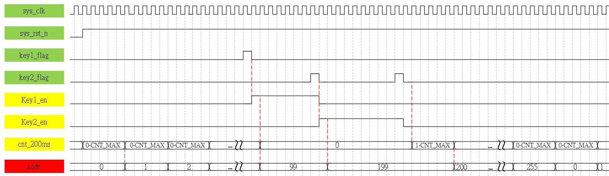
Waveform Graph_Rom_ctrl

Slide 7
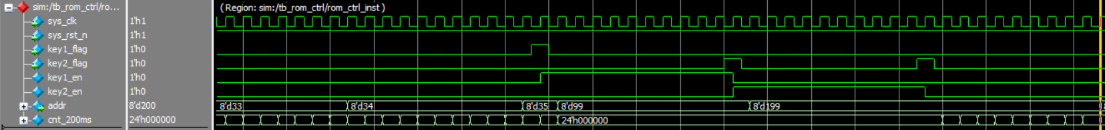
Simulation- rom_ctrl
Same as our waveform graph, correct.

Slide 8
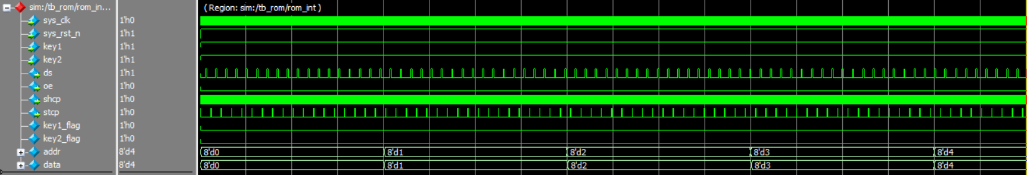
Simulation_top_rom
In this chapter, new sub-modules are rom_ctrl and ip_core rom_8x256, so if the address and the corresponding data transfer to seg_595_top module correctly, it’s no problem.

