Slide 1
Spi_flash_be

Slide 2
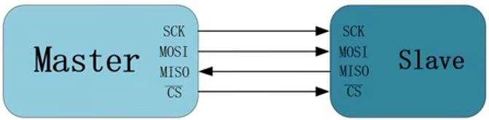
SPI_1
SPI, Serial Peripheral Interface is a protocol, in this chapter we will briefly introduce the SPI and generate the module to doing the flash BE command by SPI.
SPI should have 1 master equipment & 1 slave equipment at least, shows as below picture, it also shows the pin connection function.
SCK: Serial Clock
MOSI: Master Output, Slave Input
MISO: Master Input, Slave output
CS: Chip select, low-level valid

Slide 3
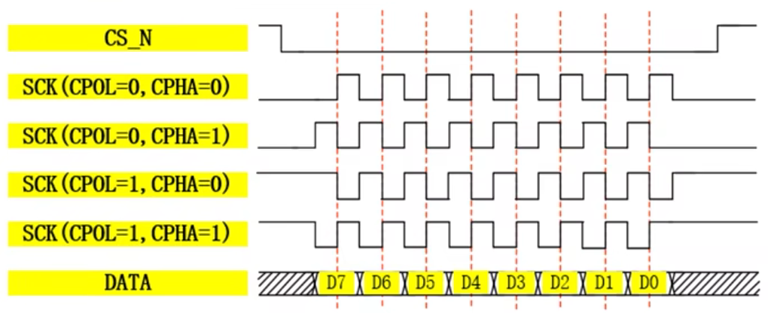
SPI_2
SPI have 4 modes, it depends on 2 parameter CPOL & CPHA as below picture.
CPOL: means the clock is high-level or low-level when IDLE state. 0 = low-level, 1 = high-level. (No cs_n signal means slave not be selected, is IDLE state)
CPHA: means data collect in odd or even edges. 0 = odd, 1 = even.

Slide 4
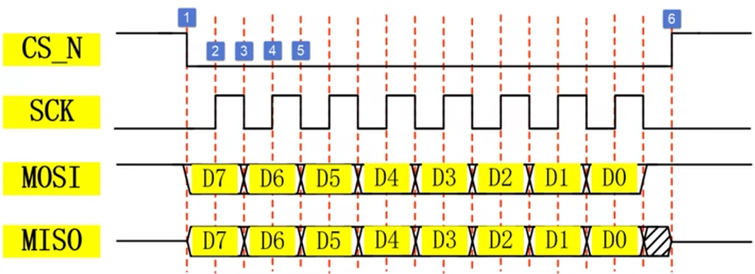
SPI_3
For example, if we using CPOL = 0 & CPHA = 0 to doing communicate, the timing as below picture.
1: CS_N negedge, means work start. 2: equipment catch the first data at odd edge. 3: data refresh at even edge. 4: equipment catch the second data at odd edge. 5: data refresh at even edge. 6: CS_N posedge, means work end.

Slide 5
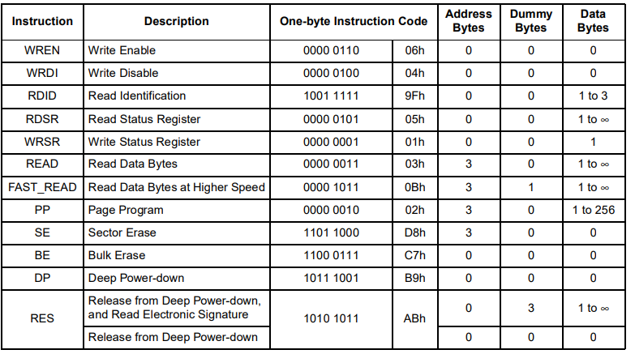
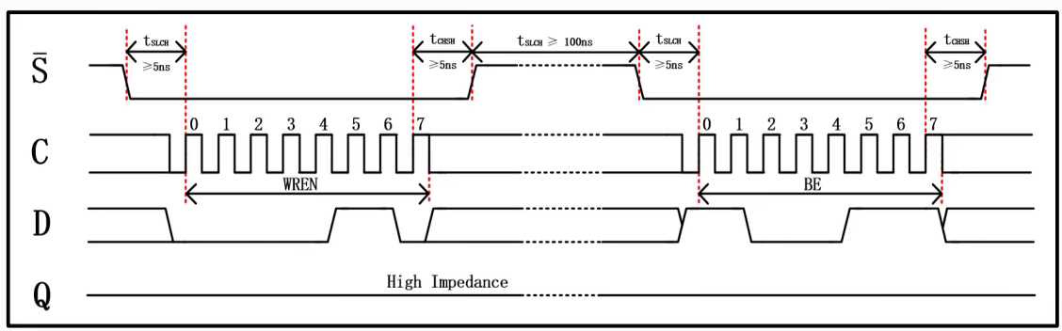
SPI_BE
In this chapter, we will using BE, Bulk Erase command to erase the data which stored at flash chip, below is the command table & timing waveform.
By the way, if we want to doing BE command, WREN command should be executed first.

Slide 6
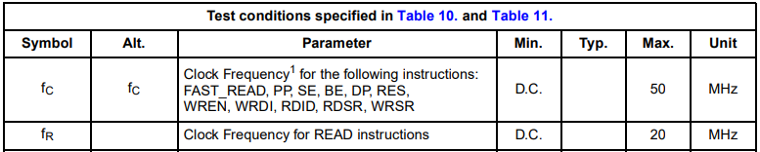
Objective
If push the key button then BE command will implement.
The parameter, CPOP = 0, CPHA = 0.
Due to read command clock max frequency is 20MHz, for module reuseable, we set the sck is 12.5MHz.

Slide 7
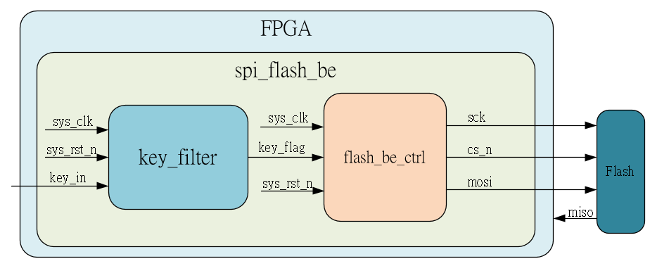
System

Slide 8
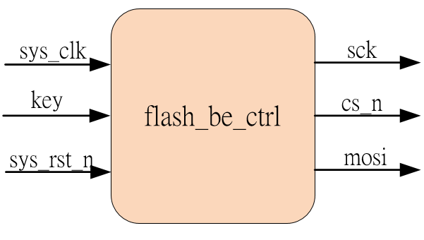
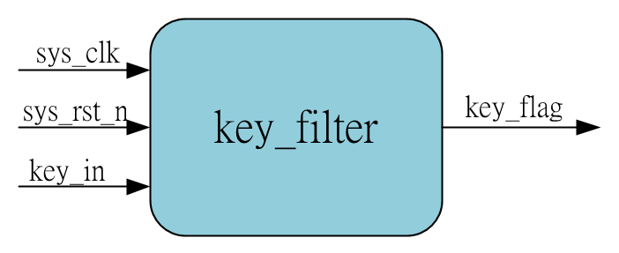
Sub-module
using previous

Slide 9
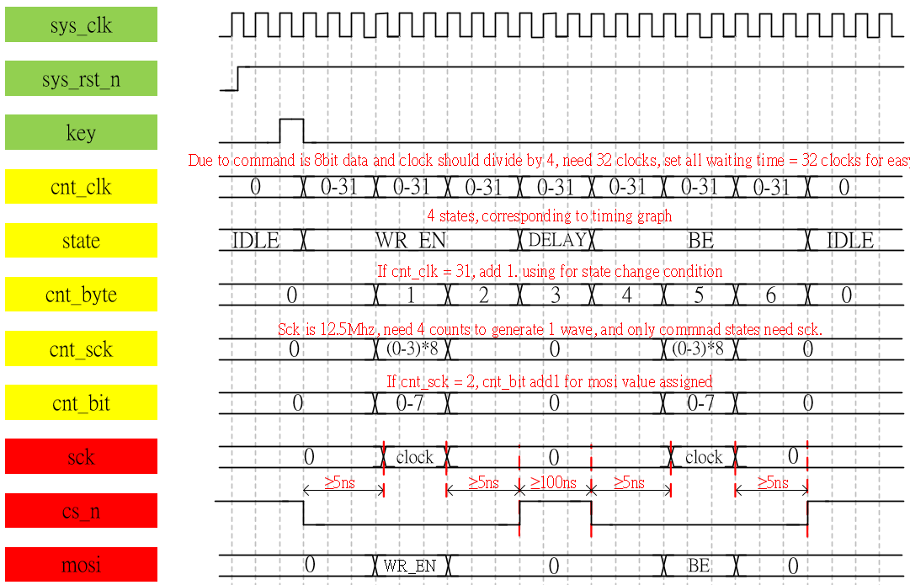
Waveform Graph – spi_flash__be_ctrl_1

Slide 10
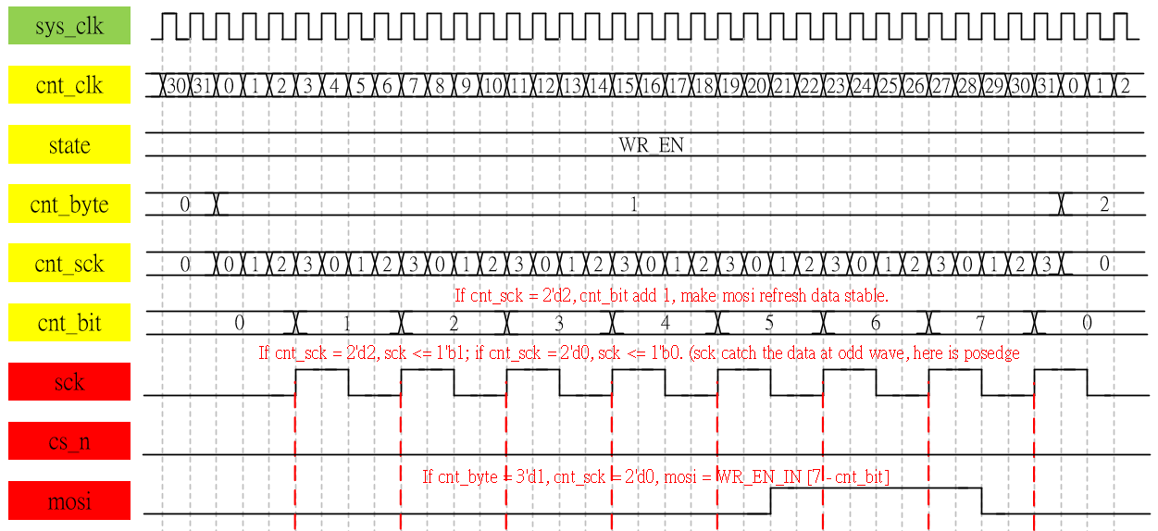
Waveform Graph – spi_flash__be_ctrl_2
Detail of WR_EN and the WR_EN command = 8'b0000_0110

Slide 11
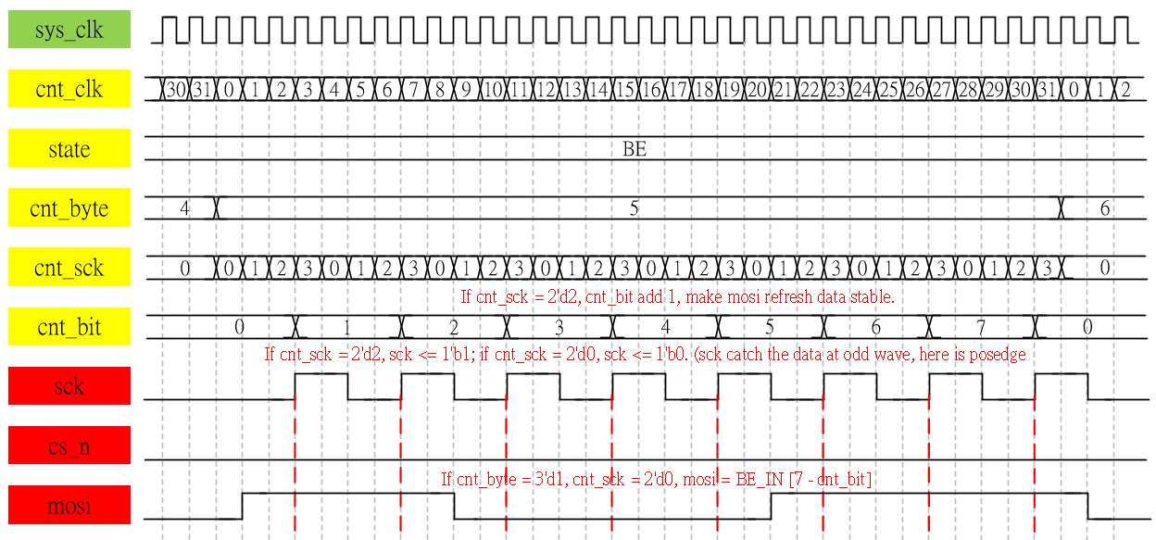
Waveform Graph – spi_flash__be_ctrl_3
Detail of BE, and the BE command = 8'b1100_0111

Slide 12

Simulation-spi_flash_be
In SPI simulate, we need to using the m25p16 test bench file, refer to sim code, if we using this, we can see the transcript show the bulk erase cycle is finished, it’s OK.
Detail please refer to sim code & quartus_prj (open by quartus II 13.0, see the test bench)

