Slide 1
Spi_flash_se

Slide 2
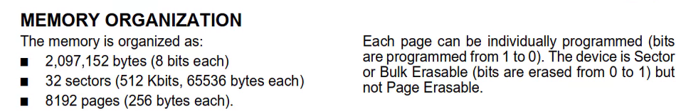
SPI_SE
In previous chapter, we have been introduced the BE, Bulk Erase, in this chapter, we will learn the SE, Sector Erase.
In this FPGA, it memory information as below picture, if we want to doing the SE command, we need to give the address value, address refer to datasheet.

Slide 3

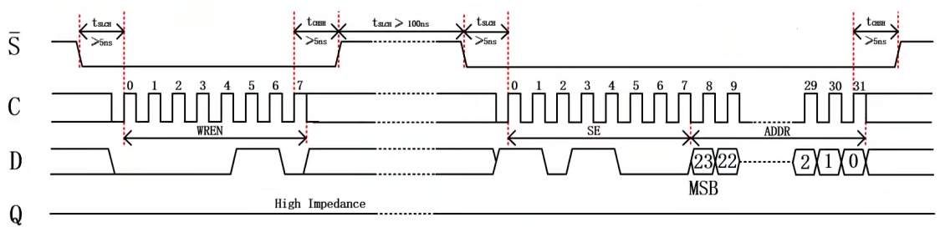
SPI_SE_Timing & command
If we want to doing the SE command, we need to WREN command first, and supply the address which sector we want to erase.

Slide 4
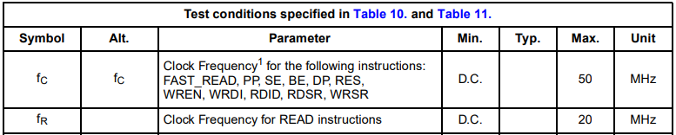
Objective
If push the key button then SE command will implement.
The parameter, CPOP = 0, CPHA = 0.
Due to read command clock max frequency is 20MHz, for module reuseable, we set the sck is 12.5MHz.

Slide 5
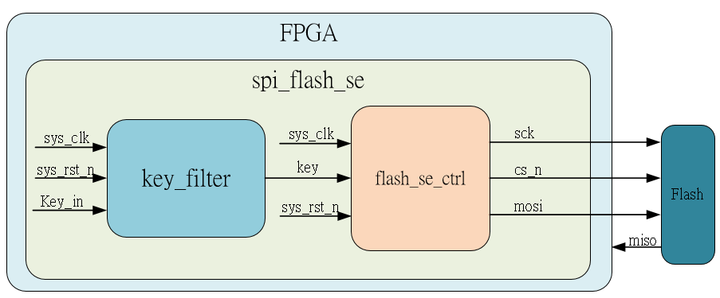
System

Slide 6
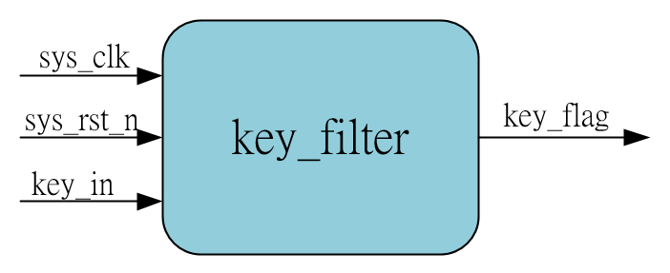
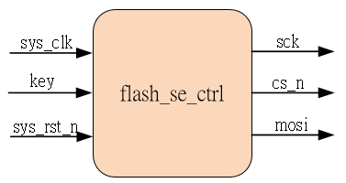
Sub-module
using previous

Slide 7
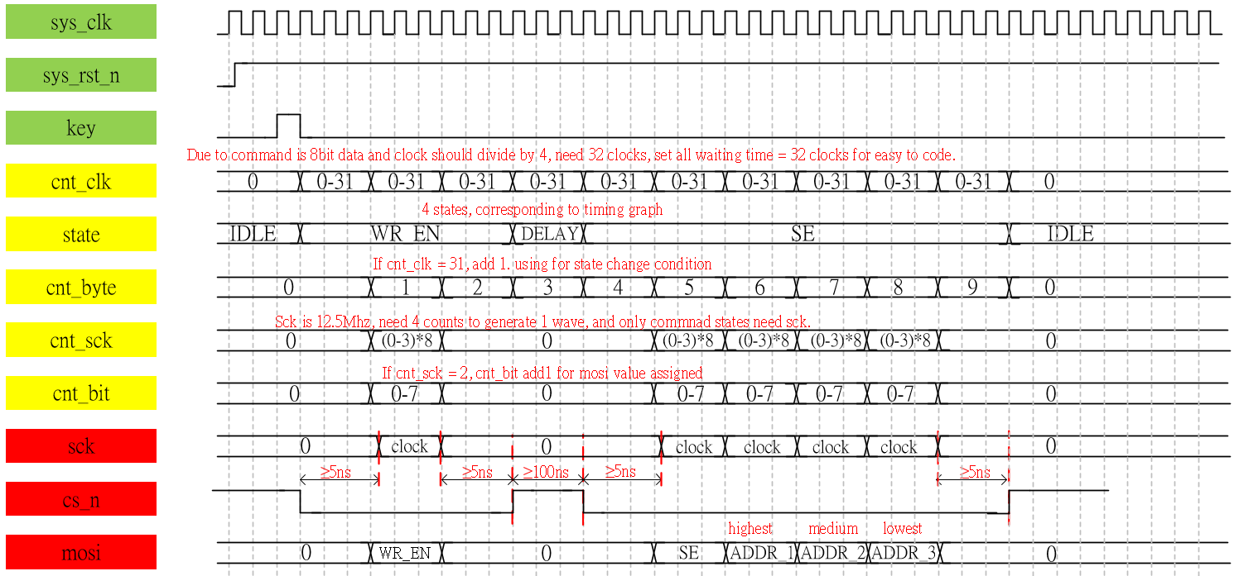
Waveform Graph – spi_flash__se_ctrl
Refer to waveform, we know the we can using spi_flash_be_ctrl to revise then get the se_ctrl module

Slide 8
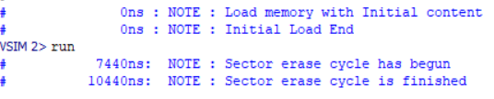
Simulation-spi_flash_be
In SPI simulate, we need to using the m25p16 test bench file, refer to sim code, if we using this, we can see the transcript show the sector erase cycle is finished, it’s OK.
Detail please refer to sim code & quartus_prj (open by quartus II 13.0, see the test bench)

