Slide 1
Spi_flash_rd

Slide 2
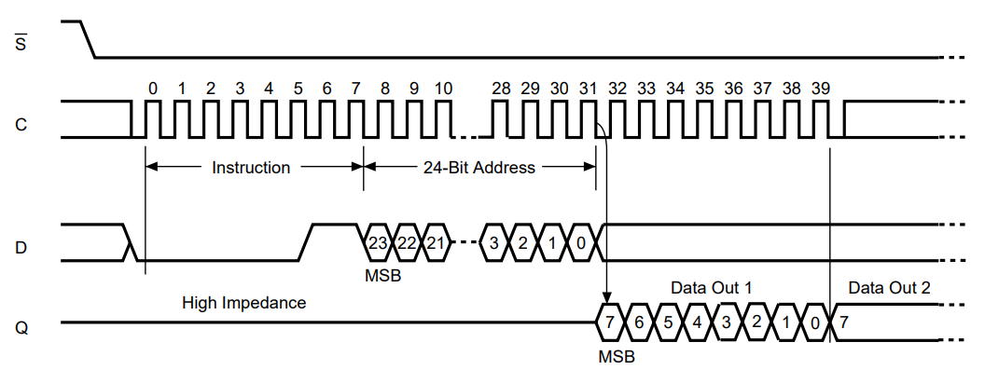
SPI_RD
In previous chapter, we have been introduced the BE and SE, this chapter we will using RD, read command to read the data from flash chip.
The READ command and timing as below picture, and the RD command doesn’t need the WR_EN first.

Slide 3
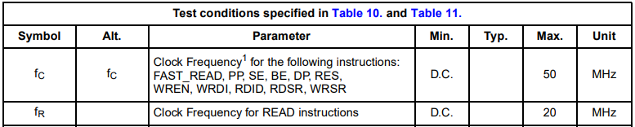
Objective
If push the key button then RD command will implement, and reading data number is 100, after reading, send the data out by tx module.
The parameter, CPOP = 0, CPHA = 0.
Due to read command clock max frequency is 20MHz, for module reuseable, we set the sck is 12.5MHz.

Slide 4
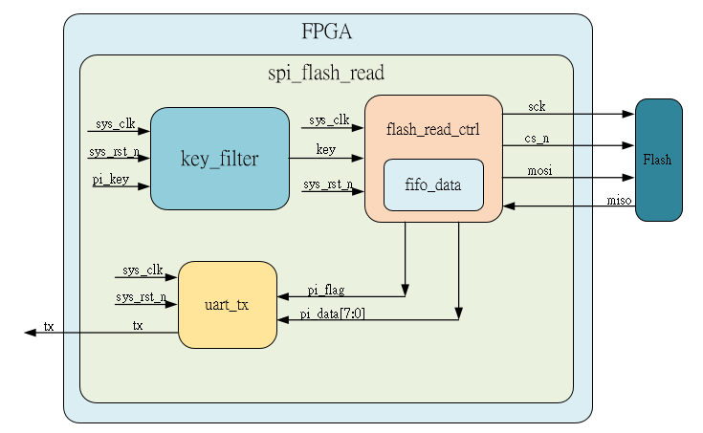
System

Slide 5
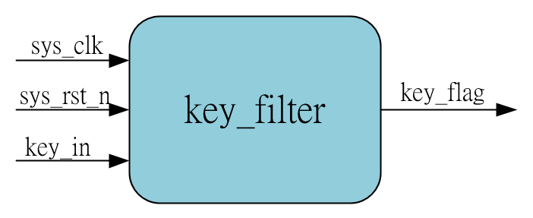
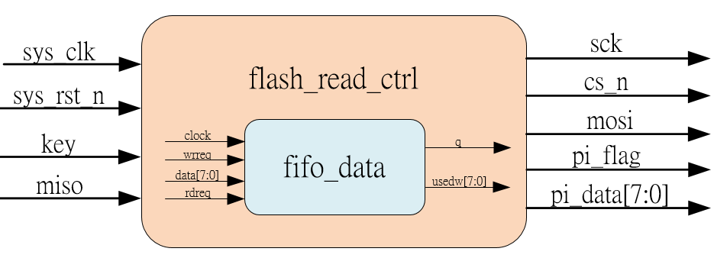
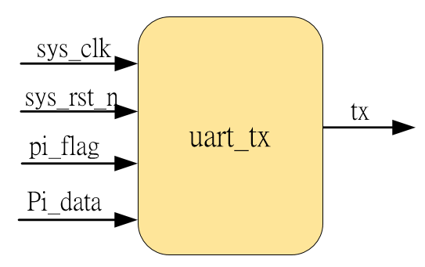
Sub-module
using previous
Inner fifo is ip_core
Using previous

Slide 6
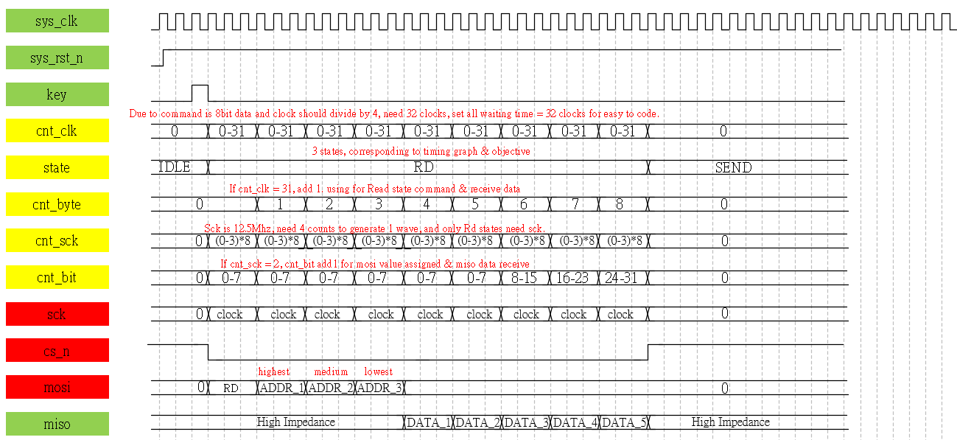
Waveform Graph – spi_flash__rd_ctrl_1
Waveform using reading 5 data to present, easy to draw & observe.

Slide 7
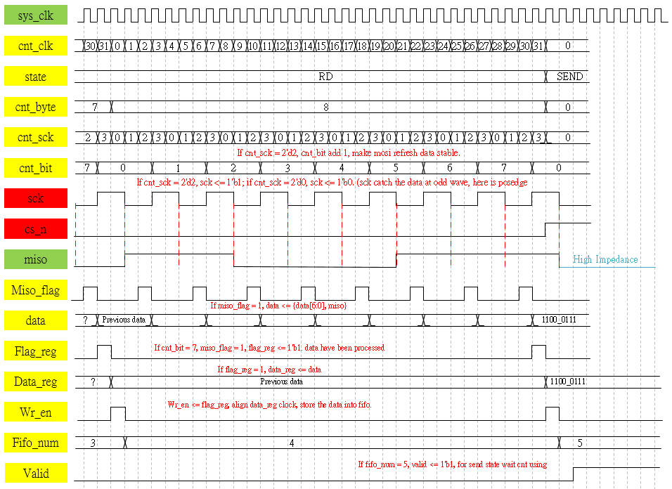
Waveform Graph – spi_flash__rd_ctrl_2

Slide 8
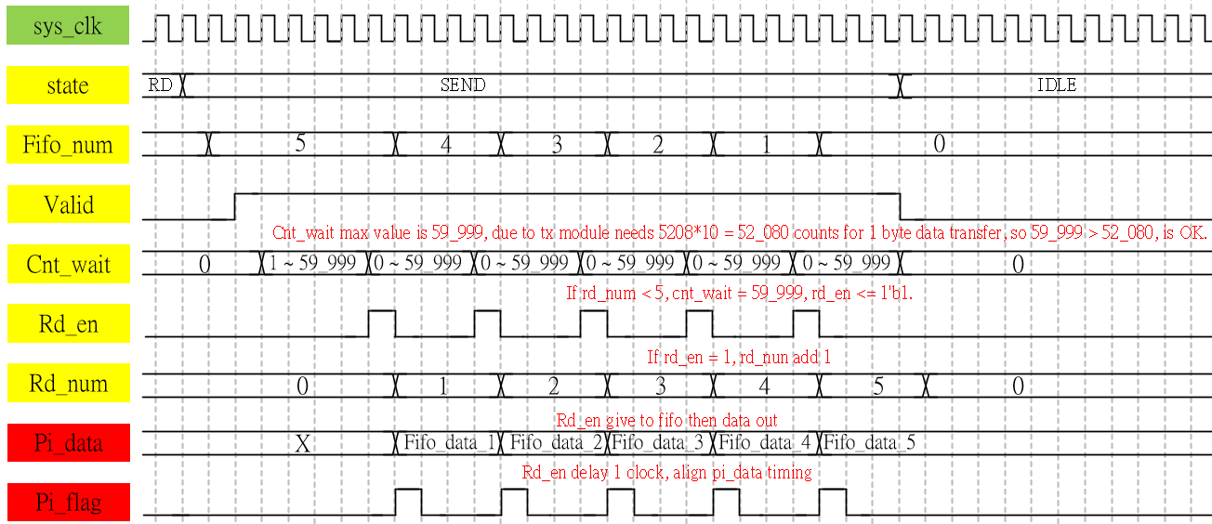
Waveform Graph – spi_flash__rd_ctrl_3

Slide 9
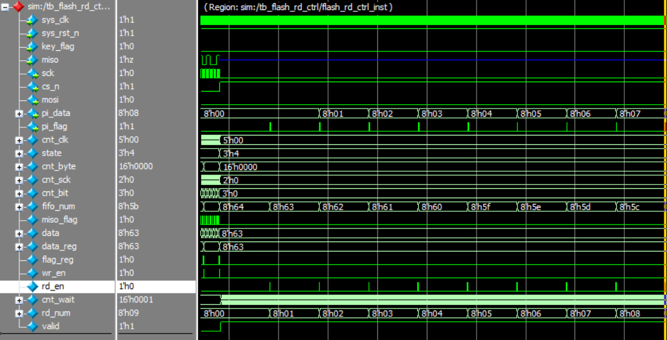
Simulation-spi_flash_rd_ctrl
Final signal pi_data is as same as our setting at initmemory.txt file, means the data reading from flash in test bench is OK. Detail please refer to sim code & quartus_prj (open by quartus II 13.0, see the test bench)

