Slide 1
ip_core_ram

Slide 2
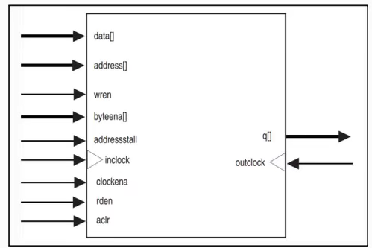
RAM
RAM (Random Access Memory),which can read and write data to corresponding address storage.
In this FPGA, we need to provide the reading address to Ram, then Ram will release the data which stored in this address, and if we provide the writing address and writing data, the data will be writen to corresponding address.
In this chapter, we using the quartus ip_core ram, and initial the ram by 1 mif file.

Slide 3
Objective
Press reading button and ram output the data which corresponding address 0 to 255 by sequence, and display the data by seven_segment_displly, display 200ms each data.
Press writing button and provide the address and data to overwrite the ram corresponding address data.
Press reading button and check the data is overwritten.
Note: 1. If wr_button pressed during reading process, reading process stop and start writing process.
2. If rd_button pressed during reading process, reading process restart and start at first address.

Slide 4
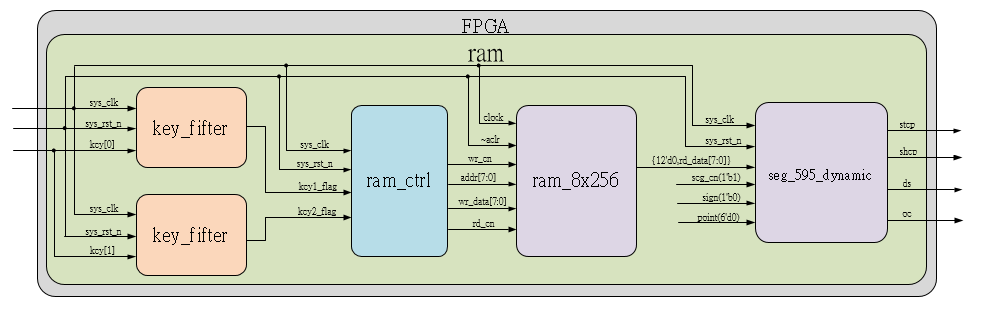
System

Slide 5
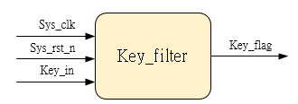
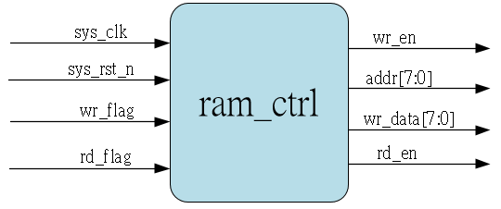
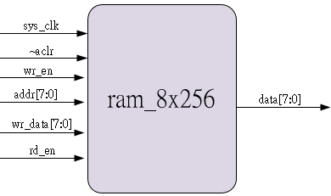
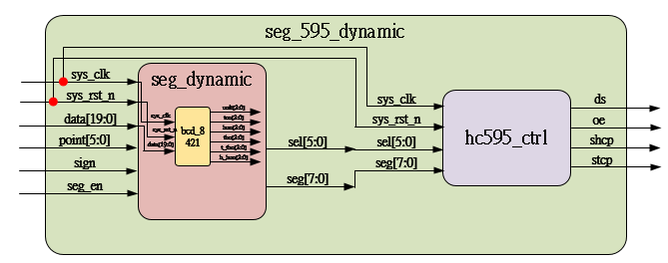
Sub_system
Using previous
Ip_core
Using previous

Slide 6
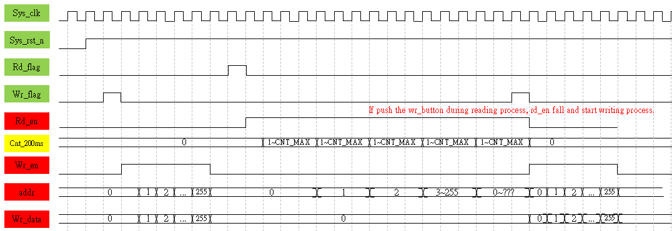
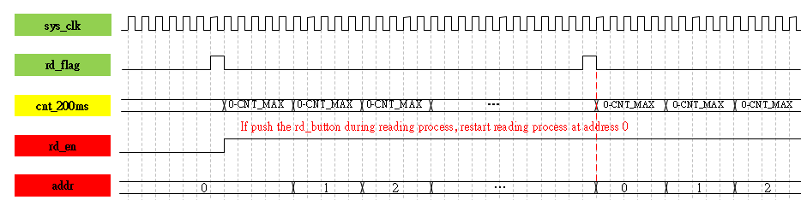
Waveform Graph_Ram_ctrl

Slide 7
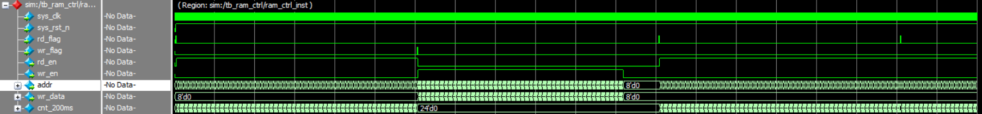
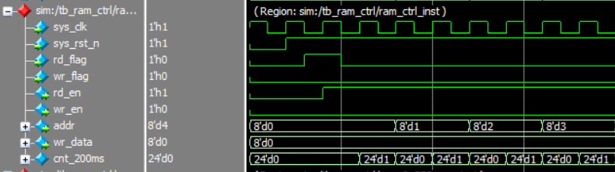
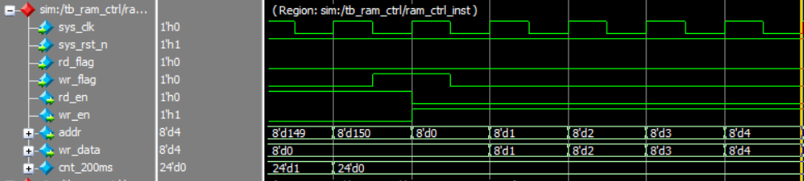
Simulation- ram_ctrl - 1
Rd_button pushed
Wr_button pushed during reading process

Slide 8
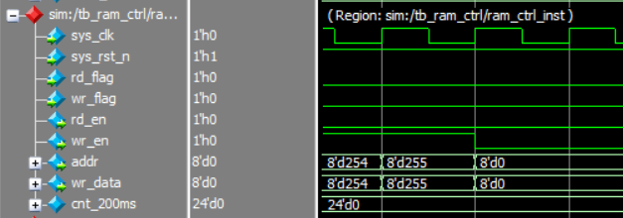
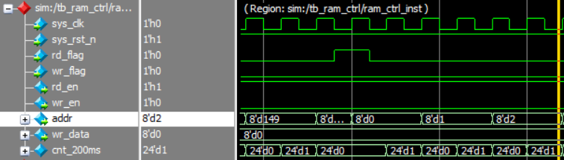
Simulation- ram_ctrl - 2
256 address have been written
Rd_button pushed during reading

Slide 9
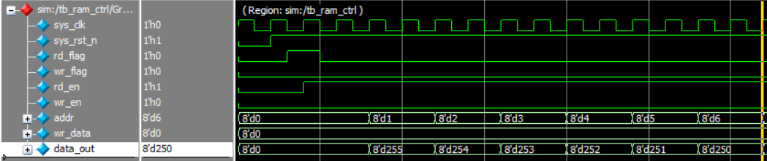
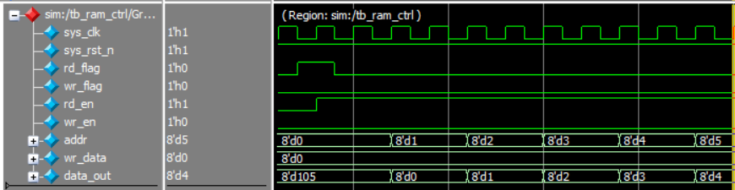
Simulation_ram_ctrl-3
First reading data, data is 255 to 0 by sequence.
After write, reading data, data is 0 to 255 by sequence, write data success.

Slide 10
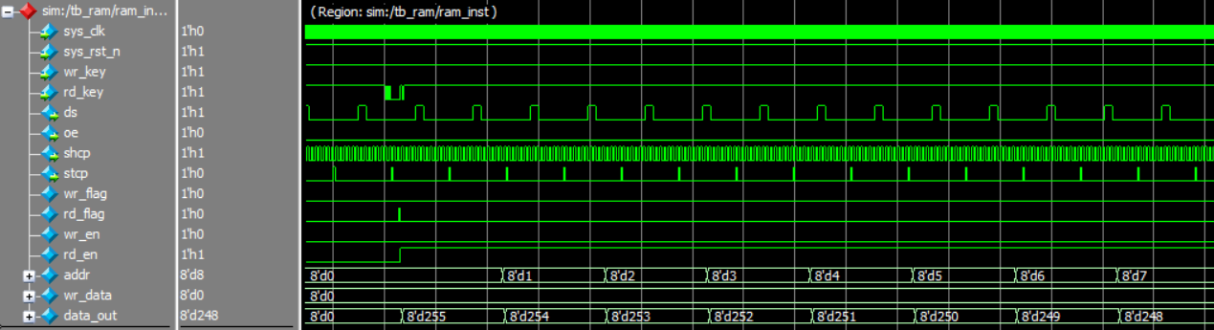
Simulation_ram
In this chapter, new sub-modules are ram_ctrl and ip_core ram_8x256, so if the address and the corresponding data transfer to seg_595_top module correctly, it’s no problem.

