Slide 1
Dig_volt

Slide 2
Dig_volt
If we want to using FPGA design the digital voltage measuring module, we can use the ADC (Analog to Digital Converter) to do.
In this chapter, we using embedfire ADC to design the module, this ADC can measure -5V to 5V and transfer to 8 bit width digital data (0 – 255).
And the this ADC sampling clock max frequency is 32MHz.
Voltage 5V
ADC
8’b1111_1111
FPGA
Voltage -5V
ADC
8’b0000_0000
FPGA

Slide 3
Objective
In this chapter, we want to generate digi_volt module and display the voltage by seven segment display, the value shows to three decimal places.
And re-zero the voltage value in first 1024 sampling clocks.
Sampling clock set to 12.5 MHz.
X
X
?.
?
?
?
V

Slide 4
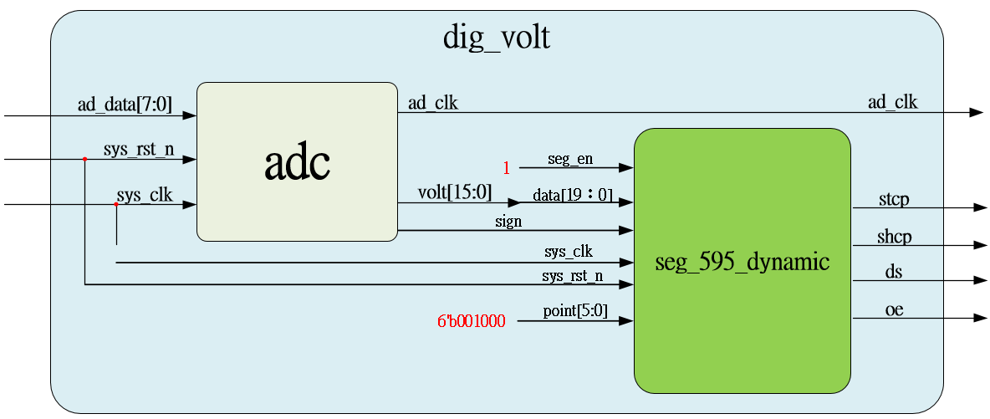
System

Slide 5
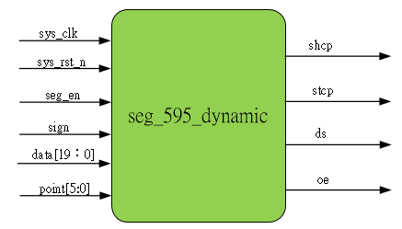
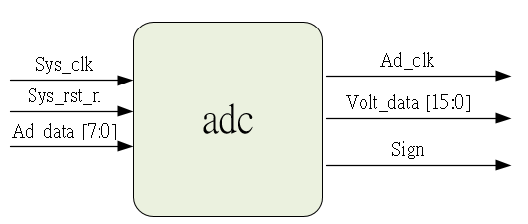
Sub-module
using previous

Slide 6
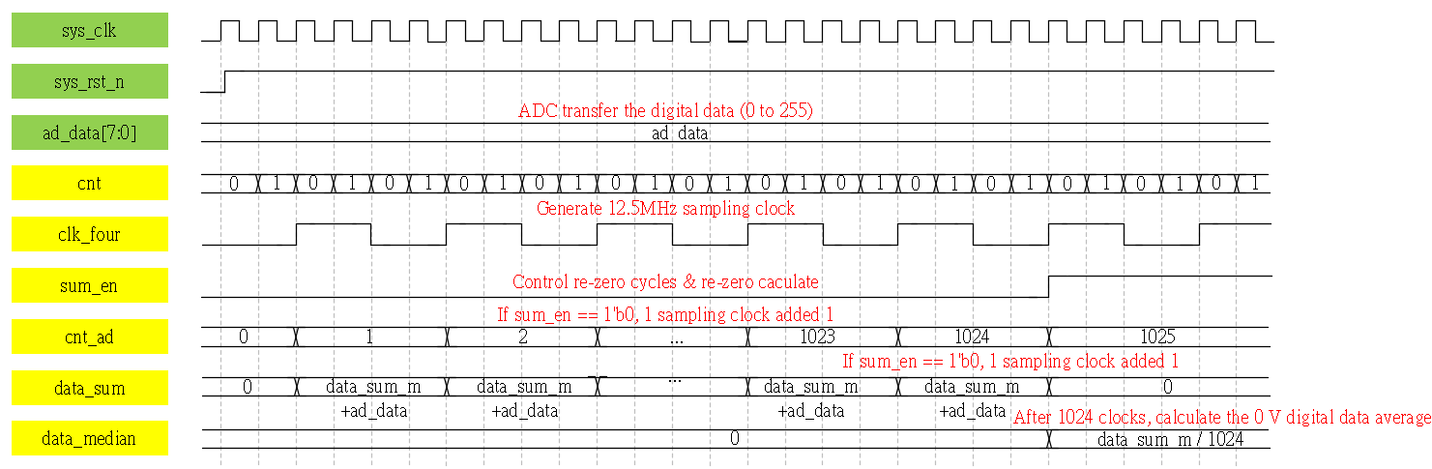
Waveform Graph – adc_1
First 1024 sampling clock is re-zero part, after rezero, sum_em raised

Slide 7
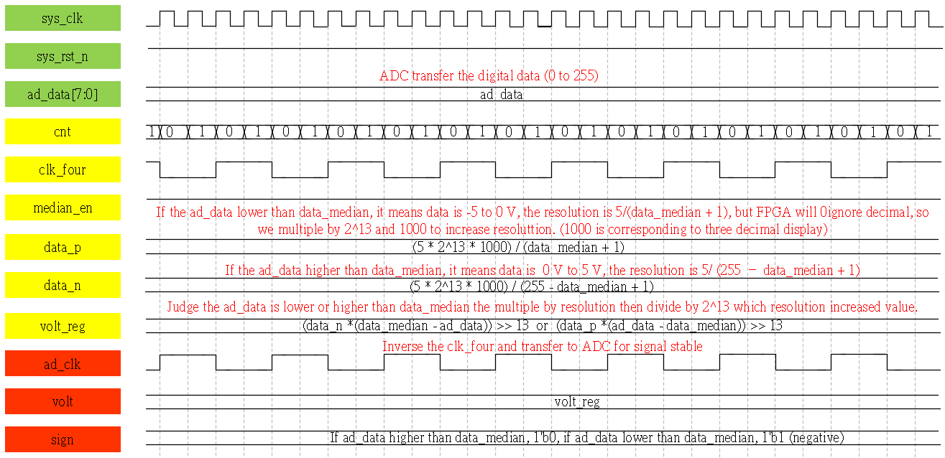
Waveform Graph – adc_2
After sum_en raised, display the voltage data measured

Slide 8
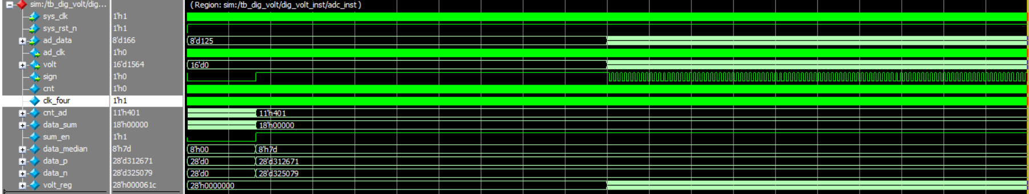
Simulation-adc
In test bench, median set to 125, OK.

Slide 9
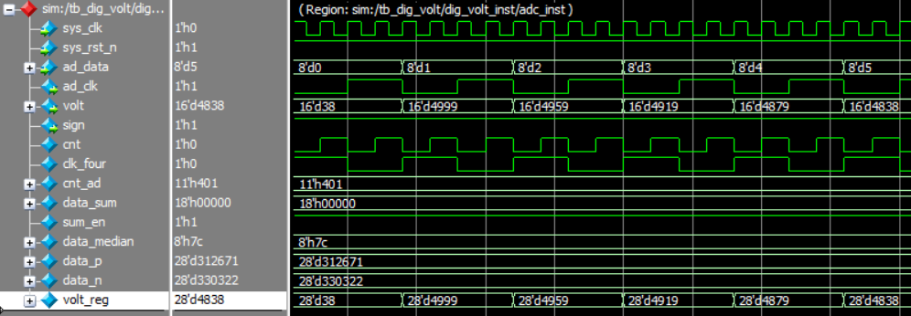
Simulation-adc_ -5V
Ad_data is 0, the volt = 16’d4999, and sign is 1’b1, shows in seven segment is -4.999, ok.

Slide 10
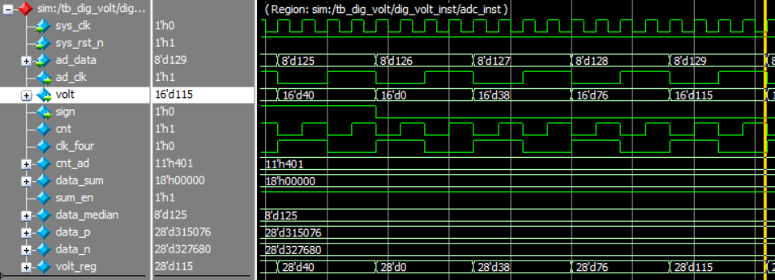
Simulation-adc_0V
Ad_data is 125, the volt = 0 and sign is 1’b0, shows 0.000, OK.

Slide 11
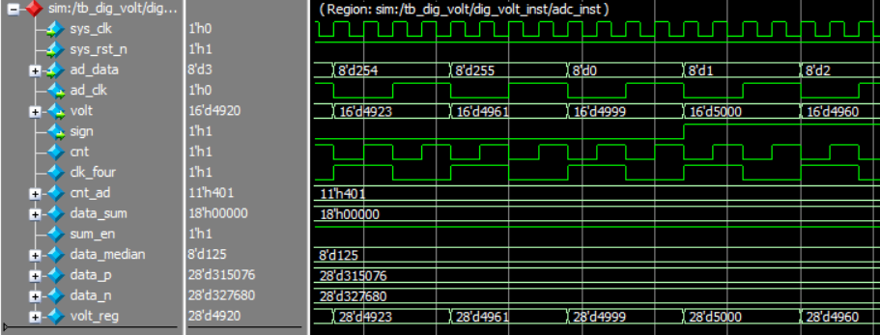
Simulation-adc_5V
Ad_data is 255, the volt = 4999 and sign is 1’b0, shows 4.999, OK.

