Slide 1
Top_inf_rcv

Slide 2
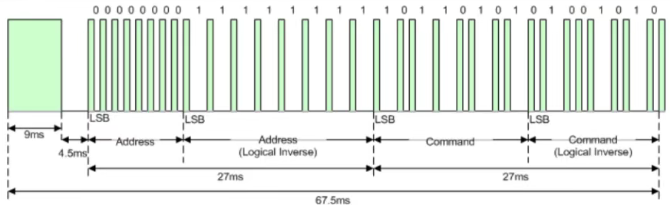
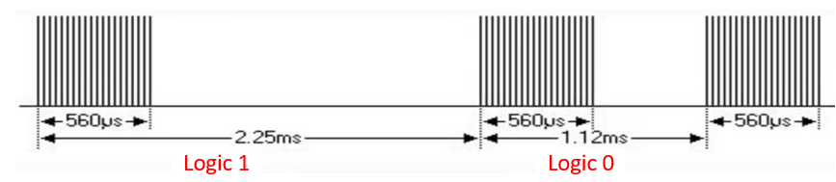
Inf_rcv - sender
Inf_rcv (Infrared remote control), is using infrared to transfer data.
In this chapter, we will using NCE protocol to doing the inf_rcv, the sender transfer total sequence as below picture, and the how to transfer logic 0 & 1 as below picture.
And the sender usually like out TV remote control, using button to control sending command.

Slide 3
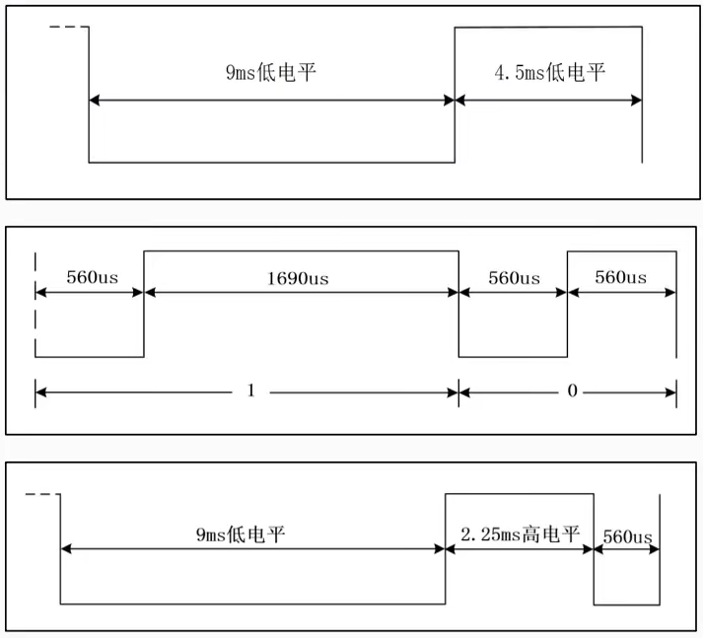
Inf_rcv - receive
Our FPGA will receive the data from infrared receiver, and the data as below picture.
Guide code, means FPGA start receive data.
Logic, FPGA receive logic 0 or 1 from infrared receiver during the process. (address, address inverse, command, command inverse)
Repeat, means the infrared sender keeping sending the same command (not release the button)

Slide 4
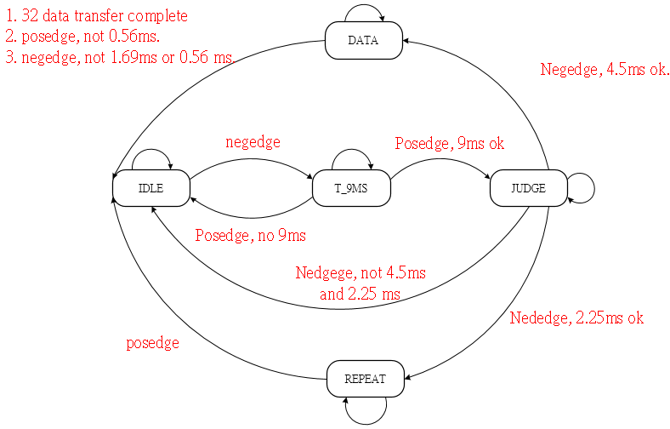
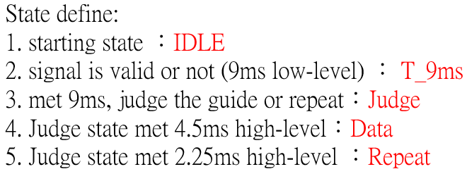
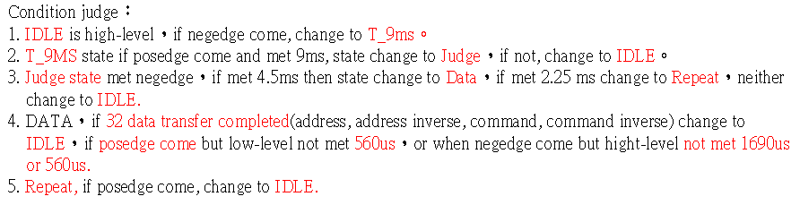
Inf_rcv – state machine
According to receive code, we can define the inf_rcv module as below states.

Slide 5
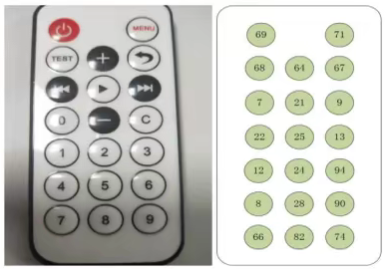
Objective
In this chapter, we want to generate top_inf_rcv module to receive the infrared remote control signal and display the command data by seven segment display, if the infrared remote control button keeping pushed, it means the repeat code and the led will light up 0.05 sec, if received 1 repeat code, light up 1 time.
Infrared remote controller
Corresponding command data

Slide 6
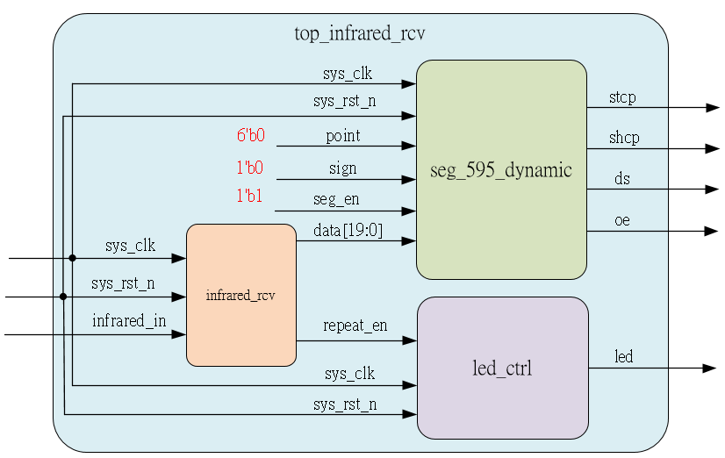
System

Slide 7
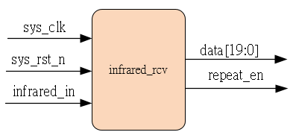
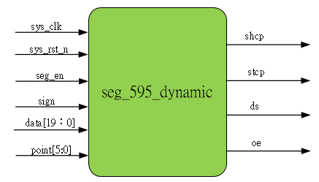
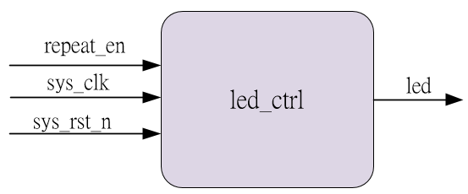
Sub-module
using previous

Slide 8
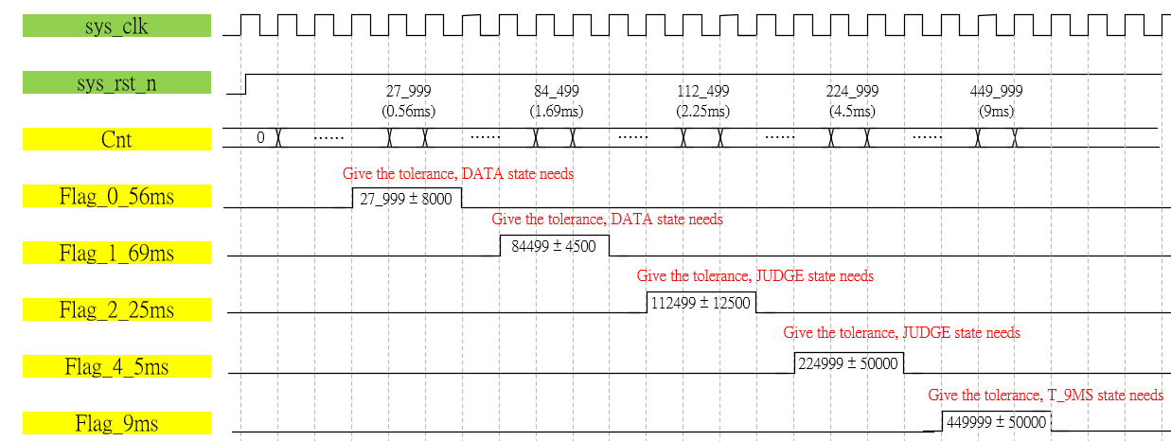
Waveform Graph – inf_rcv_1
Define the time flag and it’s corresponding state

Slide 9
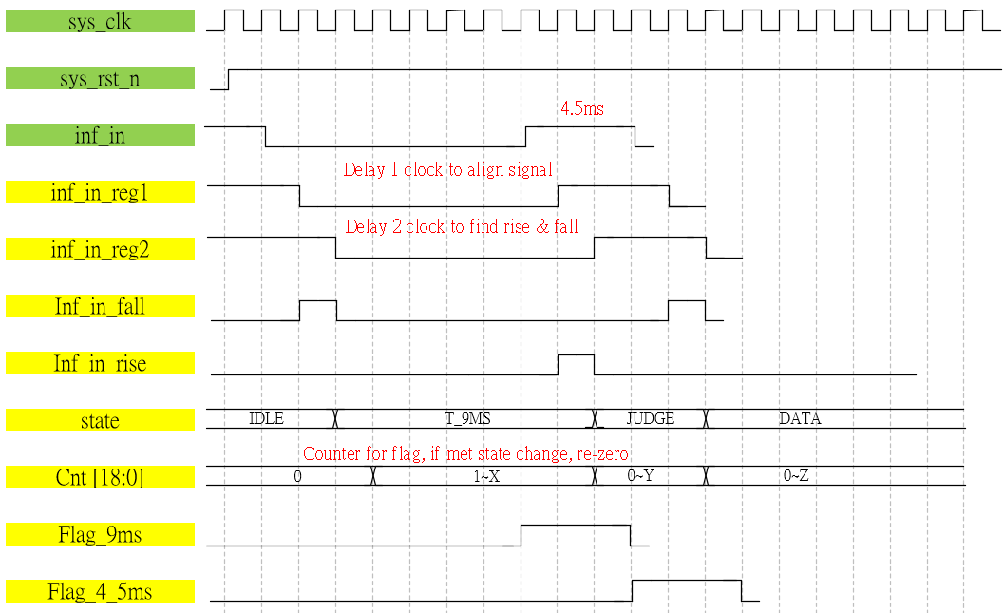
Waveform Graph – inf_rcv_2
State changed waveform graph

Slide 10
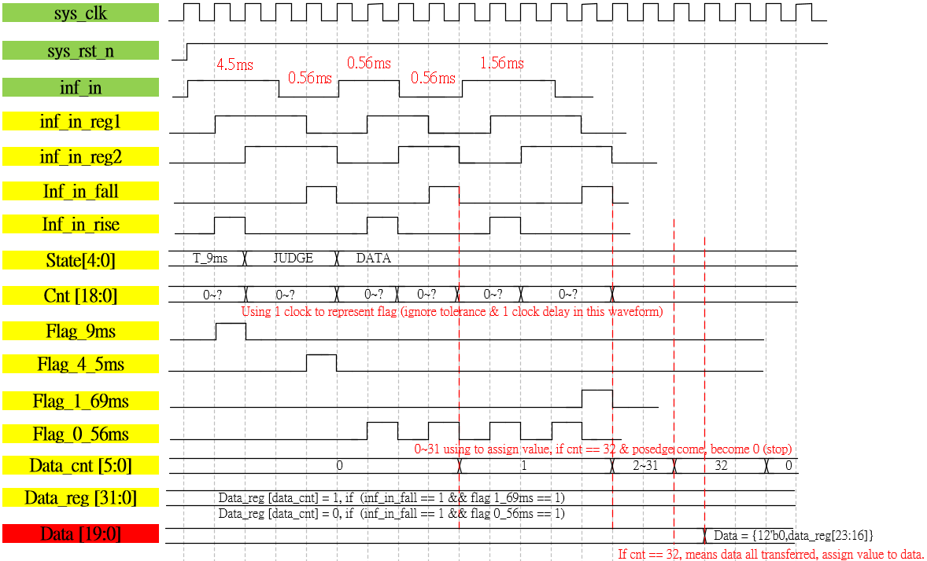
Waveform Graph – inf_rcv_3
During DATA state, hot to catch the value

Slide 11
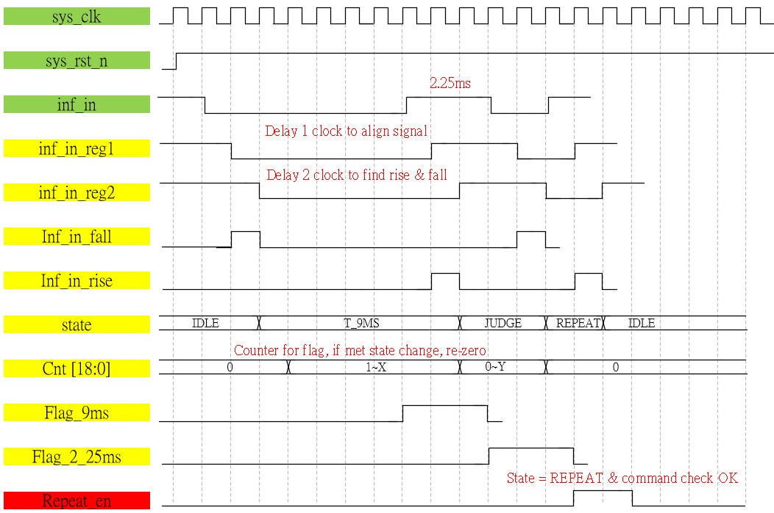
Waveform Graph – inf_rcv_4
State change to REPEAT

Slide 12
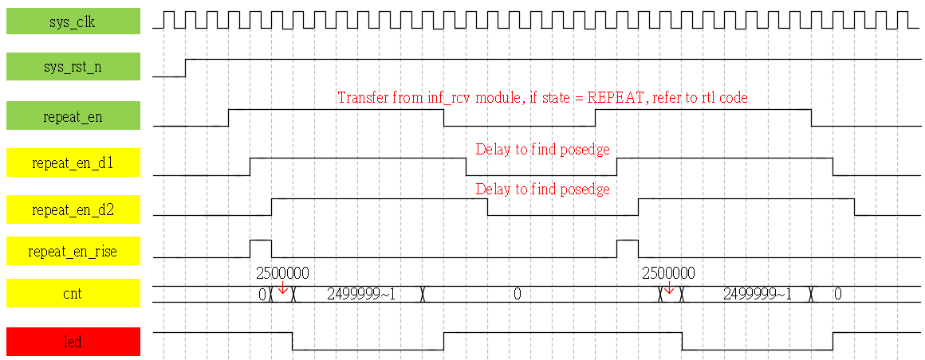
Waveform Graph – led_ctrl

Slide 13
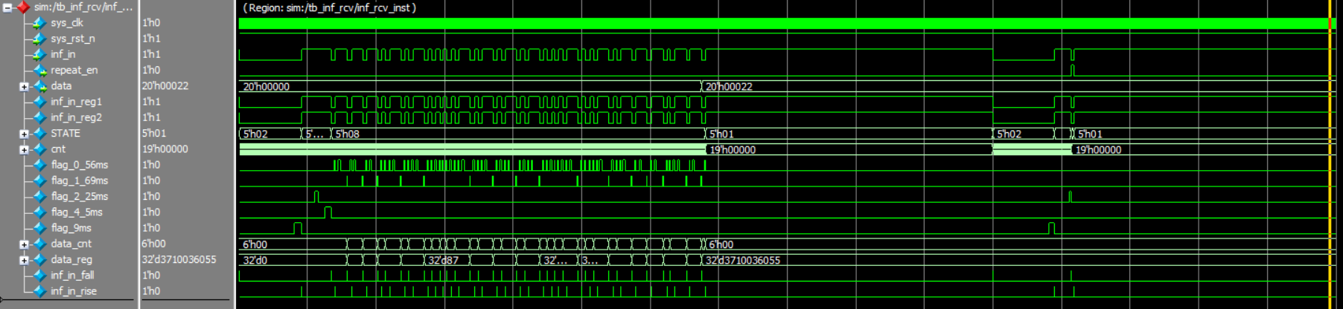
Simulation-inf_rcv
Transfer data as same as test bench setting 20’h22, OK.
And the state change is match test bench & waveform.

Slide 14
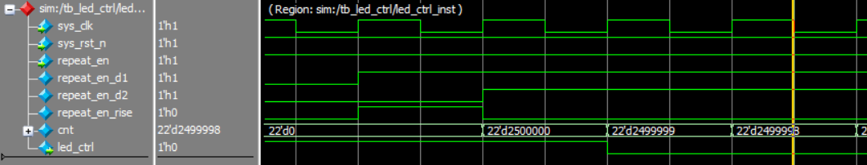
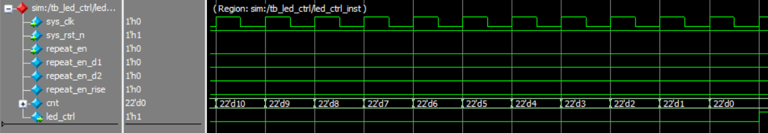
Simulation-led_ctrl
Repeat_en_rise is high-leve, cnt becom 2500000 and led_ctrl low-level, ok.
When cnt is 0, led_ctrl high-level, ok.

