Slide 1
Serial digit recognition
B06901052 電機一 馮子軒
B06901160 電機一 翁挺瑋

Slide 2
Problem description
Modern day map makings could be more accurate using digits recognition
Yet serial numbers are still hard to recognize
By associating the number with a street address, we can know the location of the building it represents

Slide 3
Data processing
SVHN consists of bonding boxes that localize the edge of the digits
To focus on digit recognition, we select the upper left-point and the bottom-right to make sure the serial numbers locate in the middle
Resized to 32x32 image

Slide 4
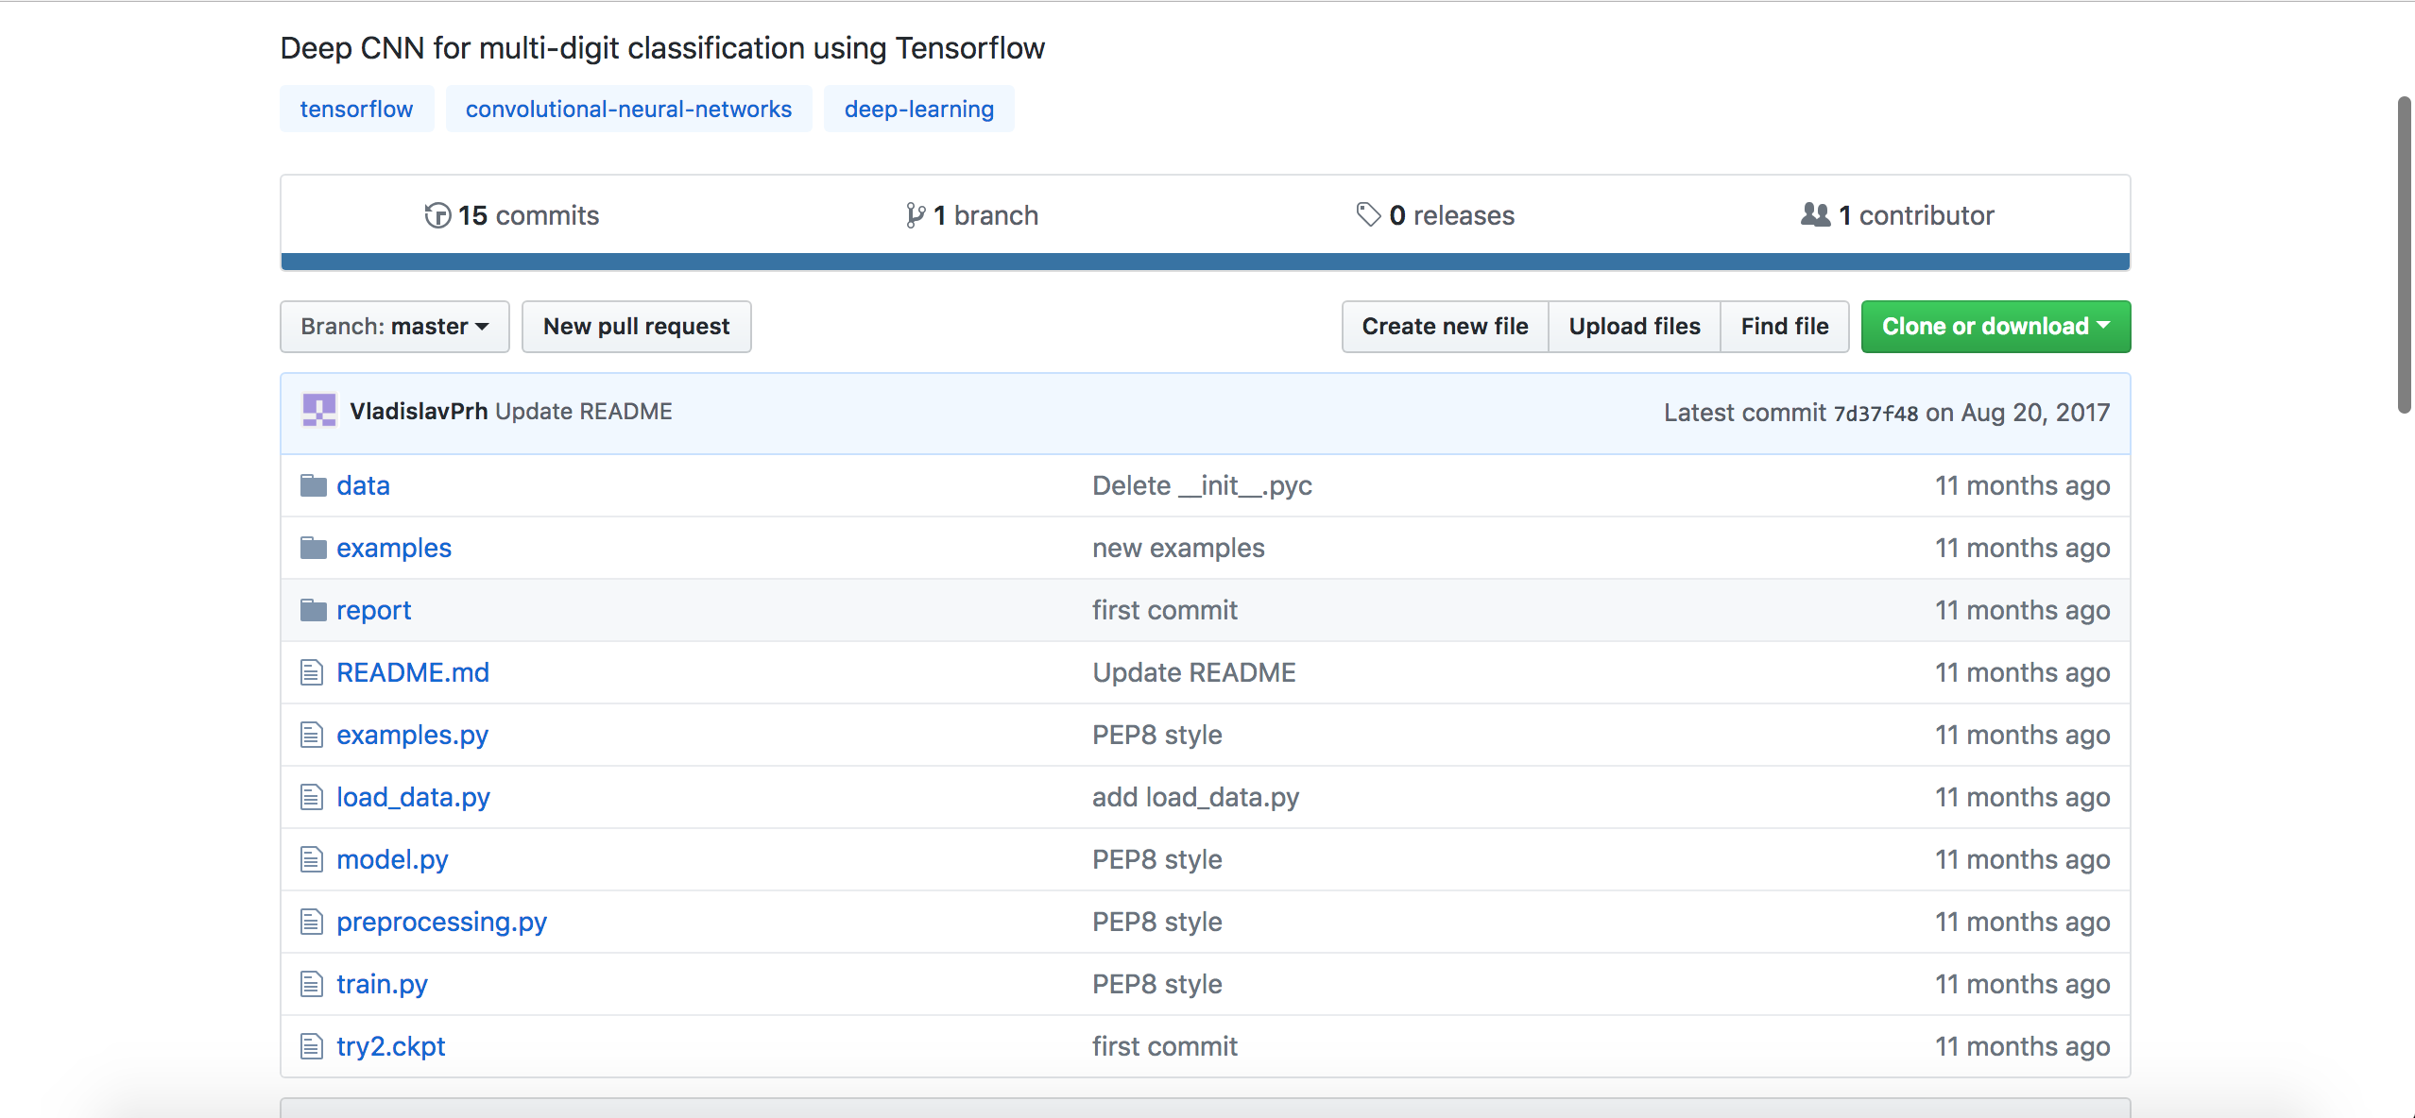
Github project from vladislaprh

Slide 5
Problem
Test Accuracy only 85%
We changed certain layers to improve that

Slide 6
Network structure
Input ⇒ Convolutional Network ⇒ RELU Function ⇒ CNN ⇒ RELU ⇒ MaxPooling
⇒ CNN ⇒ MaxPooling ⇒ Fully-connected(Dense) ⇒ RELU ⇒ Softmax

Slide 7
Accuracy vs word length

Slide 8
Length error

Slide 9
Recognition error

Slide 10
Hypothesis
We assume that the limit length for the softmax screening to be three, which fail to classify data of more than four

Slide 11
Conclusion
Both error rate rises with the increment of word length
Implement an activation function to determine the word length
Train classifiers that can only identify a particular length of digits
SVHN extra.tar.gz to make each length has the same amount of data

Slide 12
Tradition method vs goodfellow paper
Traditional Way : Slice the digits into three processes
localize, segment, and recognize
Goodfellow Way :
Using several convolutional neural layers to execute the processes simultaneously
Accuracy rises in an logarithmic form as the layer increases

Slide 13
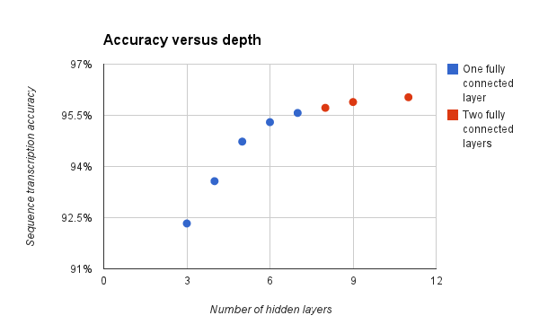
Accuracy vs Depth

Slide 14
Resource
Open Source : https://github.com/VladislavPrh/MDR
Course
Stanford CS231
Papers
Netzer, Y., et al. Reading Digits in Natural Images with Unsupervised Feature Learning. NIPS Workshop on Deep Learning and Unsupervised Feature Learning, 2011.
Goodfellow, I., et al. Multi-digit Number Recognition from Street View Imagery using Deep Convolutional Neural Networks. ICLR, 2014

