Slide 1
deep vs shallow
homework 1-1 Secret mlds 2018

Slide 2
function approximation
y = sin ( 5πx ) / (5πx)
$$y=sin(5πx)/5πx$$

Slide 3
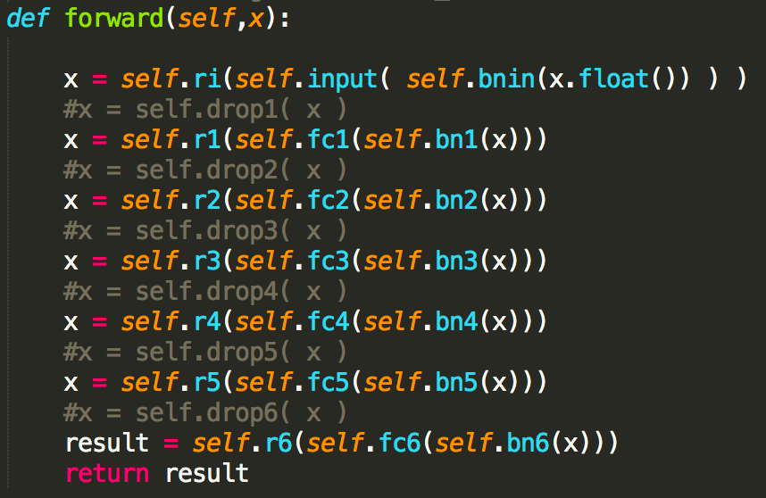
feed forward network
Text

Slide 4
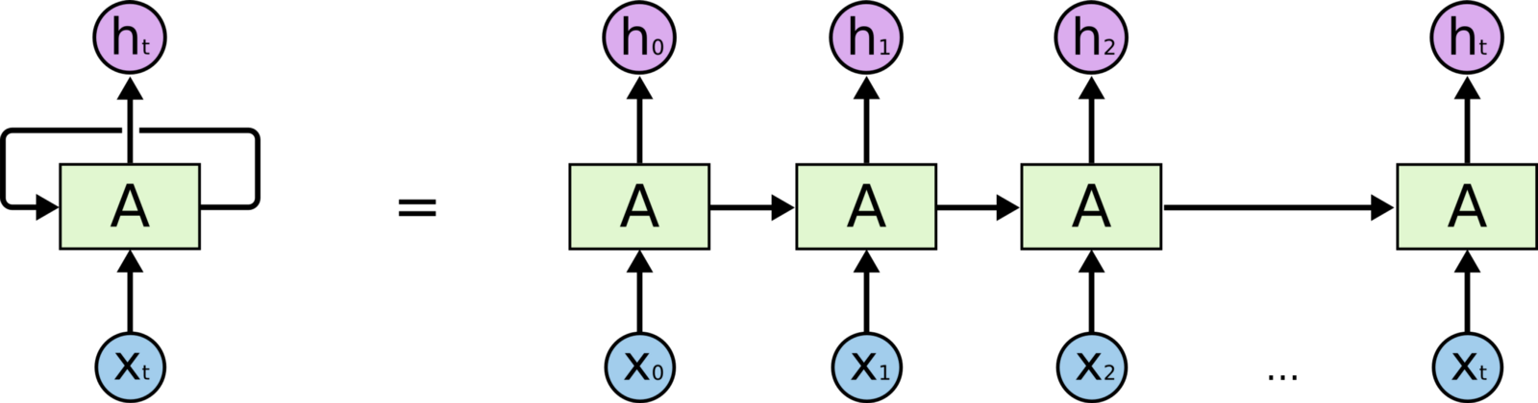
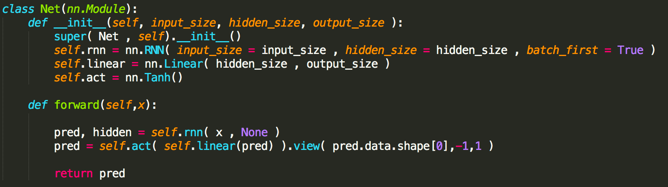
recurrent neural network
Text

Slide 5
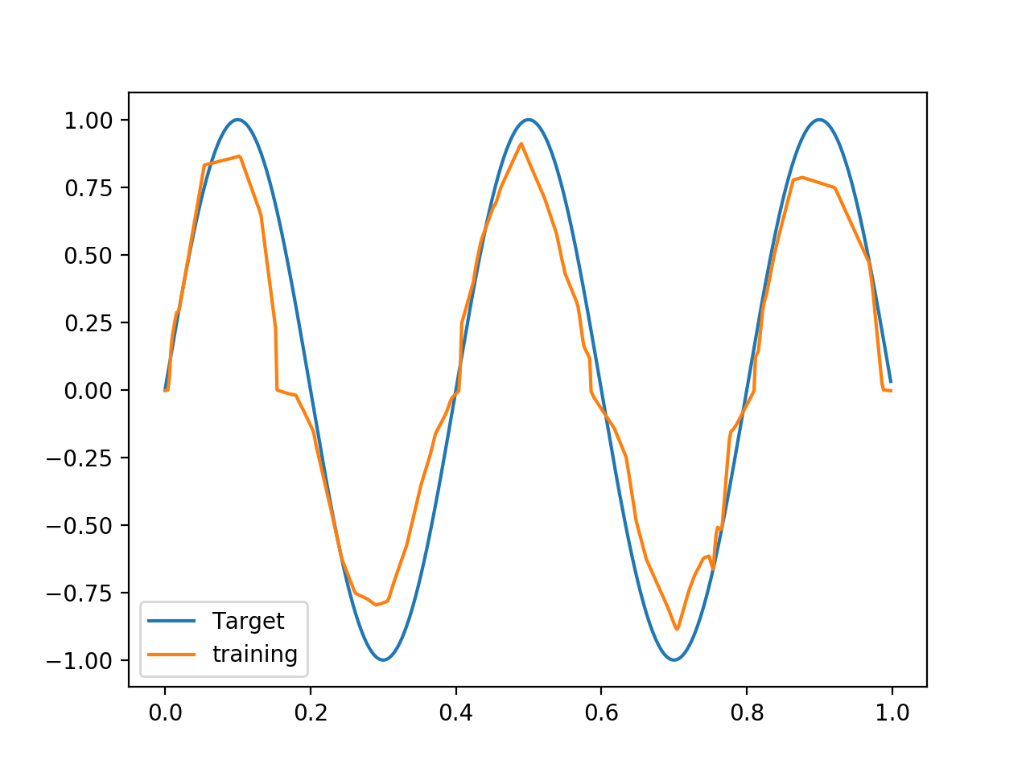
poor approximation-1
Text

Slide 6
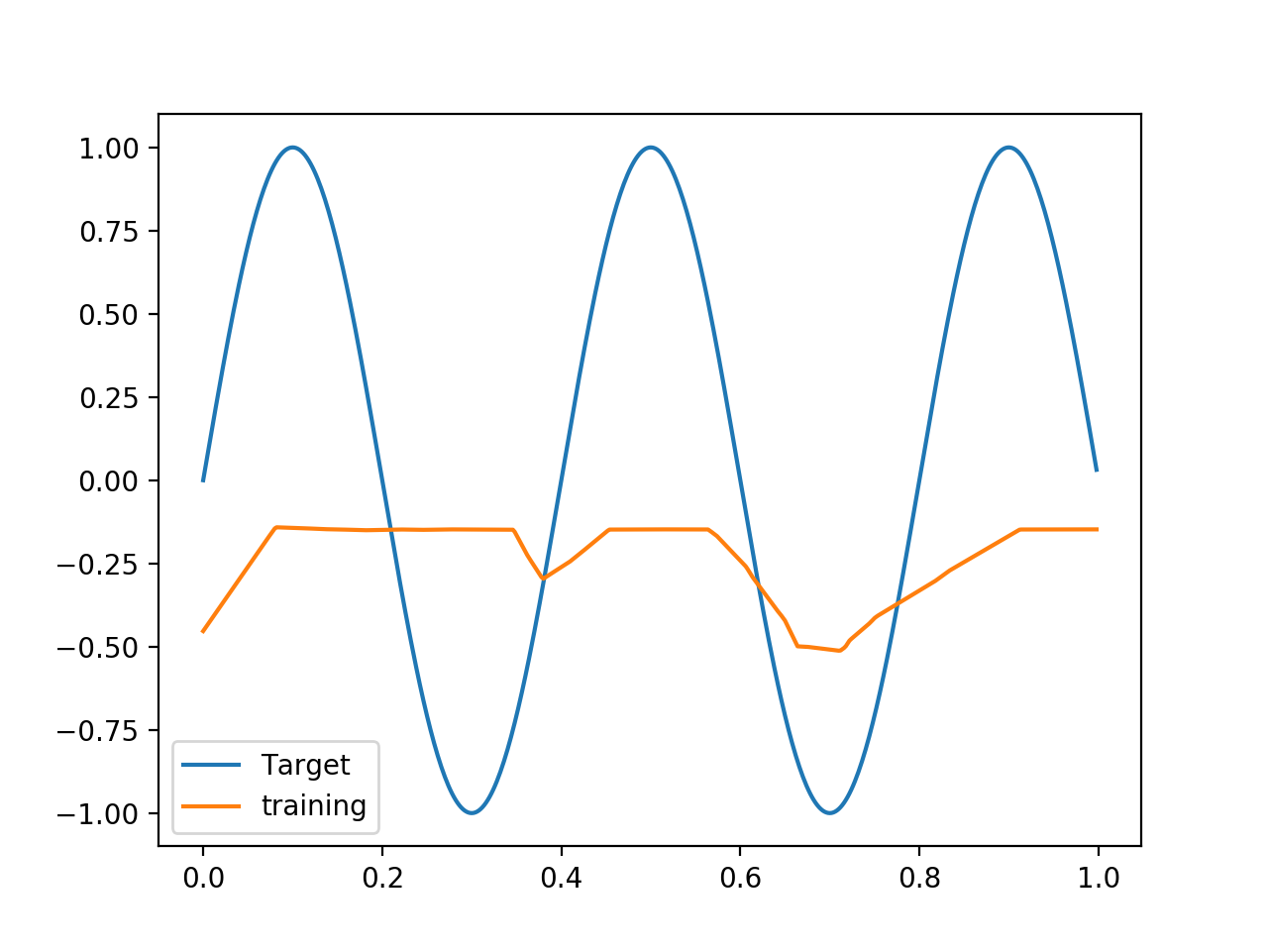
poor approximation-2
Text

Slide 7
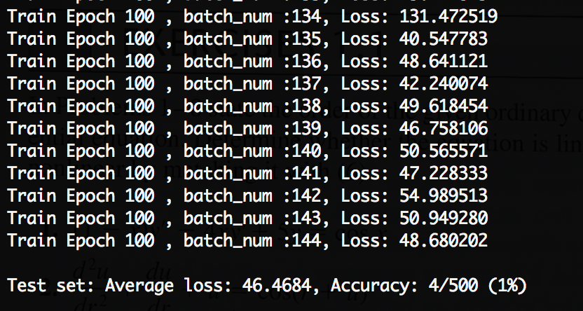
low accuracy
Text

Slide 8
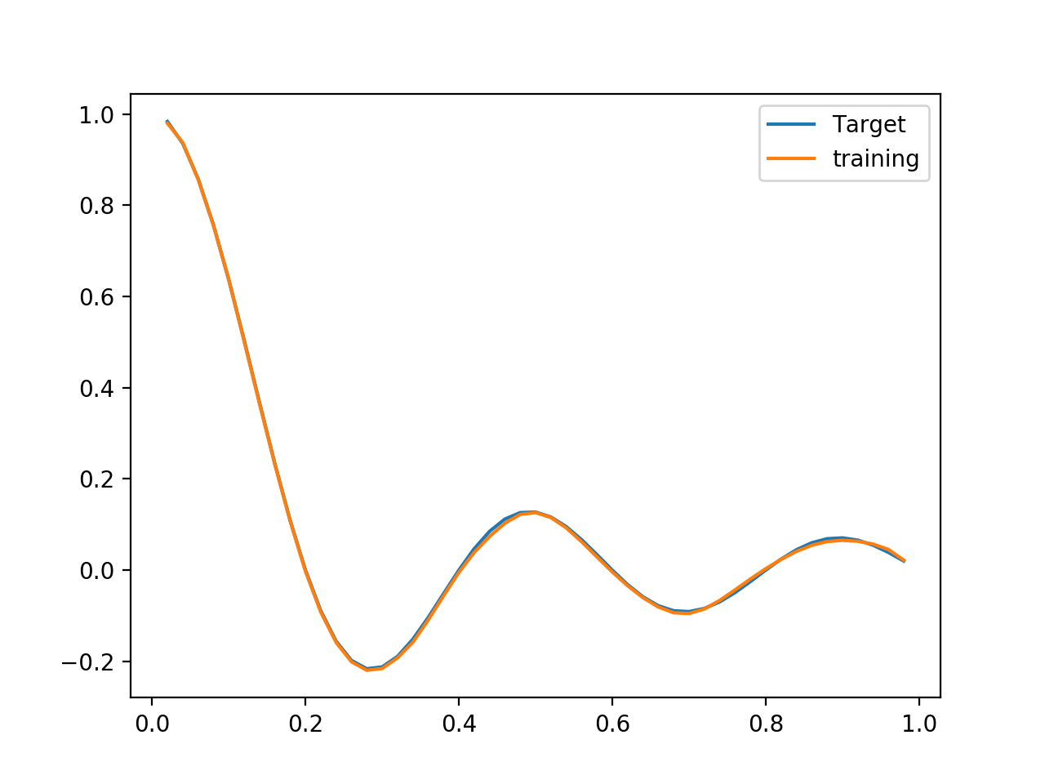
fitting after changing to run neural network
Text

Slide 9
train on actual task
Mnist + CIFAr10

Slide 10
universal approximation theorem
Text
One of the first versions of the theorem was proved by George Cybenko in 1989 for sigmoid activation functions.
Even a single layer neural network can approximate a given function with enough parameters.

Slide 11
why deep
Text
Are good minima easier to find in deep whether in shallow networks?
The main issue is that these very wide, shallow networks are very good at memorization, but not so good at generalization.

Slide 12
MNist dataset
deep vs shallow

Slide 13
MNIST deep parameters
Text
_________________________________________________________________
Layer (type) Output Shape Param #
=================================================================
dense_1 (Dense) (None, 32) 25120
_________________________________________________________________
dense_2 (Dense) (None, 10) 330
_________________________________________________________________
dense_3 (Dense) (None, 30) 330
_________________________________________________________________
dense_4 (Dense) (None, 30) 930
_________________________________________________________________
dense_5 (Dense) (None, 10) 310
_________________________________________________________________
activation_1 (Activation) (None, 10) 0
=================================================================
Total params: 27,020
Trainable params: 27,020
Non-trainable params: 0

Slide 14
MNIST Shallow parameters
Text
_________________________________________________________________
Layer (type) Output Shape Param #
=================================================================
dense_1 (Dense) (None, 32) 25120
_________________________________________________________________
dense_2 (Dense) (None, 50) 1650
_________________________________________________________________
dense_3 (Dense) (None, 10) 510
_________________________________________________________________
activation_1 (Activation) (None, 10) 0
=================================================================
Total params: 27,280
Trainable params: 27,280
Non-trainable params: 0

Slide 15
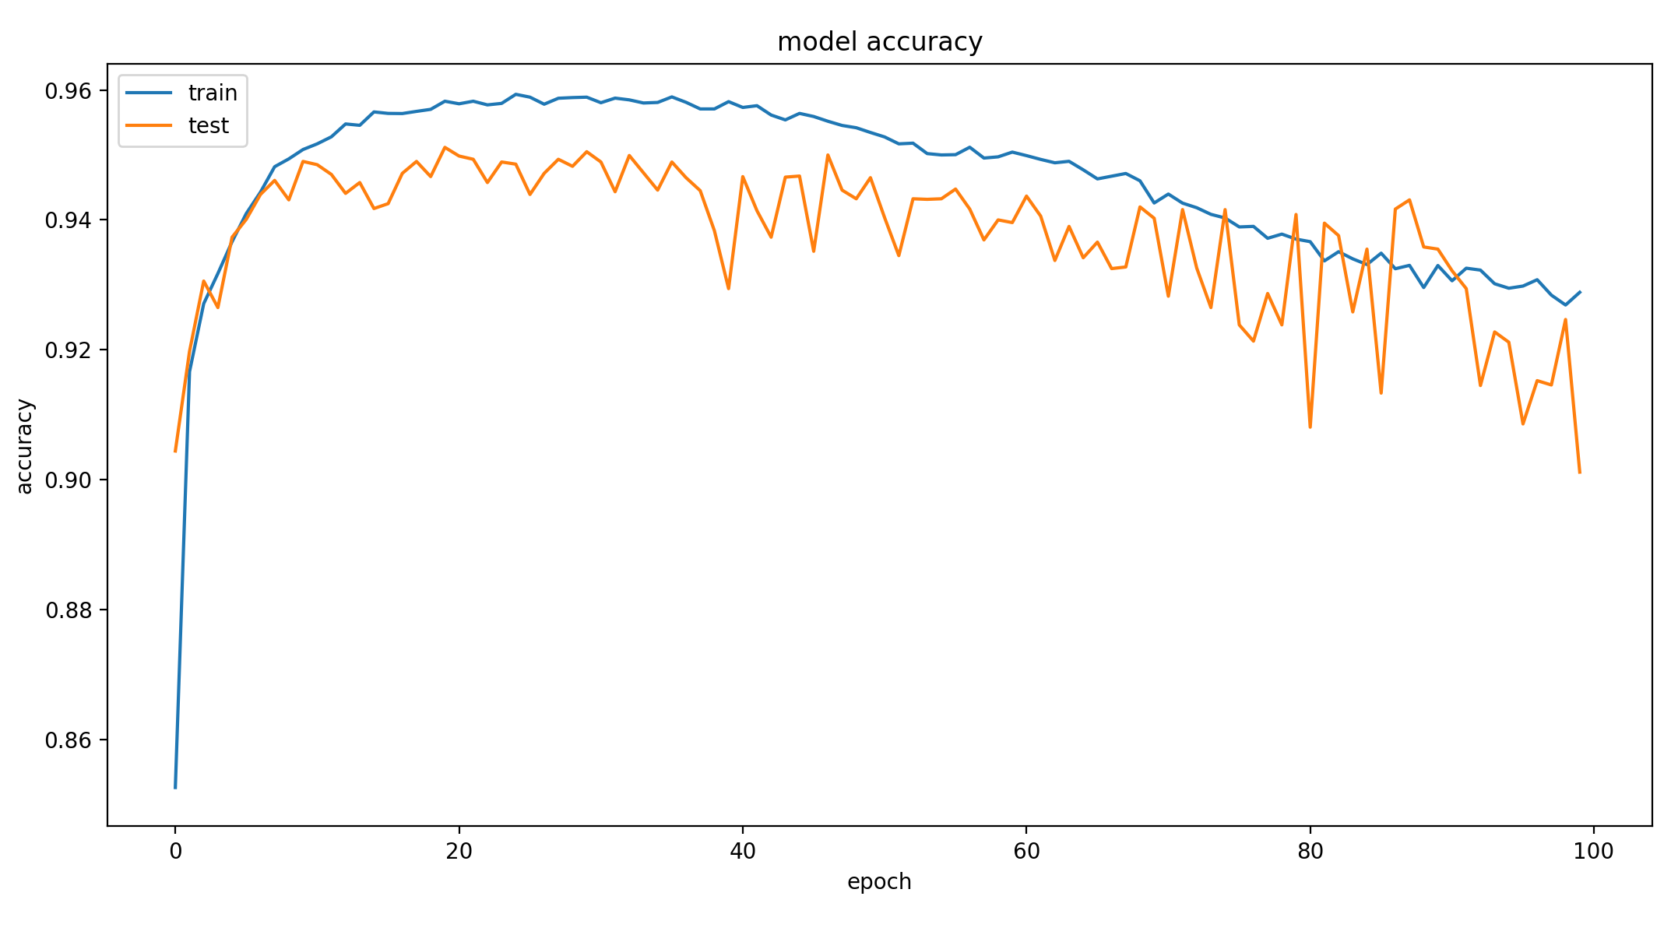
MNIST deep accuracy -90.0%
Text

Slide 16
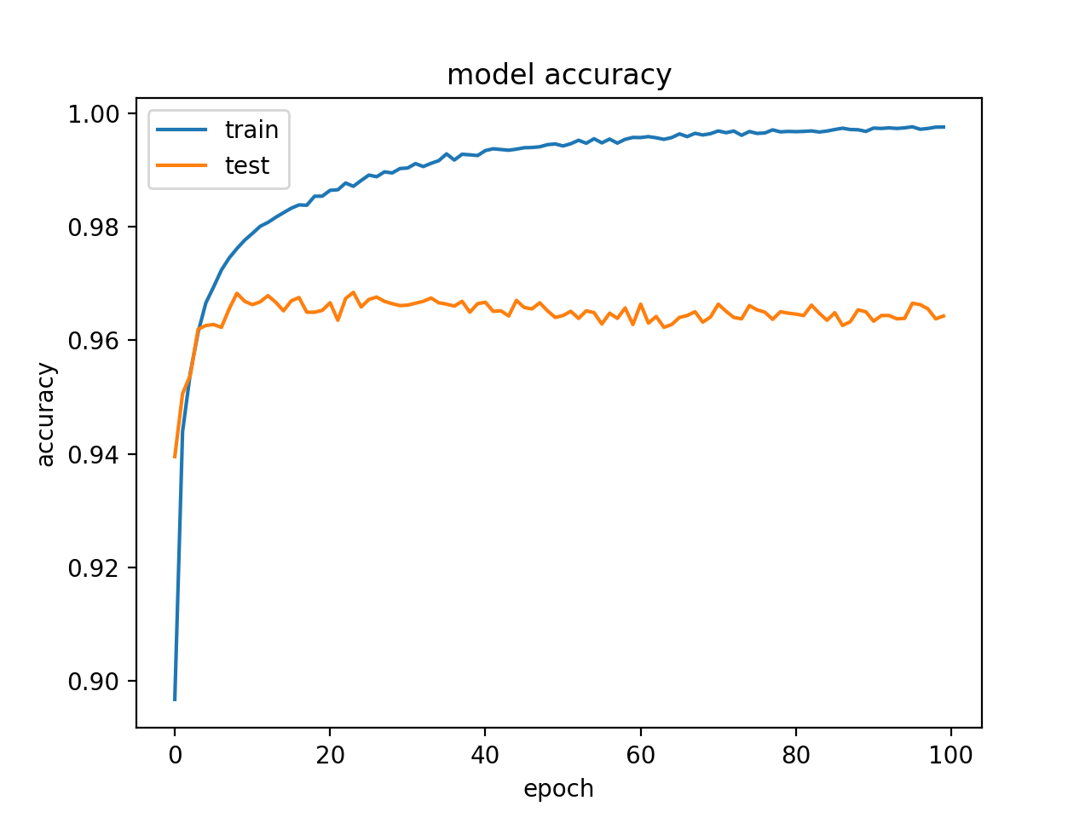
mNIST Shallow accuracy - 96.7%
Text

Slide 17
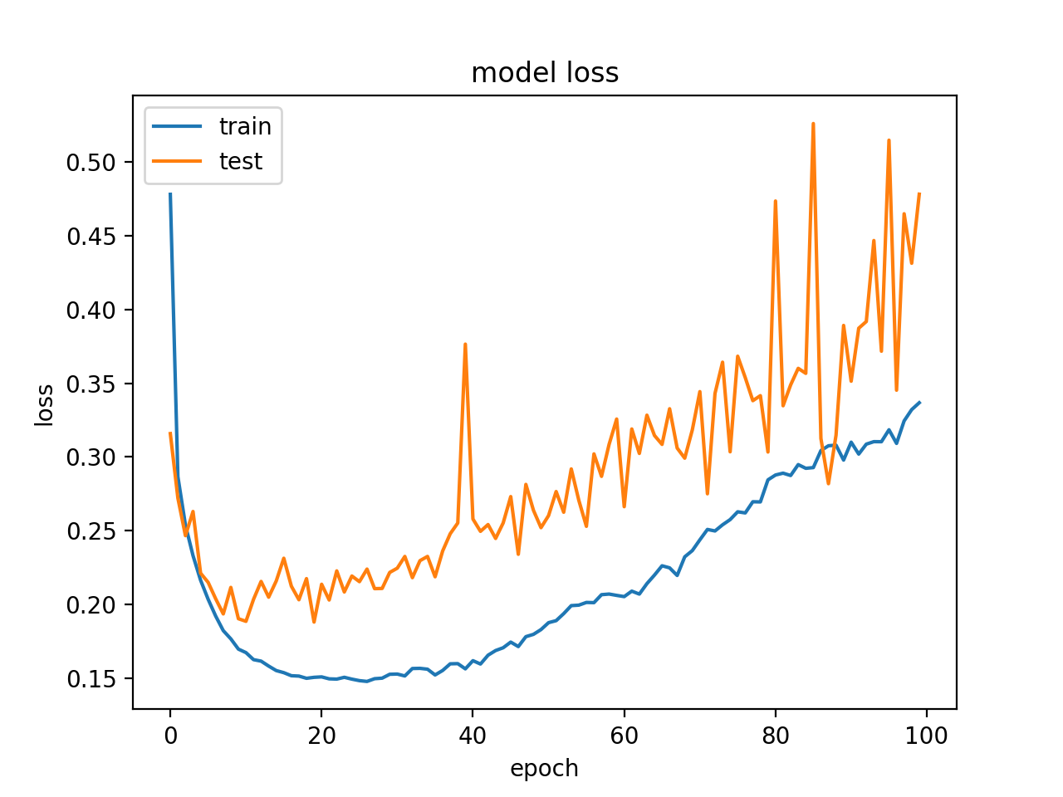
mNIST deep loss
Text

Slide 18
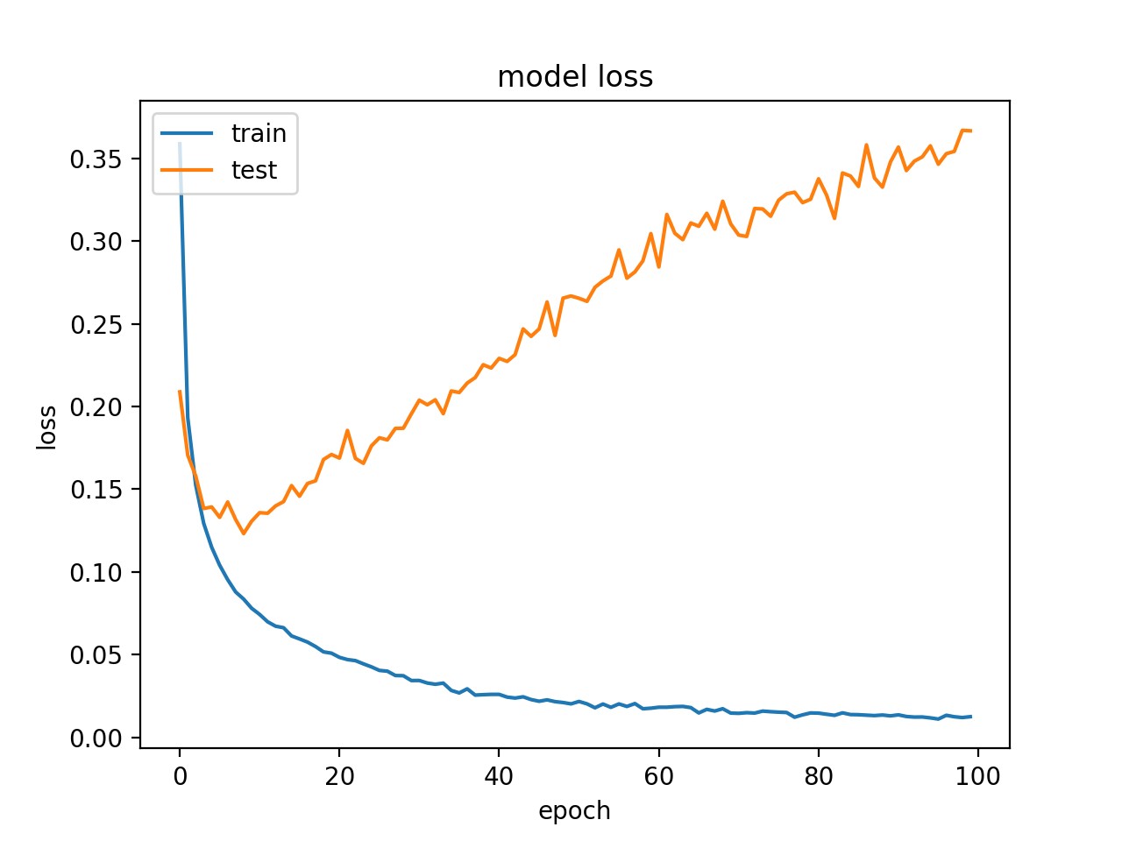
mNIST shallow loss
Text

Slide 19
why shallow performs better in this case-1
Text
Increasing the number of hidden layers might improve the accuracy or might not
If the problem is too simple, using deep networks could be analogous of approximating a linear function of polynomial lines
It depends on the complexity of the problem that you are trying to solve.
MNIST seems to be too simple

Slide 20
why shallow performs better in this case-2
Text
Increasing the number of hidden layers much more than the sufficient number of layers will cause accuracy in the test set to decrease.
It will cause your network to overfit to the training set, that is, it will learn the training data, but it won't be able to generalize to new unseen data.

Slide 21
cigar10 dataset
deep vs shallow

Slide 22
cifar10 deep parameters
Text
_________________________________________________________________
Layer (type) Output Shape Param #
=================================================================
dense_1 (Dense) (None, 32) 98336
_________________________________________________________________
dense_2 (Dense) (None, 10) 330
_________________________________________________________________
dense_3 (Dense) (None, 10) 110
_________________________________________________________________
dense_4 (Dense) (None, 10) 110
_________________________________________________________________
dense_5 (Dense) (None, 10) 110
_________________________________________________________________
activation_1 (Activation) (None, 10) 0
=================================================================
Total params: 98,996
Trainable params: 98,996
Non-trainable params: 0

Slide 23
cifar10 shallow parameters
Text
_________________________________________________________________
Layer (type) Output Shape Param #
=================================================================
dense_1 (Dense) (None, 32) 98336
_________________________________________________________________
dense_2 (Dense) (None, 100) 3300
_________________________________________________________________
dense_3 (Dense) (None, 10) 1010
_________________________________________________________________
activation_1 (Activation) (None, 10) 0
=================================================================
Total params: 102,646
Trainable params: 102,646
Non-trainable params: 0

Slide 24
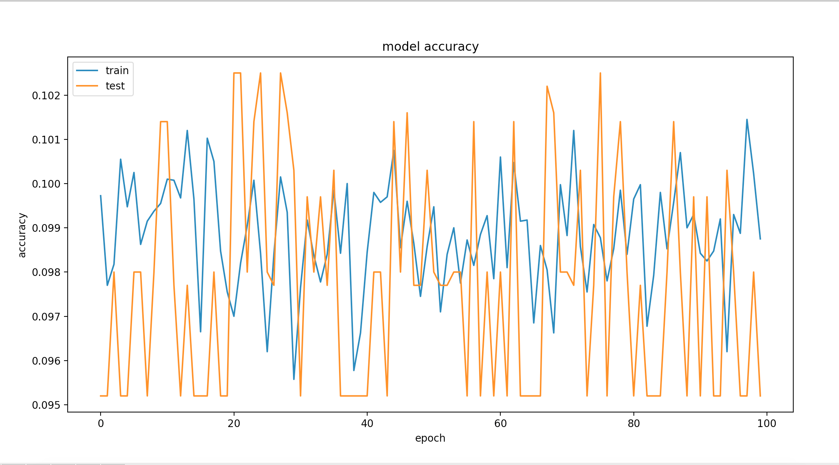
CIFAR10 deep accuracy -9.8%

Slide 25
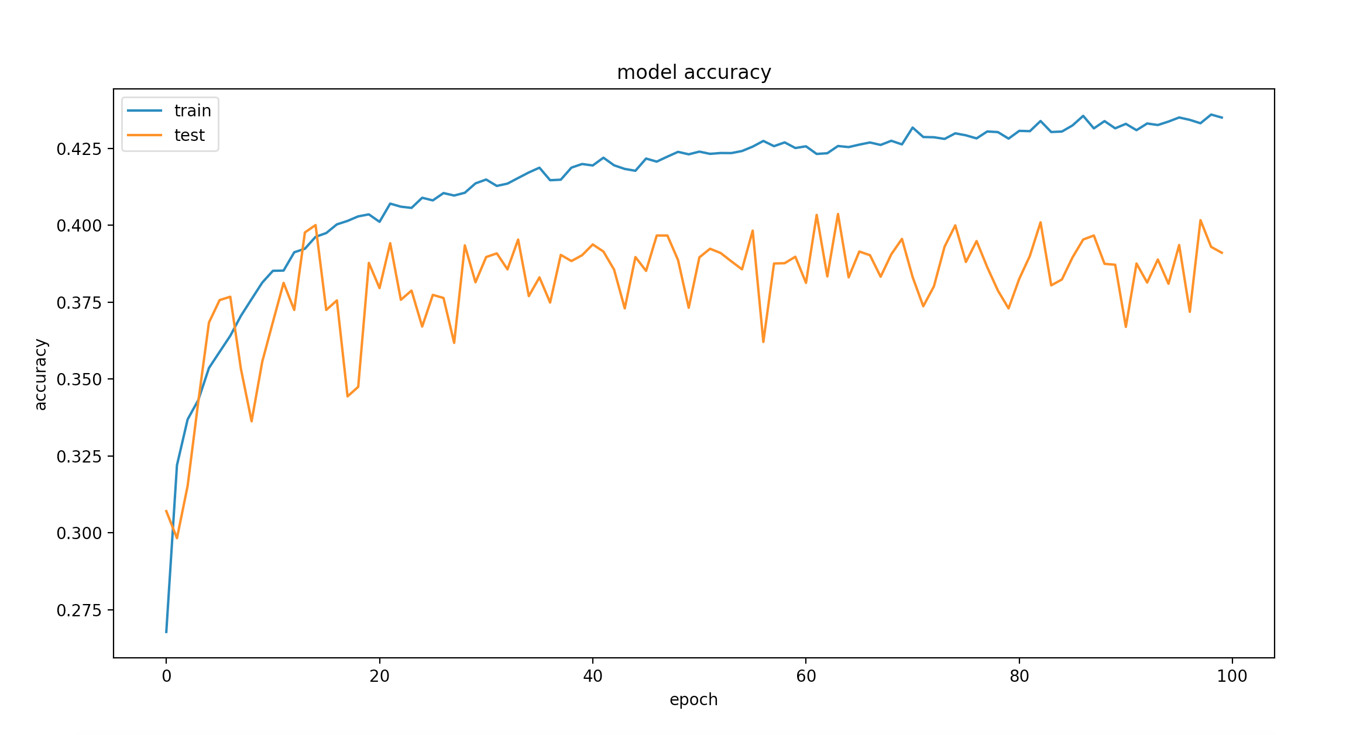
CIFAR10 shallow accuracy -43.2%

Slide 26
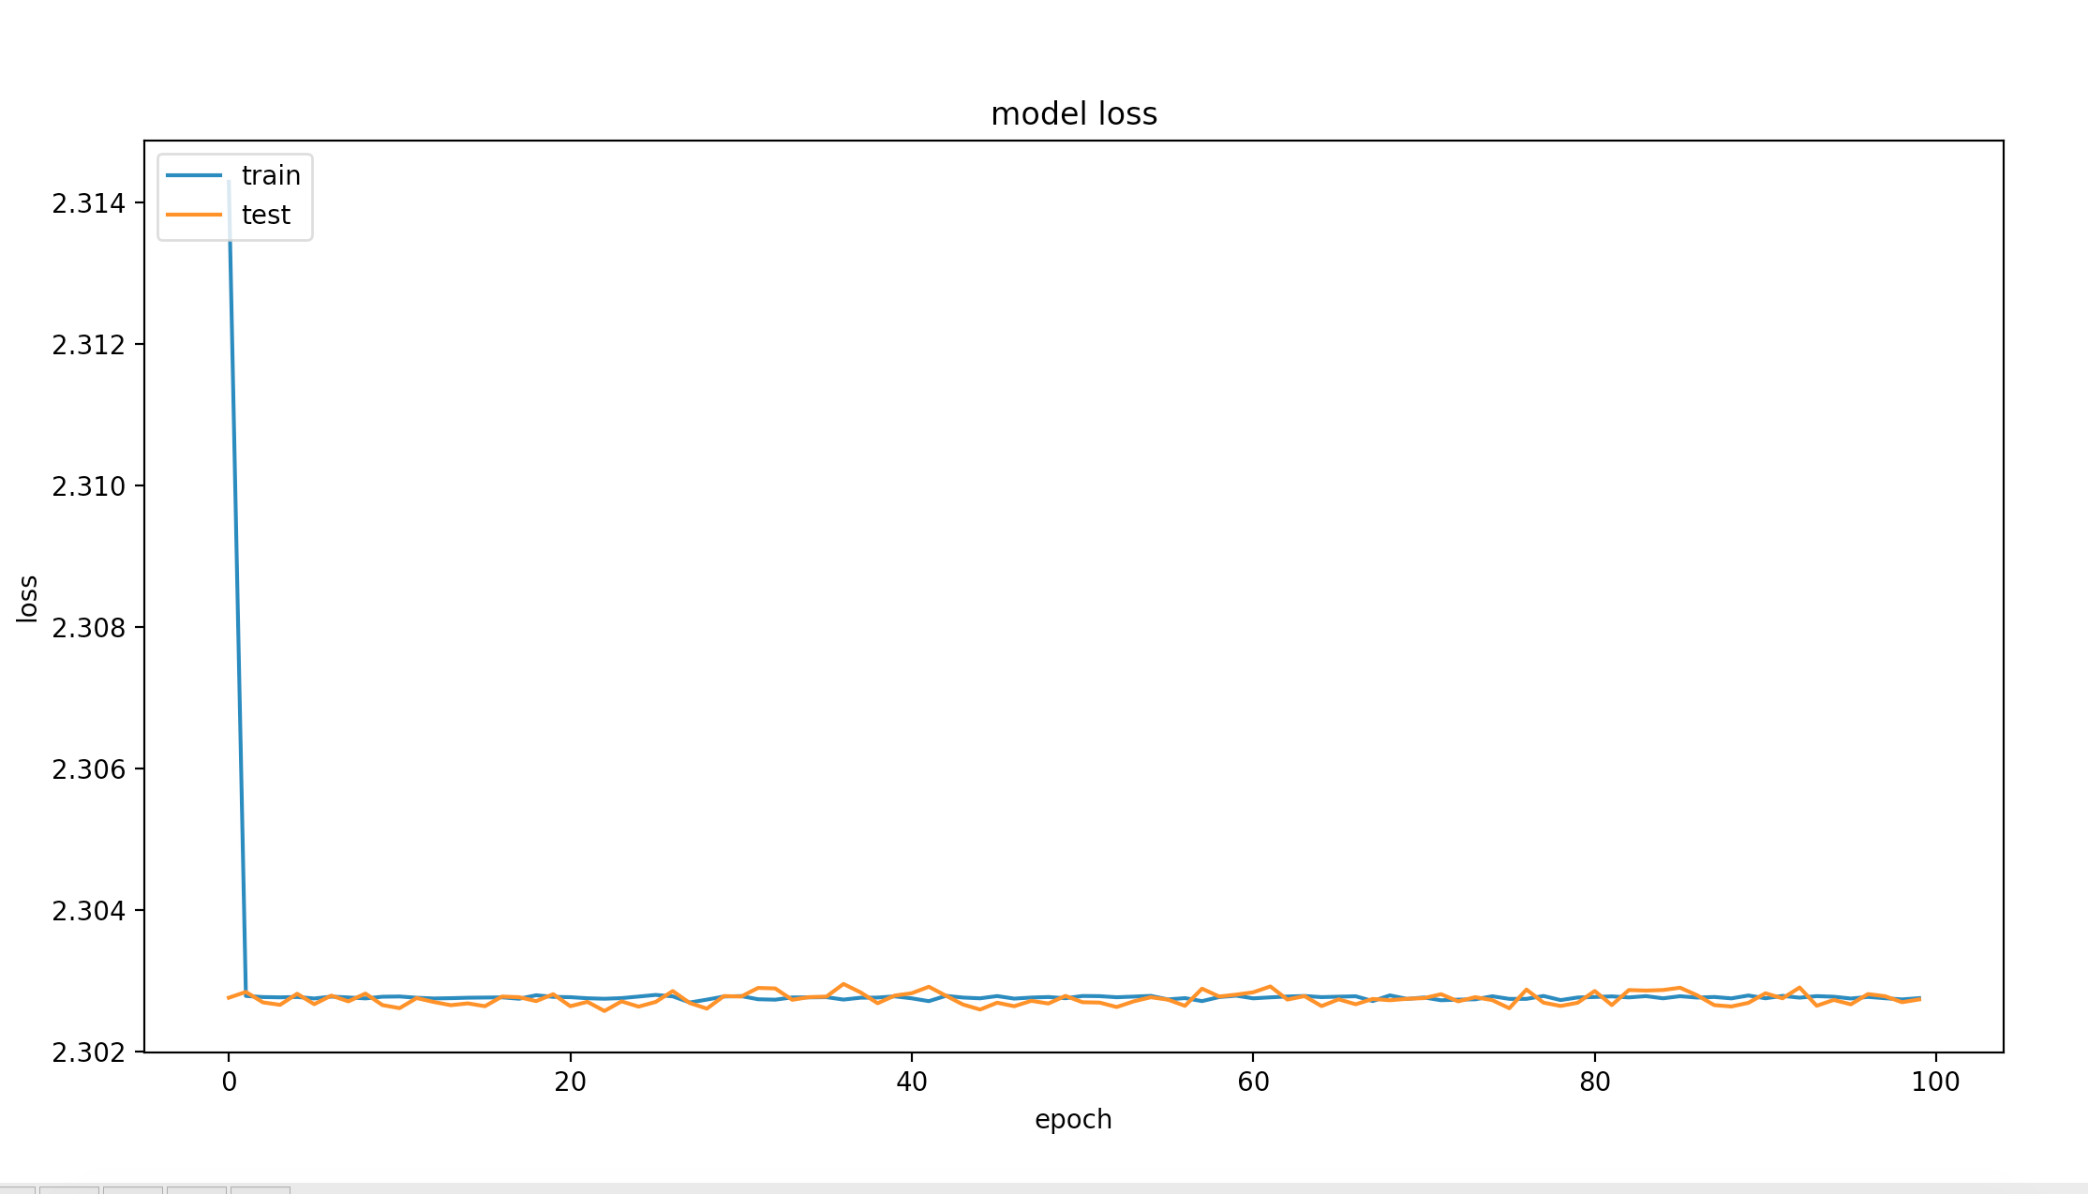
CIFAR10 deep loss

Slide 27
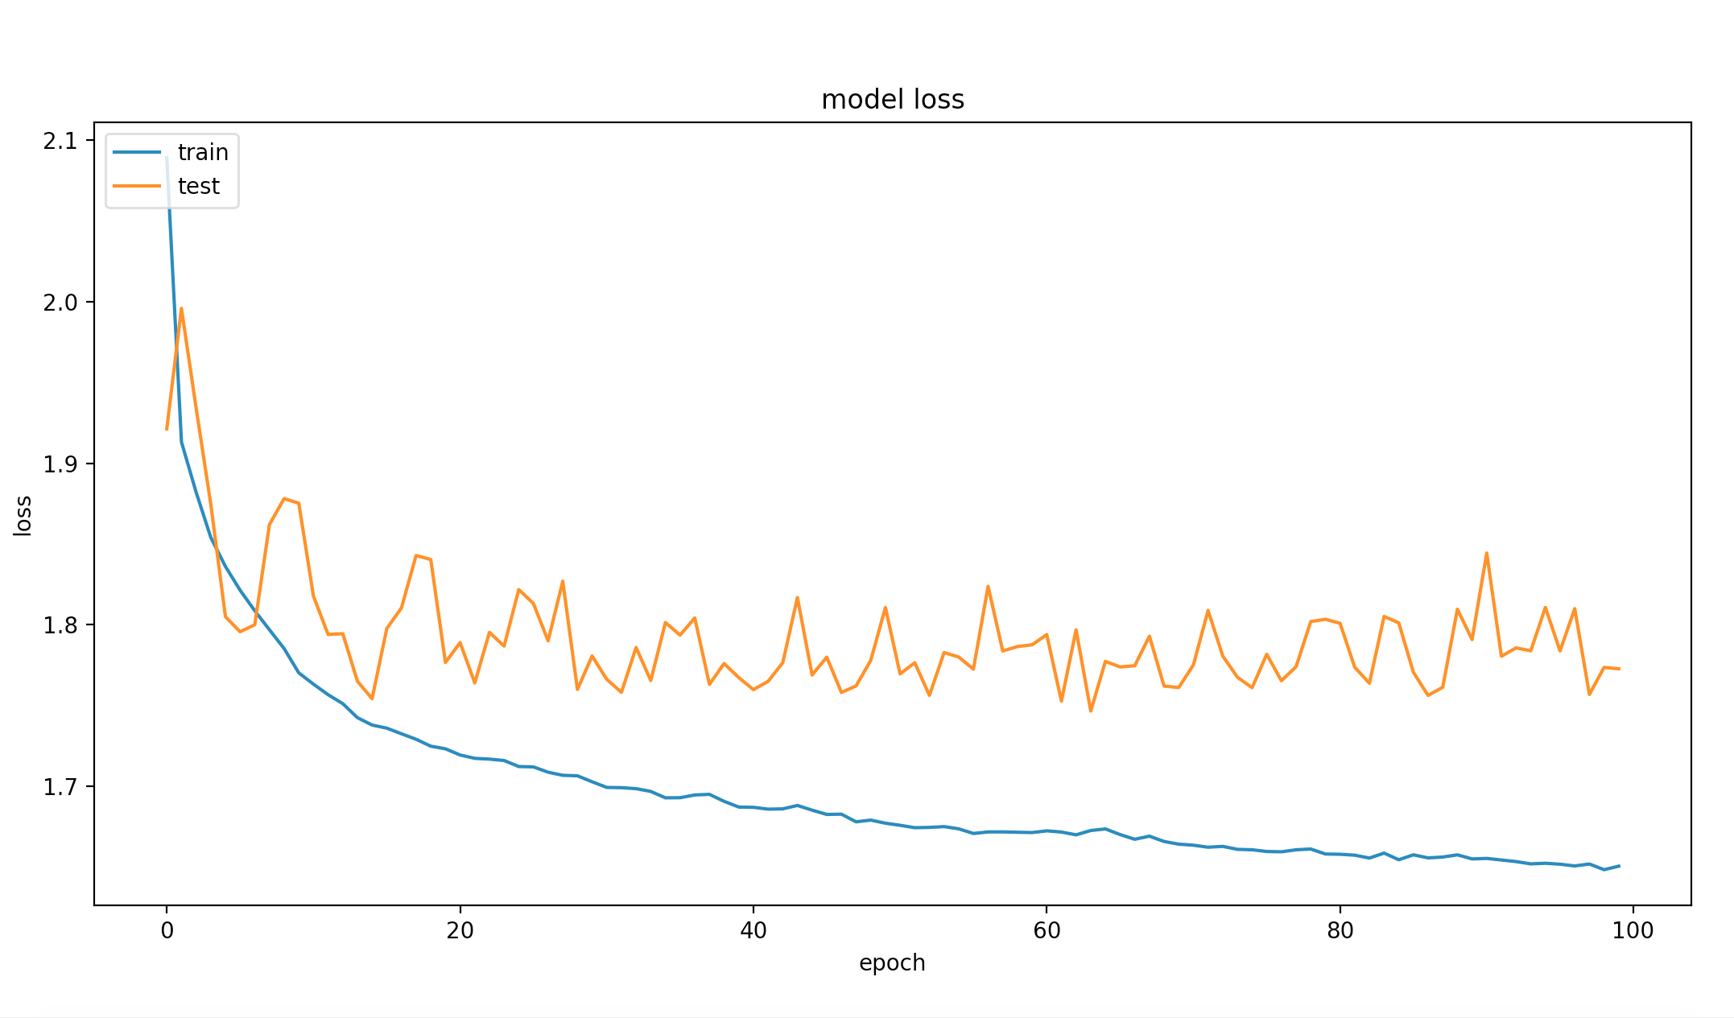
CIFAR10 shallow loss

Slide 28
why shallow performs better in this case
Text
Depends on other factors such as regularization to avoid overfitting.
Trying to solve an ordinary problem, given a shallow and a really deep network, training both for the same number of epochs, one would probably get a better test accuracy in the shallow one.
Learning rate might be too big for CIFAR10

Slide 29
most common issues
Text
Not enough epochs so the network might stuck on a plateau
Learning rate too big which might skip local minimums

Slide 30
Additional issues why shallow seems better
Text
When a neural network is very deep for a given problem, it tends to try and recreate the identity.
Usually the first layer of the neural network effectively optimizes the task. The following layers are merely adding noise.
Not good trying to make an identity function from a nonlinear set of activations.
RESNET proposed to skip over activations

Slide 31
end
thank you

