Slide 1
MLDS 2018 Fall
HW4-1 - Policy Gradient
2018/12/21
adlxmlds@gmail.com

Slide 2
Time Schedule
Jan 18th 14:20 Deadline (all in one)

Slide 3
Outline
Outline
Introduction
  Game Playing : Pong
Deep Reinforcement Learning
  Policy Gradient
  Improvements to Policy Gradient
Training Hints
Grading & Format
  Grading Policy
  Code Format
  Report
  Submission

Slide 4
Game Playing
Introduction
Implement an agent to play Atari games using Deep Reinforcement Learning
In this homework, you are required to implement Policy Gradient
The Pong environment is used in this homework

Slide 5
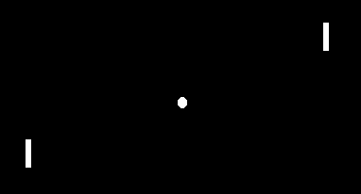
Environment
Introduction
Pong
https://gym.openai.com/envs/

Slide 6
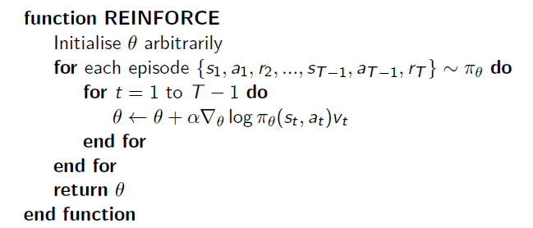
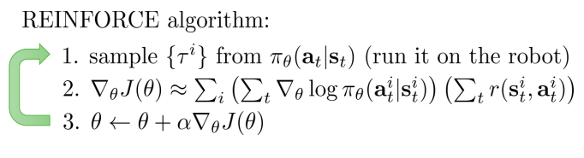
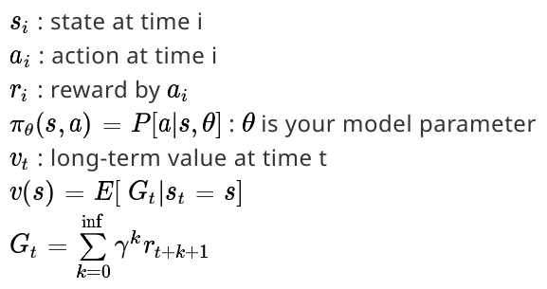
Policy Gradient
Deep Reinforcement Learning
Update per step → SGD → High Variance
Update per episode or by mini batch
  episode : A player win the game (21)
  mini batch : someone get some points
Notes:
add notation (Done)

Slide 7

REINFORCE Baseline on Pong
Deep Reinforcement Learning
Training loop(simplest version):
  Play until a game is over(one player gets 21 points) with policy network and store (s,a,r) tuples into memory m.
  Discount and normalize rewards in memory into to reduce variance
  Approximate gradient
  Clear the memory m

Slide 8
Improvements to Policy Gradient
Deep Reinforcement Learning
Variance Reduction
Natural Policy Gradient
Trust Region Policy Optimization
Proximal Policy Optimization
http://rll.berkeley.edu/deeprlcourse/f17docs/lecture_4_policy_gradient.pdf
http://rll.berkeley.edu/deeprlcourse/f17docs/lecture_13_advanced_pg.pdf
Notes:
give explanation

Slide 9
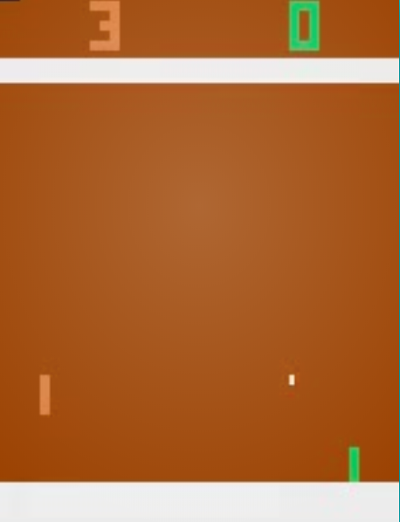
Preprocessing for States
Training Hint
Which is better ?
  rgb channel or gray scale
    0.2126 * Red + 0.7152 * Green + 0.0722 * Blue
  single or residual
    s’(t) = s(t+1) - s(t)
    represent change of pixel
  scoreboard yes or no?
Notes:
which is better give graph example
explain rgb and give graph example
ok ok

Slide 10
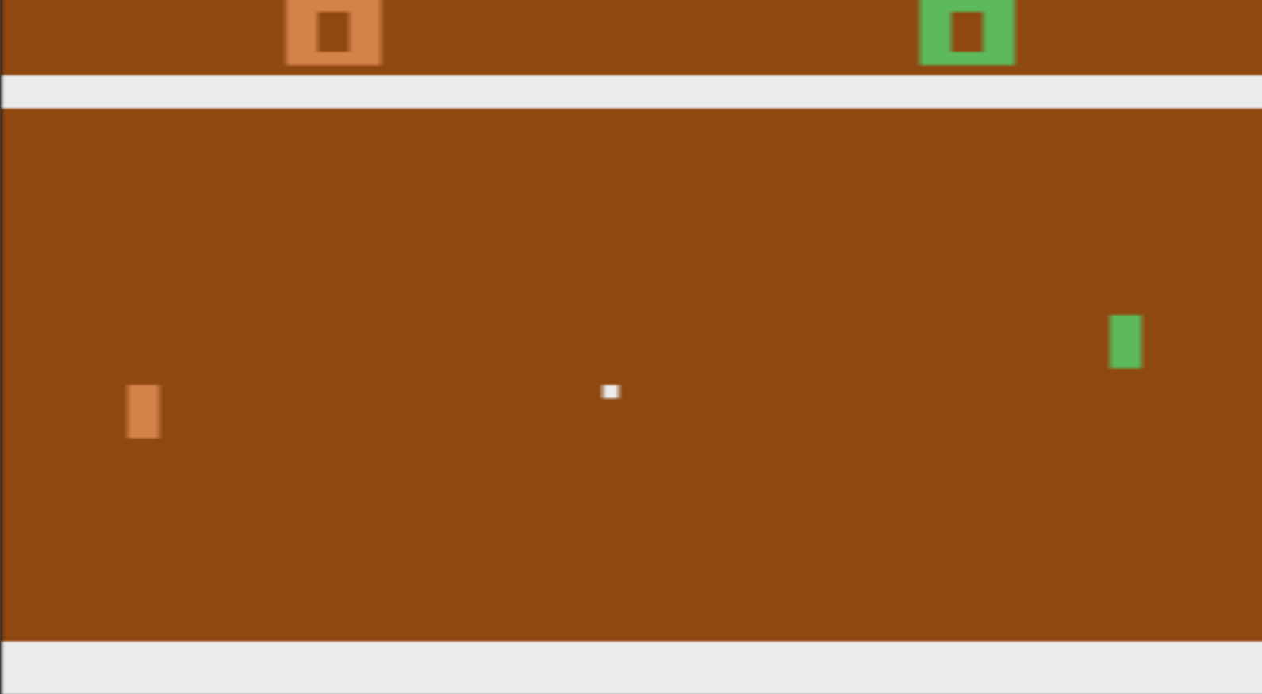
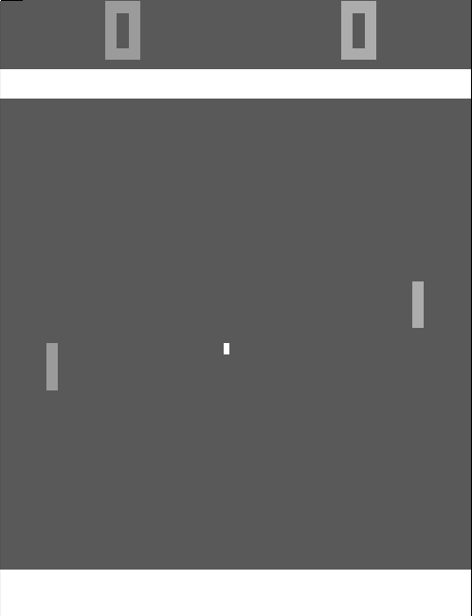
RGB vs Gray scale
Notes:
add diff graph!!!

Slide 11
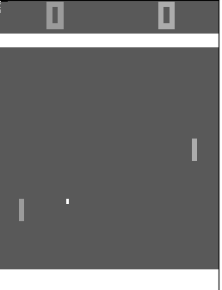
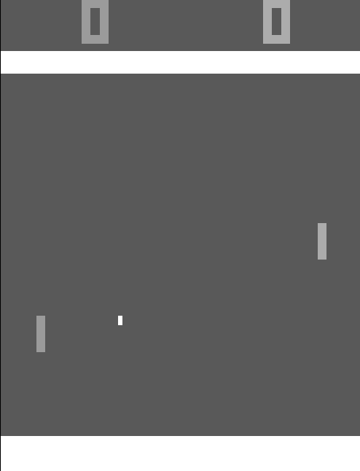
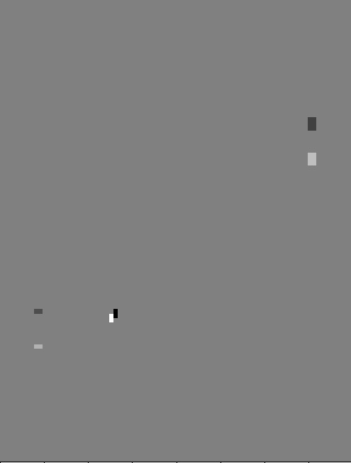
Residual State
S1
S2
S1
S1’

Slide 12
Reward and Action
Training Hint
Reward normalization
  More stable
  http://karpathy.github.io/2016/05/31/rl
  https://arxiv.org/pdf/1506.02438.pdf
Action space reduction
Reset the running add of discounted reward to zero if a player scores (Pong specific)
Notes:
show the reward normalized graph
give option for discounted reward
ok
add diff graph …

Slide 13
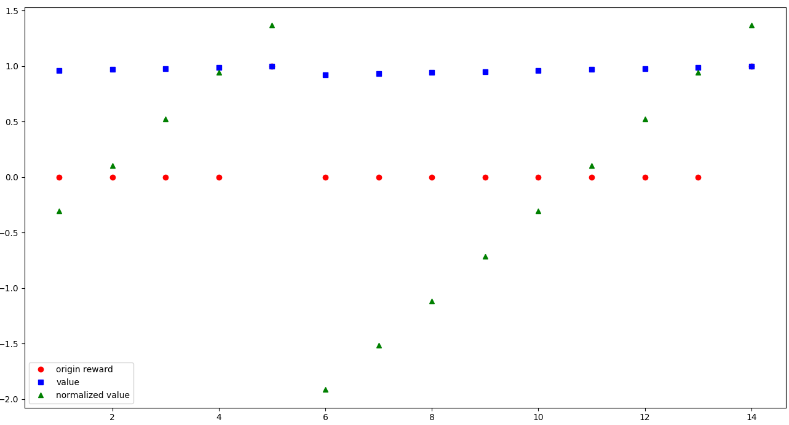
Reward normalization
Not same high!

Slide 14
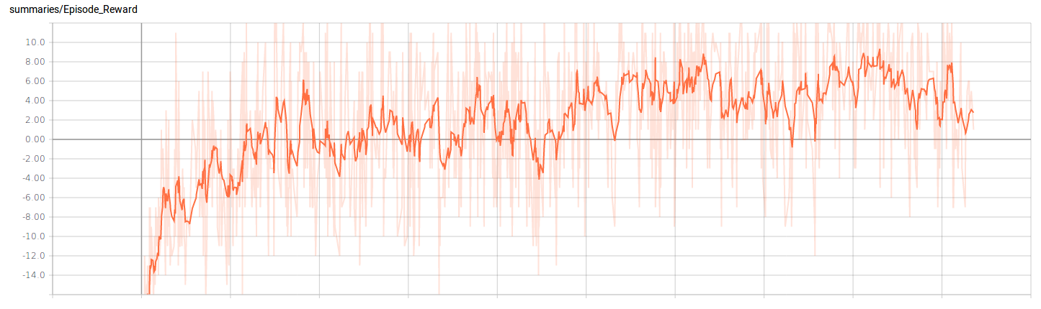
Training Plot
Training Hint
The unit of x-axis is 1000 episode
Around 6000 episode to reach baseline in “average”
Mind your preprocessing if your curve differs from this too much
Baseline Network Structure : Flatten + Two-layer FNN
  256 dimension hidden layer
  output layer (action space size)
Update per episode (21 point game)
Freeze random seed!
Notes:
freeze seed is important ! ok

Slide 15
Grading Policy
Grading & Format
Code Baseline
Report

Slide 16
Baseline
Grading & Format
Policy Gradient
  Getting averaging reward in 30 episodes over 1 in Pong
  Without OpenAI’s Atari wrapper & reward clipping
  Improvements to Policy Gradient are allowed
Notes:
3 ok

Slide 17
Code Format
Grading & Format
Please download the sample files from github
Follow the instructions in README to install required packages
Four functions you should implement in agent_[pg|dqn].py
__init__(self, env, args)
init_game_setting(self)
train(self)
make_action(self, state, test)
DO NOT add any parameter in __init__(), init_game_setting() and make_action()
You can add new methods in the agent_[pg|dqn].py
You can add your arguments in argument.py

Slide 18
Report
Grading & Format
Up to 6 pages (4-1 + 4-2 + 4-3), in Chinese
Describe your Policy Gradient model
Plot the learning curve to show the performance of your Policy Gradient on Pong
  X-axis: number of time steps
  Y-axis: average reward in last 30 episodes
Implement 1 improvement method on page 8
  Describe your tips for improvement
  Learning curve
  Compare to the vanilla policy gradient
Notes:
all for six
one extra method
ok ok ok

Slide 19
Submission
Grading & Format
Submit your presentation files to: google drive
Your github must have several files under the directory: hw4/
  README
  Other implementation files
  Your models
In your README:
  Specify the toolkits/libraries and their corresponding version
  Describe how to download your models

Slide 20
Submission
Grading & Format
Deadline: 2019/1/18 14:20 (GMT+8)
Your github should have 5 files under directory hw4/
  agent_dir/agent_pg.py
  agent_dir/agent_dqn.py
  [saved_model_file] * 2
  report.pdf
  argument.py (optional)
  download.sh (optional)
  other files you need
If your model is too large for github, upload it to a cloud space and write download.sh to download the model
Do not upload any file named the same with other sample codes

Slide 21
Grading
Grading & Format
Please use Python with version >= 3.5
The TAs will execute ‘python3 test.py --test_pg --test_dqn’ to run your code on ubuntu
The execution for both model should be done within 10 minutes respectively, excluding model download
Recommended packages
  PyTorch
  Tensorflow (CUDA 9.0)
  Numpy
  Scipy
  Pandas
  Python Standard Lib
  Keras
Notes:
No keras
On ubuntu plz

Slide 22
Related Materials
Course & Tutorial:
  Berkeley Deep Reinforcement Learning, Fall 2017
  David Silver RL course
  Nips 2016 RL tutorial
Blog:
  Andrej Karpathy’s blog
  Arthur Juliani’s Blog
  Openai
Text Book:
  Reinforcement Learning: An Introduction
Repo:
  https://github.com/williamFalcon/DeepRLHacks

