Slide 1
MLDS 2018 Fall
HW4-2 - Deep Q Learning
2018/12/21
adlxmlds@gmail.com

Slide 2
Outline
Outline
Introduction
  Game Playing : Breakout
Deep Reinforcement Learning
  Deep Q-Learning (DQN)
  Improvements to DQN
Grading & Format
  Grading Policy
  Code Format
  Report
  Submission

Slide 3
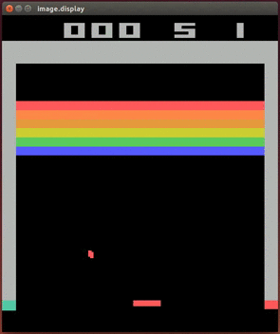
Environment
Introduction
Breakout

Slide 4
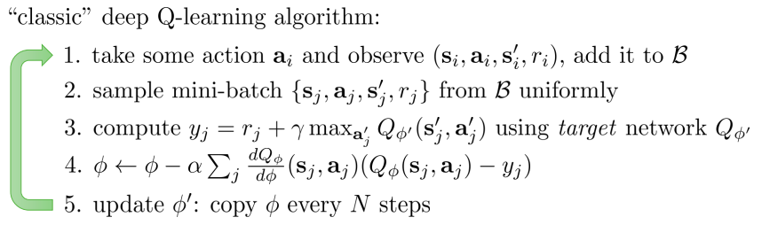
Deep Q-Learning (DQN)
Deep Reinforcement Learning
Replay buffer
Notes:
Alpha:學習效率

Slide 5
Deep Q-Learning (DQN)
Deep Reinforcement Learning
The action should act ε-greedily
  Random action with probability ε
Linearly decline ε from 1.0 to some small value, say 0.025
  Decline per step
  Randomness is for exploration, agent is weak at start
Hyperparameters
  Replay Memory Size 10000
  Perform Update Current Network Step 4
  Perform Update Target Network Step 1000
  Learning Rate 1.5e-4
  Batch Size 32

Slide 6
Improvements to DQN
Deep Reinforcement Learning
Double Q-Learning
Dueling Network
Prioritized Replay Memory
Noisy DQN
Distributional DQN
https://arxiv.org/pdf/1710.02298.pdf

Slide 7
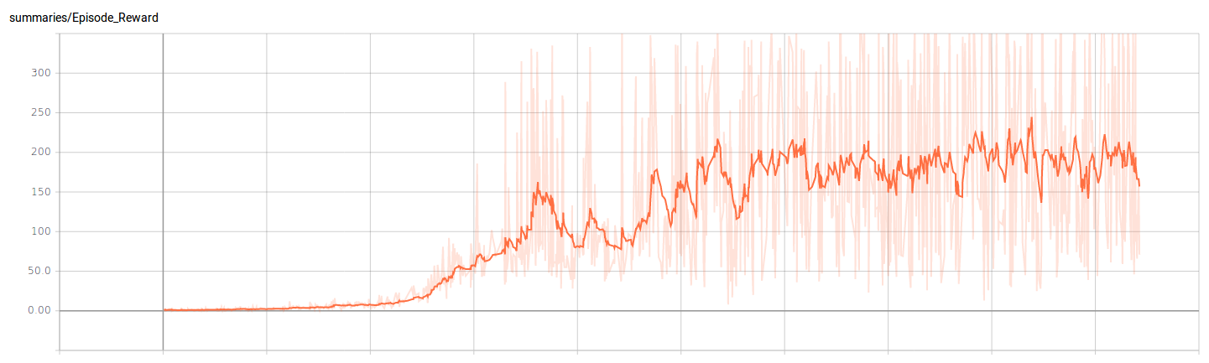
Training Plot
Training Tips
X-axis : 1000 episodes/unit
Y-axis : Unclipped reward per episode

Slide 8
Why Reward is clipped
Training Tips
Performing the same action for 4 frames
  To use data more efficiently
Reward may be up to 4
  If positive, clip to 1 → reduce variance
How to see your unclipped reward
Use the test function
Turn off the clip_reward option of your environment and do the clipping by yourself.

Slide 9
Asynchronous Update (Optional)
Training Tips
In tensorflow, feed_dict does the copy thing
  Upon updating, the agent have to wait for it to continue exploring.
Try run the update asynchronously
  Main thread : Collect data
  The other thread : Copy data to GPU
  GPU : Training
  Using the thread/multiprocessing module
This is totally not necessary for you to get baseline, just some speed-up you can try.
  This can go wrong and annoying if you’re not familiar with threading, thus I recommend not to try it unless you are confident enough.

Slide 10
Grading Policy
Grading & Format
Code Baseline
Report

Slide 11
Baseline
Grading & Format
DQN
  Getting averaging reward in 100 episodes over 40 in Breakout
  With OpenAI’s Atari wrapper & reward clipping
    We will unclip the reward when testing

Slide 12
Report
Grading & Format
Up to 6 pages (4-1 + 4-2 + 4-3), in Chinese
Describe your DQN model
Plot the learning curve to show the performance of your Deep Q Learning on Breakout
  X-axis: number of time steps
  Y-axis: average reward in last 30 episodes
Implement 1 improvement method on page 6
  Describe your tips for improvement
  Learning curve
  Compare to origin Deep Q Learning

Slide 13
Related Materials
Course & Tutorial:
  Berkeley Deep Reinforcement Learning, Fall 2017
  David Silver RL course
  Nips 2016 RL tutorial
Blog:
  Andrej Karpathy’s blog
  Arthur Juliani’s Blog
Text Book:
  Reinforcement Learning: An Introduction
Repo:
  https://github.com/williamFalcon/DeepRLHacks

Slide 14

Double DQN
Deep Reinforcement Learning
The formula
often overestimates the maximum Q value.
Thus instead choose the action of the max Q in the target network, choose the action of the max Q in the current network.
https://arxiv.org/pdf/1710.02298.pdf
Which is a_j’ = max_a_j’Q_ϕ(s_j’, a_j’), then
y _j= r_j + gamma * Q_ϕ’(s_j’, a_j’)

Slide 15
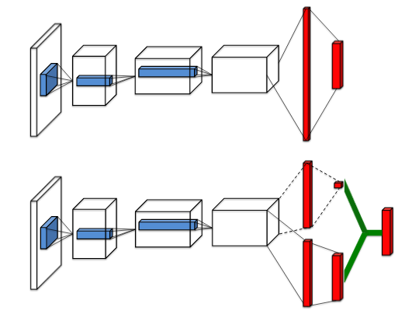
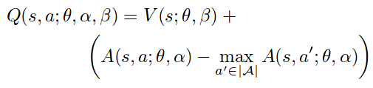
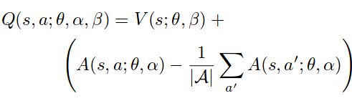
Dueling Network
Deep Reinforcement Learning
In many state, action does not counts.
  DQN trys to find out the max Q in each state
Use same network to output Value and Advantage
Why should it be the Advantage?
  Add loss constraint
Alternative Q function, more stable (more used)

Slide 16

Prioritized Replay Memory
Deep Reinforcement Learning
DQN : Sample from replay memory uniformly
We can sample the replays with large loss more often
Thus we sample with the probability
  TD ERROR =
  p_t ∝ |TD ERROR|^ω
  ω is a hyperprameter, 0.5 in Rainbow
https://arxiv.org/pdf/1511.05952.pdf
Notes:
Temporal difference

Slide 17


Prioritized Replay Memory
Deep Reinforcement Learning
However, the resulting gradient estimator is biased, since we are sampling from a different distribution
  Correct by inportance sampling weights
With ρ_i = 1 / P(i), the IS weights
β is linearly declined to 1
  β = 1 → Unbiased
  Try to learn quicker → Try to converge correctly
https://arxiv.org/pdf/1511.05952.pdf

Slide 18
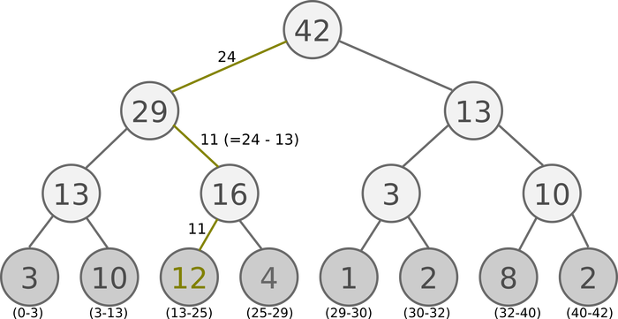
Prioritized Replay Memory
Deep Reinforcement Learning
Using array, the complexity of sampling is O(n)
  Try another data structure
Sum Tree, which prioiritized sampling can be O(lgn)
  Devide the priorities into k groups(batch size) by the max priority
  That is if the max is 42, batch size = 6, we devide them into [1, 7], [8, 14], …., [36, 42]
  Randomly sample a number from
  each interval
  Go down the sum tree by
  the priority to retrieve
  the data at the leaf
https://arxiv.org/pdf/1511.05952.pdf

Slide 19
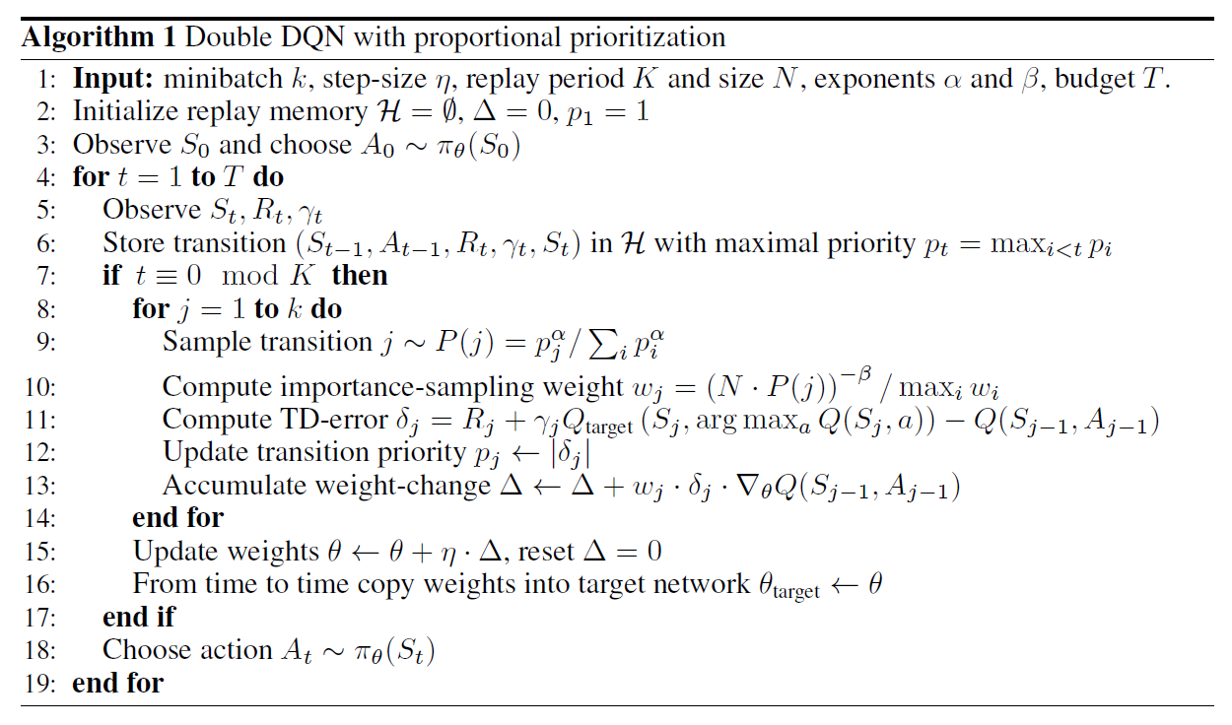
Prioritized Replay Memory
Deep Reinforcement Learning

