Slide 1
特斯拉發電機
電機一 翁挺瑋
機械一 郭律佑

Slide 2
The war of current 1880-1890

Slide 3
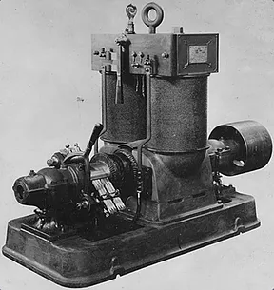
Direct Current vs alternating current
Direct current - Dynamo
Alternating current - Polyphase

Slide 4
Tesla Ac Generator

Slide 5
Polyphase system (Balanced 3-phase)
Combination of two or more than two voltages
Displaced from each other by an equal phase.
Each of them has a single alternating voltage of the same magnitude and frequency.

Slide 6
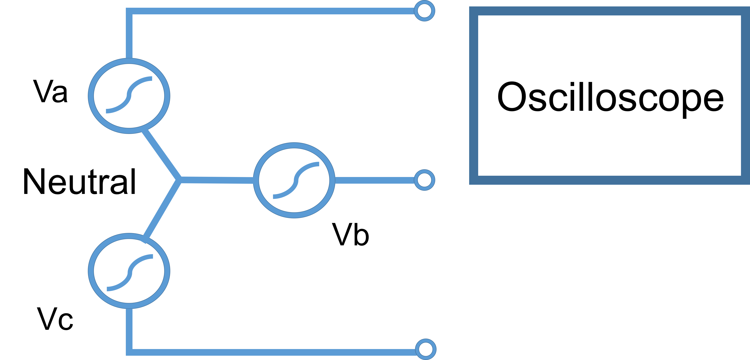
三相發電機

Slide 7
實驗原理

Slide 8
三相交流發電機

Slide 9

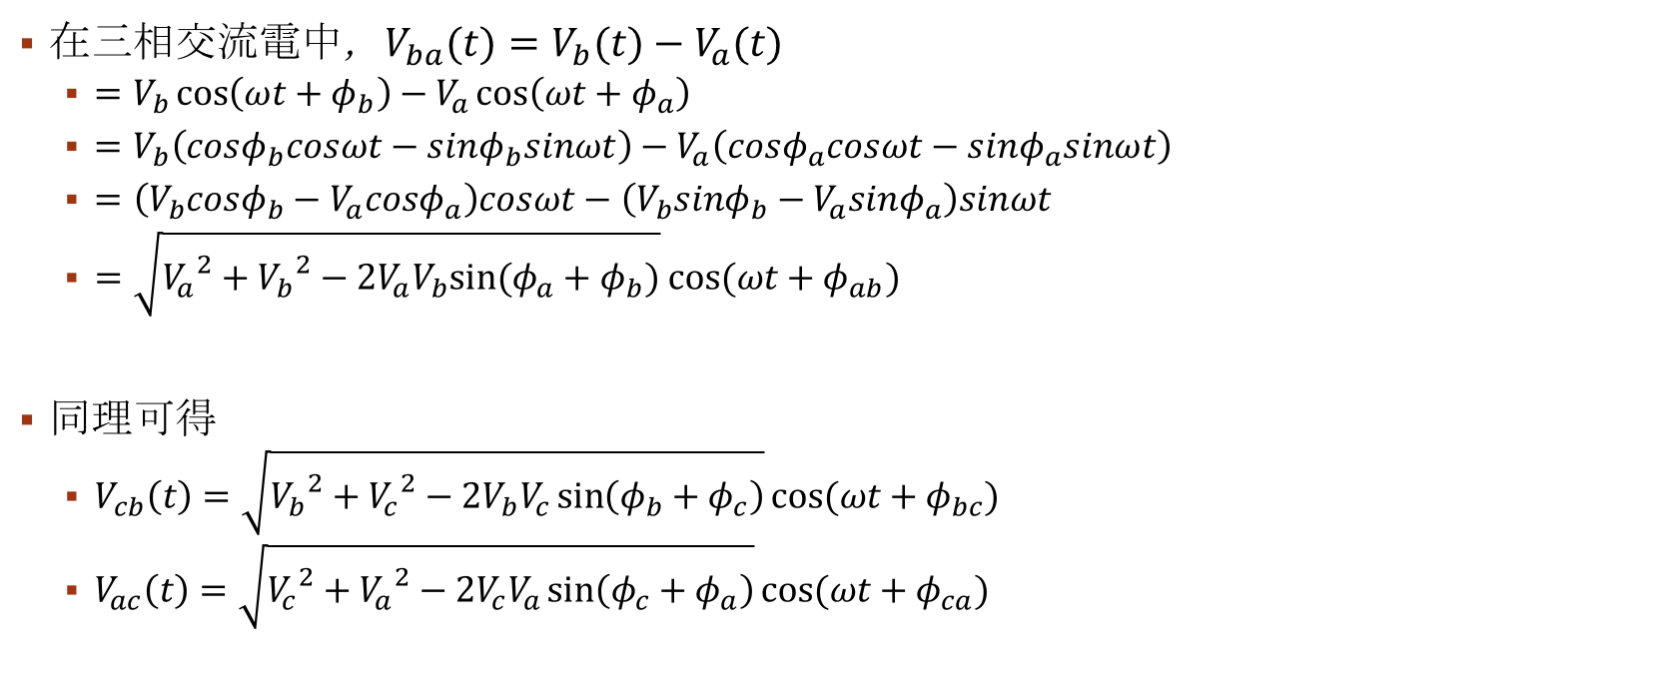
電位函數$V_{max}cos\left(ωt+φ\right)$
在三相交流電中，$V_{ba}(t)=V_{b}(t)−V_{a}(t)$
$=V_{b}\cos\left(ωt+φ_{b}\right)−V_{a}\cos\left(ωt+φ_{a}\right)$
$=V_{b}\left(cosφ_{b}cosωt−sinφ_{b}sinωt\right)−V_{a}\left(cosφ_{a}cosωt−sinφ_{a}sinωt\right)$
$=\left(V_{b}cosφ_{b}−V_{a}cosφ_{a}\right)cosωt−\left(V_{b}sinφ_{b}−V_{a}sinφ_{a}\right)sinωt$
$=\sqrt{{V_{a}}^{2}+{V_{b}}^{2}−2V_{a}V_{b}cos(φ_{a}−φ_{b})} cos⁡(ωt+φ_{ab})$
同理可得
$V_{cb}\left(t\right)=\sqrt{{V_{b}}^{2}+{V_{c}}^{2}−2V_{b}V_{c}cos(φ_{b}−φ_{c})}cos⁡(ωt+φ_{bc})$
$V_{ac}\left(t\right)=\sqrt{{V_{c}}^{2}+{V_{a}}^{2}−2V_{c}V_{a}cos(φ_{c}−φ_{a})}cos⁡(ωt+φ_{ca})$

Slide 10
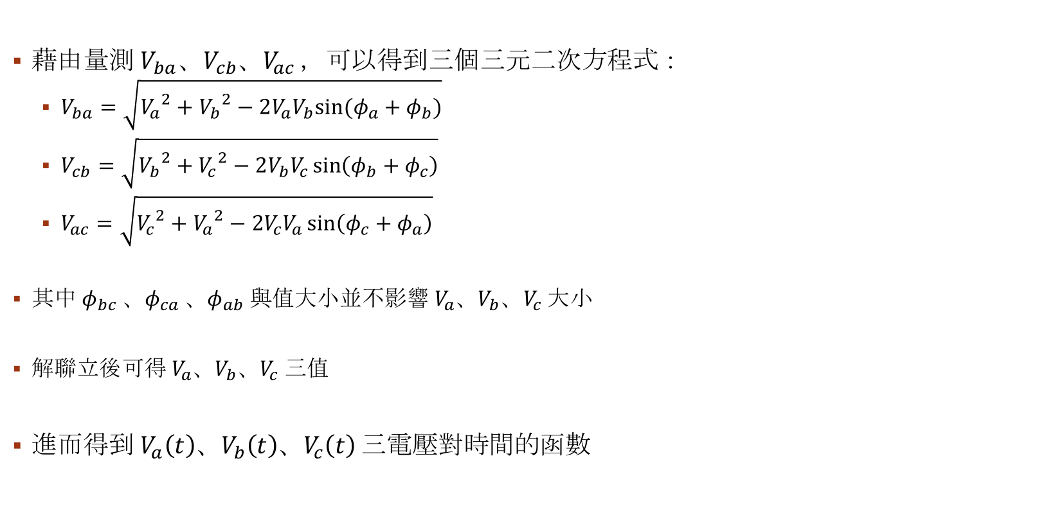
電位函數$V_{max}cos\left(ωt+φ\right)$
藉由量測${ V}_{ba}、V_{cb}、V_{ac}$ ，可以得到三個三元二次方程式：
$V_{ba}=\sqrt{{V_{a}}^{2}+{V_{b}}^{2}−2V_{a}V_{b}cos(φ_{a}−φ_{b})}$
$V_{cb}=\sqrt{{V_{b}}^{2}+{V_{c}}^{2}−2V_{b}V_{c}cos(φ_{b}−φ_{c})}$
$V_{ac}=\sqrt{{V_{c}}^{2}+{V_{a}}^{2}−2V_{c}V_{a}cos(φ_{c}−φ_{a})}$
其中$φ_{bc}$、$φ_{ca}$、$φ_{ab}$與值大小並不影響$V_{a}、V_{b}、V_{c}$大小
解聯立後可得$V_{a}、V_{b}、V_{c}$三值
進而得到$V_{a}\left(t\right)、V_{b}\left(t\right)、V_{c}\left(t\right)$三電壓對時間的函數

Slide 11
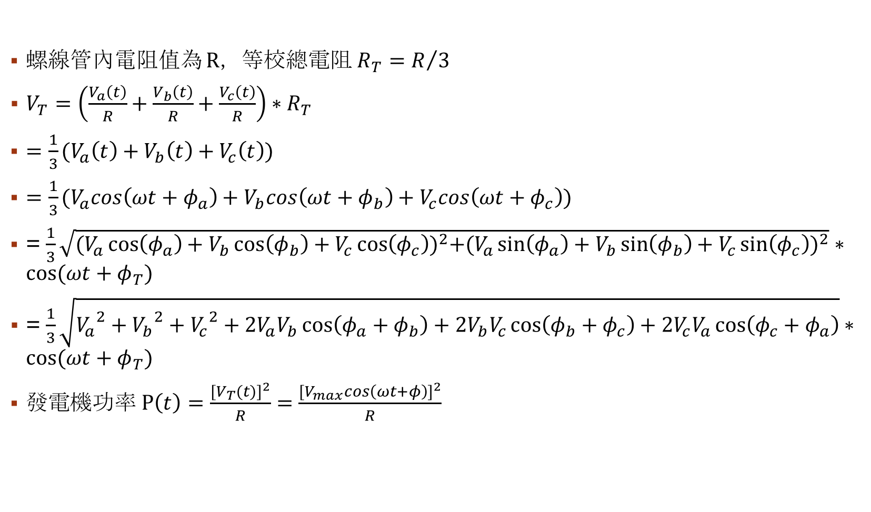
能量損耗
螺線管內電阻值為 R，等校總電阻$R_{T}=R/3$
$V_{T}=\left(\frac{V_{a}\left(t\right)}{R}+\frac{V_{b}\left(t\right)}{R}+\frac{V_{c}\left(t\right)}{R}\right)∗R_{T}$
$=\frac{1}{3}(V_{a}\left(t\right)+V_{b}\left(t\right)+V_{c}\left(t\right))$
$=\frac{1}{3}(V_{a}cos\left(ωt+φ_{a}\right)+V_{b}cos\left(ωt+φ_{b}\right)+V_{c}cos\left(ωt+φ_{c}\right))$
= $\frac{1}{3}\sqrt{{(V_{a}\cos\left(φ_{a}\right)+V_{b}\cos\left(φ_{b}\right)+V_{c}\cos\left(φ_{c}\right))}^{2}+{(V_{a}\sin\left(φ_{a}\right)+V_{b}\sin\left(φ_{b}\right)+V_{c}\sin\left(φ_{c}\right))}^{2}} ∗cos⁡(ωt+φ_{T})$
= $\frac{1}{3}\sqrt{{V_{a}}^{2}+{V_{b}}^{2}+{V_{c}}^{2}+2V_{a}V_{b}\cos\left(φ_{a}+φ_{b}\right)+2V_{b}V_{c}\cos\left(φ_{b}+φ_{c}\right)+2V_{c}V_{a}\cos\left(φ_{c}+φ_{a}\right)}∗cos⁡(ωt+φ_{T})$
發電機功率$P\left(t\right)=\frac{{[V_{T}(t)]}^{2}}{R}=\frac{{[V_{max}cos\left(ωt+φ\right)]}^{2}}{R}$

Slide 12
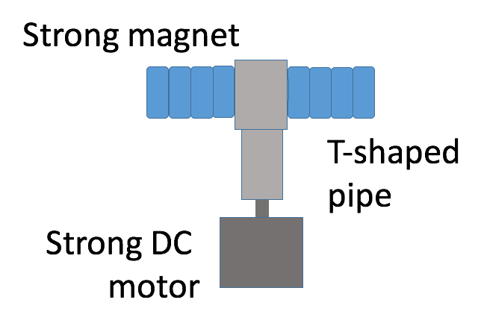
強扭力磁鐵馬達

Slide 13
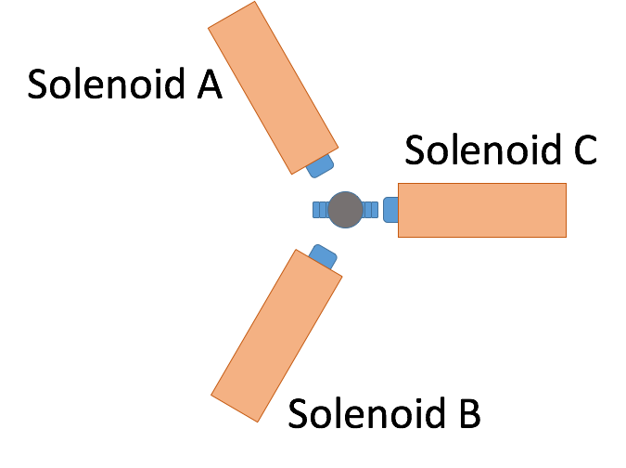
螺線管
螺線管內置放一軟鐵棒
正極接到同一點
負極拉出作為電位差量測點

Slide 14
裝置電路圖

Slide 15
實驗結果

Slide 16
