Slide 1
CMPE final project
University Name: San Jose State University
Course: CMPE 281
Student: Tingjia Zhang
Student ID: 015242708
Professor: Sanjay Garje
Project introduction: DirectIndustry Web Guide
Collaborator: Hung Le(Special thanks for helping)

Slide 2
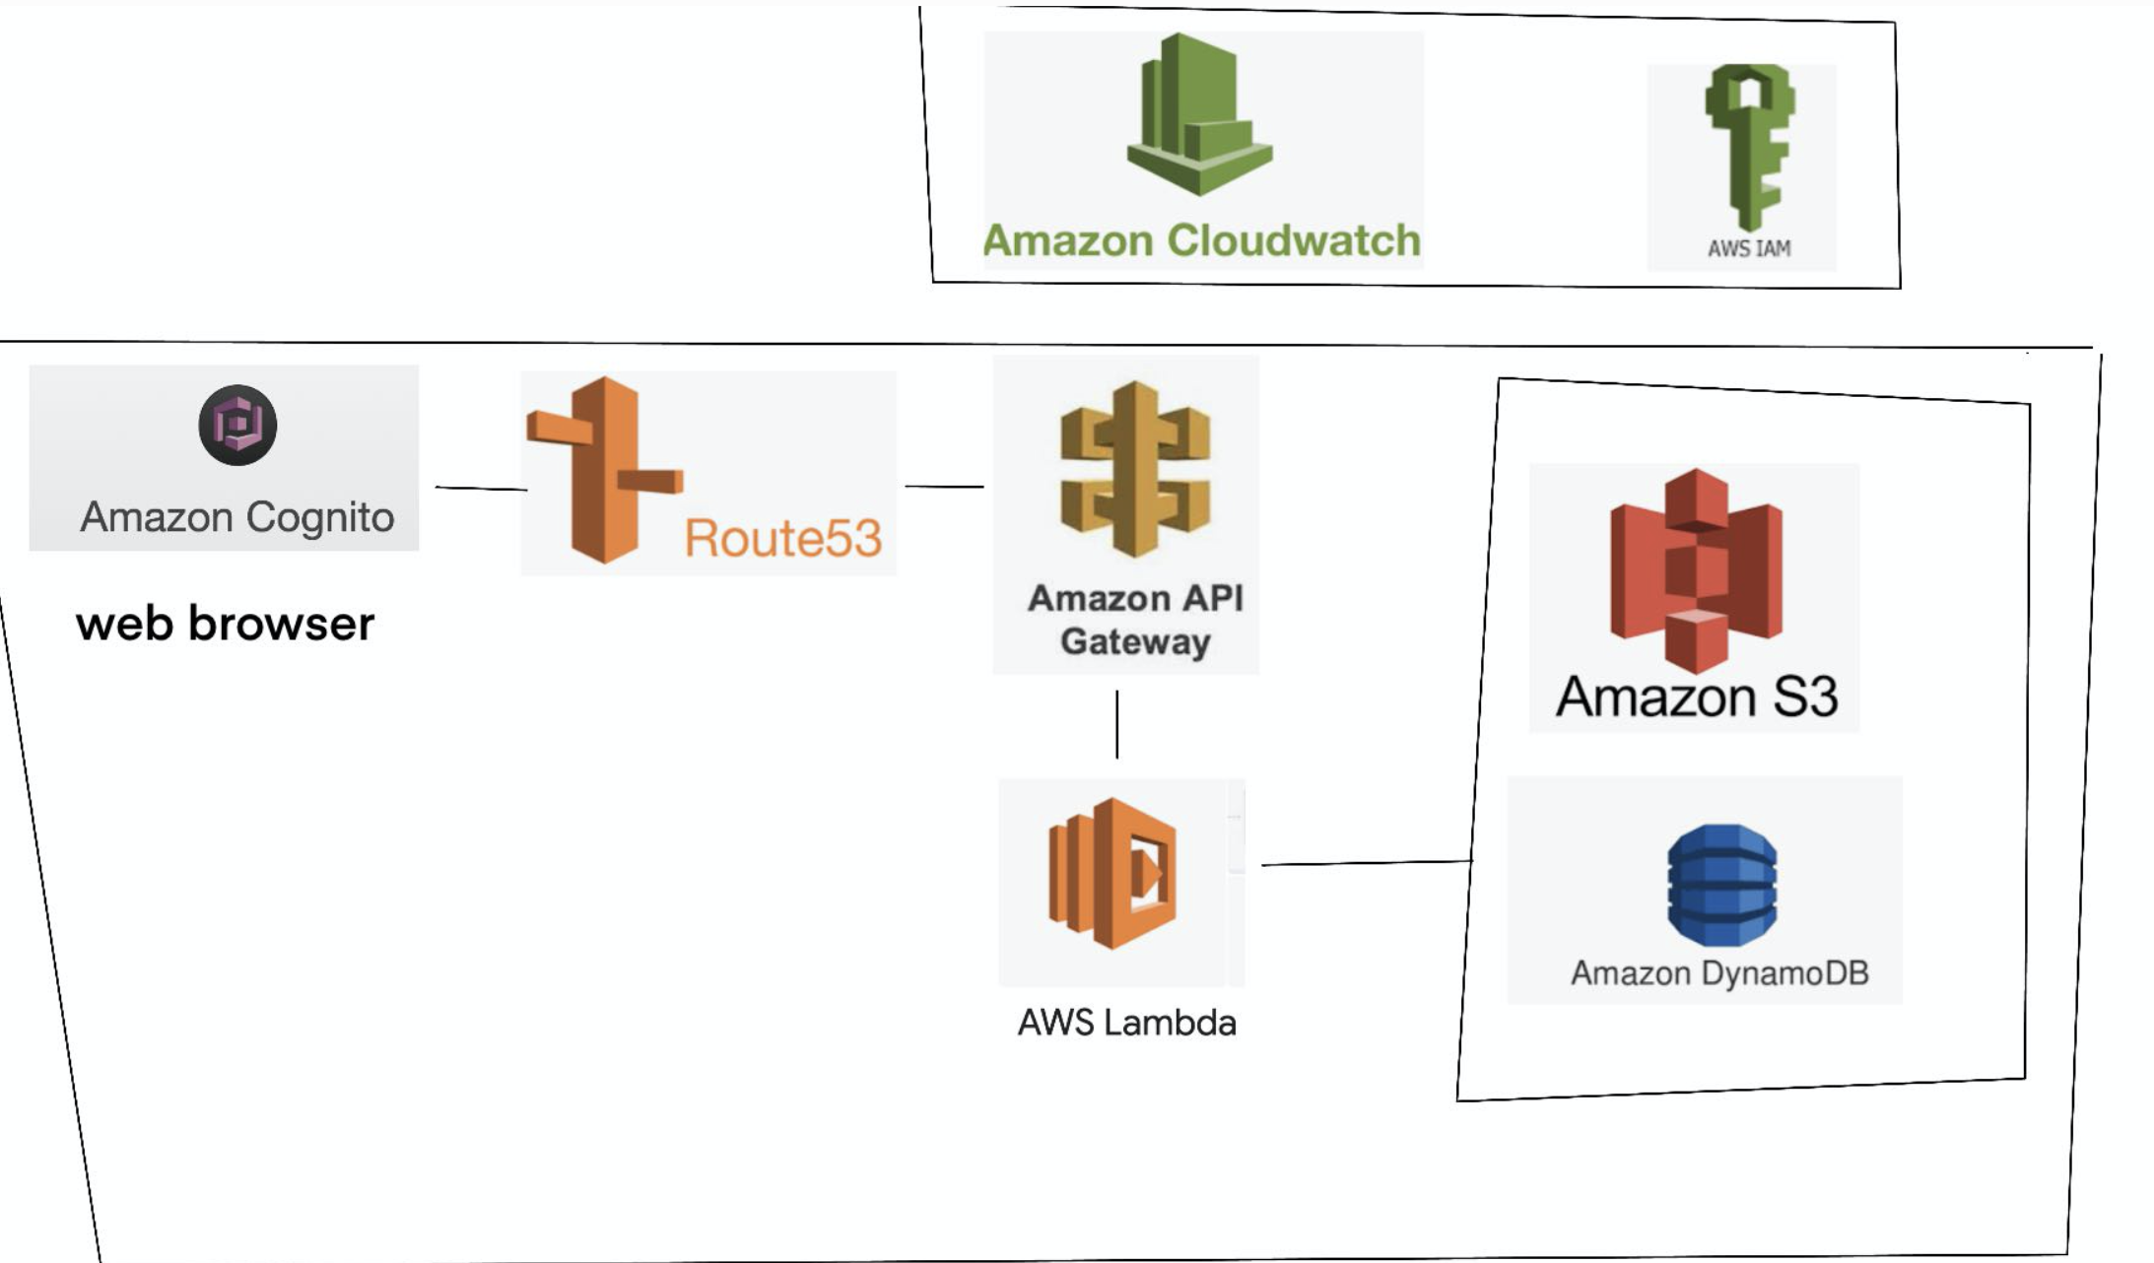
Project Technology Schematics

Slide 3

Home page

Slide 4
Demo display Time

Slide 5
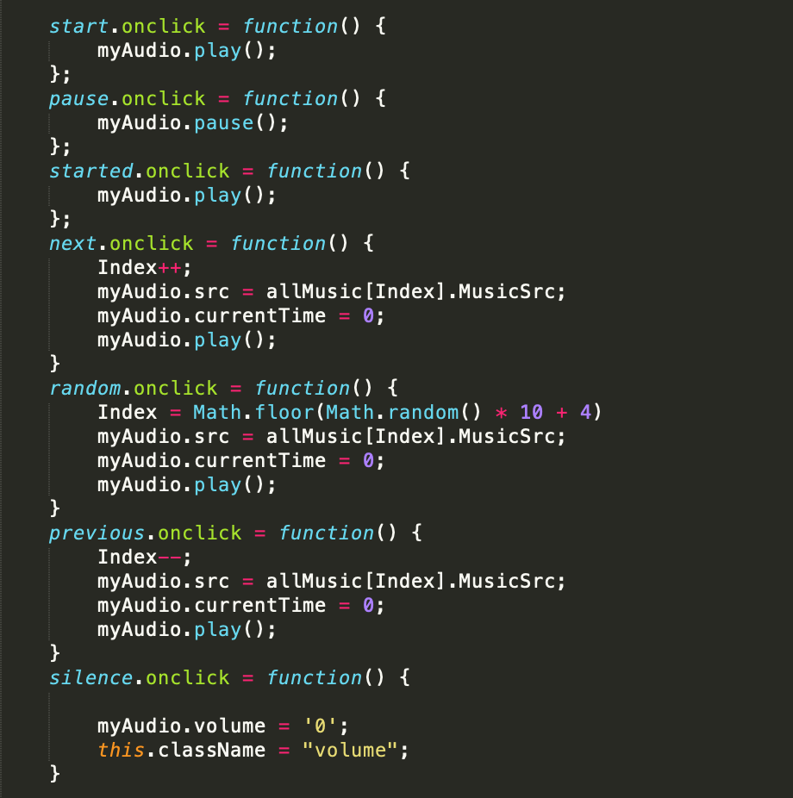
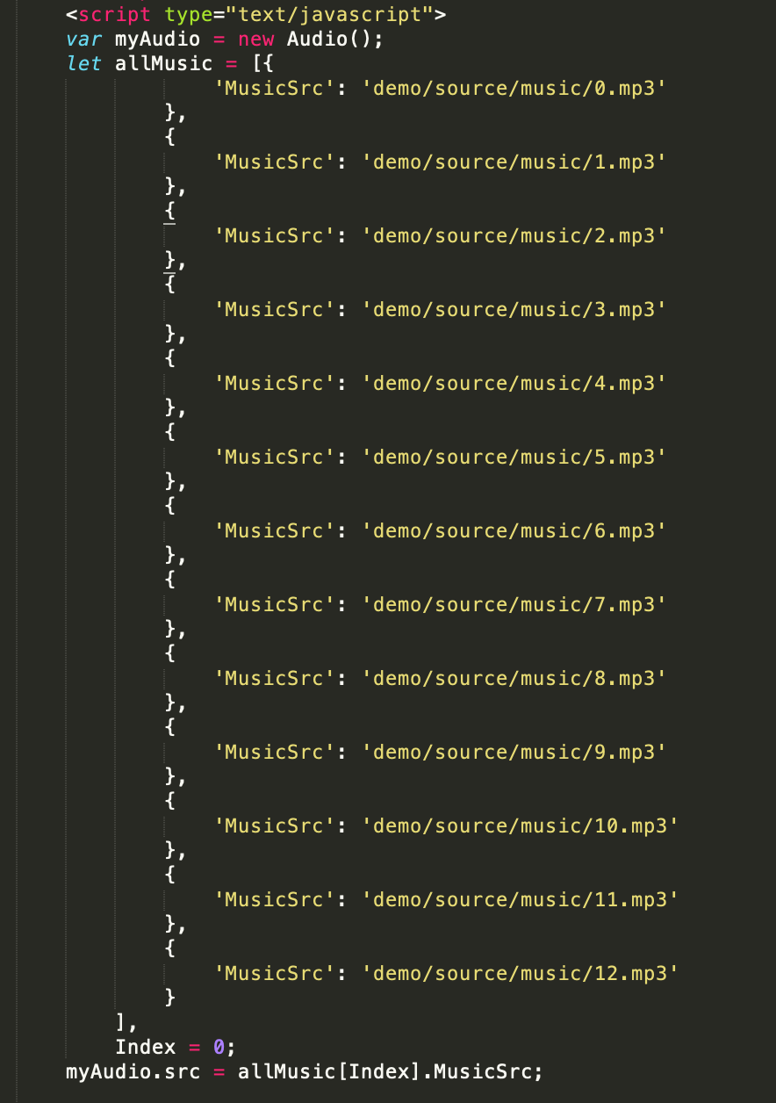
Music player

Slide 6

Lock Screen

Slide 7
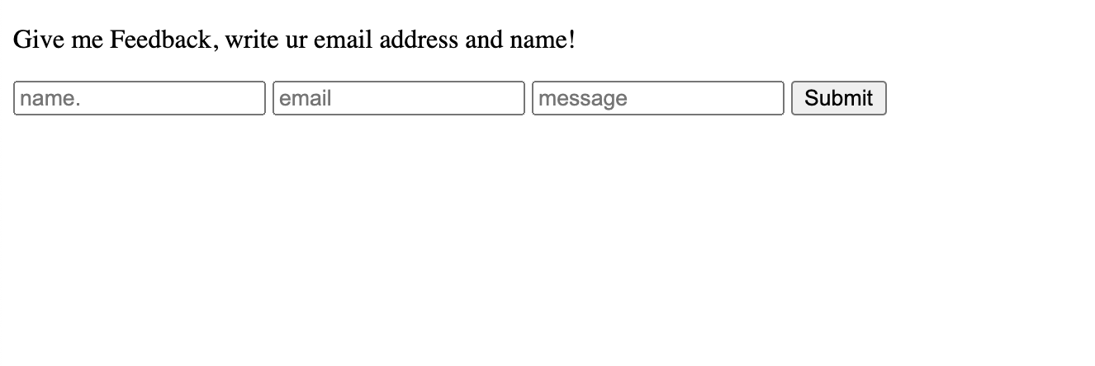
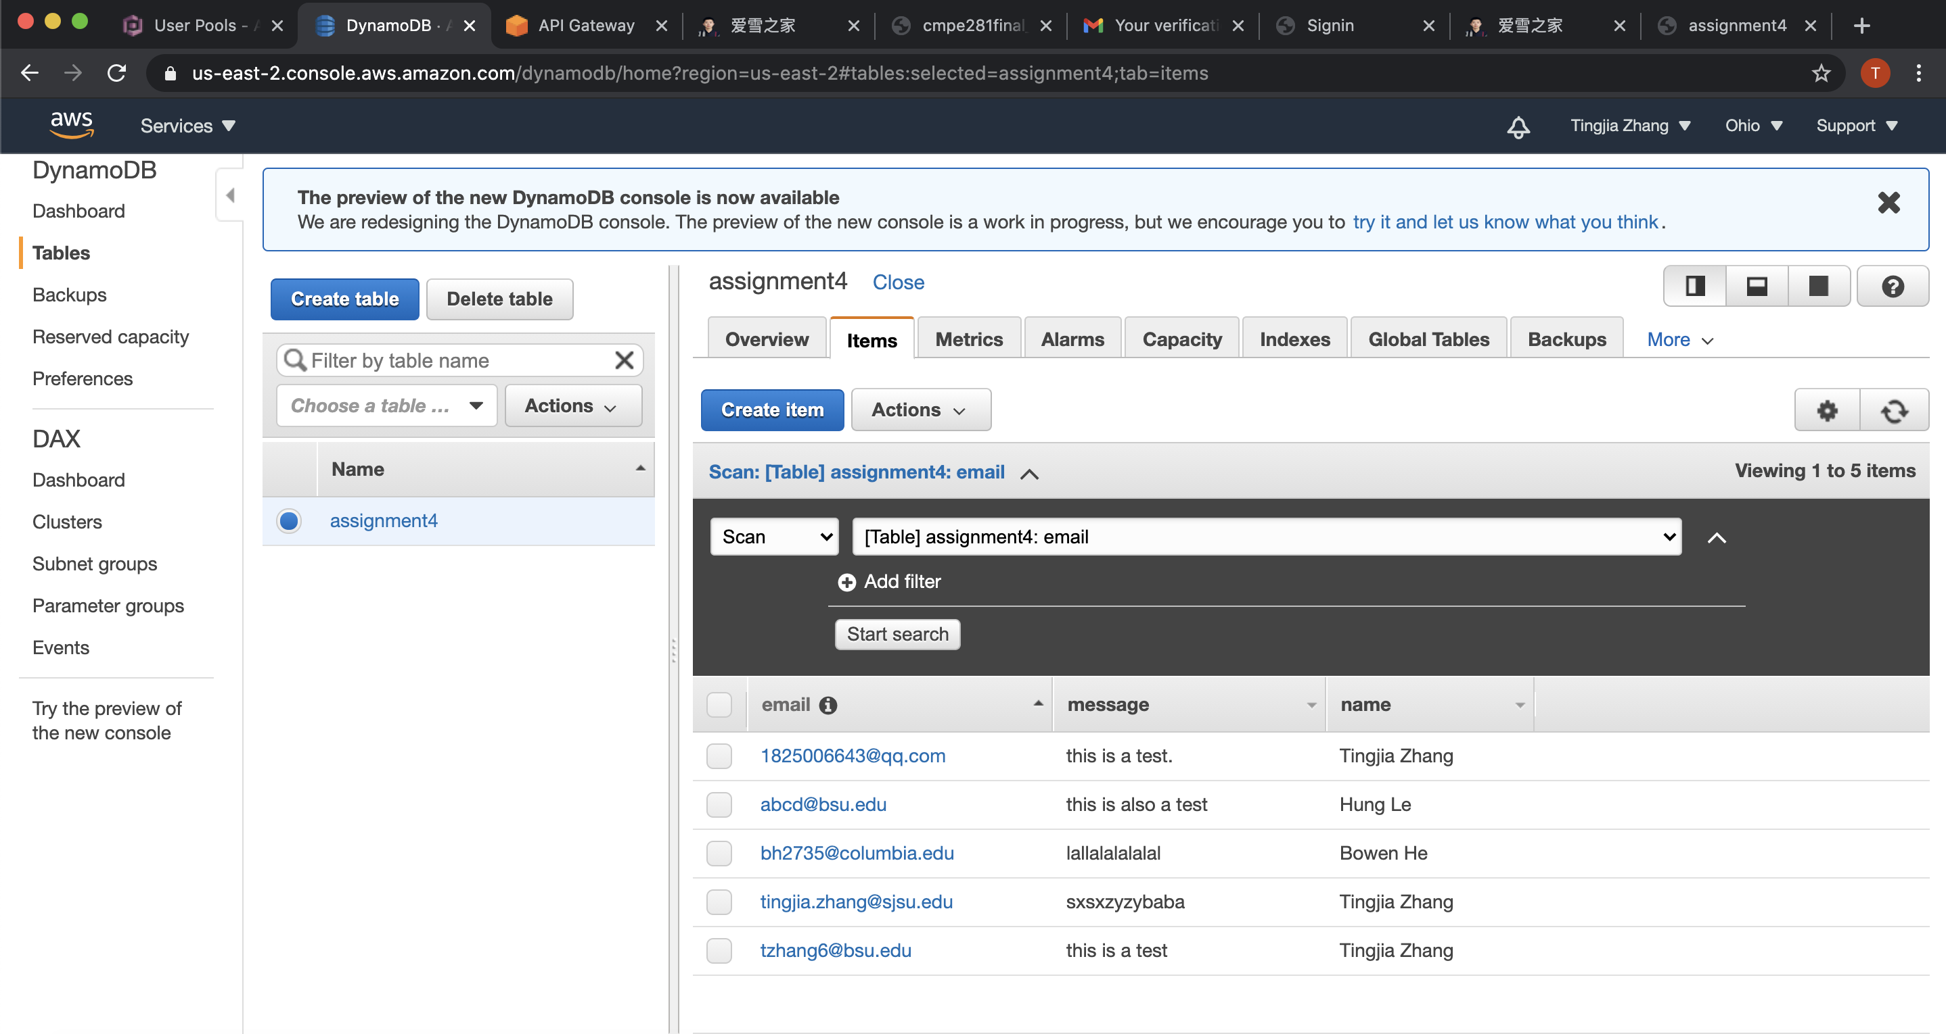
Connect me

Slide 8
About the cost

Slide 9
Offline mode settings

Slide 10
Versions

Slide 11
About the copyright

Slide 12
Any questions?

Slide 13
Thx

