Slide 1
Practice 9
Window Program Design

Slide 2
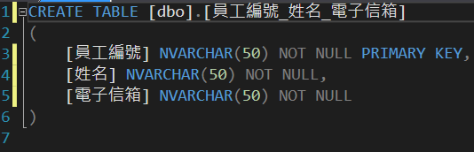
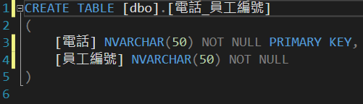
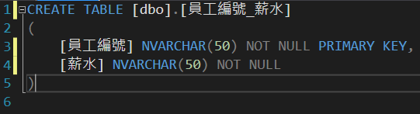
Tables
employee ID_name_email
employee ID
name
email
Create a database that includes three Tables:
1. [employee ID_name_email]
Use employee ID as the Primary Key
2. [phone number_employee ID]
Use phone number as the Primary Key
3. [employee ID_salary]
Use employee ID as the Primary Key
Phone number_employee ID
phone
employee ID
employee ID_salary
employee ID
salary

Slide 3
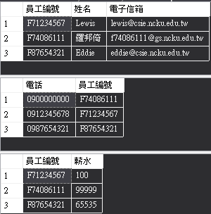
INSERT & SELECT
name
employee ID
email
1. Add in 3 more data into [employee ID_name_email] data sheet
a. “F71234567”-”Lewis”-”lewis@csie.ncku.edu.tw”
b. “F87654321”-”Eddie”-”eddie@csie.ncku.edu.tw”
c. {your student ID}-{your name}-{your email}
2. Add in 3 more data into [phone number_employee ID] data sheet
a. “0912345678”-” F71234567”
b. “0987654321”-” F87654321”
c. “0900000000”-{your student ID}
3. Add in 3 more data into [employee number_salary] data sheet
a. “F71234567”-”100”
b. “F87654321”-”65535” c. {your student ID}-”99999”
4. Use SELECT to show the content of the three data tables (as shown on the right)
Phone number

Slide 4
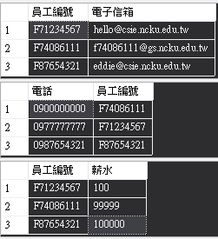
UPDATE & SELECT
1. UPDATE phone number, email, and salary
email: Change the email of “F71234567” to ”hello@csie.ncku.edu.tw”
phone: Change the phone number of ”F71234567” to”0977777777” salary: Change the salary of ”F87654321” to ”100000”
2. SELECT specific columns in the three data tables respectively:
[employee ID_name_email]: SELECT employee ID, email
[phone number_employee ID]: SELECT phone number, employee ID
[employee ID_salary]: SELECT employee ID, salary

Slide 5
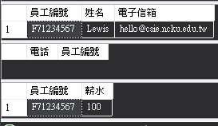
DELETE & SELECT
1. DELETE data of “F71234567” from the [phone number_employee ID] data table
2. WHERE SELECT specific data from the three data tables
[employee ID_name_email]: SELECT data of those name “Lewis”
[phone number_employee ID]: SELECT data of employee ID “F71234567”
[employee ID_salary]: SELECT data of employee ID “F71234567”

Slide 6
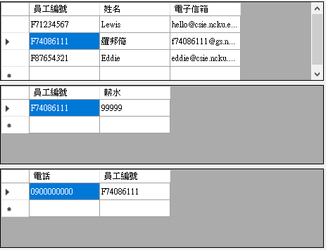
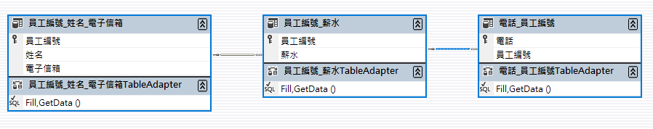
RELATION
Create RELATION in the three data tables:
1. Employee ID of [employee ID_name_email] relation to Employee ID of [employee ID_salary]
2. Employee ID of [employee ID_salary] relation to Employee ID of [phone number_employee ID]
Create 3 DataGridView on WinForm in order:
1. [employee ID_name_email] data table
2. Relation 1 corresponds to[phone number_employee ID] data table
3. Relation 2 corresponds to [employee ID_salary] data table
When data of [employee ID_name_email] is clicked, the other two DataGridView should show corresponding data

Slide 7
Submission
Please export the slide to a pdf. The file name should be “Practice9_student ID_name” and includes the following screenshot（Each question on one page with its title）:
1. “Insert & Select” :
Includes results of SQL Command and the three data tables
2. “Update & Select” :
Includes SQL Command and the results of the three data tables’ specific Columns
3. “Delete & Select” :
Includes SQL Command and the results of the three data tables
4. Program running screen:
Must include three dataGridView and select own student ID
Besides the pdf, you should submit the complete project folder (compress it into a zip file, and the file name is same as the pdf )

Slide 8

Example
The image should include:
1. SQL Commands
2. Execution results
Please write all the commands together
And show the results of the three data tables at once

Slide 9
NOTE
1. For { } , please insert your own student ID, name, email address
2. Please do not change anything in “ ”
3. Please use ‘ ’ for strings (e.g. ’This is a string.’)
4. For string in Chinese, you should use N’ ’ (e.g. N’ Chinese string’）
5. Please implement in the database according to the order of “Insert & Select”, “Update & Select”, “Delete & Select” , and screenshot accordingly.

