Slide 1
The Electromagnetic Environment of High Voltage Transmission Line
主讲人：刘寒玉 2016010926
Notes:
Today, I will briefly introduce the Electromagnetic Environment for High Voltage Transmission Line.
/*In order to achieve the optimal allocation of energy resources in our country despite the unbalanced electricity demand and energy distribution, the construction of UHV power grid becomes necessary. However, people worry about the electromagnetic pollution caused by the high voltage line. So let’s take a deep look at it.*/

Slide 2
1
The electric environment
2
The magnetic environment
CONTENTS
3
Optimization method
4
Reference
Notes:
I’ll talk about four parts.
(read them)
The most important part in this lecture is the optimization.

Slide 3
The electric environment

Slide 4
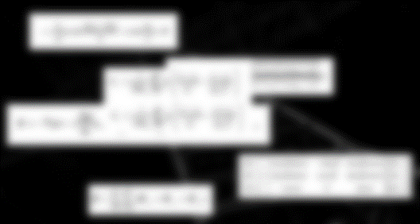


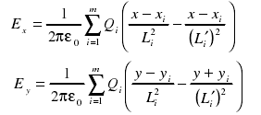

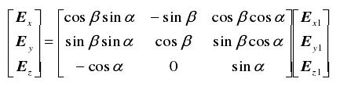

The electric environment
The electric environment
The magnetic environment
Optimization method
reference
Notes:
There are electric field generated by the transmission line.
To calculate the electric field generated by the line, we use a method called charge simulation method.
we take the droop of the transmission line into considerationo, which can be considered as a good conductor. We then can calculate the equivalent charge on the transmission line and get the potential of the transmission line. And the electric field intensity in any point in the space can be calculated in according to the superposition principle.
And we finally get the result.
You might find it difficult to understand. But don’t worry, me too. Today I won’t talk about the detailed calculation.
I am going to show you the result and the optimization method.
How can we use this result and minimize the influence of the electromagnetic environment.

Slide 5
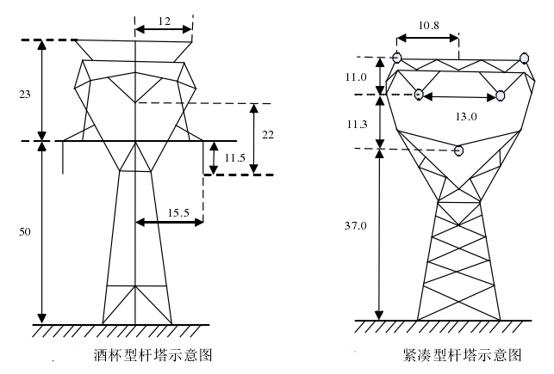
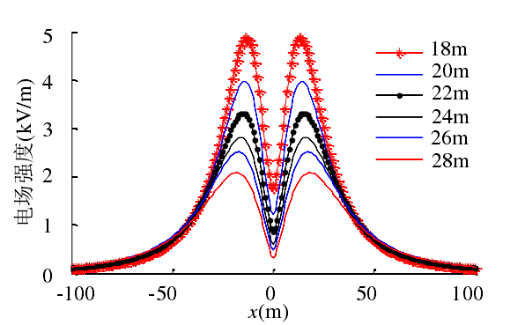
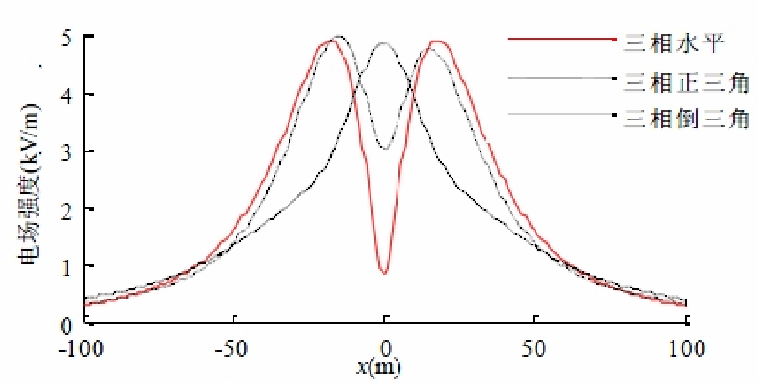
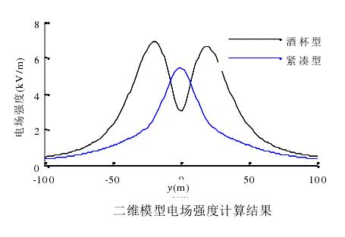
The electric environment
The layout of the transmission line
The height of the transmission line
The distance between three phases
The structure and size of bundled conductors
……
The electric environment
The magnetic environment
Optimization method
reference
Notes:
So let’s go on.
Basing on the calculation we made, we can know that the electric environment is related with the layout of the transmission line, The height of the transmission line, The distance between three phases, The structure and size of bundled conductors. And so on.
Due to the limited time, I ‘ll mainly introduce the first and the second points.
This picture shows the relationship between the intensity of electric field and the layout. If the transmission lines are constructed in the horizontal way, the result is the red line with two maximum values.
And the inverted triangle? The result is the black line with one maximum value. The regular triangle also have two maximum values
Basing on the analyze of its actual value, we find that the inverted triangle is the best choice.
This can be proved by the actual type of transmission tower. The first is the cup-type tower, because it looks like a cup. The right one is the compacted tower. The left tower arrange the transmission line in regular triangle way, while the right one arrange the line in inverted triangle way. And we get the result. To get this result, we assume any other factors is the same. In this graph we can clearly judge that the compacted tower is better.
So, this is the layout, and what about the height?
Yes, the intensity of the electric field on the ground decrease with the increase of the height of the transmission line.
It inspires us that if we want to reduce the intensity on the ground we can simply rise the height of the transmission line

Slide 6
The magnetic environment

Slide 7
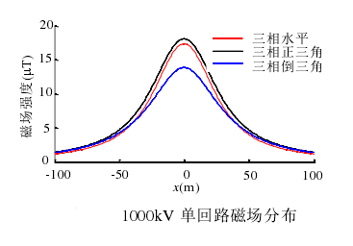
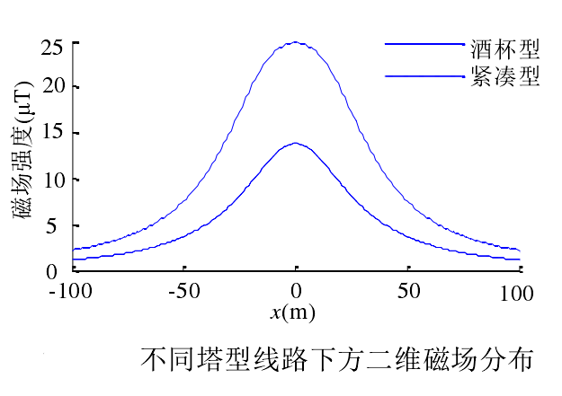
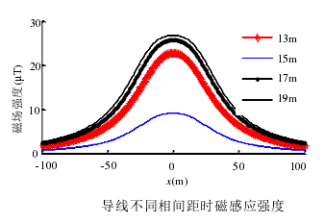
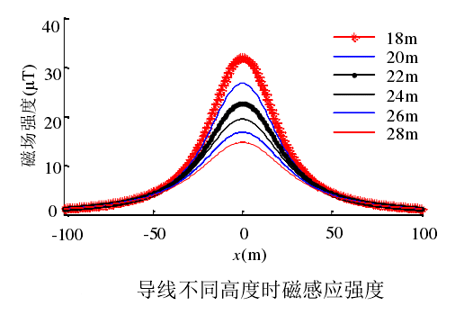
The magnetic environment
The layout of the transmission line
The height of the transmission line
The distance between different lines
……
The electric environment
The magnetic environment
Optimization method
reference
Notes:
So now let’s come to the magnetic environment part.
Magnetic field is generated by the transmission line. And we also omit the detailed calculation. If you are interested in the calculation, you can look at the reference.
The intensity of the magnetic field is related with the layout and the height---just like electric environment. It also is related with the distance between different phases.
The layout is almost the same as the electric environment. When the transmission line is put in inverted triangle layout, the intensity of magnetic field is the lowest.
And this is also shown in the type of tower. If we use the cup-type tower, we will get the upper line which means the higher intensity. If we use the compacted tower we will get the lower intensity.
Now ,the height.
It is also the same. The intensity decrease as the line become higher.
Things get more interesting when if we take a look the distances between different phases line.
We can see that before the distance reach a certain point, it decrease with the increase of the distance. And after the point it actually increase as the distance becomes wider.

Slide 8
Optimization method

Slide 9
Optimization method
Rise the height of the transmission lines
The electric environment
Reasonable control of distance between different phase lines
03
01
The magnetic environment
Optimization method
f
Optimization method
reference
02
Change the layout of the transmission lines
Notes:
So after all the analyzation, how can we minimize the influence caused by the electromagnetic environment.
There are mainly 3 ways …
Actually all of these is related with the reasonable choose of transmission tower.
So what kind of tower should we choose?
Cup-type tower? Compacted tower? Or other towers?

Slide 10
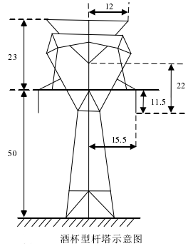



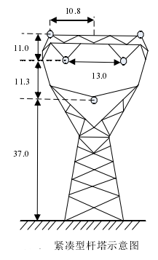
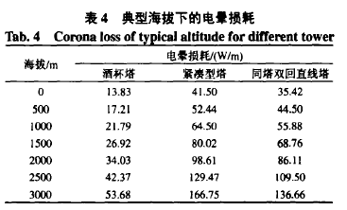
Optimization method
type of tower | Electric field | Magnetic field | Noise | Line corridor width | Corona loss | Solidity | engineering cost
Cup-type tower
Compacted tower
Notes:
Let’s take a look.
Let’s compare the cup-type tower and the compacted tower.
First is the electric field.
We already know that compacted tower does a better job.
And so does magnetic field.
Noise
The noise is a problem. It disturbs people. Making it unable to construct near the resident area.
For cup-type tower, it works good in low altitude area, while the compacted tower cannot meet the demand 55DB. It inspire us that we can use the cup-type tower at the low altitude resident area.
And line corridor area?
The cup-type tower take up more area. Which means it cost more for the area under the line can not be effectively used.
And corona loss?
If we look at this form we will find that the corona loss in high – altitude area of compacted tower is intolerable. Comparing with it, the cuptype tower does a good job
And the cup-type tower is more tough, it can be used in area that has strong wind or snow.
If we can choose the type o tower reasonably we then can make full use of it . Avoid the disadvantages and make the best of the advantages.
And these is not the only way to minimize the influence. We can also change the type of line. Raise the diameter for instance. Other methods can make up the disadvantages of these towers.
线电
干扰和可听噪声可通过选择大半径导线或适当增
加分裂导线根数来满足要求:
酒杯塔可满足各项电磁环境控制指标,
特别是高海拔地区也完全满足,低海拔地区还可减
小导线半径,但其线路走廊宽度较大。

Slide 11
reference
The research on electromagnetic environment of EHV transmission line 张可心 硕士学位论文
高电压输电线路工频电磁环境 许杨等 电力学报
1000 k V 特高压输电线路的电磁环境 邵方殷等 电网技术
Study on electromagnetic environment of UHV AC Transmission Lines 黄道春 The 8th International Power Engineering Conference (IPEC 2007)
特高压输电线路电磁环境数值模拟研究 陈博栋 硕士学位论文
The electric environment
The magnetic environment
Optimization method
reference

Slide 12
Thanks for listening !

