Slide 1
Illustration
ICPS2020ASIA

Slide 2
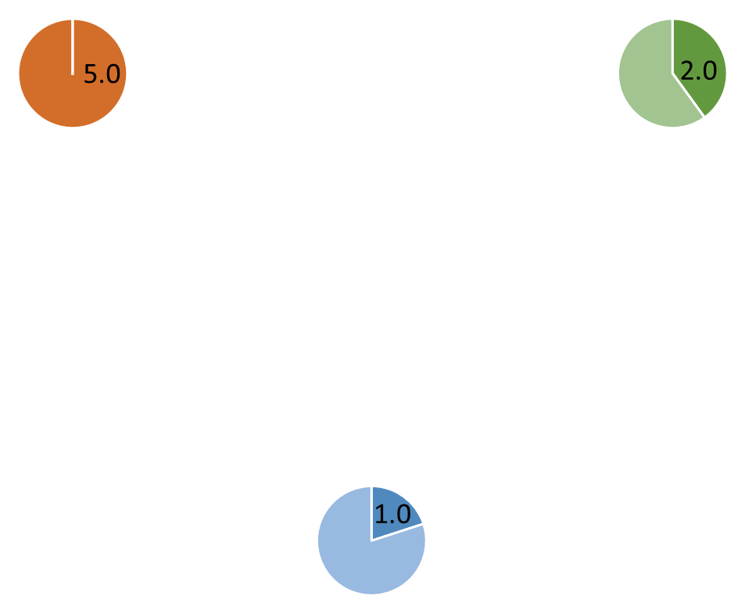


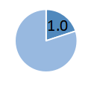
0.50
0.50
0.50
Generator set 1 output 5MW
Node 1 known information
Generator set 2 output 2MW
0.50
Generator set 3 output 1MW
0.33
0.33
0.50
The consensus graph edge weight
Indicating that unit 1 transfers 50% of the output to unit 2
0.33

Slide 3
Node 1 known information
2.5
0.48
1
0.42
2.5
0.5
Generator set 1 output 5MW
1
Generator set 2 output 2MW
0.5
Generator set 3 output 1MW
0.33
0.33
0.33
0.50
The consensus graph edge weight
Indicating that unit 1 transfers 50% of the output to unit 2
0.33
0.42
1.0
0.33

