Slide 1
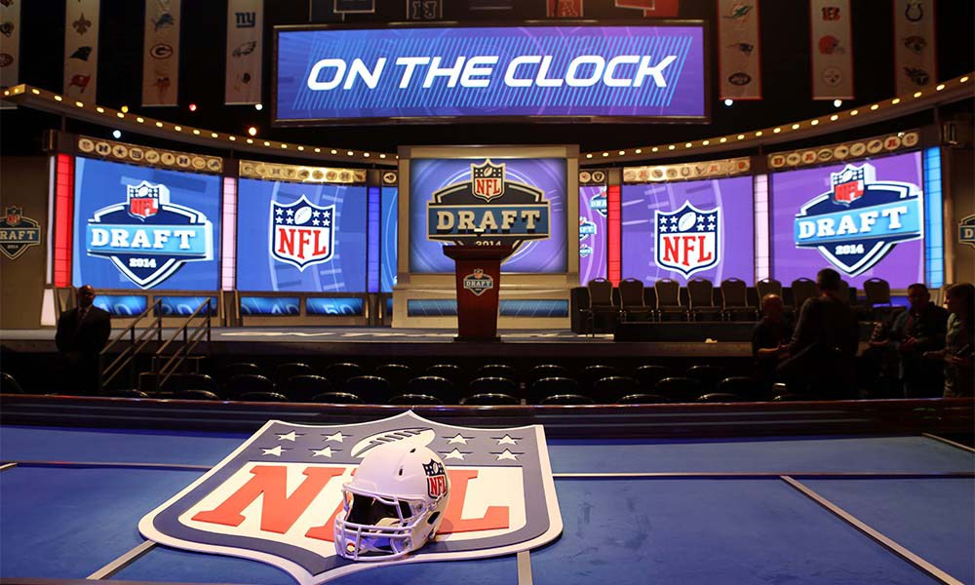
Web Scraping The NFL Draft
Trent Jerde

Slide 2
National Football League
Average franchise value: $2.3 billion.
$$$ in advertising, marketing, sales …
And …

Slide 3
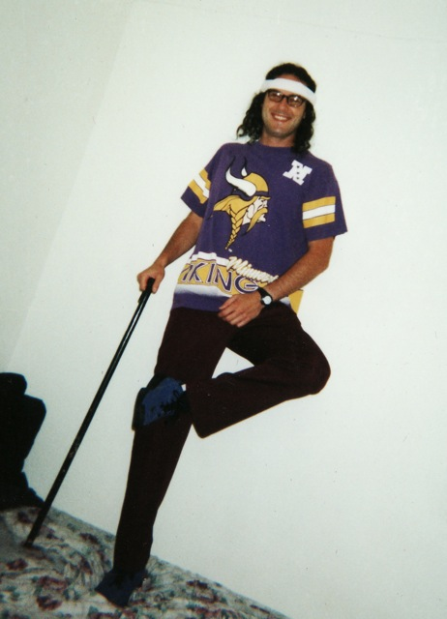
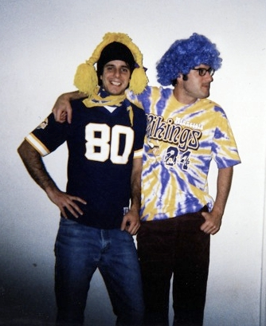
People Love Football!

Slide 4
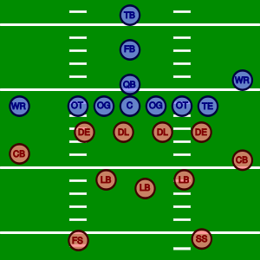
NFL Team
32 teams
53 players per team:
Offense: Quarterback, running back,
tight end, wide receiver, guard, tackle.
Defense: End, tackle, linebacker,
cornerback, safety.

Slide 5
Where Players Come From
Colleges
Part of conferences, somewhat regionally established.
Drafted by NFL teams in yearly draft.
7 rounds
Draft order is from worst team in previous season to best.
Teams can trade draft positions for strategic purposes.

Slide 6
Draft Decision Making
NFL teams scout college players year around.
Prior to the draft, college players perform physical and mental drills at the NFL combine.
Teams invest $$$ trying to select great players.

Slide 7
Project Question
Can data science inform us about the NFL draft process?
What positions and conferences are selected preferentially within the 7 rounds?

Slide 8
Data Science Methods
Scrapy for web scraping:
Wikipedia pages from the last ten years of NFL drafts.
Round, pick, team, player, position, college, conference.
R ggplot 2 for data visualization.

Slide 10
Future Directions
Draft selection changes over time.
May reflect game strategies.
Compare draft selections with player performance metrics.
Compare drafts of successful teams (New England Patriots, Green Bay Packers) vs. unsuccessful teams (Cleveland Browns, Jacksonville Jaguars).

