Slide 1
InstaPredict
“Likes” Predictor for Instagram Photos
Kyle Gallatin, Chris Capozzola, Tom Hunter, Mayank Shah

Slide 2
“Likes” are an Instagram issue
An internal Instagram study showed teens delete up to ½ of all posts due to a lack of likes
The Instagram story is an effort to combat the vanity of the “likes” metric
A “likes” prediction engine would allow users to know how their photos will do before they’re posted

Slide 3

Simplified Data Flow
Web Scraping
Features
Model
Post information
User information
Image features
Previous likes
Followers, etc...
Neural Network
GBM

Slide 4
Web Scraping

Slide 5
Web Scraping for Photos and User Info
Instagim
Instaliga
We scraped our using two sites, Instagim & Instaliga. We were limited by lack of instagram API access, and ended up with 45k observations.
Scrapy
BeautifulSoup
Photos, likes, comments caption, filter, username
Followers, following, number of posts, bio, likes/comment on previous 20 photos

Slide 6
EDA and Features

Slide 7
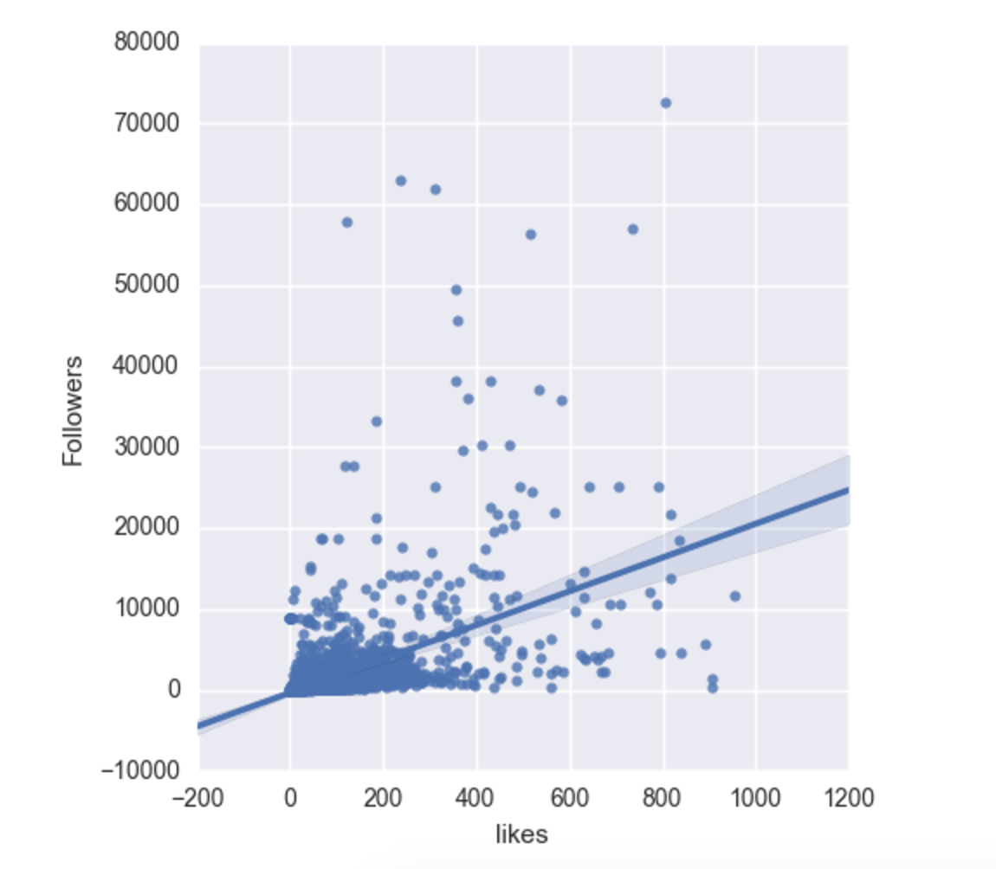
Likes and Followers - Correlated but Varied
We banked on followers being a large predictor, but due to the activity of different accounts and their user base, there is a large amount of variance

Slide 8
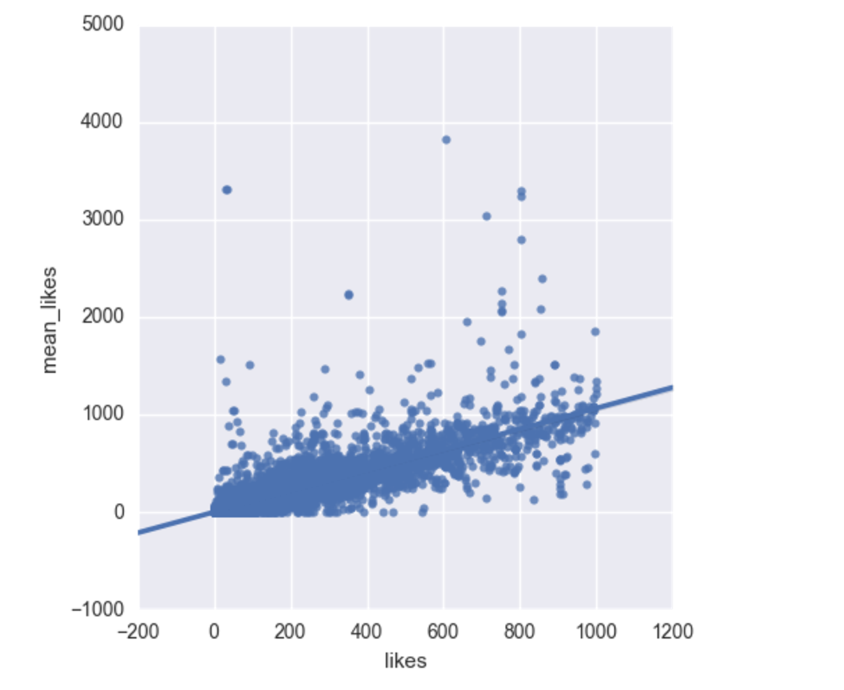
Mean and Median Likes on Previous posts
The mean likes on their previous 20 posts was a better predictor, allowing us to take into account a number of other factors and specify a range in which we should be guessing

Slide 9
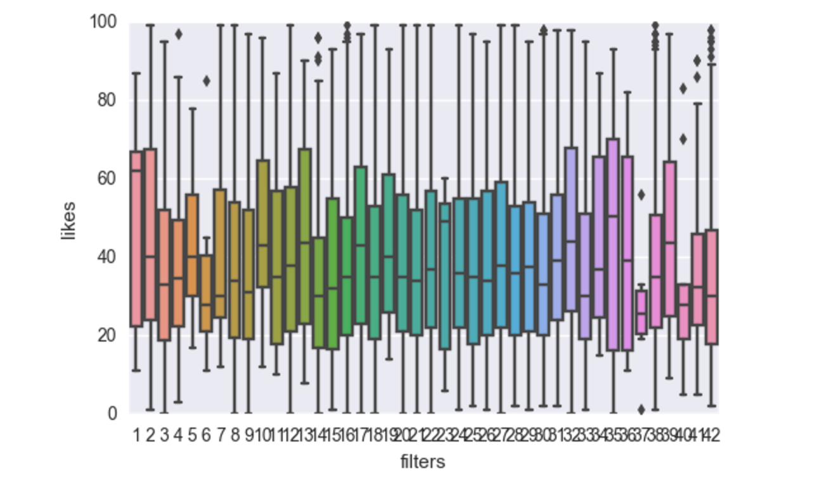
Filters had little impact
The filters had little correlation with the mean of the overall likes. We’d likely need much more information regarding different tags and subsets, and the common filters used on them.

Slide 10
Extracting photo features
In order to supplement the data from the posts and user information we looked into extracting additional features from the images themselves.
Basic Image Features:
Summary statistics on the different color bands using PIL library in Python
Simple Luminance calculation based off of image array
More Complex Features:
Number of faces in image
Amount of blur in Image

Slide 11
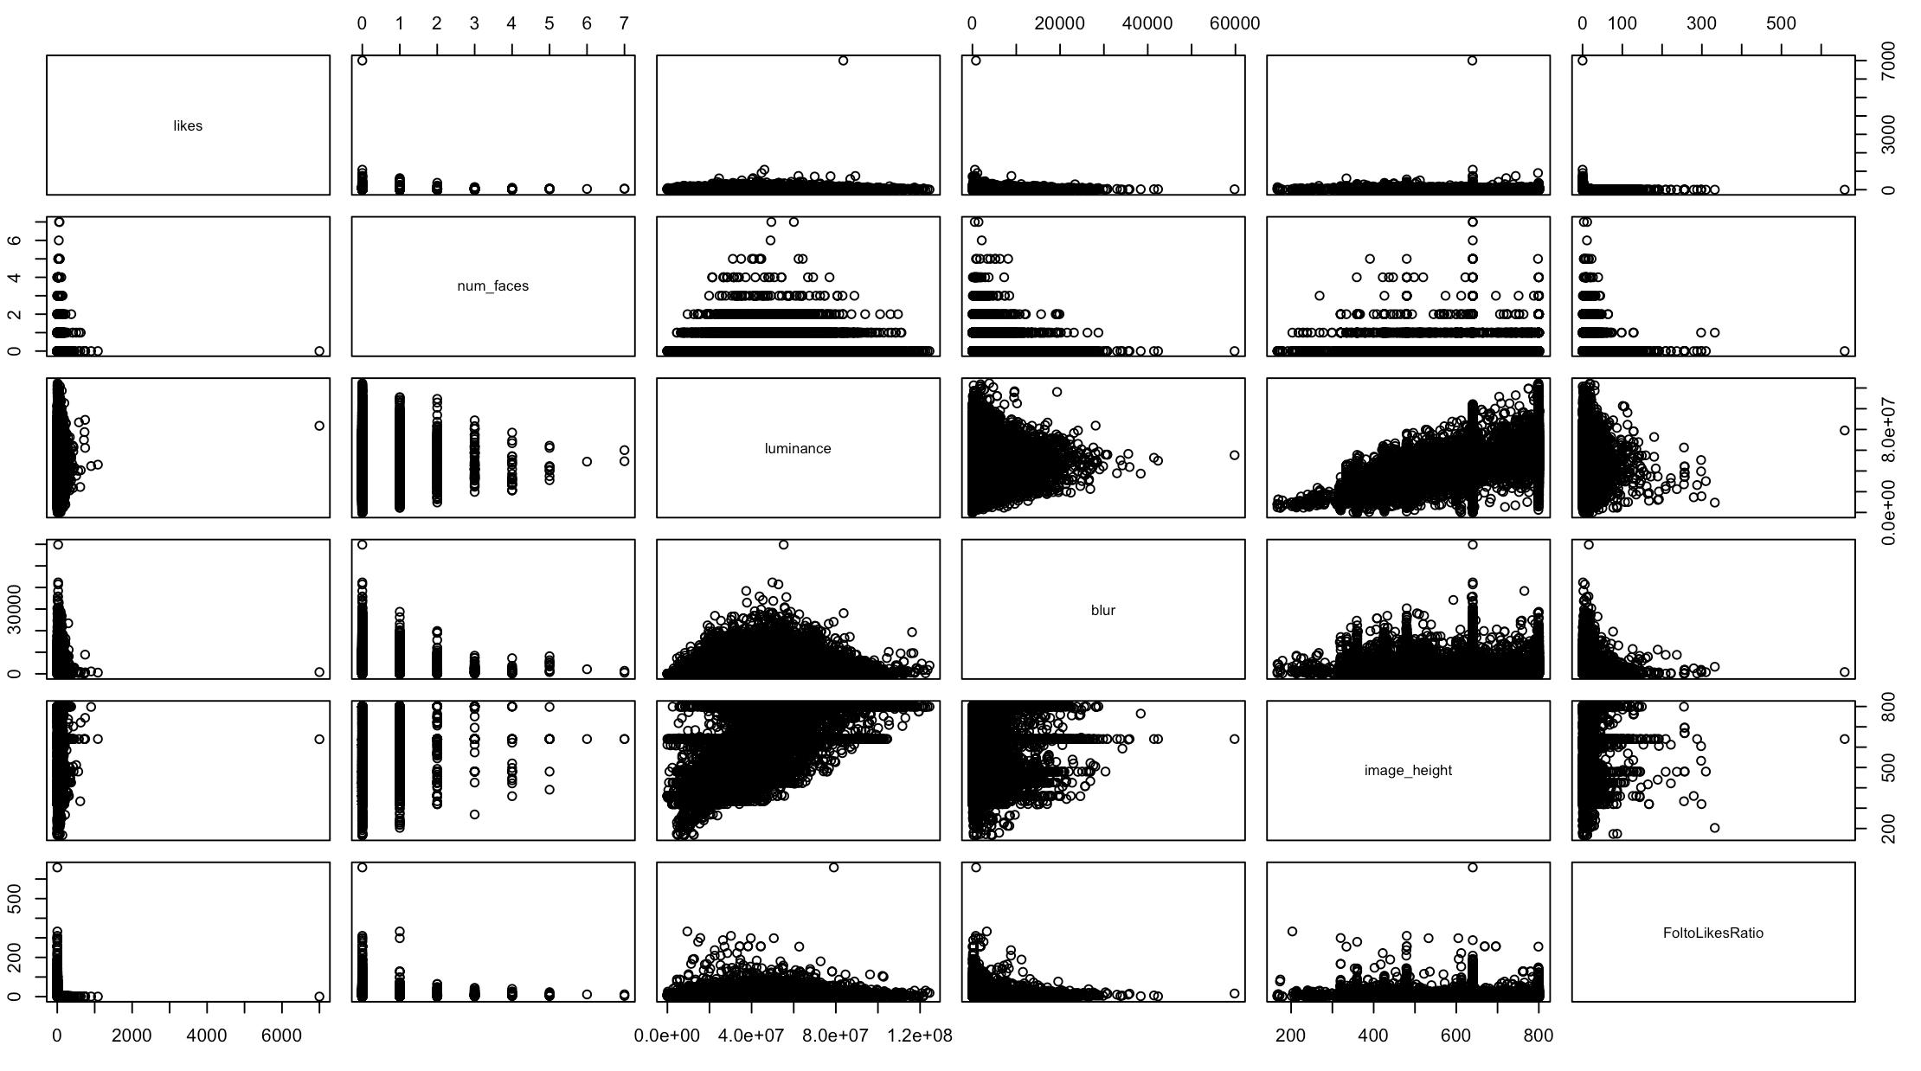
Data Extracted from Photos

Slide 12
The Models

Slide 13
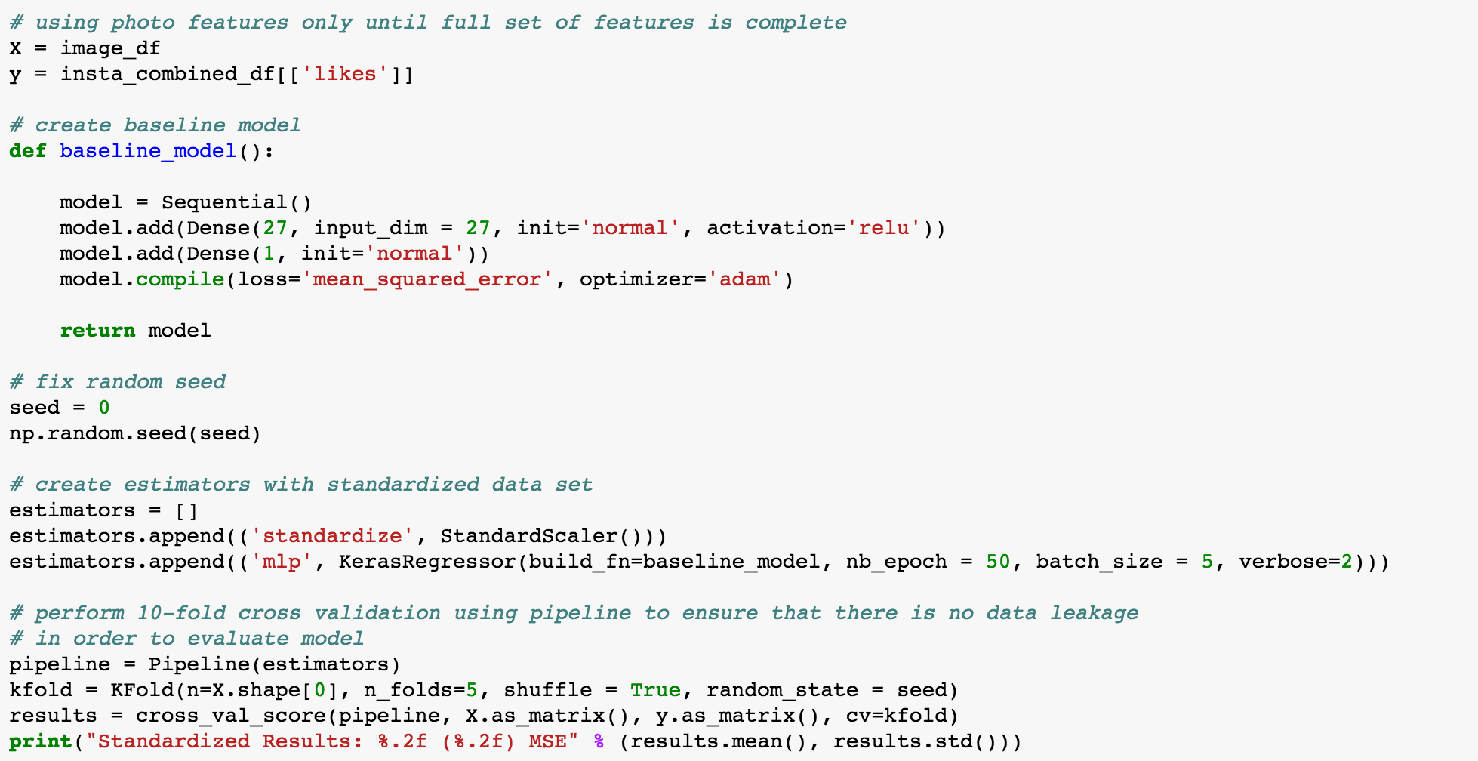
Model 1 - The Neural Network
Our NN was built using Keras, but didn’t end up yielding results as good as other models.

Slide 14
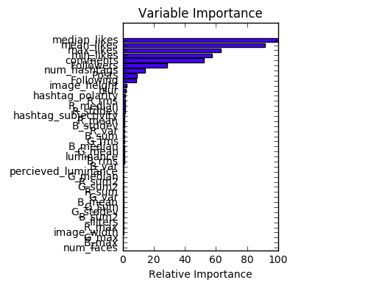
Model 2 - GBM
Given our GBM produced an error less than that of our neural network, we decided to use it as our final model. As one would assume, previous post information accounts for much of the feature importance

Slide 15
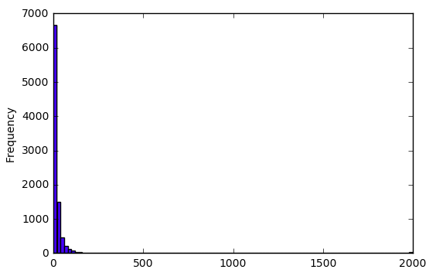
Model Results
Tuning the Gradient Boosting Regressor, we were able to then measure the success of the model by applying it to a set of test data.
By comparing our predicted results to the actual amount of likes a post received in our test set, we saw that 95% of the predictions were within 30 likes.

Slide 16
Flask app - Instapredict
Design:
Input a photo and your username. Back end extracts the features from the photo, and scrapes other necessary info from public accounts
Current limitations
Public accounts only
Data needs to be live scraped (no direct API access from Instagram)
No current input to test how filters, hashtags, and captions could improve your post

Slide 17
Future Directions
More data - Millions of photos are posted every second
Subsets - It’s likely we’d need different models for different tags
Date/Time - The time a photo is posted and how long it’s been up effect likes
Follower involvement - Specific lists of users followers would let us quantify their activity, and how often they like a user’s posts
Image features - Tons more information could be extracted from photos
….the possibilities are borderline endless

Slide 18
Special Thanks
Special thanks to the instructors of NYCDSA for putting up with our shit. Zeyu especially helped with some key aspects of this project.
Special thanks to Jake for help with web scraping. But not for the Instagram key for which he did not provide us. We do not thank him for that.
Special thanks to Professor Emilio Ferrara of USC for supplying us with his data, although we ended up only using our own scraped data for analysis.

