Slide 1
Web Portal and Promotion Analysis

Slide 2
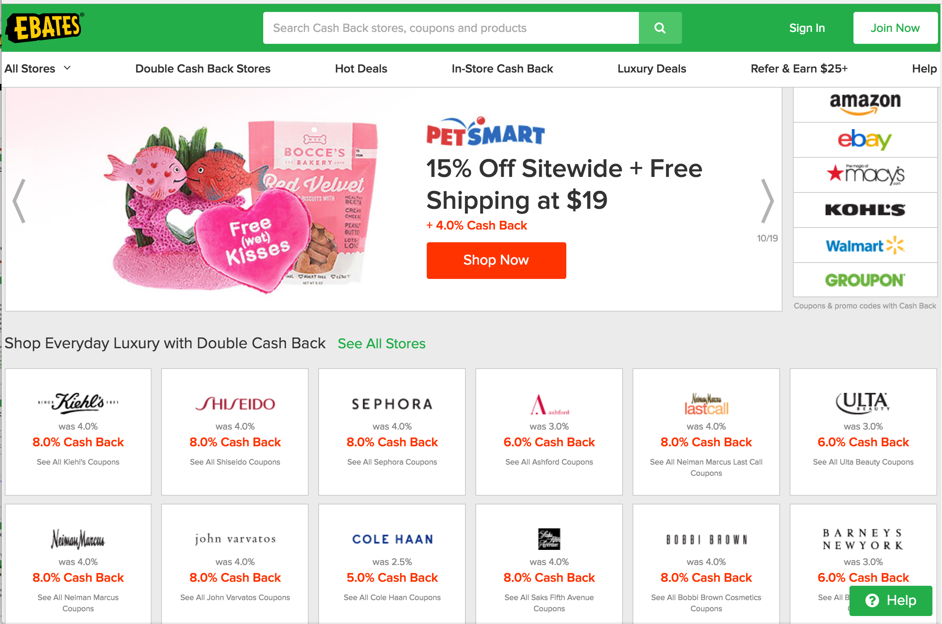
EBATES Online Retail Sales Portal/Aggregator

Slide 3
EBATES Business Model
Attract consumers through the use of ‘cash back’ discounts via a retail web portal
Pass through web consumers to retail partner sites leveraging heavy marketing promotion using coupons and % off web purchases
Capture consumer data through portal registration and on partner sites (among other shopping behavior data)
Calculate ‘dollar rewards’ for final consumer purchases
Partner pays Ebates for referral and reward > Ebates pays consumer cash back reward for shopping through the portal
$1B in cash back since inception in 1999 > $20B in retail purchases > 5% average cash back > 6 million users & growing Source: Motley Fool
Marketing Promotion: Cash is KING $$$$$$$
Notes:
back

Slide 4
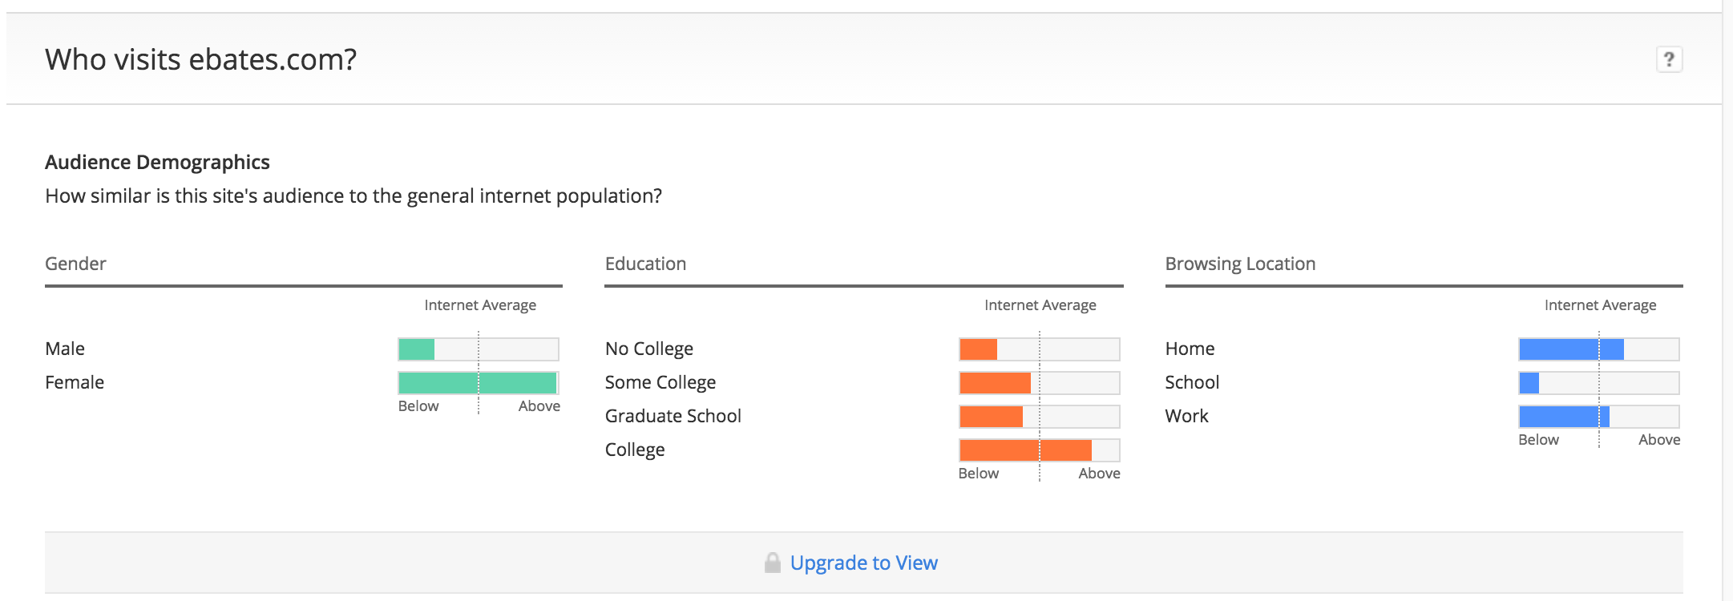
EBATES Web Portal Demographics
Female, College Educated, Browsing from Home
Source: Amazon Alexa, http://www.alexa.com/siteinfo/ebates.com, 2017
Notes:
back

Slide 5
Cash Back Promotion Segmentation: % Off Purchases vs. $ Back
Summary of Promotional Segmentation since website inception:
In Store Cash Back Offers: two observations
Remainder of data, 27.1% does not disclose cash back
 | Total Cash Back | Avg Total Cash Back | Avg Cash Back | Total Purchases | % of Data
% Cash Back | $489,313,553 | $317,736 | $5,763 | $21,495,633,558 | 70.5%
Dollars Off | $4,149,739 | $79,803 | $22 | N/A | 2.4%
Total Cash Back and Total Purchases are cumulative since site launch in 1999

Slide 6
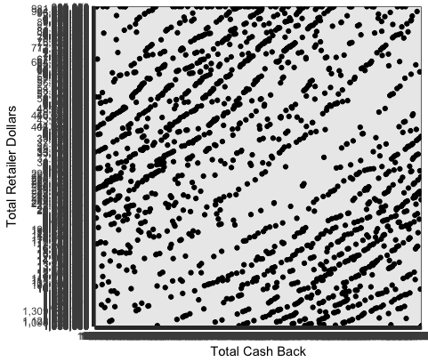
Distribution of Cash Back to Total Dollars

Slide 7
Top Retailers by Total Cash Back
Store Names | Coupons | Cash Back Offer | Total Cash Back | Total Purchase Amount
Macy's | 70 Coupons | 3.0% Cash Back | $29,444,817 | $981,493,900
Kohl's | 27 Coupons | 3.0% Cash Back | $28,935,206 | $964,506,867
Nordstrom | 18 Offers | 2.0% Cash Back | $21,811,161 | $1,090,558,050
Sephora | 9 Coupons | 8.0% Cash Back | $14,460,391 | $180,754,888
eBay | 22 Coupons | 5.0% Cash Back | $13,834,090 | $276,681,800
JCPenney | 15 Coupons | 3.0% Cash Back | $13,508,414 | $450,280,467
Groupon | 9 Coupons | 7.0% Cash Back | $13,449,360 | $192,133,714
Walmart | 35 Coupons | 1.0% Cash Back | $13,098,686 | $1,309,868,600
Sears | 119 Coupons | 1.0% Cash Back | $11,229,544 | $1,122,954,400
Neiman Marcus | 5 Offers | 8.0% Cash Back | $7,647,776 | $95,597,200
Coupons, Total Cash Back and Total Purchase Amount are cumulative since site launch in 1999
Notes:
back

Slide 8
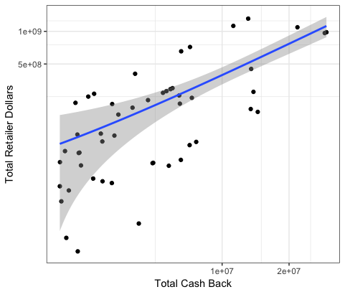
Distribution of Top 50 Retailers: Cash Back to Total Dollars

Slide 9
Top Brands Proprietary Cash Back Data: NAs
538 Retailers withholding cash back data
List of Top Brands:
Store Name | Coupons | Cash Back Offer
adidas | No Coupons Available | No Discount
Amazon | 37 Coupons | Up to 10.0% was 0.0%
American Girl | 4 Coupons | 1.0% Cash Back
Apple Store | No Offers Available | No Discount
Bluefly | 4 Coupons | Coupons Only
Costco | No Coupons Available | No Discount
DoubleTree by Hilton | 6 Coupons | 2.0% Cash Back
Dylan's Candy Bar | 9 Coupons | 3.0% Cash Back
Embassy Suites by Hilton | 5 Coupons | 1.0% Cash Back
Estee Lauder | 4 Coupons | 3.0% Cash Back
Firestone | No Coupons Available | No Discount
fitbit | No Coupons Available | 4.0% Cash Back
Harrah's Reno | 1 Coupon | 2.5% Cash Back
Home Depot | No Coupons Available | No Discount
Jimmy Choo | 1 Coupon | 4.0% Cash Back
Judith Ripka | No Coupons Available | 3.0% Cash Back
La-Z-Boy | No Coupons Available | 2.5% Cash Back
Mattress.com | 1 Coupon | 4.0% Cash Back
Office Depot/OfficeMax | 8 Coupons | 4.0% Cash Back was 2.0%
Pottery Barn | No Coupons Available | No Discount
REI | No Coupons Available | No Discount
Victoria's Secret | 19 Coupons | Coupons Only
Wayfair | No Coupons Available | No Discount
Wine Country Gift Baskets | 5 Coupons | 5.0% Cash Back
Zappos | No Coupons Available | No Discount

Slide 10
Top Retailers by Cash Back to Coupons
Store Names | Coupons | Cash Back Offer | Total Cash Back | Total Purchase Amount
Macy's | 70 Coupons | 3.0% Cash Back | $29,444,817 | $981,493,900
Kohl's | 27 Coupons | 3.0% Cash Back | $28,935,206 | $964,506,867
Nordstrom | 18 Offers | 2.0% Cash Back | $21,811,161 | $1,090,558,050
Sephora | 9 Coupons | 8.0% Cash Back | $14,460,391 | $180,754,888
eBay | 22 Coupons | 5.0% Cash Back | $13,834,090 | $276,681,800
JCPenney | 15 Coupons | 3.0% Cash Back | $13,508,414 | $450,280,467
Groupon | 9 Coupons | 7.0% Cash Back | $13,449,360 | $192,133,714
Walmart | 35 Coupons | 1.0% Cash Back | $13,098,686 | $1,309,868,600
Sears | 119 Coupons | 1.0% Cash Back | $11,229,544 | $1,122,954,400
Neiman Marcus | 5 Offers | 8.0% Cash Back | $7,647,776 | $95,597,200
Coupons, Total Cash Back and Total Purchase Amount are cumulative since site launch in 1999
Notes:
back

Slide 11
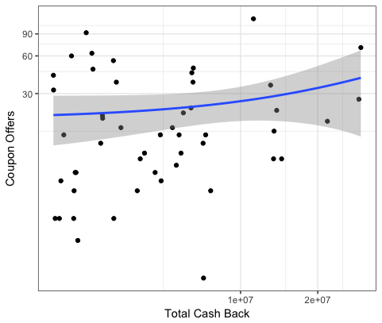
Top 50 Retailers: Cash Back to Coupon Promotion

Slide 12
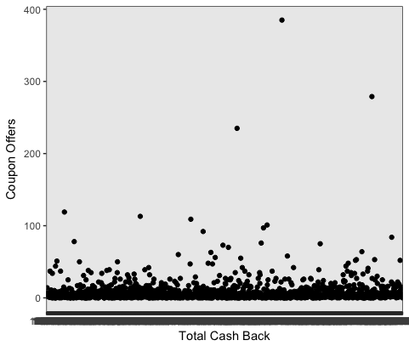
All: Cash Back to Coupon Promotion

Slide 13
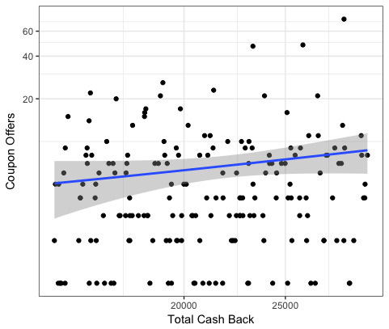
Distribution at the Mean: Cash Back to Coupon Promotion

Slide 14
Coupon Promotion: NAs
Proprietary cash back gives little insight
Many retailers are unknown or new to the site
StoreNames | Coupons | CashBack
Flash Steals | 149 Coupons | 3.5% Cash Back
JemJem | 75 Coupons | Up to 4.0%
Park N Fly | 68 Coupons | 3.0% Cash Back
Everbuying.net | 58 Coupons | 1.5% Cash Back
TinyDeal.com | 56 Coupons | 1.5% Cash Back
italist.com | 55 Coupons | 3.5% Cash Back
Newchic | 51 Coupons | 5.0% Cash Back
SmartFares | 42 Coupons | Up to $4.50
Sixity Powersports | 40 Coupons | 3.75% Cash Back
Amazon | 37 Coupons | Up to 10.0%
Best Cigar Prices | 35 Coupons | 6.0% Cash Back
1STOPlighting | 33 Coupons | 5.0% Cash Back
Vanity Planet | 31 Coupons | 10.0% Cash Back
SKUSKY | 31 Coupons | 4.0% Cash Back
Dress Lily | 31 Coupons | 2.5% Cash Back
ContactsDirect | 31 Coupons | 7.0% Cash Back
Alphabetdeal | 28 Coupons | 5.0% Cash Back
TOMTOP | 25 Coupons | 3.5% Cash Back
Cotton On | 25 Coupons | 3.5% Cash Back
Samuels Jewelers | 24 Coupons | 3.5% Cash Back
Free Country | 23 Coupons | 3.0% Cash Back
CitySights NY | 23 Coupons | 7.5% Cash Back
Sulwhasoo | 22 Coupons | 9.0% Cash Back
BarcelÌ_ Hotels | 22 Coupons | 3.0% Cash Back
Yoins | 21 Coupons | 5.0% Cash Back
Victoria's Secret | 19 Coupons | Coupons Only
Shopko | 19 Coupons | Up to 2.0%

Slide 15
Promotion Summary - Next Steps
EBATES is a huge site and growing. Sold for $1B to Rakuten in 2014
Brand is important to the portal: Attracts consumers and drives retail dollars
Next Steps:
Need further segmentation to drill down into promotion strategy:
Retail category
New retailer to the site
Home page promotion
Coupon A/B testing: offer, position, creative

