Slide 1

Kaggle Machine Learning COMPETITION
By Mayank Shah And Vahe Voskerchyan

Slide 2
XGBoost + Features
Model Score
4 seeds blended together
Photo/Description/Feature Count
Price per Photo/Description/Feature
Distance from Subway
Distance from Subway divided by # of Lines at Subway
Distance from Equinox
Distance from Starbucks
One Hot Encoding of Description
One Hot Encoding of Features
.55724

Slide 3

Don’t Reinvent the Wheel
Companies such as Starbucks, Equinox, Whole Foods, etc. have already spent millions of dollars and years of time to determine where people want to be
Demand in New York City is largely determined by what is around you, not your home itself
Distance to successful company’s locations was as indicative as the location of the listing itself
Distance to Subway Stations, and the # of Subway Lines at that station were features that followed that same line of thinking

Slide 4
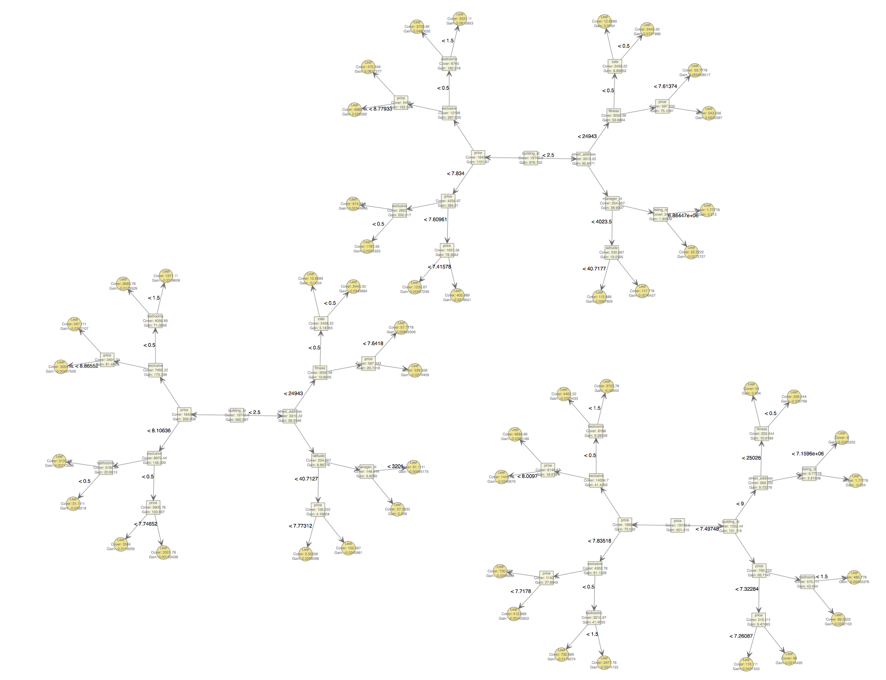

Slide 5

Useless Blends and Misguided Features
Price per Bedroom, Price per Bathroom
One Hot Encoding of Features
One Hot Encoding of Descriptions
GLMNET – Lasso, Ridge, and Elastic Net
Junk listing aka listings containing multiple NAs (or incorrect long/lat)
Sentiment Analysis
Street or Avenue
Image Brightness (Would have taken so long to run, aborted)
Did we cheat? Outside data sets

Slide 6

Takeaways and Future Plans
Continue working on this competition
Ensemble multiple models using caretEnsemble
Apply KNN
New feature for interest level of nearest listings
For future competitions:
Cross Validation was underused this time, need to utilize that more in future competitions
Try in Python

