Slide 1

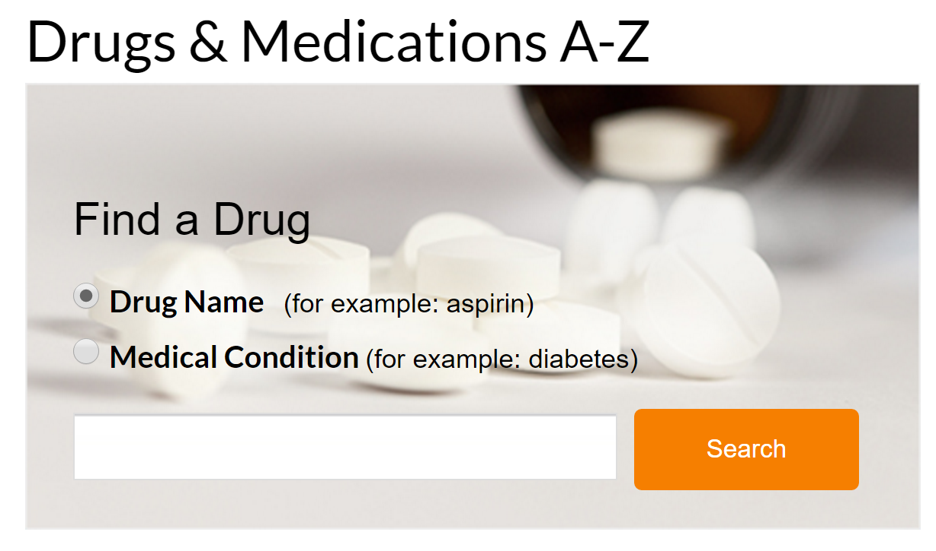



SCRAPE ALL THE DRUGS

Slide 2
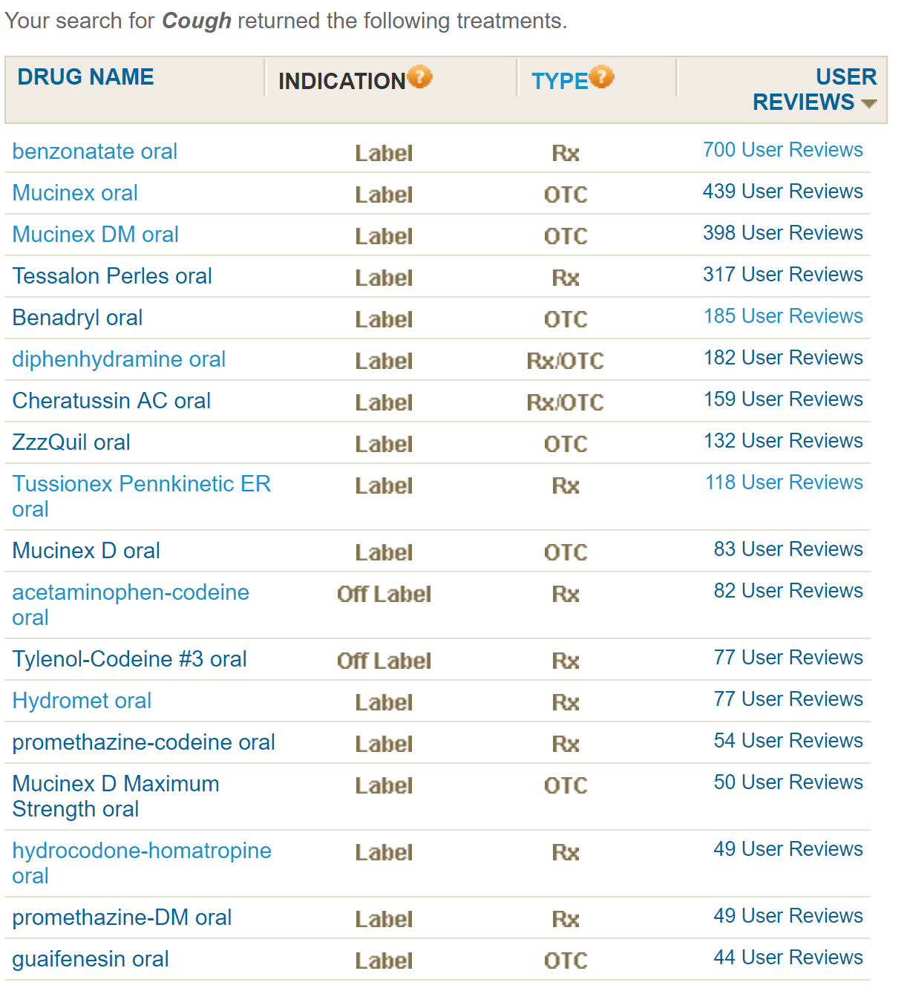
Why?
Why does Cough return 600+ drugs?
http://www.webmd.com/drugs/condition-3205-Cough.aspx?diseaseid=3205&diseasename=Cough&source=2 (See for yourself)
Which one do I choose?
Wait… you mean I have to load 3 different webpages before I can see the price?
For every drug?

Slide 3
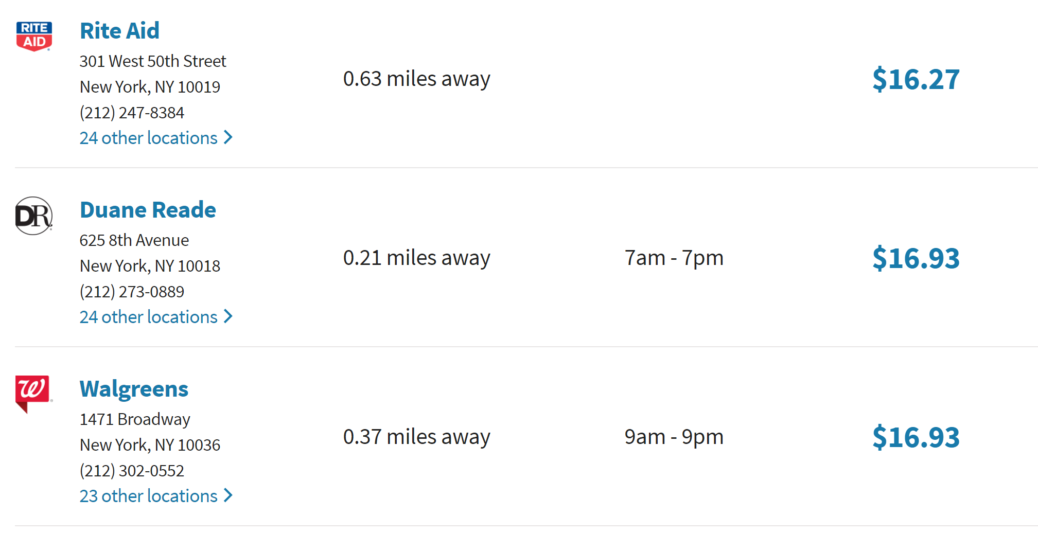
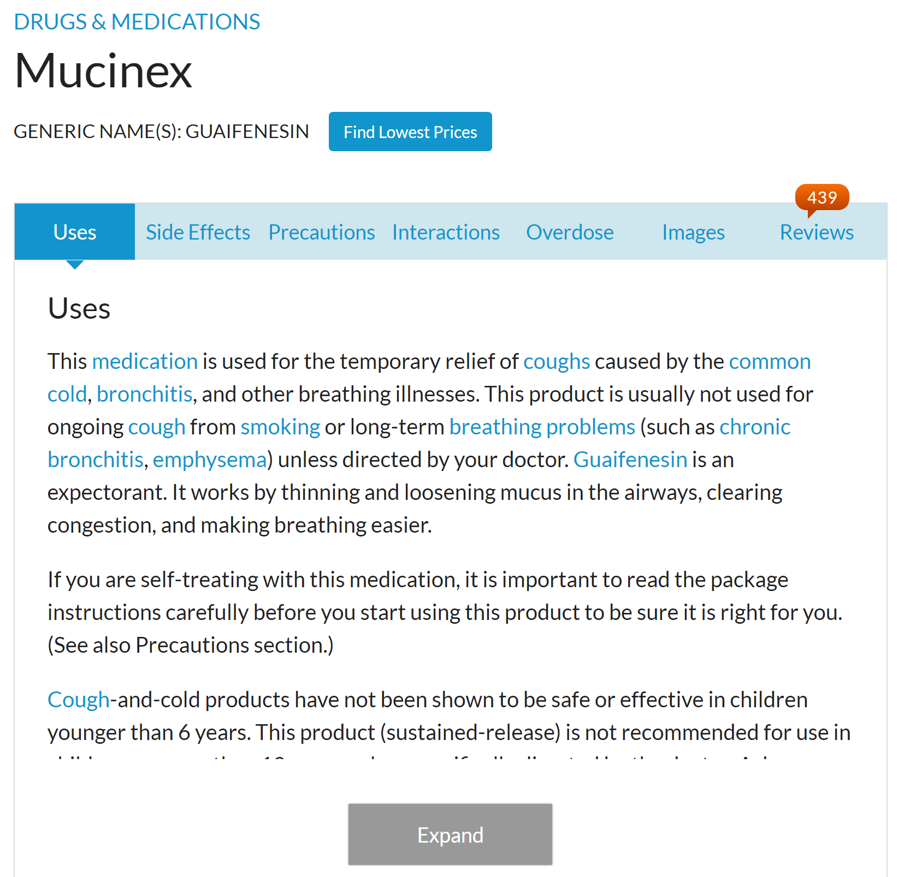
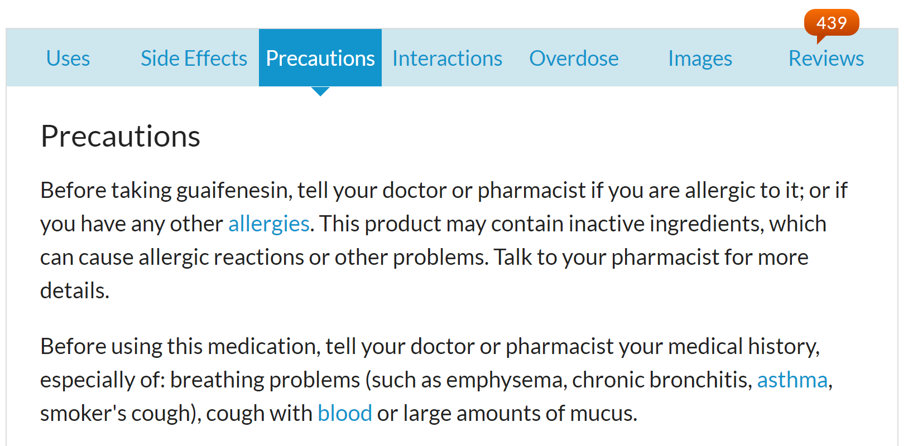
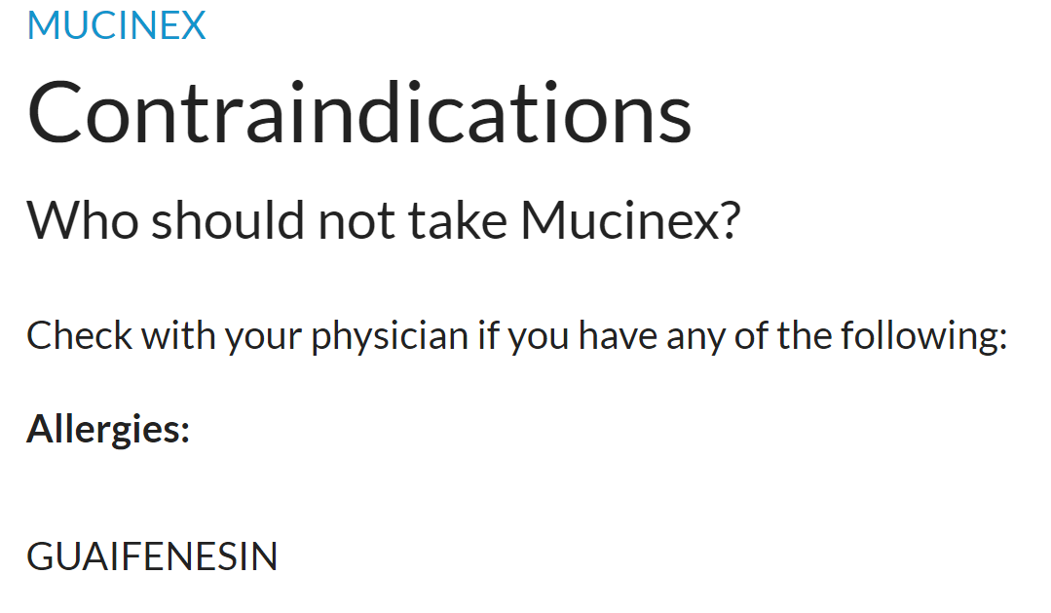

600 tabs later…
Guess I can’t take this then :(

Slide 4
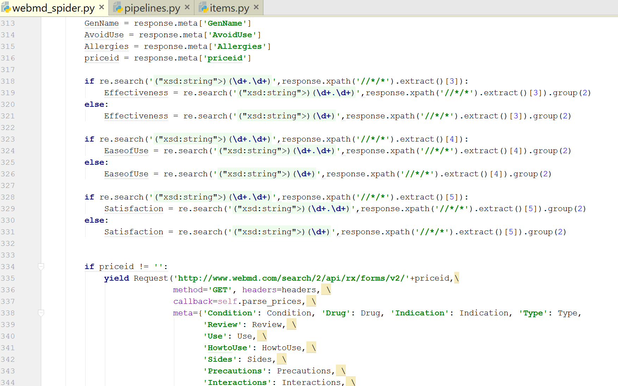
So much RegEx…

Slide 5
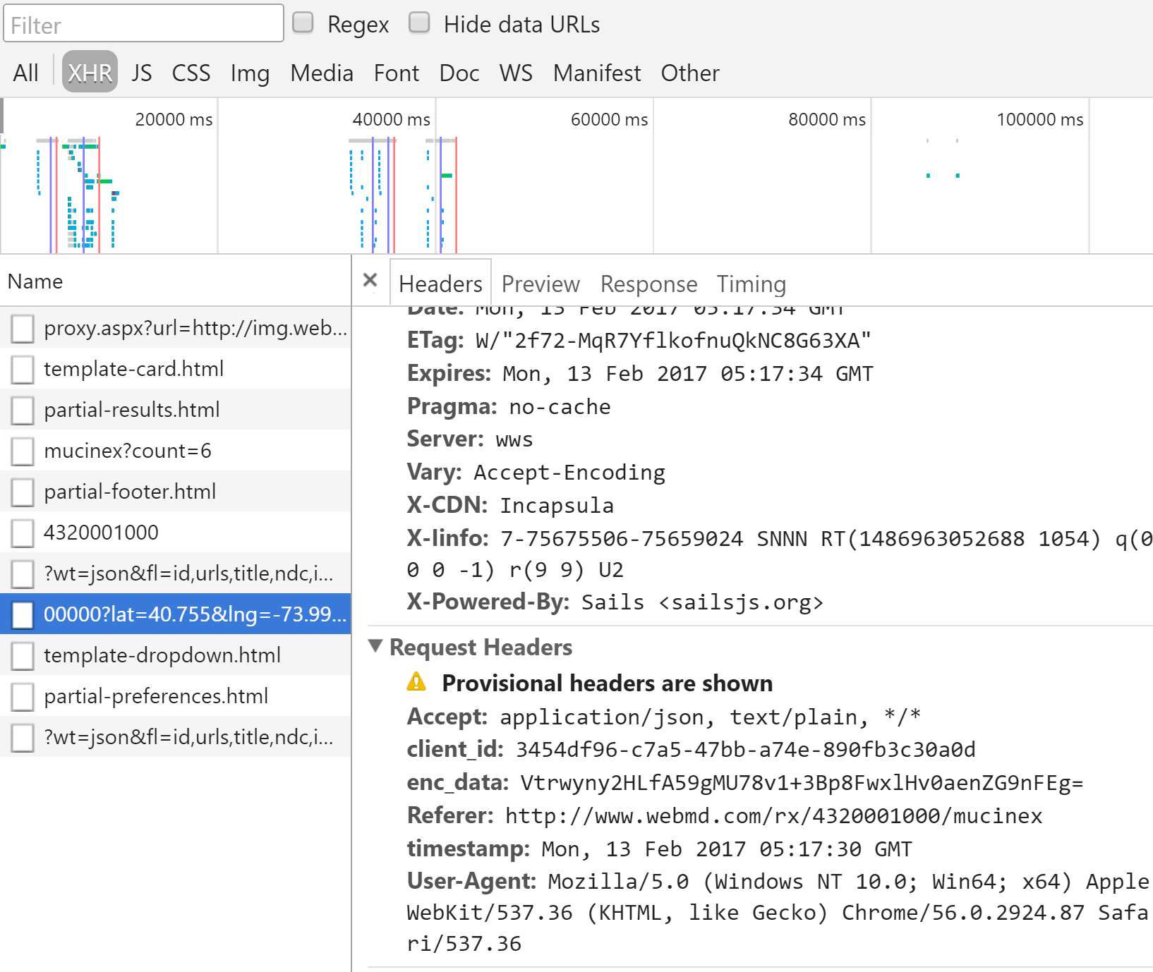
Dynamic pages

Slide 6
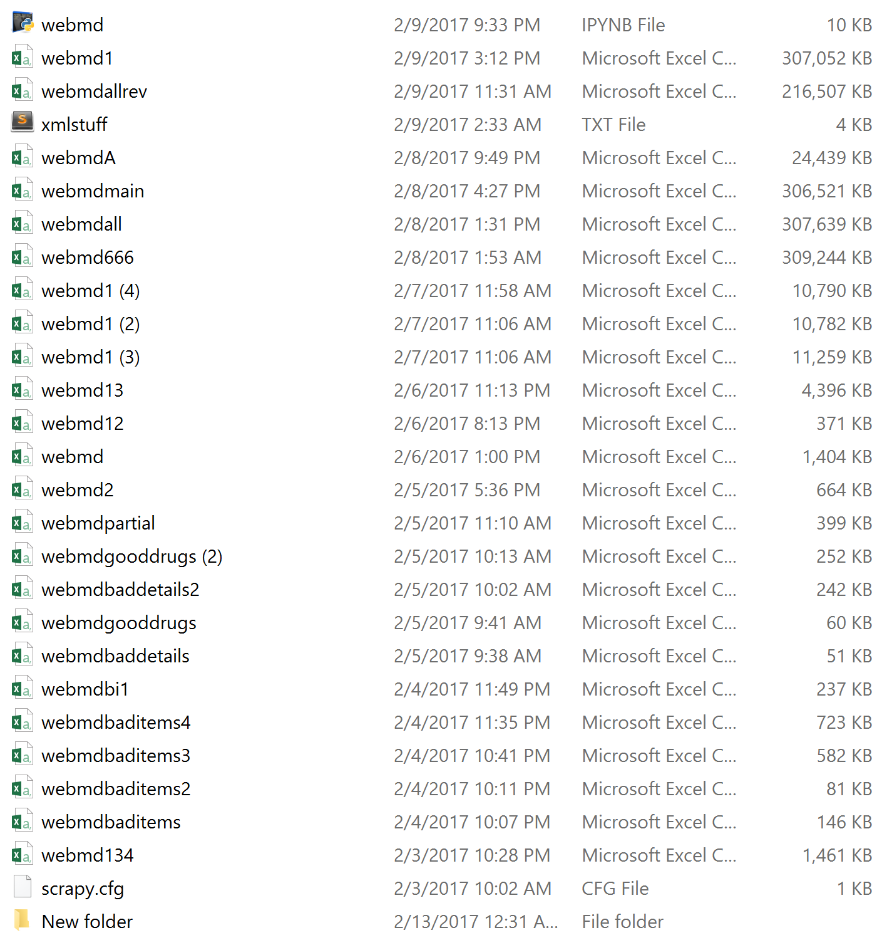
After many hours of debugging and rescraping:
This is good
The rest are bad

