Slide 1

What Makes A New YORK Times Bestseller?
Dr. David Letzler
NYC Data Science Academy
Notes:
NOTE:
To change the image on this slide, select the picture and delete it. Then click the Pictures icon in the placeholder to insert your own image.

Slide 2
The Paucity of Book Sales Data
Unlike film box office receipts, TV viewership, and music sales/streaming, there is no high-quality measure of book sales
Nielsen’s BookScan tracks purchase-point sales, but these are only a minority of total print sales
Amazon’s rankings do not provide unites sold, are hard to track over time, and represent less than a third of total book sales

Slide 3
The New York Times Bestseller Metric
The Times bestseller lists also do not provide unit sales, and their methodology is opaque and not necessarily reflective of total sales
They do provide accessible, consistent data through an API to allow comparisons over time, especially in a top-heavy market
Furthermore, the lists’ prestige make them a predictor as well as reflector of sales: being a Times bestseller is a marketing boon

Slide 4
What Fiction Sells Best?
Initial Questions in Shiny Dashboard:
How much of the market do the “Big Five” own?
How well do their imprints do against each other in various genres and on the different lists?
Where can independent and self-published authors horn in on the hierarchy?
How much time-share do the mega-sellers take on the list?

Slide 5
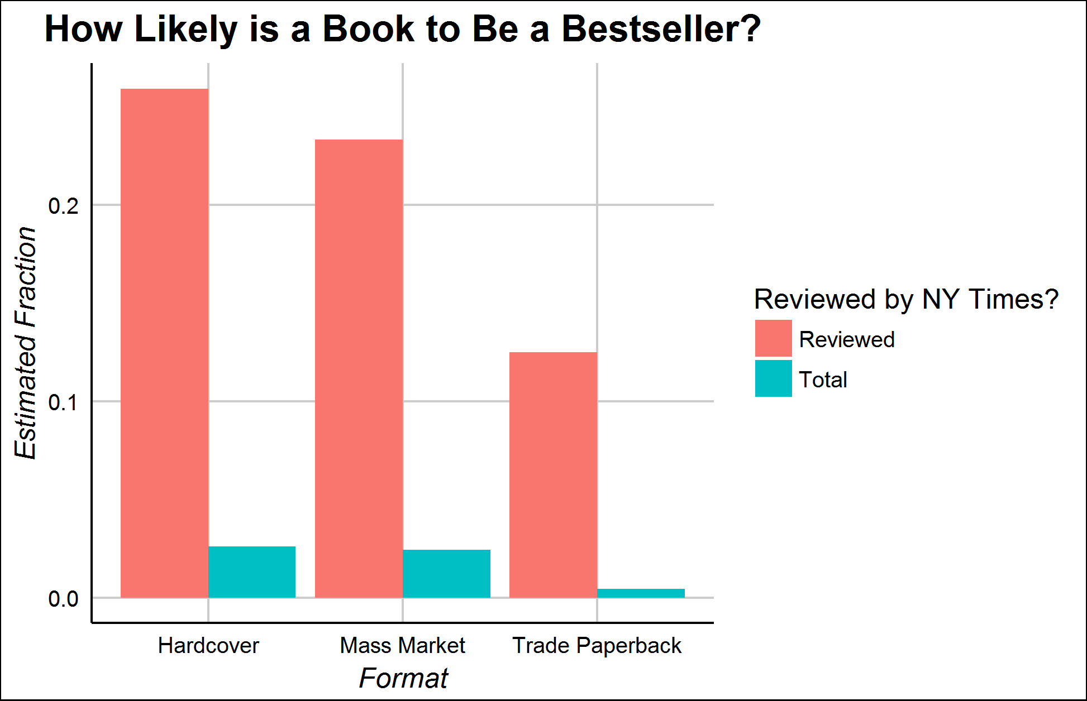
The Times Book Review Boost
The Times Book Review is as prestigious as the bestseller list
It reviews only ~350 of ~40,000 new fiction titles each year in the US
Reviewed books are much likelier to be bestsellers
Causation or Correlation?

Slide 6
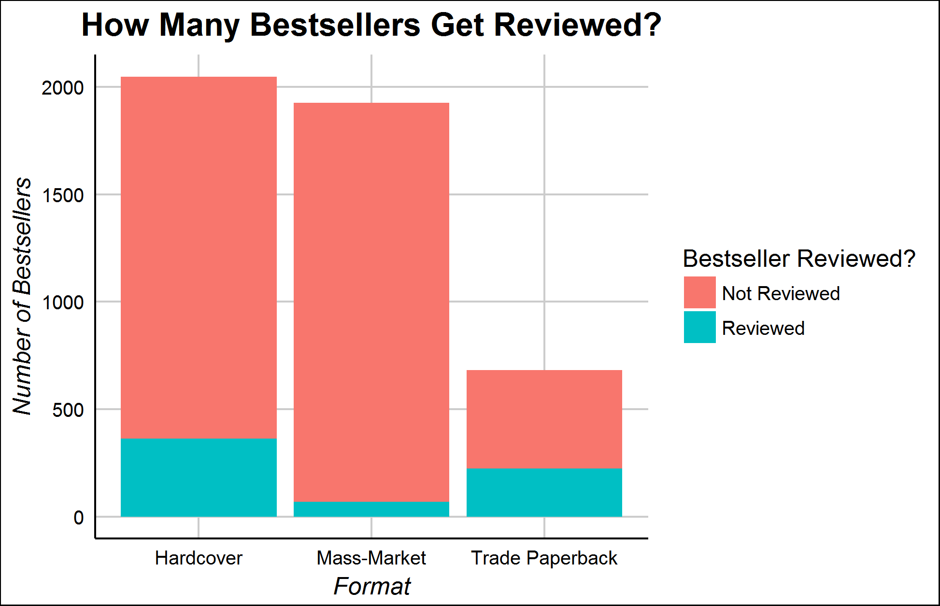
Is the NYTBR Big Enough to Matter?
Only a small fraction of bestsellers get reviewed at all
Over a third of the trade-paper list gets reviewed, but only 3% of the mass-market list does
How much does the Book Review matter?

Slide 7
The Difficulty in Classifying NYT Reviews
New York Times book reviews are designed to be read carefully rather than easily scanned
The average review is nearly 1200 words long, and they do not contain “star” ratings
This project became, largely, an effort to figure out how to classify these kinds of documents

Slide 8
Challenge I: Distinguishing Fiction/Nonfiction
Based on API URLs, I scraped every review from 2008-present
However, the API did not allow me to limit to fiction only, leaving me with many
How to extract only the fiction reviews from the set?

Slide 9
Topic Modeling
Topic modeling is an unsupervised Bayesian machine learning technique
It assumes that each corpus’s documents are generated from a set of “topics,” which are word frequency distributions across the whole vocabulary
It uses sampling and chain iteration (similar to tensorflow) to try to generate the topics that underlie the corpus
Topics can be interpreted in terms of their most populous words

Slide 10
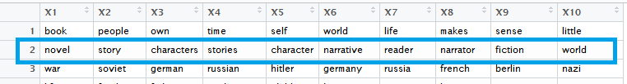
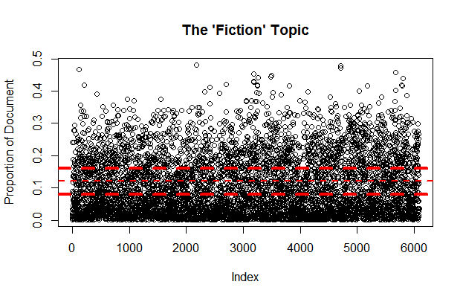
The “Fiction” Topic
I trained a 30-topic model on the set of book reviews.
As expected, one topic clearly indicated “fiction.”
I used a manual decision tree to isolate the fiction reviews

Slide 11
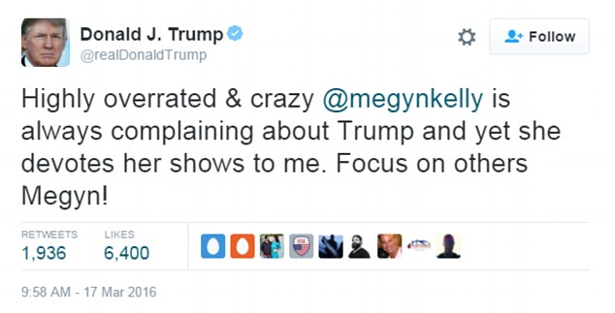
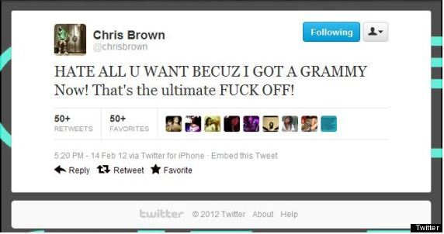
Challenge II: Book Reviews are not Tweets
Basic sentiment classifiers are designed to classify texts like tweets, which are short and not emotionally subtle
These do not require much effort to classify

Slide 12
The Problems of NYTBR Style
By hand annotation, I found that over 75% of sentences in the book reviews do not directly comment on the quality of the book
This will cause problems for classifiers, which will cluster reviews based on subject matter rather than quality judgment
However, they frequently use charged language to describe books…

Slide 13
An Example—Toni Morrison’s Paradise
Paradise […] addresses the same great themes of her 1987 masterpiece, Beloved: the loss of innocence, the paralyzing power of ancient memories and the difficulty of accepting loss and change and pain. It, too, deals with the blighted legacy of slavery. It, too, examines the emotional and physical violence that human beings are capable of inflicting upon one another.—Michiko Kakutani
Sentiment Judgment of David Letzler (Ph.D. in English): Very Positive
Sentiment Judgment of Syuzhet (designed by Matt Jockers, ipse): -17.5

Slide 14
Idea I: Filtering to Author/Book Comments

