Slide 1
Taming News Flow
Kamal Sandhu

Slide 2
Question?

Slide 3
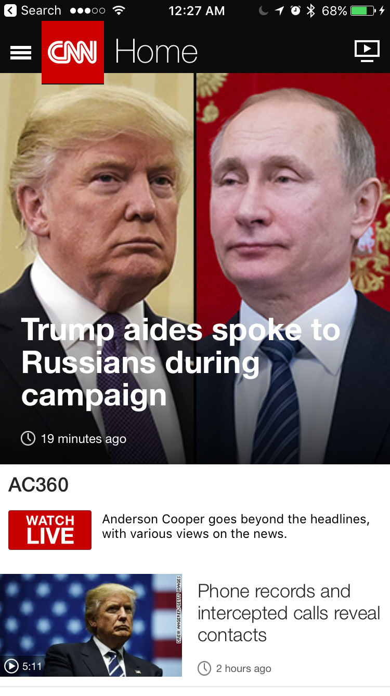
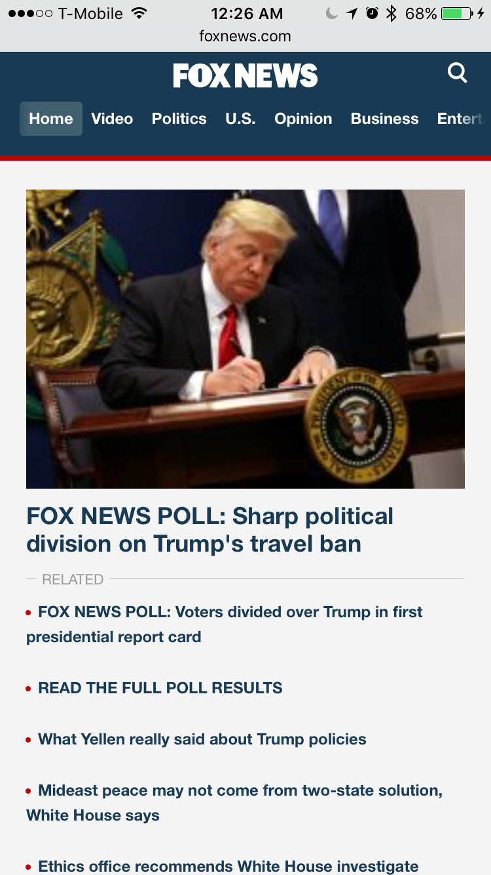
Different Medium Different Spin

Slide 4
Starting Point
Chose three sources –
- Reuters
- CNN
- Fox News
Aim –
- Scrape articles
- Quantify differences

Slide 5
Four Part Game Plan
Step 1 – Scrape news articles
Step 2 – Download scraped data from the cloud
Step 3 – Get NLP API responses
Step 4 – Analyze the analyzed information

Slide 6
Step 1 - Scrape news articles
Tools used:
PyCharm - IDE
Scrapy – We all know Scrapy
ScrapingHub – Service to automate scraping and store data
Crawlera – IP rotation service

Slide 7
Step 2 – Download scraped data from the cloud
Tools used:
1. ScrapingHub API
2. JSON
This is where the problems started …

Slide 8
Step 2 – Download scraped data from the cloud
Problems:
Number of articles that needed to be fetched.
Making different API calls for different spiders.
Solutions:
Build wrapper for wrappers.
Download, clean and save files one at a time.
Use JSON instead of 2-dimentional file systems.

Slide 9
Step 3 – Get NLP API responses
Contemplated using different sources but settled on 2
Google Natural Language Processing API
TextRazor Natural Language Processing API

Slide 10
Step 3 – Get NLP API responses
Google Natural Language Processing API
Analyzes up to 5,000,000 characters per month for free
Sentiment analysis including magnitude and emotion (positive or negative)
Tokenizes text and assigns part of speech labels
Derives entities from the text
Returns a generator and data can be extracted as lists or dictonaries

Slide 11
Step 3 – Get NLP API responses
TextRazor API provides a similar service –
Relations between parts of speech
Entailments
Coarse topics
Returns a generator and different parts of analysis can be extracted as lists of dictionaries

Slide 12
Step 3 – Get NLP API responses
Challenges –
Number of files
Size of files
Tracking the number of requests
Making best use of resources by only sending an article to an API once
Solutions -
Use hash function of the article body to generate file names
Check the file name against analyzed files to make sure each article is only sent in once (although other schemes could have been used)

Slide 13
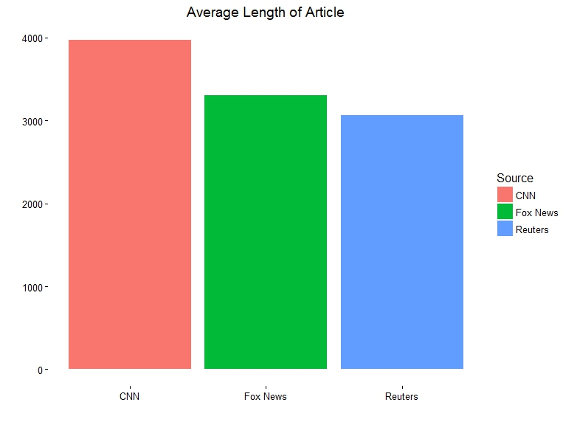

Slide 14
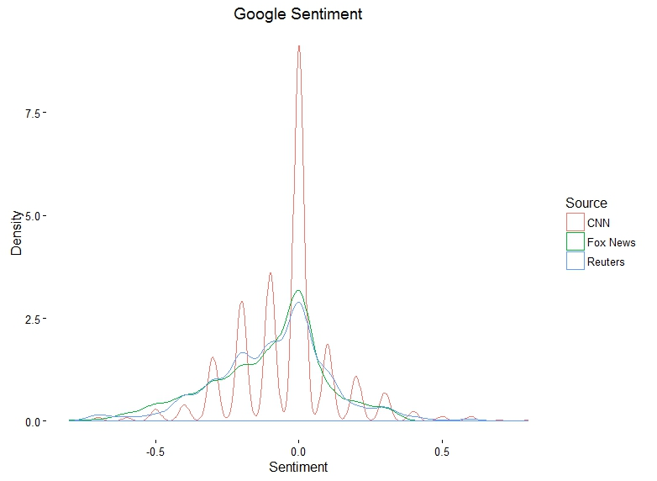

Slide 15
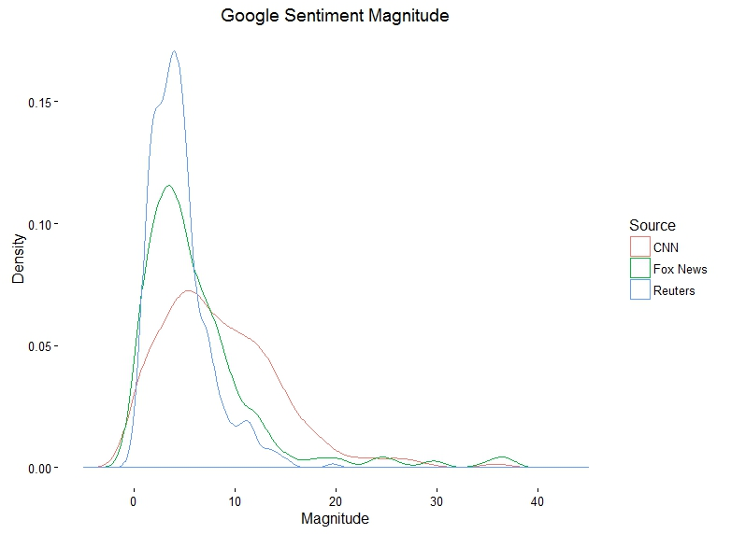

Slide 16
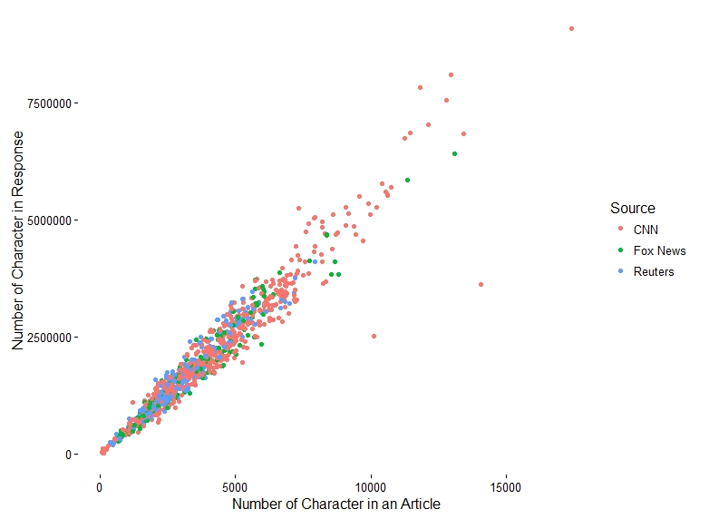

Slide 17
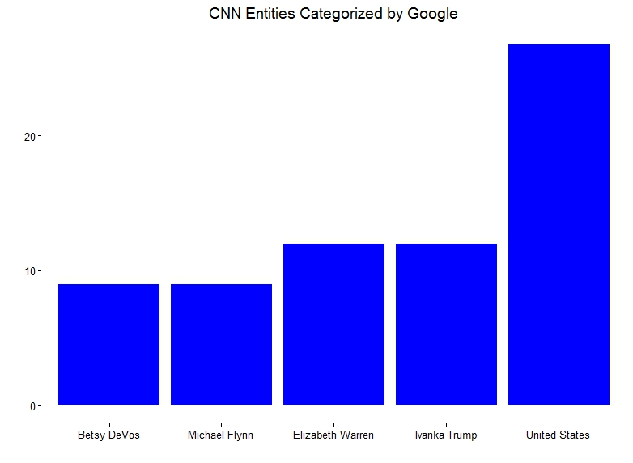

Slide 18
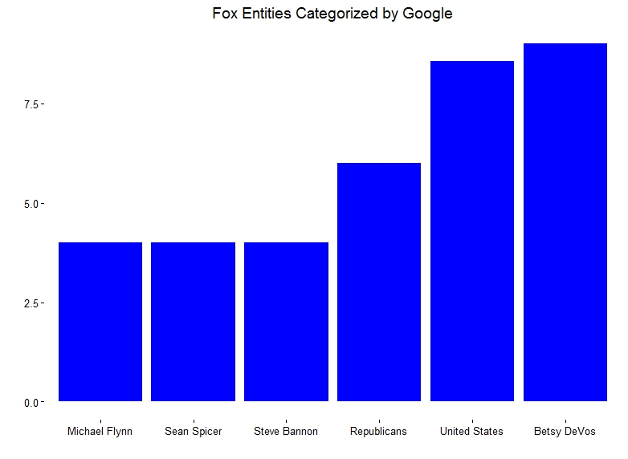

Slide 19
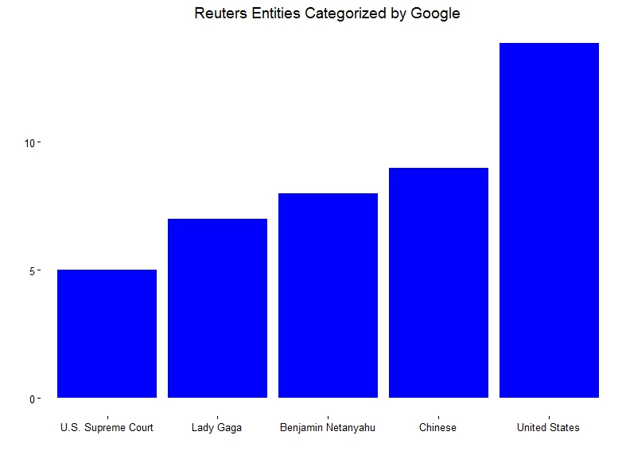

Slide 20
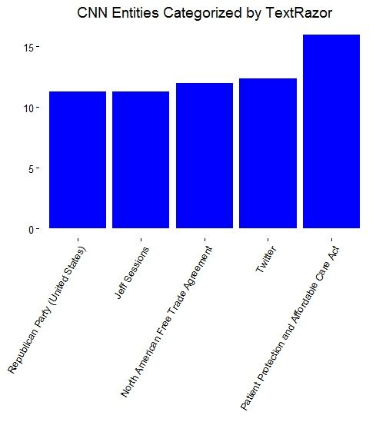

Slide 21
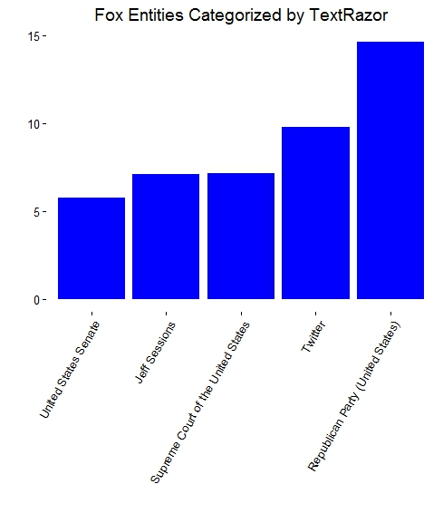

Slide 22
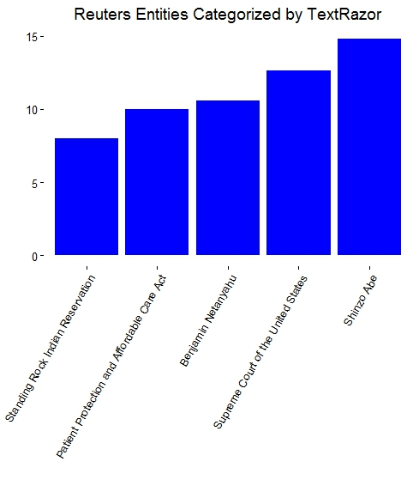

Slide 23
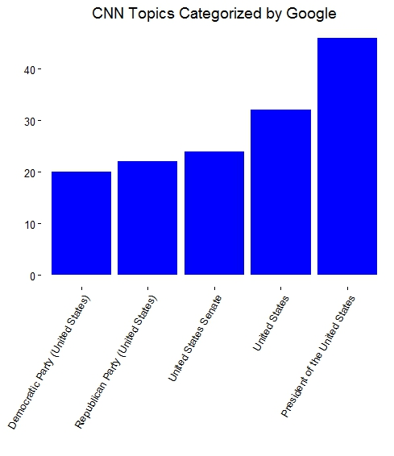

Slide 24
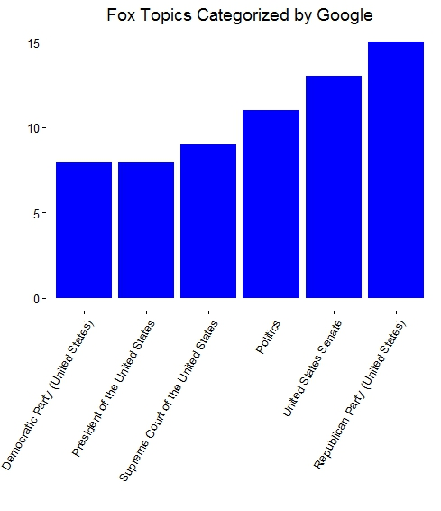

Slide 25
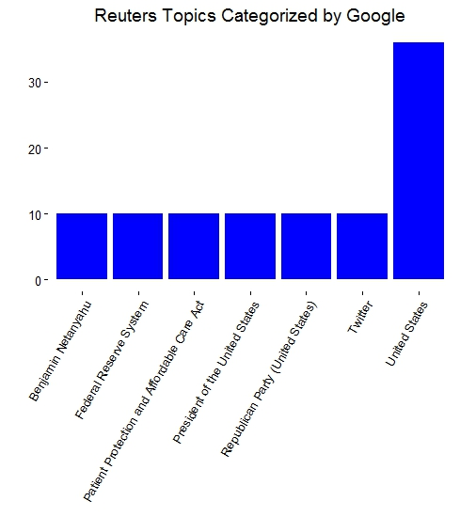

Slide 26
What did I learn?
Plan before you code (use pseudocode)
Maximize the use of interactive development enviornments (IDE)
Do not try to overload your laptop
Code/debug on local machine and deploy on cloud
Code efficiency is more important than impressive hardware
Scrapy, json file handling, Google/TextRazor API’s, ScrapingHub, some NLTK and that CNN is always freaking out

