Slide 1

Mapping Four Years of Common Core Test Data in NYC Public Schools
Dr. David Letzler
New York Data Science Academy

Slide 2

Common Core State Standards
Conceived in 2007-2009 as uniform national curriculum
Adopted by 45 states (and various territories) by 2013
Basis of standardized tests administered to grades 3-8 in NYC public schools

Slide 3
Features of “NYC Common Core Test Results” Shiny App
Each public school enrolling students in grades 3-8 is represented by a labeled dot
Each dot is colored on a red-green spectrum to indicate percentage of students scoring at Level 3 or 4 (“Proficient”), with the score represented in the pop-up label
Each school is overlaid onto a map of all 2166 NYC official Census Tracts (2010)
Each tract is labeled with its neighborhood and median household income (2010)
Scores can be filtered to ELA/Math tests, any year in 2013-2016, any grade 3-8 (or all), any income quintile (or all), and any range of proficient students

Slide 4
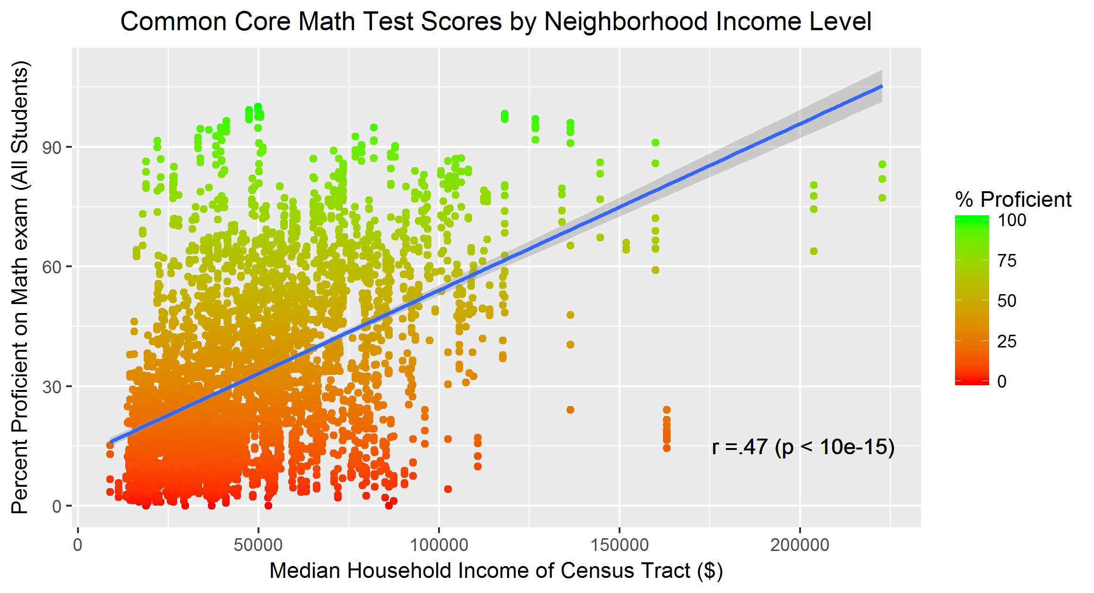
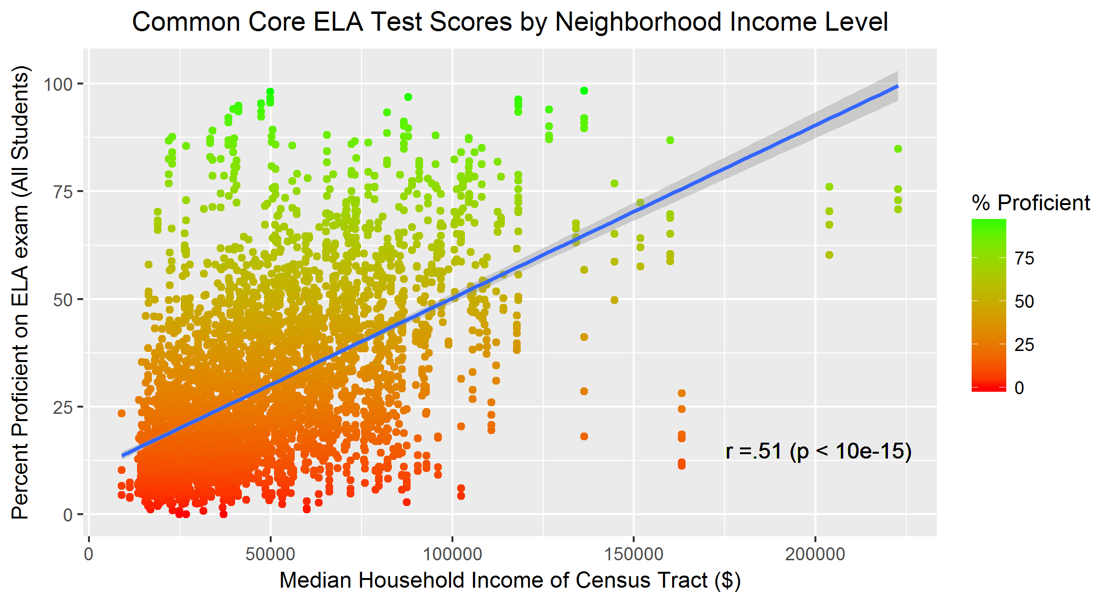
School Proficiency is Correlated (Imperfectly) with Neighborhood Income

Slide 5
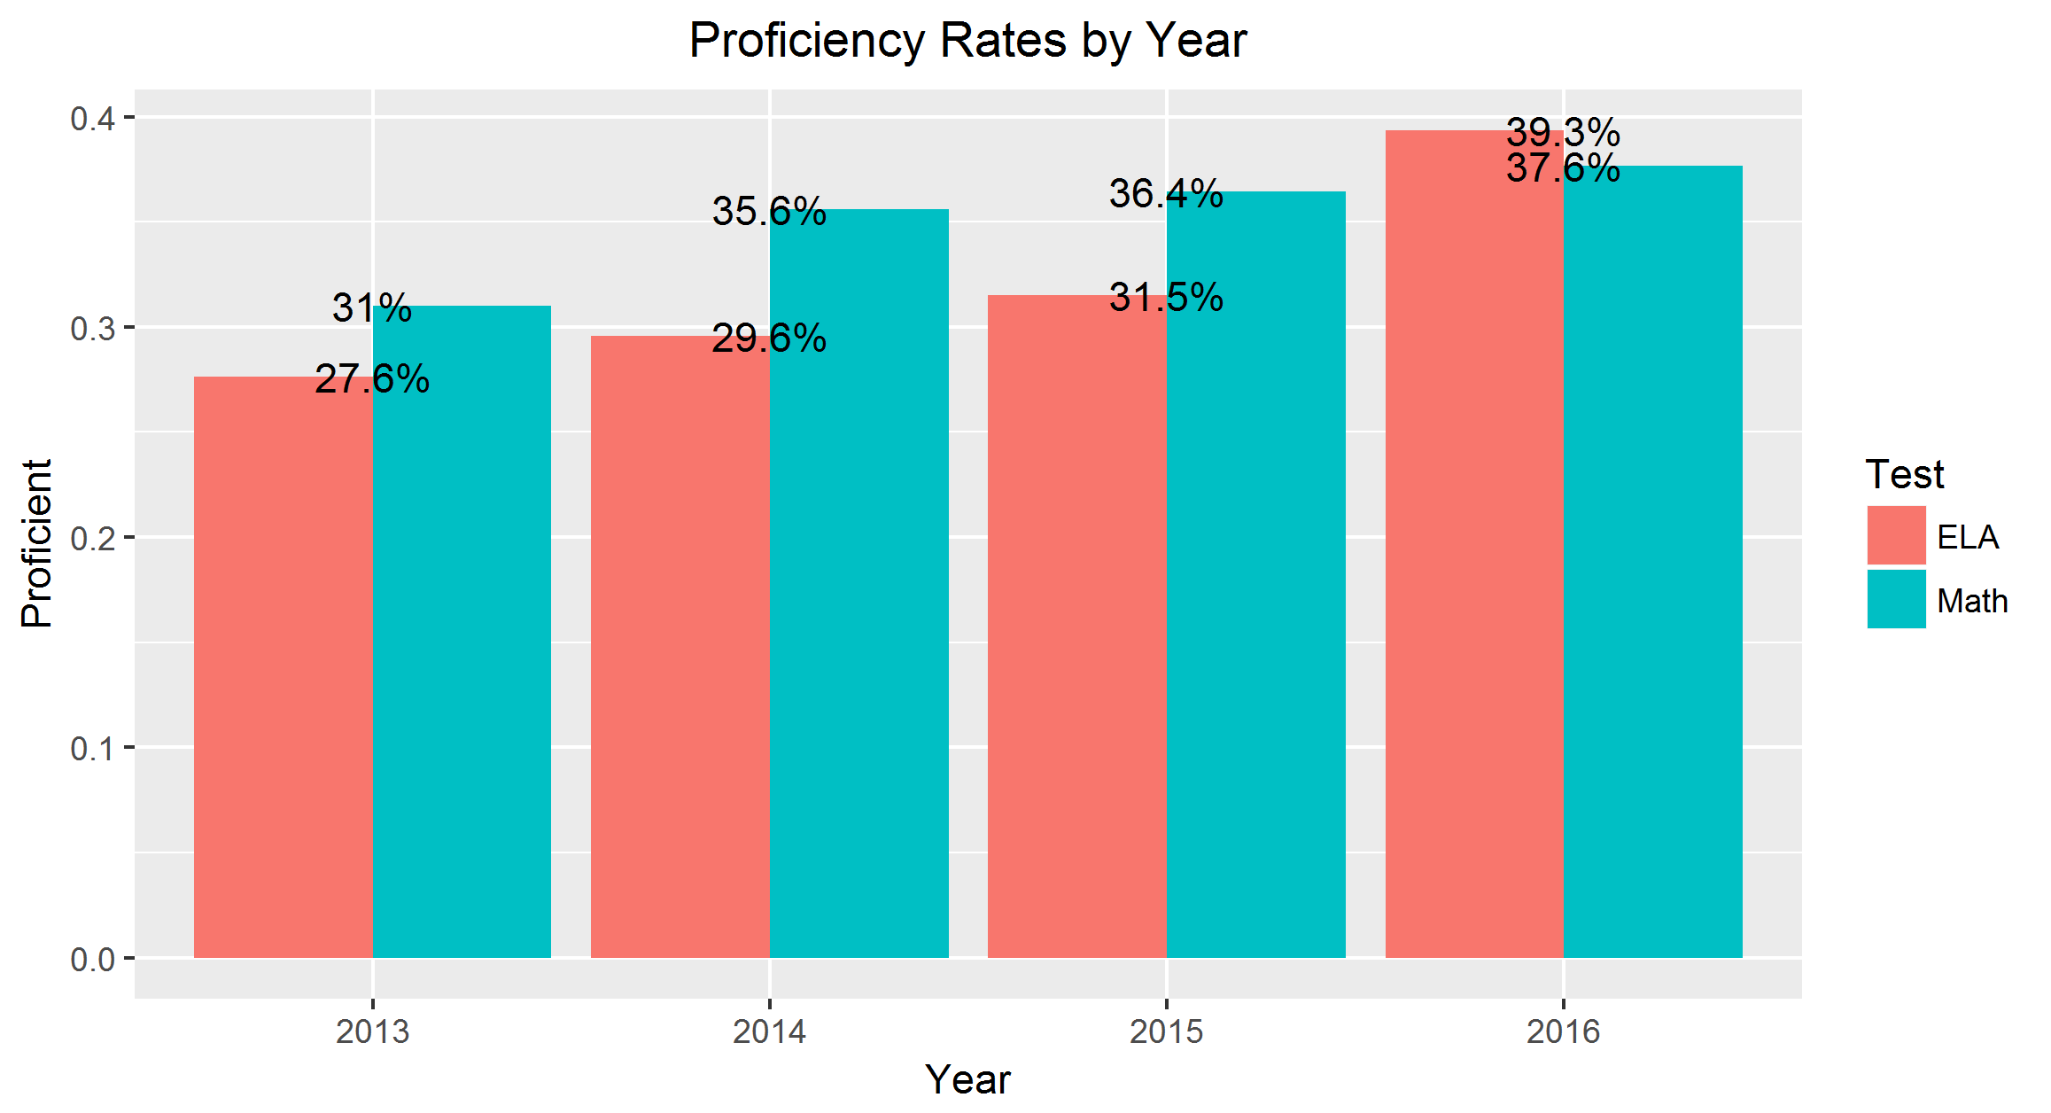
Scores are Increasing Each Year…

Slide 6
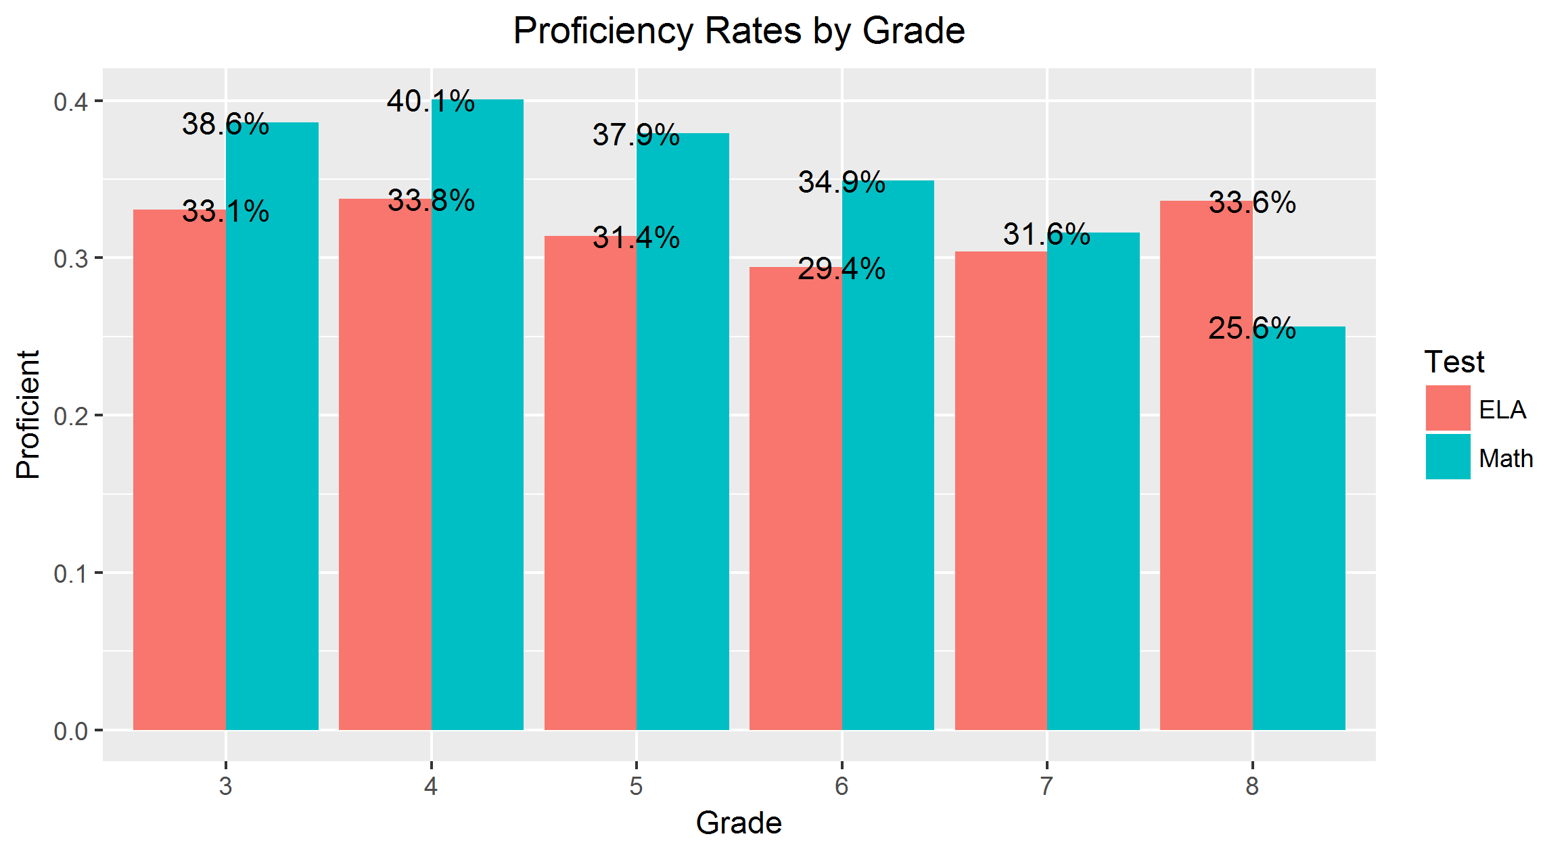
…but Students Perform Worse as They Age

Slide 7
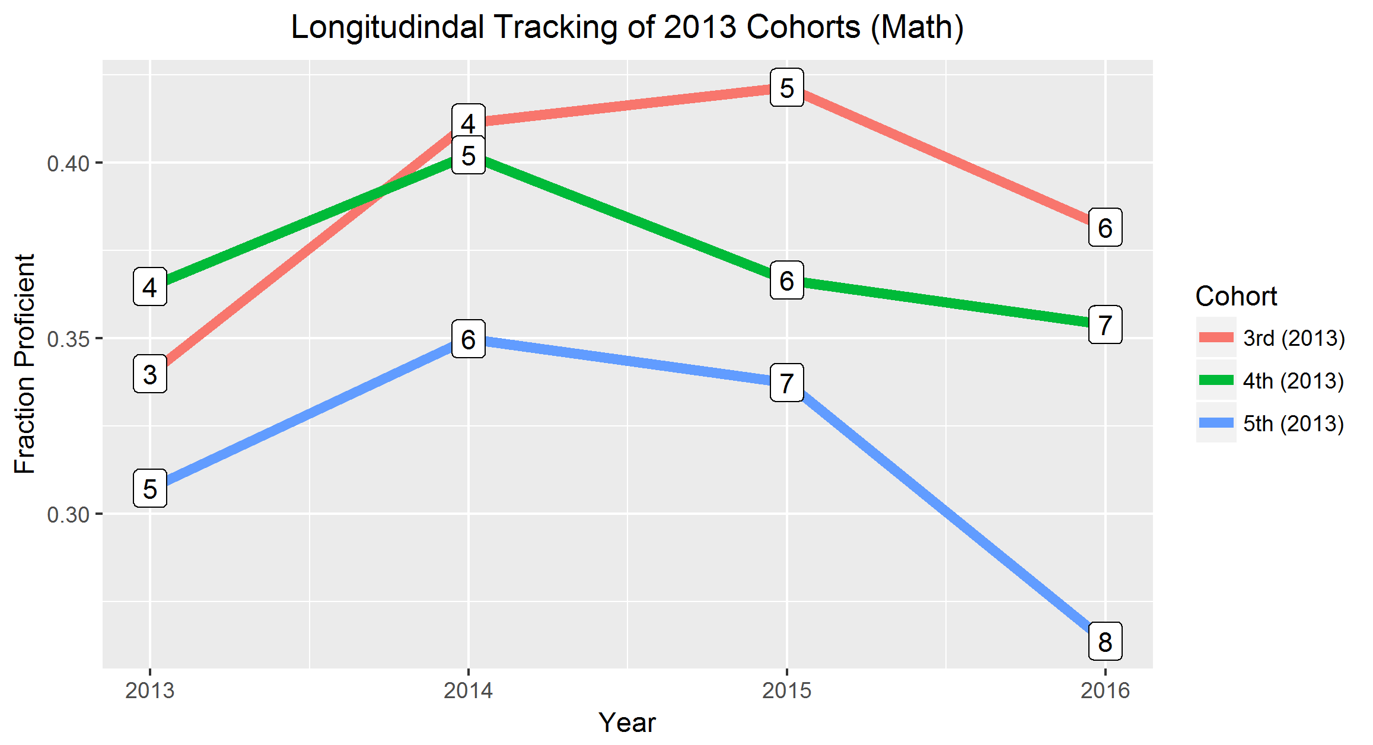
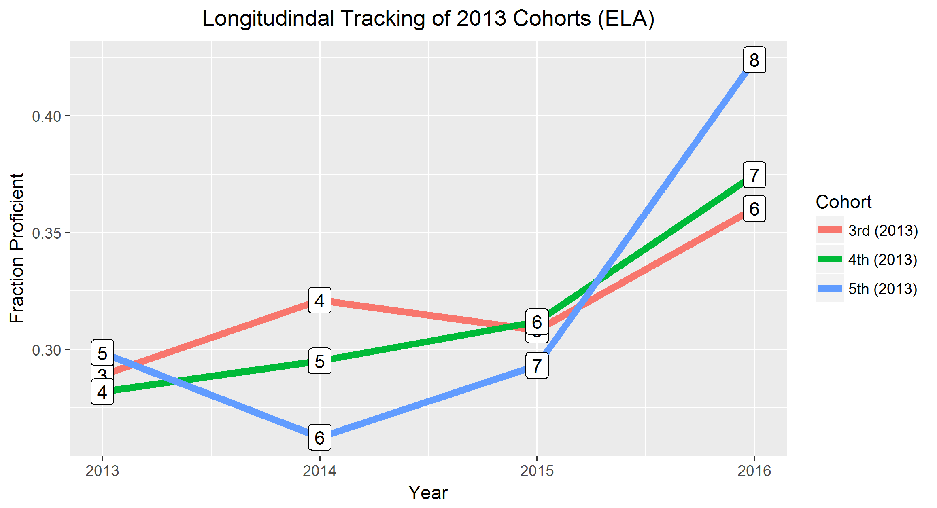
Cohorts Improve in English, but not in Math

Slide 8

Takeaways
ELA Proficiency appears to be improving within and between grade cohorts.
Math Proficiency remains problematic, especially in low-income areas.
Income demographics mean something, but not everything!

