Slide 1

What Makes A New YORK Times Bestseller?
Dr. David Letzler
NYC Data Science Academy
Notes:
NOTE:
To change the image on this slide, select the picture and delete it. Then click the Pictures icon in the placeholder to insert your own image.

Slide 2

The Paucity of Book Sales Data
Unlike with film, TV, and music, there is no high-quality measure of book sales
Nielsen’s BookScan tracks purchase-point sales, but these are a minority of total sales
Amazon’s rankings are hard to aggregate and represent less than a third of total sales

Slide 3
The New York Times Bestseller Metric
The Times bestseller lists provide accessible, consistent data through an API to allow comparisons over time
Furthermore, the lists’ prestige make them a predictor as well as reflector of sales: being a Times bestseller is a marketing boon
Caveat: they do not provide unit sales, and their methodology is opaque and not necessarily reflective of total sales

Slide 4
What Fiction Sells Best?
Initial Questions for Shiny Dashboard:
How much of the market do the “Big Five” own?
How well do their imprints do against each other in various genres and on the different lists?
Where can independent and self-published authors horn in on the hierarchy?
How much time-share do the mega-sellers take on the list?

Slide 5
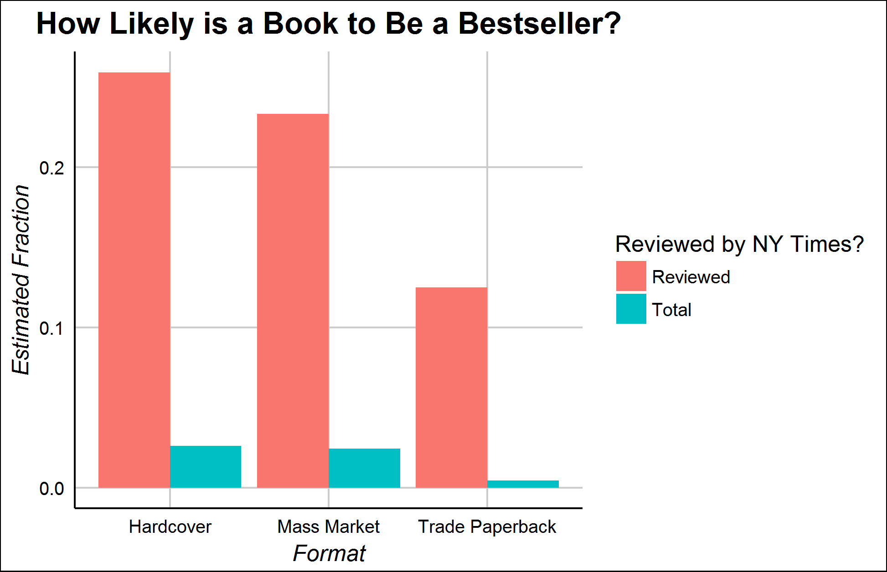
The Times Book Review Boost
The Times’ Book Review is as prestigious as its bestseller list
It reviews only ~350 of ~40,000 new fiction titles each year
Reviewed books are much likelier to be bestsellers
Causation or Correlation?

Slide 6
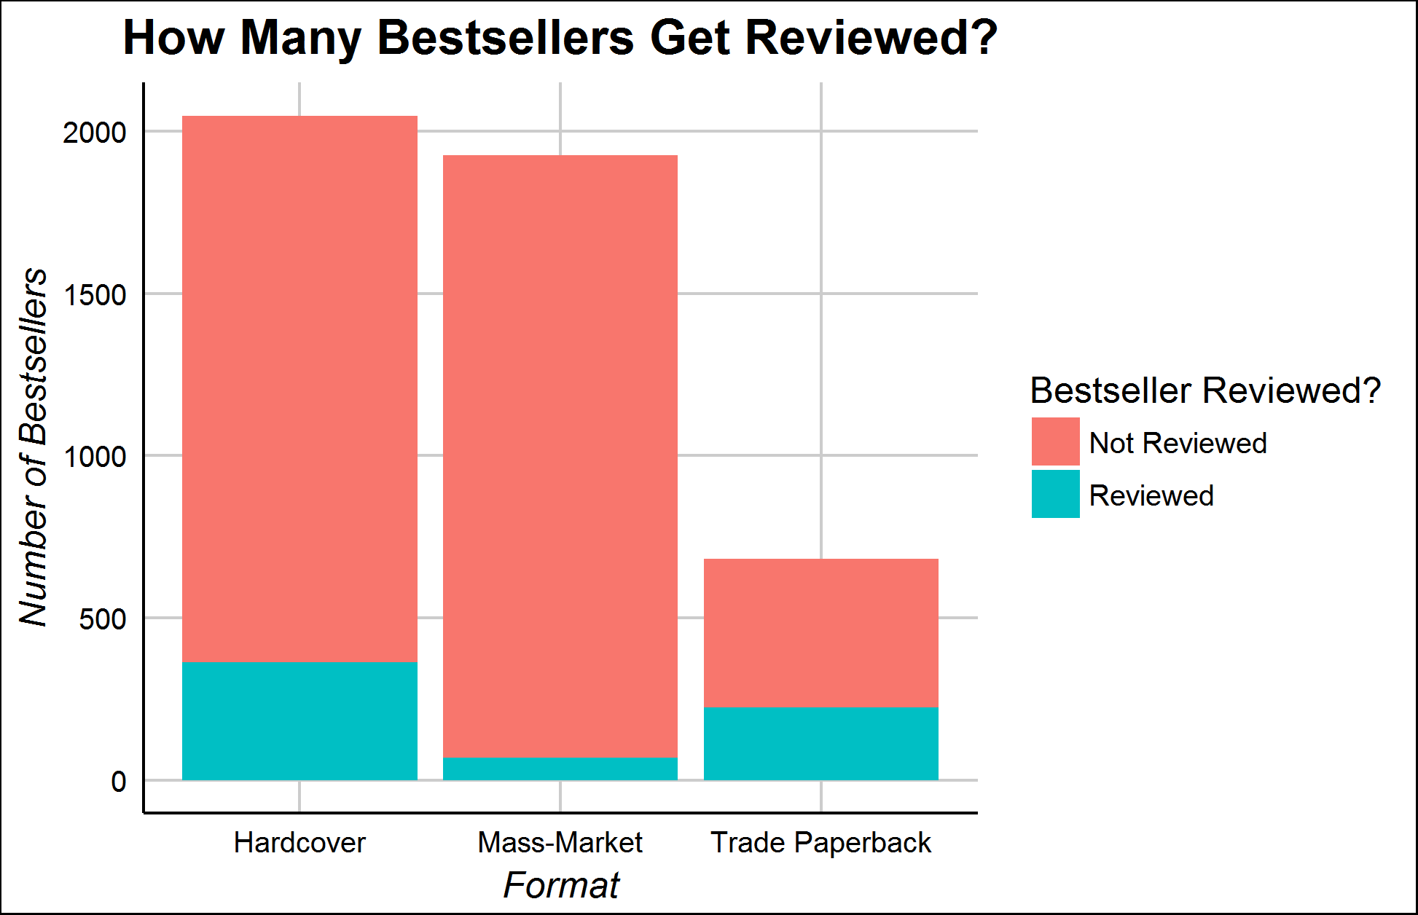
Is the NYTBR Big Enough to Matter?
Only a small fraction of bestsellers get reviewed at all
Over a third of the trade-paper list gets reviewed, but only 3% of the mass-market list does
How much does the Book Review matter?

Slide 7

The Difficulty in Classifying NYT Reviews
New York Times book reviews are designed to be read carefully rather than easily scanned
The average review is nearly 1200 words long
They do not contain “star” ratings to indicate a total judgment to those who do not want to read

Slide 8
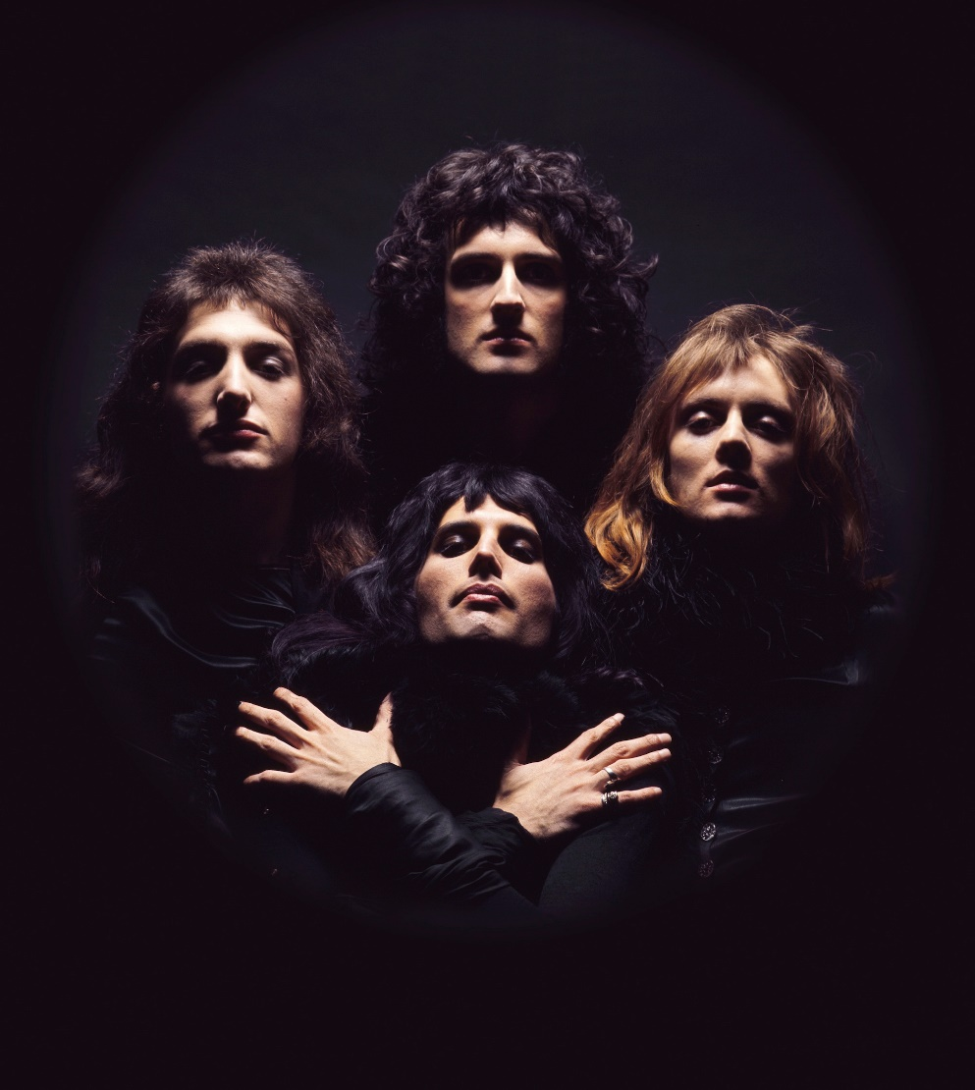
Challenge I: Distinguishing Fiction/Nonfiction
Based on API URLs, I scraped every book review from 2008-present
The API did not allow me to limit my queries to fiction only, leaving me with many nonfiction and poetry reviews
How to tell which books were about real life and which are just fantasy?

Slide 9
Topic Modeling
Topic modeling is an unsupervised Bayesian machine learning technique
It assumes that each corpus’s documents are generated from a set of “topics,” which are word frequency distributions across the whole vocabulary
It uses sampling and chain iteration (similar to tensorflow) to try to generate the topics that underlie the corpus
Topics can be interpreted in terms of their most frequent words

Slide 10
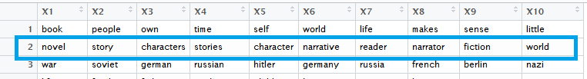
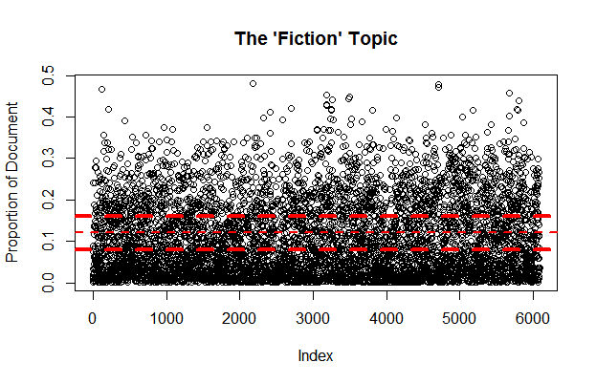
The “Fiction” Topic
I trained a 30-topic model on the set of book reviews.
As expected, one topic clearly indicated “fiction”
I used a manual decision tree to isolate the fiction reviews
Estimate ~95% accuracy

Slide 11
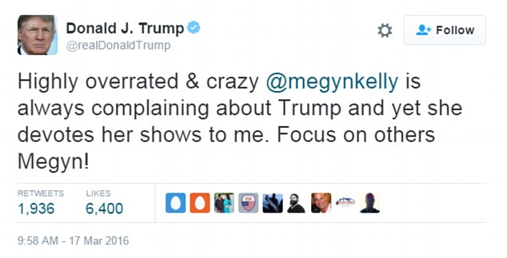
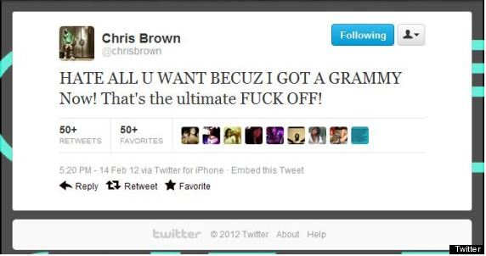
Challenge II: Book Reviews are not Tweets
Basic sentiment classifiers are designed to classify texts like tweets, which are short and not emotionally subtle
These do not require much effort to classify

Slide 12
The Problems of NYTBR Style
The Times critical style is considerably subtler
By hand annotation, I found over 75% of sentences in the book reviews do not directly judge the book
Classifiers will tend to cluster reviews based on subject matter rather than critical judgment
Sentiment classifiers will frequently pick up on language not intended to directly judge the book…

Slide 13
An Example—Toni Morrison’s Home
[…] Threaded through the story are reminders of our country's vicious inhospitality toward some of its own. On his way south, Frank makes use of a Green Book, part of the essential series of travelers' guides for African-Americans during a more overtly racist era. On a train, he encounters fellow passengers who've been beaten and bloodied simply for trying to buy coffee from a white establishment. He meets a boy who, out playing with a cap gun, was shot by a policeman and lost the use of one arm.—Michiko Kakutani
Sentiment Grade by David Letzler (Ph.D. in English): Positive
Sentiment Grade by Syuzhet (designed by Matt Jockers, ipse): -15.5!

Slide 14
Idea I: Filtering to Author/Book Comments
If we are looking for judgment of the quality of the author or book, rather than discussion of the plot, we could filter only to sentences that mention author/book title.
The Kakutani review is now reduced to sentences more like:
This haunting, slender novel is a kind of tiny Rosetta Stone to Toni Morrison's entire oeuvre.
Syuzhet Score: -1.97 (and the review is more negative later)

Slide 15
Good, But Not Quite There
Classification accuracy improved to about 66%
The sentiment scores were still not very good at some comments. For example, take this comment about Nora Roberts’ books—
So it would be an understatement to say that Nora Roberts deals in feminine wish fulfillment, especially when David turns out to be the kind of man who is excited by making the perfect jewelry purchase for his beloved, when he has teenage children who won't really mind a stepmom, and when he also turns out to be a stern corporate boss ready to upbraid Pilar's ex-husband on the job. Even when David is injured during one of the occasional moments of light mayhem in ''The Villa,'' he remains the romance reader's idea of a perfect 10.—Janet Maslin
Syuzhet Score: +7.1 Letzler Score: Arch Shade-Throwing

Slide 16
Idea II: Word2Vec-CNN
I trained a convolution neural network based on a Word2Vec to recognize the patterns of critical language
I hand-coded two thousand sentences from 50 reviews as “positive,” “negative,” or “neutral”
Used Word2Vec instead of Doc2Vec to isolate critical sentences and prevent algorithm from grouping based on book content
Inspected models/parameters by looking at a set of critical words (e.g., “authentic,” “lazy,” “chilling,” etc.) to make sure it was grouping them correctly
Trained/tested Word2Vec in CNN on labeled set—81% accuracy

Slide 17
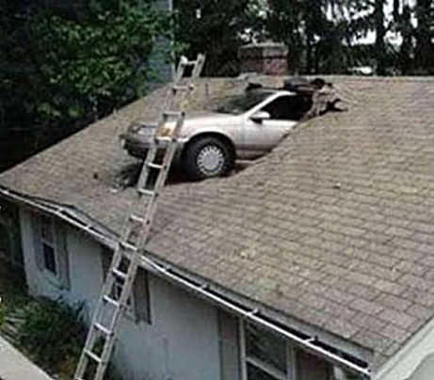
It Did Not Work At All
The predictions on unlabeled sentences did not yield strong results
Using every sentence yielded predictions that appeared nearly random
Predictions that used only sentences that mentioned the author/book performed better, but not over 60%

Slide 18

Consolation Prize
As it was my best available model, I used sentiment on author/book sentences only to evaluate reviews
I decided to look solely at the Trade Paperback list, since it had the highest percentage of reviewed books and the best response to the sentiment scoring

Slide 19
Results?
The average bestseller did have a higher mean review score than the average reviewed book, at 0.97 to 0.87—but a t-test did not find this difference significant
A similar result holds for Sunday bestseller reviews versus regular bestseller reviews—the mean Sunday score is more generous (1.14 to 0.7), but not at the level of significance
There is a significant difference in review length, as bestseller reviews are five sentences longer on average

