Slide 1
SDR update - July 2023
Meibin Chen and Tak Igusa
Johns Hopkins University

Slide 2
REVIEW OF ORIGINAL MODEL
L5
L5
L5
Mothers with complications
Mothers with complications
Mothers with complications
L4
L4
L4
L2/L3
L2/L3
L2/L3
Transferred mothers
Transferred mothers
Home
Home
Home
1. Mothers’ initial choice of delivery
2. Subset of mothers with complications
3. Mothers with complications transferred
4. Health outcomes for all mothers

Slide 3
REVIEW OF ORIGINAL MODEL
The model models four components of the maternal care continuum in Kakamega County, Kenya:
Choice of delivery facility
Maternal complications
Transfer of mothers with complications
Maternal mortality
Several parameters were required in the model, but not in the recorded data:
Proportion of low and high complications
Proportion of transferred and not transferred complications given severity
Mortality rates at facility levels
The effect of transfers on mortality rates
These parameters were calibrated by matching the recorded rates below with the rates determined by the model
Delivery at facility levels
Complications at facility levels
Mortality rates at facility levels

Slide 4
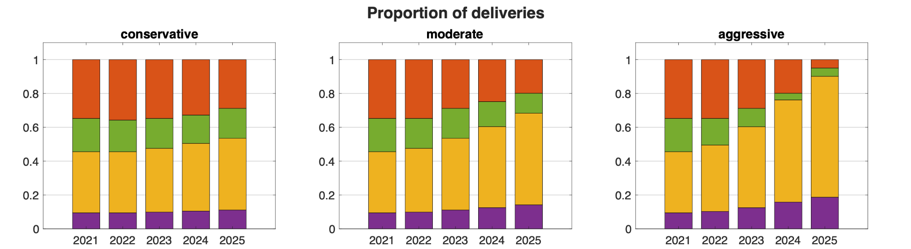
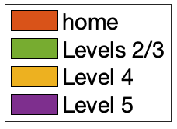
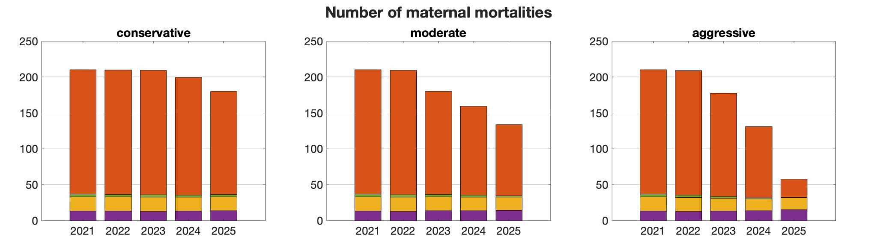
Scenario Outputs: Distribution of Deliveries and Maternal Mortalities [1,2]

Slide 5
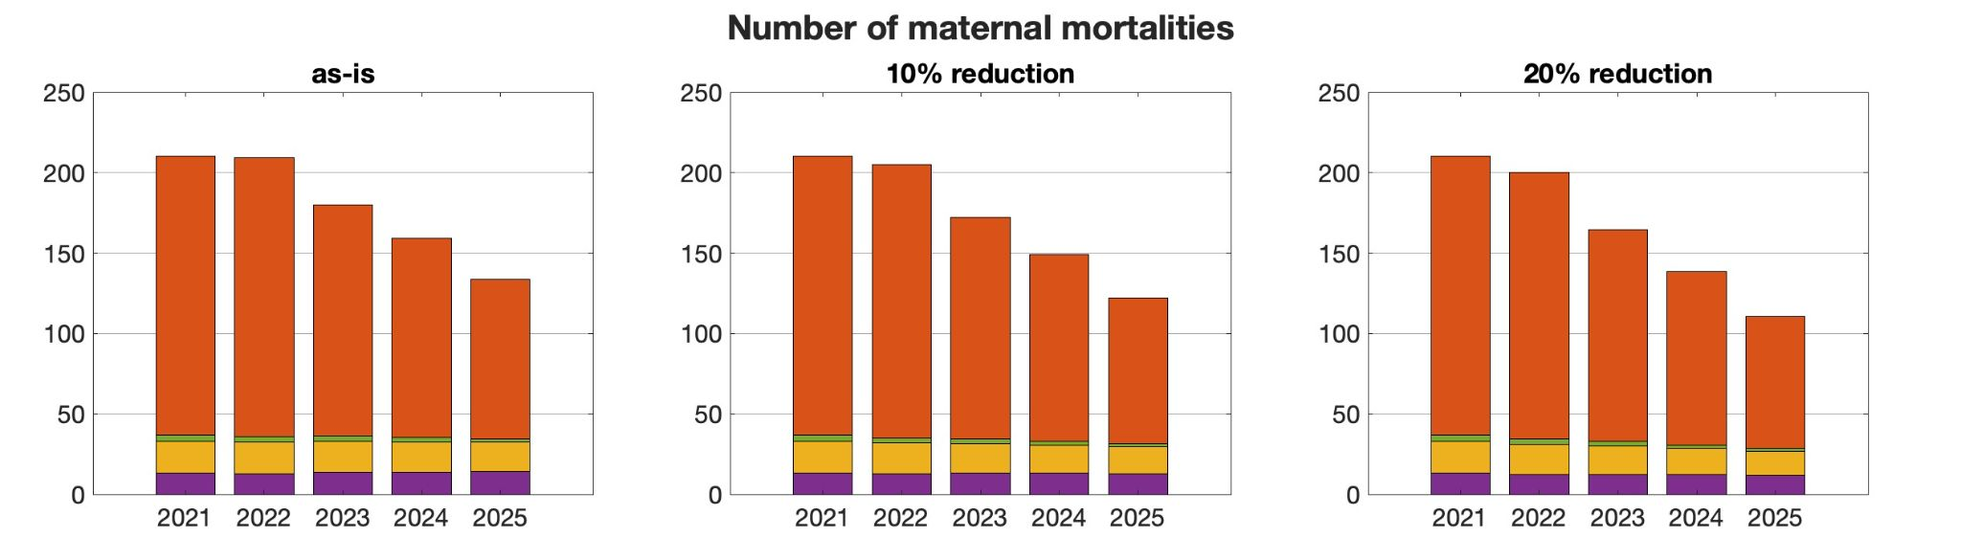
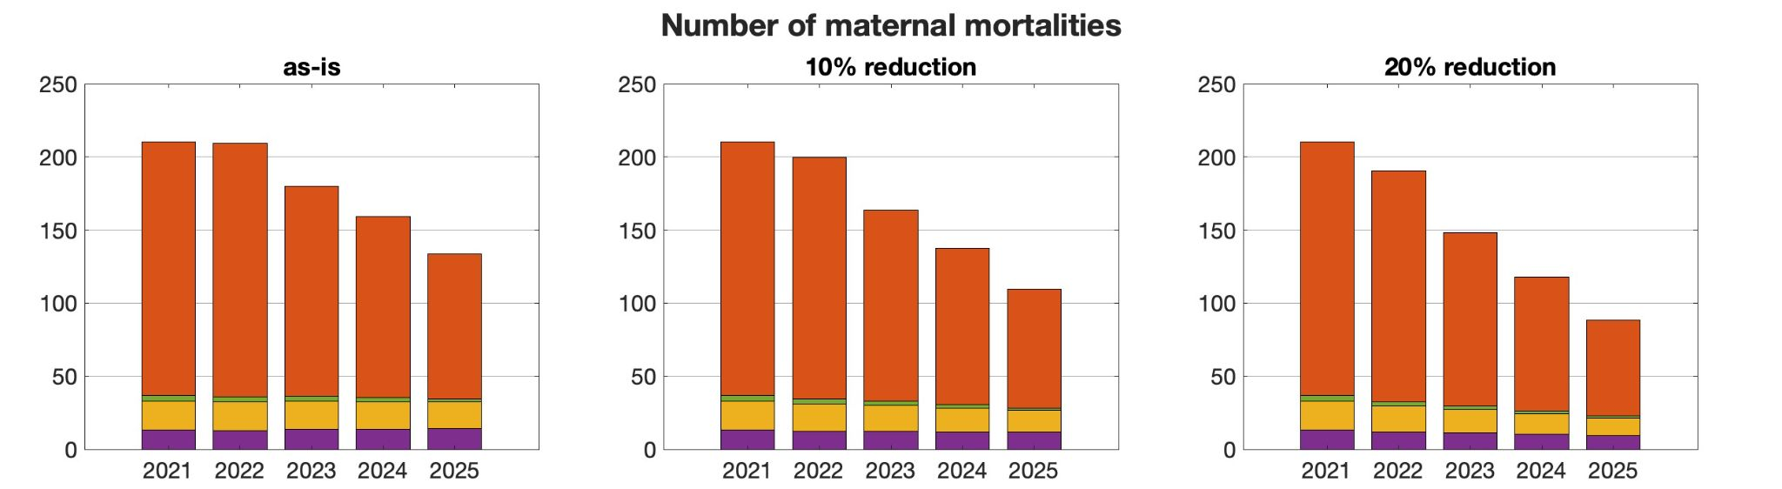
Scenario Outputs: Moderate SDR with Reduced Complications Due to Increased ANC Visits vs. Mortalities for Moderate SDR with Increased ANC Visits and SDR Impacts on Health Services Quality [1,2,3 vs. 1,2,3,4]
No SDR + ANC effect
SDR + ANC effect

Slide 6
Scenario Outputs: Cost of Sustaining SDR for each DALY Averted in Kakamega County, Kenya [5]
Scenario | DALYs averted | Cost per DALYs averted
 | Maternal mortalities and near-misses | KSh | USD
conservative | 10,103 | KSh 190,000 | $1541
moderate | 25,616 | KSh 80,000 | $645
aggressive | 51,112 | KSh 45,000 | $367

Slide 7


Choosing a better model: a linear programming and agent-based model
An agent-based model for SDR
Considers the characteristics of each individual mother for decisions
Does not consider changing community effect, for example, over-capacity at a facility over time
A linear programming-based model for SDR
Optimizes the community–wide objective function and fits the data using constraints
Is incomplete in its use of individual mothers’ preferences
The facility-seeking scenario in Kakamega requires consideration of both the decision-making based on individual preferences and constraints and the aggregated effect of individual decisions on the community and care environment

Slide 8




OVERVIEW OF ABM and LP Model: Part 1 Calibration
Mother goes to antenatal care facility, where she is assessed for pregnancy risk.
Mother goes from antenatal care facility to her intended delivery facility.
Mother possibly develops complication during delivery
Mother is possibly transferred.
Mother’s transfer location is determined.
Mortality rates at facilities is determined.
5. New delivery facility
4. Referral
Health outcomes at facility
Pregnant mother
1. ANC facility
2. Initial delivery facility
3. Complication
Original delivery facility

Slide 9
STEP 1 OF ABM
Mother is assigned risk level to ANC facility according to the following distribution:
[0.33, 0.26, 0.41] → [0,1,2] where 0 = low risk, 1 = medium risk, 2 = high risk (1)
0
Low risk
0.33
0.26
1
Medium risk
0.41
2
High risk
https://bmjopen.bmj.com/content/12/1/e050670 Kenya

Slide 10
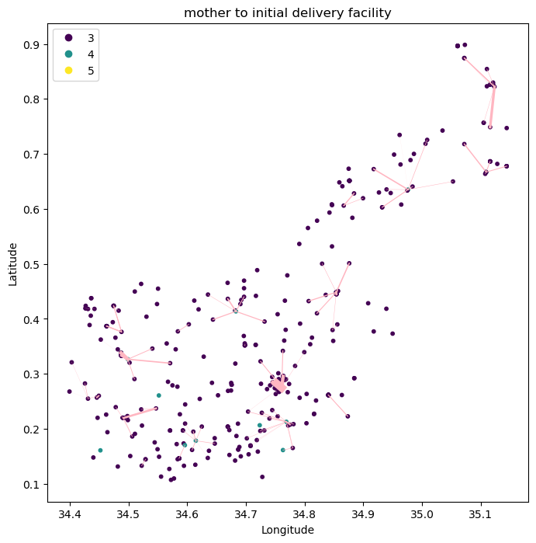
STEP 2 OF ABM
Mother is distributed from antenatal care facility to delivery facility with consideration for the following factors:
Distance to facility
Mother’s risk level and level of the facility
Capacity of the facility for EmONC (C-sections conducted)

Slide 11
STEP 3 OF ABM
3. Mother possibly develops complication from risk level according to the following distribution:
[0,1,2] → [0,0.02,0.07] → [0,1,2] where 0 = no complication, 1 = low complication, 2 = high complication
(low risk to complication : high risk to complication ~ 1:3 (2), 0.26*n + 0.41*3n = 0.035 (from data) n = 0.0235, 3n = 0.07, [0,1,2] → [0,n,3n] → [0,0.02,0.07] → [0,1,2]
Low risk
Med. risk
High risk
0
1
2
1
0.02
0.07
0
1
2
No comp.
Low comp.
High comp.
(2) https://www.ncbi.nlm.nih.gov/pmc/articles/PMC4728153/ U.S. ratio of low to high for eclampsia and uterine rupture is approximately 1:3

Slide 12
ABM Step 4
4. Mother is possibly transferred given complication level
Home -> L4/L5
L2/3 -> L4/L5
No comp.
0
No comp.
0
0
No transfer
0
No transfer
Low comp.
1
Low comp.
1
0.16
0.5
1
Transferred
1
Transferred
2
0.31
2
1
High comp.
High comp.
L4 -> L5
No comp.
0
0
No transfer
Low comp.
1
0.21
1
Transferred
2
0.41
High comp.

Slide 13
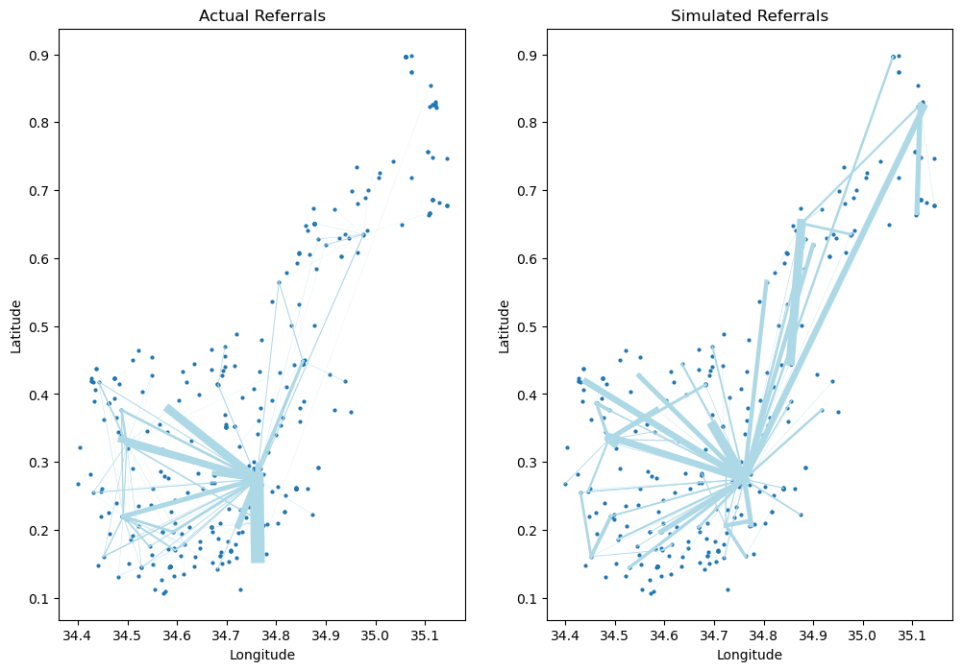
ABM Step 5
5. Mother, if referred, goes to the nearest L4 facility with EmONC capabilities or the L5 facility
Actual referrals is referral data from one referral company, Rescue.co
Simulated referrals is generalized to represent all referrals.

Slide 14
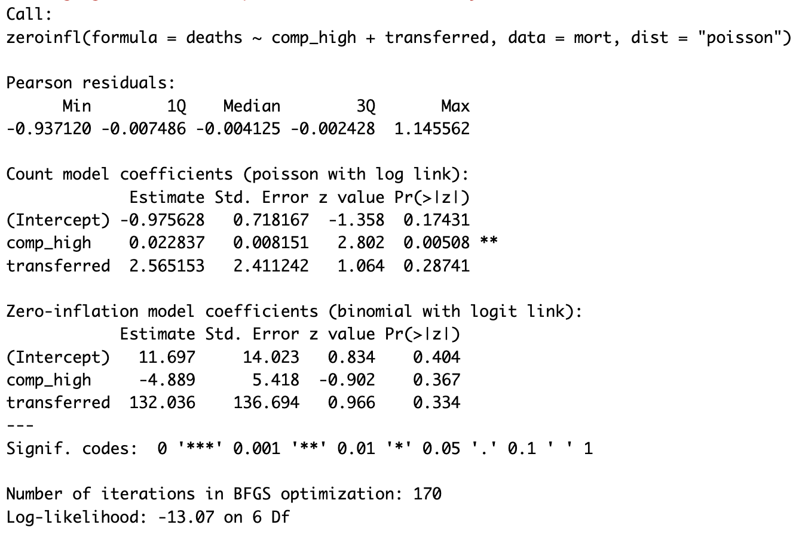
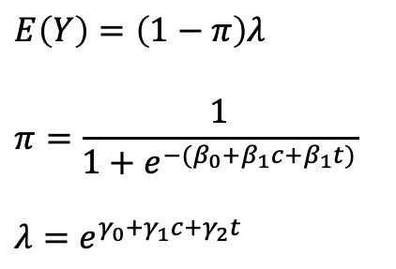
STEP 6 OF ABM
6. Mortality rates at facilities is determined using a zero-inflated Poisson model fit to the original mortality counts at the facility level.
The zero-inflated Poisson regression model includes two parts: a binary component that models the probability of observing a zero versus a non-zero value, and a Poisson component that models the count data for non-zero values.
$E\left(Y\right)=\left(1−π\right)λ$
$$π=\frac{1}{1+e^{−(β_{0}+β_{1}c+β_{1}t)}}$$
$$λ=e^{γ_{0}+γ_{1}c+γ_{2}t}$$

Slide 15
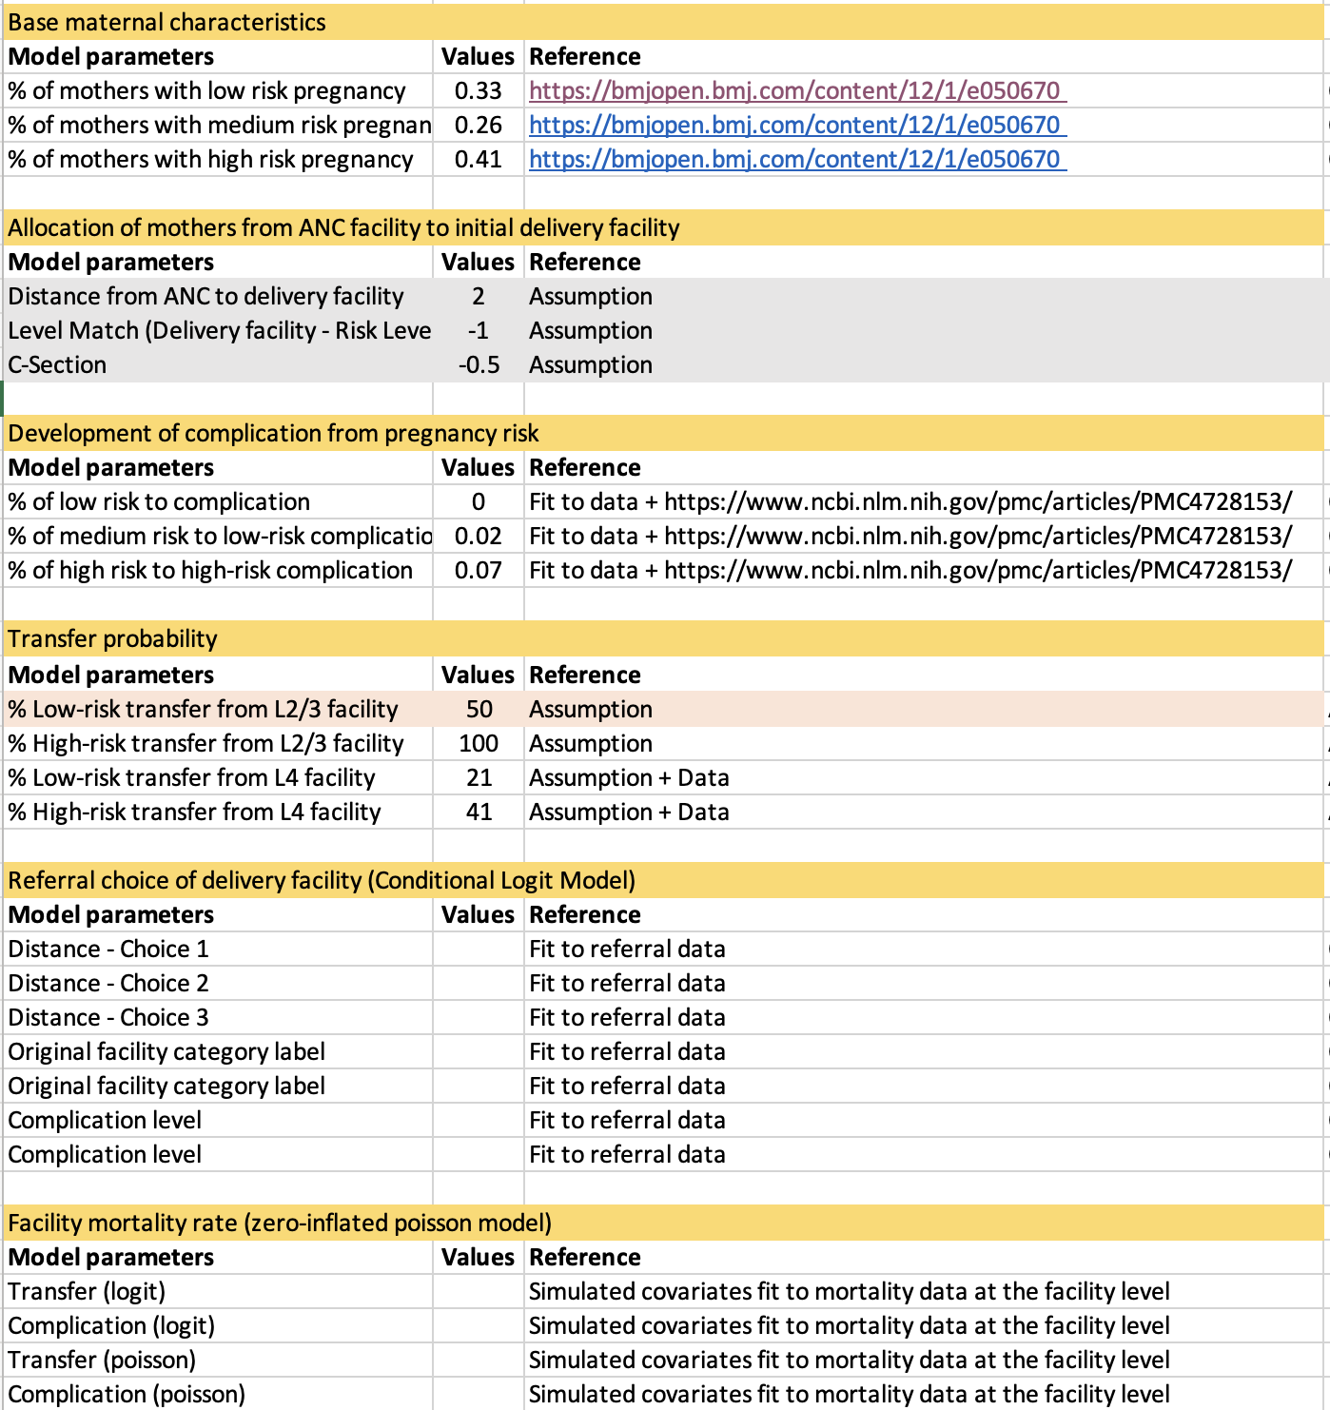
OVERVIEW OF MODEL PARAMETERS

Slide 16
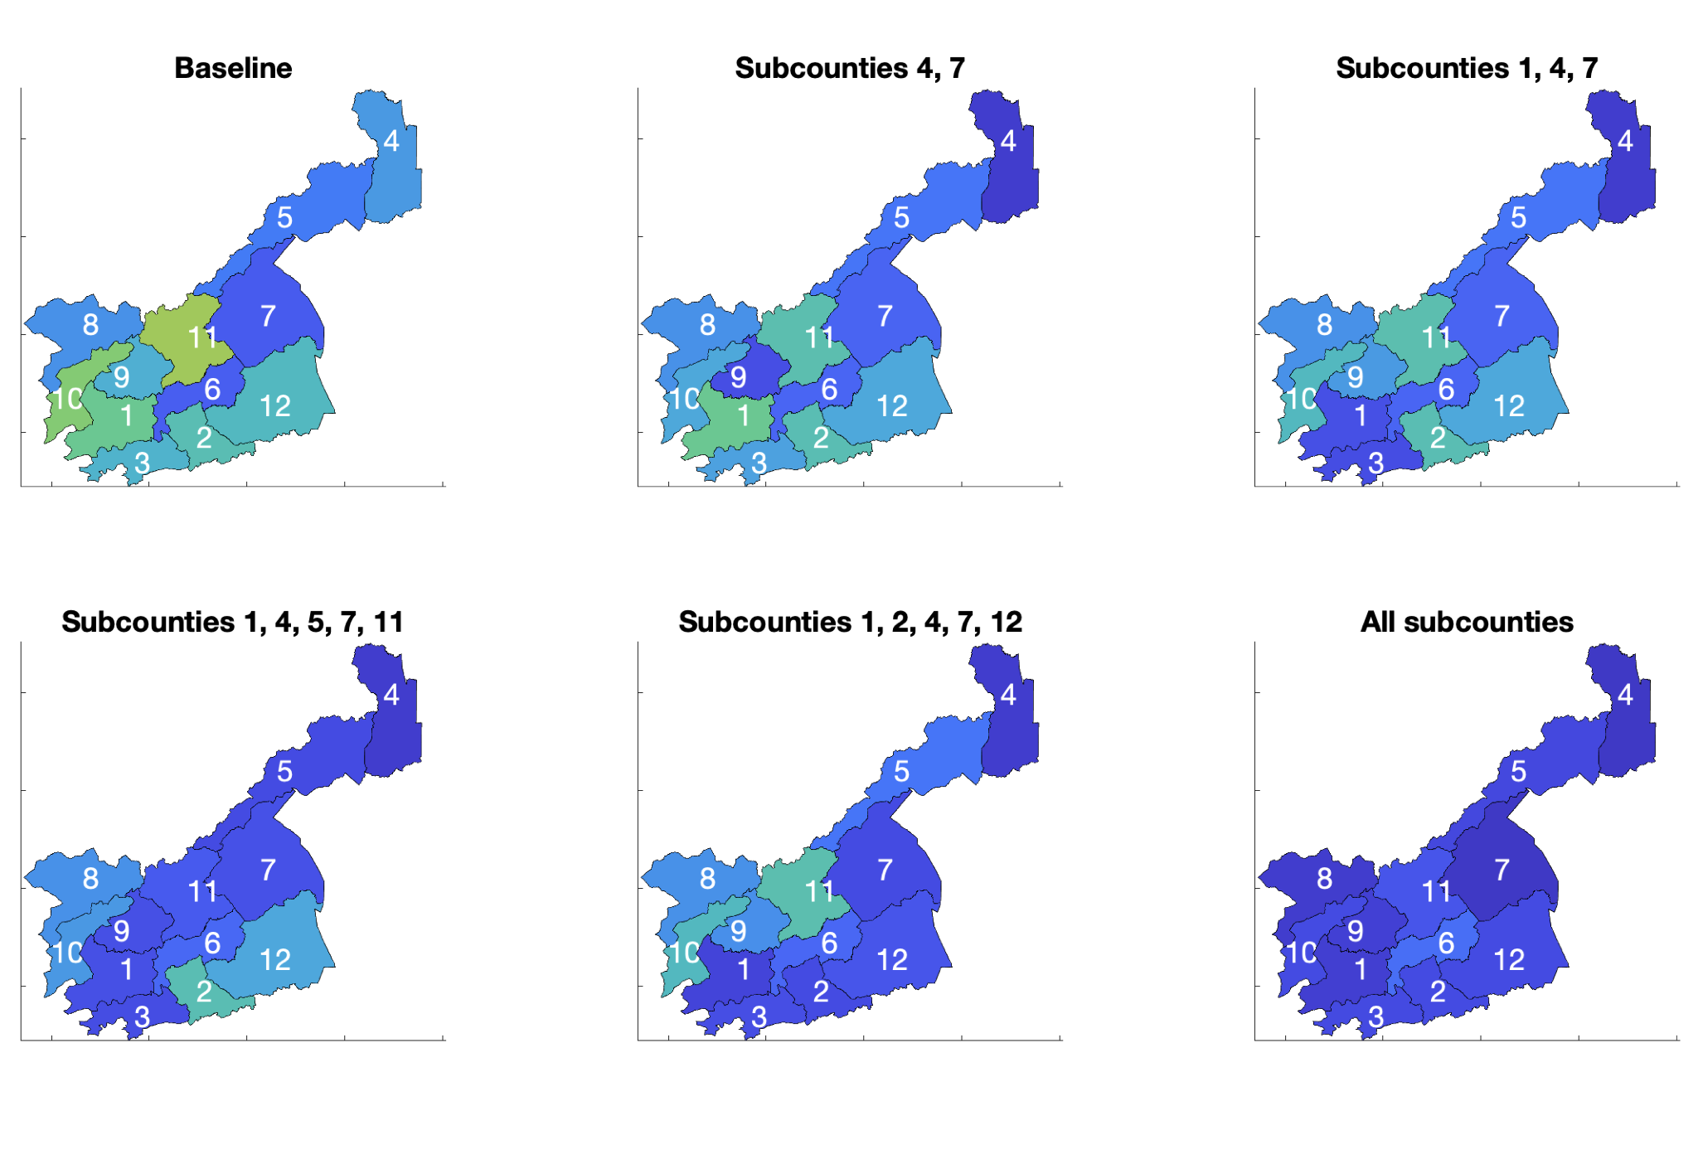
OVERVIEW OF ABM AND LP Model - Part 2: Simulation of scenarios and results
Baseline
MMR = 0.316%
Subcounties 4,7
MMR = 0.252%
Subcounties 1,4,7
MMR = 0.230%
Effect of shift of deliveries from L2/3 to L4 and a 25% increase of capacity on MMR.
Baseline to full deployment
Subcounties 1,4,5,7,11
MMR = 0.175%
Subcounties 1,2,4,7,12
MMR = 0.189%
All subcounties
MMR = 0.0.857%
Subcounty MMR color scale

Slide 17
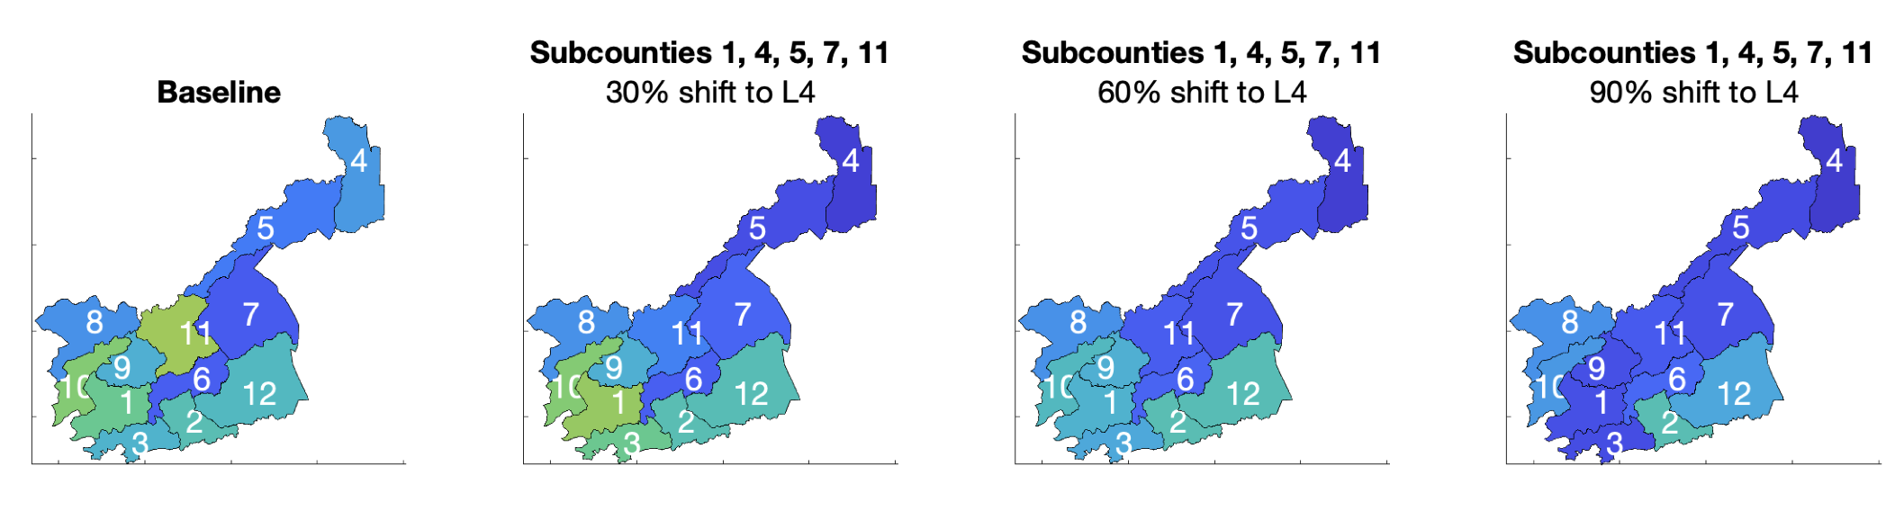
OVERVIEW OF ABM AND LP Model - Part 2: Simulation of scenarios and results
Effect of extent of shift of deliveries to L4 facilities on MMR of all mothers, including mothers delivering at home
Deployment in subcounties 1, 4, 5, 7, and 11
Baseline
MMR = 0.316%
30% shift from L2/3 to L4
MMR = 0.280%
60% shift from L2/3 to L4
MMR = 0.237%
90% shift from L2/3 to L4
MMR = 0.175%
Subcounty MMR color scale

Slide 18
OVERVIEW OF ABM AND LP Model - Part 2: Simulation of scenarios and results
Effect of extent of shift of deliveries to L4 facilities on Facility MMR.
Deployment in subcounties 1, 4, 5, 7, and 11
Baseline
Facility MMR = 0.0395%
30% shift from L2/3 to L4
Facility MMR = 0.0410%
60% shift from L2/3 to L4
Facility MMR = 0.0443%
90% shift from L2/3 to L4
Facility MMR = 0.0493%
Subcounty Facility MMR color scale

Slide 19
OVERVIEW OF ABM AND LP Model - Part 2: Simulation of scenarios and results

Slide 20
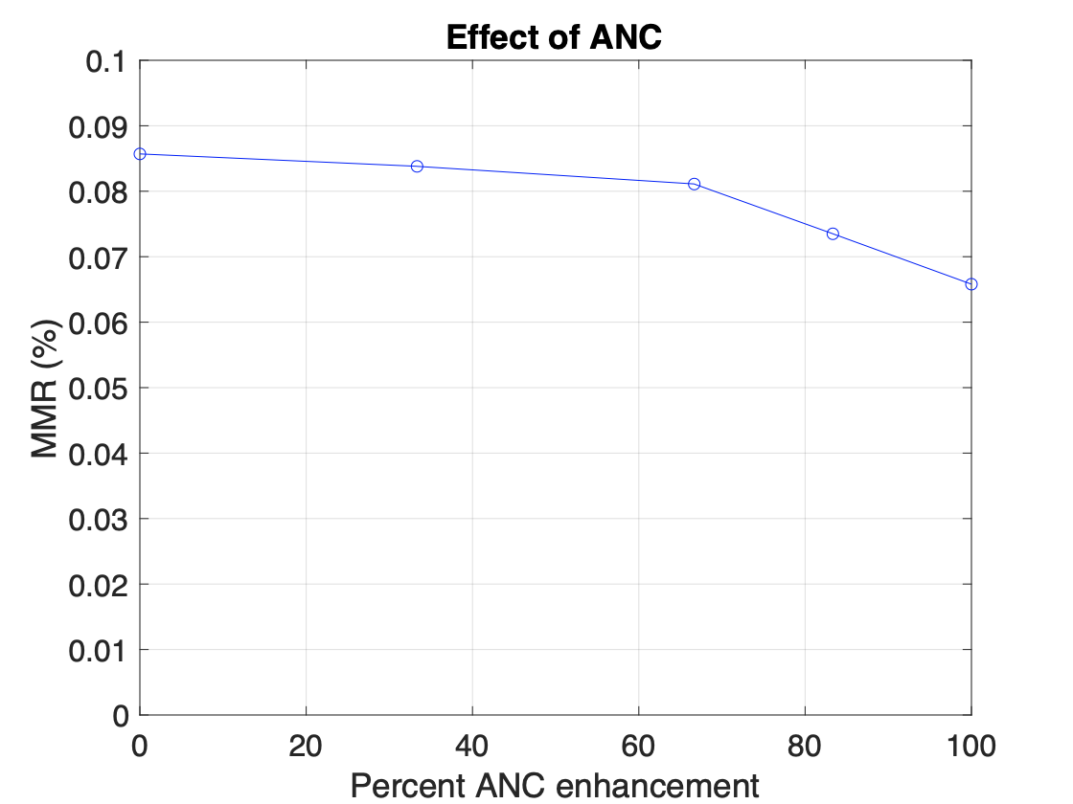
OVERVIEW OF ABM AND LP Model - Part 2: Simulation of scenarios
Effect of level of ANC services on MMR
100% ANC enhancement corresponds to the level of service reported in an RCT in Zimabwe (Lancet, 1996)
Risk ratio = 0.78

Slide 21
REVIEW OF ABM and LP Model
We simulate the effects of shift of deliveries to higher level facilities, increase of facility capacity, and effect of quality ANC on maternal mortality rates through pathways of mothers in the care continuum:
Initial choice of delivery facility
Complication development
Potential transfer
Transfer facility
Health outcome

Slide 22
Looking forward to the Kakamega Trip
Face validity of the current model with experts and community members in Kakamega
Build context that may not be easily observable in the data
Gain greater insight into behaviors of the mothers that can help refine the model

Slide 23
OVERVIEW OF ABM - Part 2: Simulation of scenarios
1. Trends in maternal mortality without intervention
2. Distribution of deliveries at different facility levels
3. Effects of ANC visits
4. Effects of SDR on healthcare quality
5. DALY calculations

Slide 24
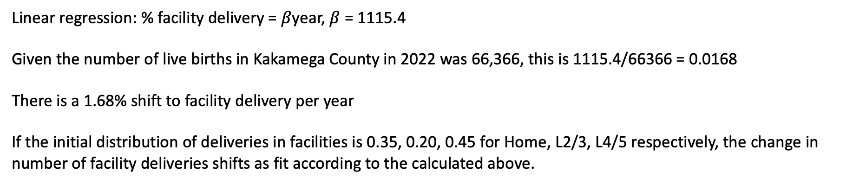
OVERVIEW OF ABM - Part 2: Simulation of scenarios
1. Trends in maternal mortality without intervention
We assume the natural decrease in maternal mortality over time is due to the shift to facility deliveries over time without intervention.
2. Distribution of deliveries at different facility levels
3. Effects of ANC visits
4. Effects of SDR on healthcare quality
5. DALY calculations
According to the Kenya MOH: # of facility births over time
2014 | 2015 | 2016 | 2017 | 2018 | 2019
38732 | 42717 | 43563 | 38334 | 45348 | 46007
Linear regression: % facility delivery = $β$year, $β$ = 1115.4
Given the number of live births in Kakamega County in 2022 was 66,366, this is 1115.4/66366 = 0.0168
There is a 1.68% shift to facility delivery per year
If the initial distribution of deliveries in facilities is 0.35, 0.20, 0.45 for Home, L2/3, L4/5 respectively, the change in number of facility deliveries shifts as fit according to the calculated above.

Slide 25
OVERVIEW OF ABM - Part 2: Simulation of scenarios
1. Trends in maternal mortality without intervention
We consider the following scenarios for shifts in deliveries.
2. Distribution of deliveries at different facility levels
2021 2022 2023 2024 2025
3. Effects of ANC visits
Percent births | Conservative
% of births at home | 0.35 | 0.35 | 0.35 | 0.33 | 0.30
% of births at L2/L3 facilities | 0.20 | 0.19 | 0.18 | 0.17 | 0.18
% of births at L4/L5 facilities | 0.45 | 0.45 | 0.47 | 0.50 | 0.53
4. Effects of SDR on healthcare quality
5. DALY calculations
Percent births | Moderate
% of births at home | 0.35 | 0.35 | 0.30 | 0.25 | 0.20
% of births at L2/L3 facilities | 0.20 | 0.18 | 0.18 | 0.15 | 0.12
% of births at L4/L5 facilities | 0.45 | 0.47 | 0.53 | 0.60 | 0.68
Percent births | Aggressive
% of births at home | 0.35 | 0.35 | 0.30 | 0.20 | 0.05
% of births at L2/L3 facilities | 0.20 | 0.16 | 0.11 | 0.04 | 0.05
% of births at L4/L5 facilities | 0.45 | 0.49 | 0.60 | 0.76 | 0.90

Slide 26
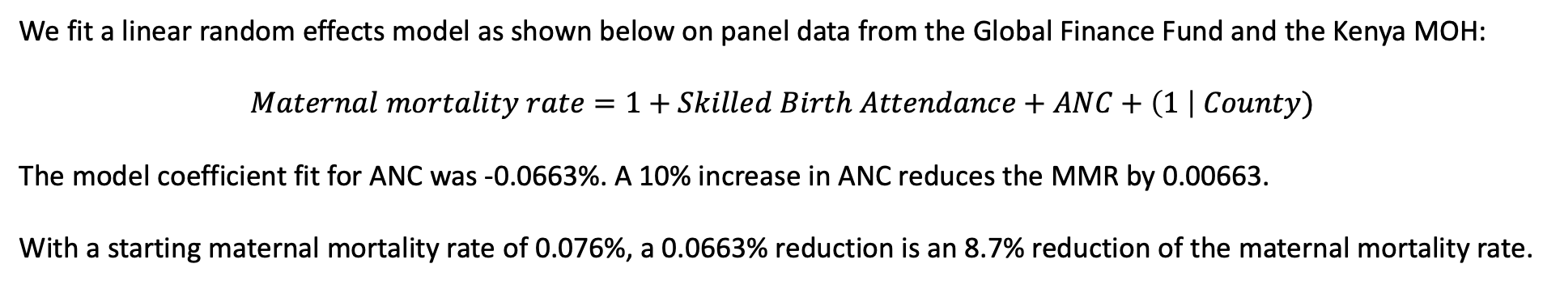
OVERVIEW OF ABM - Part 2: Simulation of scenarios
1. Trends in maternal mortality without intervention
We assume ANC reduces complications, so the calculated below is incorporated into the model as a reduction of complications by 8.7%.
2. Distribution of deliveries at different facility levels
3. Effects of ANC visits
4. Effects of SDR on healthcare quality
5. DALY calculations
We fit a linear random effects model as shown below on panel data from the Global Finance Fund and the Kenya MOH:
$$Maternal mortality rate=1+Skilled Birth Attendance+ANC+\left(1 \right| County)$$
The model coefficient fit for ANC was -0.0663%. A 10% increase in ANC reduces the MMR by 0.00663.
With a starting maternal mortality rate of 0.076%, a 0.0663% reduction is an 8.7% reduction of the maternal mortality rate.

Slide 27
OVERVIEW OF ABM - Part 2: Simulation of scenarios
1. Trends in maternal mortality without intervention
No current data on effects of SDR on healthcare quality, so assumption is that SDR reduces maternal mortality directly.
2. Distribution of deliveries at different facility levels
3. Effects of ANC visits
4. Effects of SDR on healthcare quality
5. DALY calculations

Slide 28
OVERVIEW OF ABM - Part 2: Simulation of scenarios
1. Trends in maternal mortality without intervention
2. Distribution of deliveries at different facility levels
3. Effects of ANC visits
4. Effects of SDR on healthcare quality
5. DALY calculations
DALY averted =
66 for maternal mortalities
21.77 for maternal near miss
Frequency of maternal near miss to maternal mortalities: 12.35:1
If 76.5 additional lives were saved because of a shift in deliveries according to the moderate scenario, 76.5*66 + 76.5*12.35*21.77 = 25,616 DALY averted

Slide 29
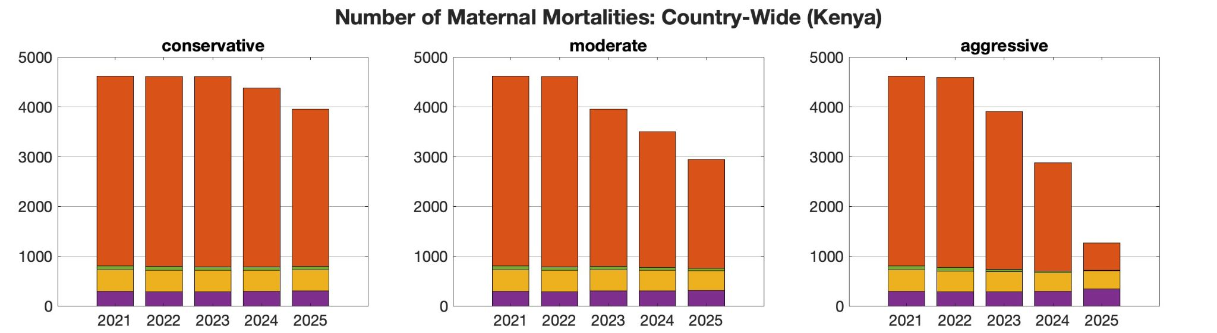
Scenario Outputs: Distribution of Deliveries and Maternal Mortalities, Extension to National Scale [1,2]

Slide 30
Scenario Outputs: Moderate SDR with Reduced Complications Due to Increased ANC Visits vs. Mortalities for Moderate SDR with Increased ANC Visits and SDR Impacts on Health Services Quality [1,2,3 vs. 1,2,3,4]
No SDR + ANC effect
SDR + ANC effect

Slide 31
REVIEW OF ABM PART 2
We consider 4 scenarios and present the effects of the scenarios through our model using 2 outcome measures
Four scenarios:
Trends in maternal mortality without intervention
Changes in the distribution of deliveries at different facility levels
Changes in ANC behavior on reducing complications
Changes in healthcare quality because of SDR
Two outcome measures:
Maternal mortalities
Disability-adjusted life years averted

