Slide 1
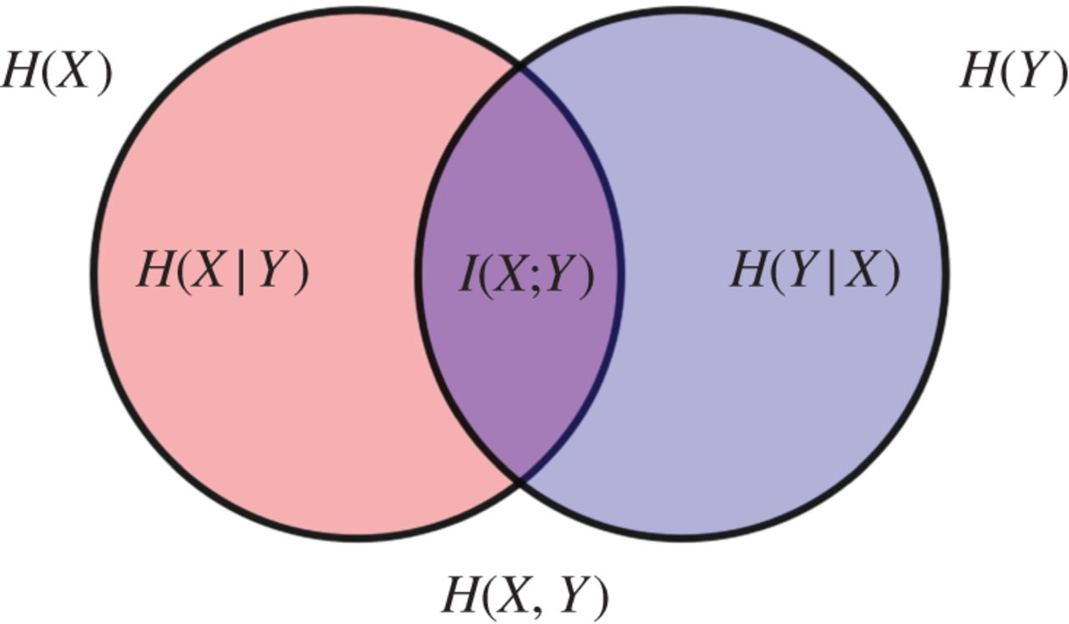
Discover Correlations among Spatio-temporal Data Sets
8 datasets: over 100GB
Large data processing: Spark
Data cleaning: missing values
Temporal and spatial resolutions
Correlation metrics: Mutual information
Tingyan Xiang
Lu Yin
Shenghui Zhou

Slide 2
Architecture
Collect Data
Collect and store raw data sets on HFS
Output well structured tables with keys and values in the same format
Aggregate on keys
Aggregation on keys such as average, sum and max
Correlation Computation
Pre-process Data using Spark
(year, month, day, hour, zip)
Pairwise correlation among attributes

Slide 3

Grid Search
Point in polygon problem:
Polygons of corresponding district
Point (longitude, latitude)
Speed up through grid searching:
the number of grids
memory
speed

Slide 4

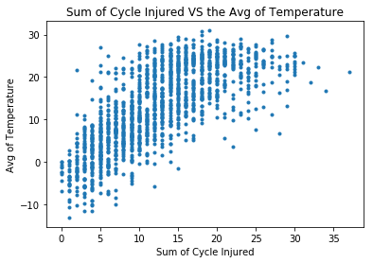
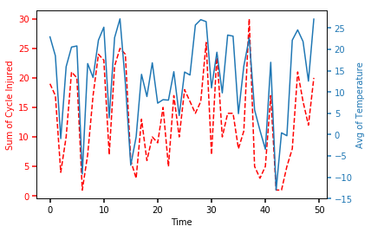
Weather Vs Collision
Positive correlation between temperature and the number of bicycle injury
Hypothesis: Higher Temperature More Bicycle Rider Injury?
Average Temperature vs Number of Bicycle Rider Injury : 0.8056

Slide 5




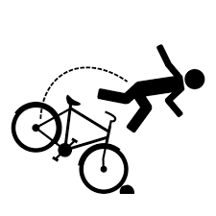

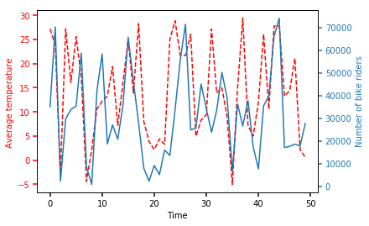
Weather, CitiBike, Collision
Average Temperature vs Number of Bicycle Riders: 1.1537
Number of Bicycle Riders vs Number of Bicycle Rider Injury: 0.8622

Slide 6
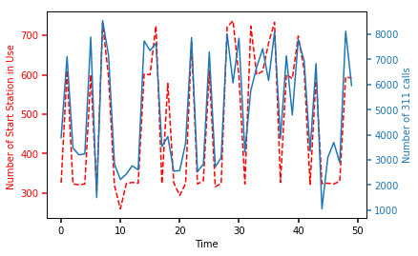
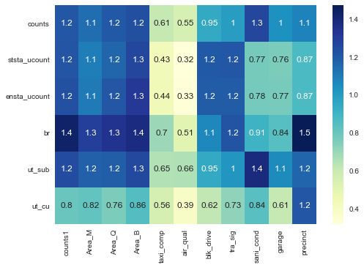
CitiBike Vs 311
There are many positive correlated pairs between CitiBike Data and 311 Data
Number of Start Station in Use vs Number of 311 Calls : 1.2168

Slide 7
Comparison between MI and Pearson Correlation
 | Mutual Information | Pearson Correlation
Pros: | Categorical, Non-linear, Sparse data | Directions, Quantify, Interpretability, Scale from -1 to 1
Cons: | No direction, Binning Comparison | linear assumption

Slide 8
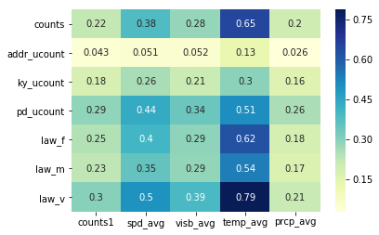
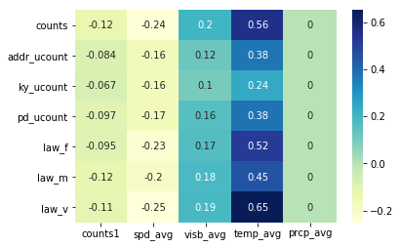
MI and Pearson Correlation
Heat map of mutual information
Heat map of correlation
 | Pearson | MI(bin =10) | MI(bin = 30) | MI(bin = 60)
Pair 1 | -0.1239 | 0.0520 | 0.2223 | 0.4972
Pair 2 | 0.6508 | 0.4322 | 0.7872 | 1.5353
|Pair1/Pair2| | 5.2526 | 8.3115 | 3.5413 | 3.0879

Slide 9
Takeaways and What we learnt
Different aggregation functions such as Average, Frequency Count, Max are suitable for different variables.
Detailed granular data points can be noisy and are not necessary useful. For example keys with hour or even minute are too small to see the underlying correlation.

