Slide 1
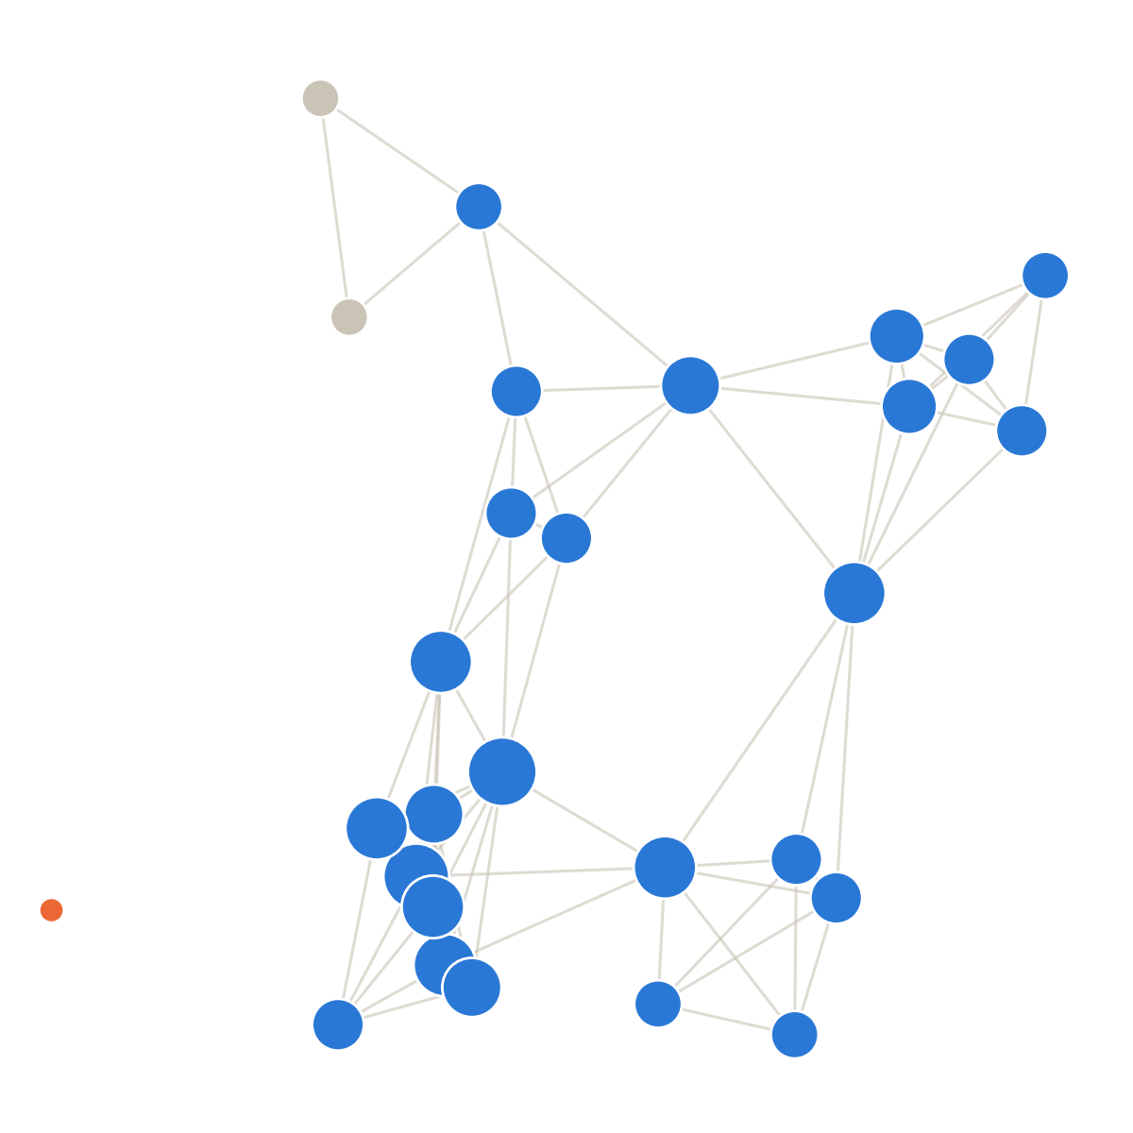
ECC3841 NETWORK ECONOMICS · PRESENTATION 1
Network Position and
Academic Performance
Does where you sit in a friendship network predict your grades,
beyond who your direct friends are?
Team [names] · [Date]
1

Slide 2
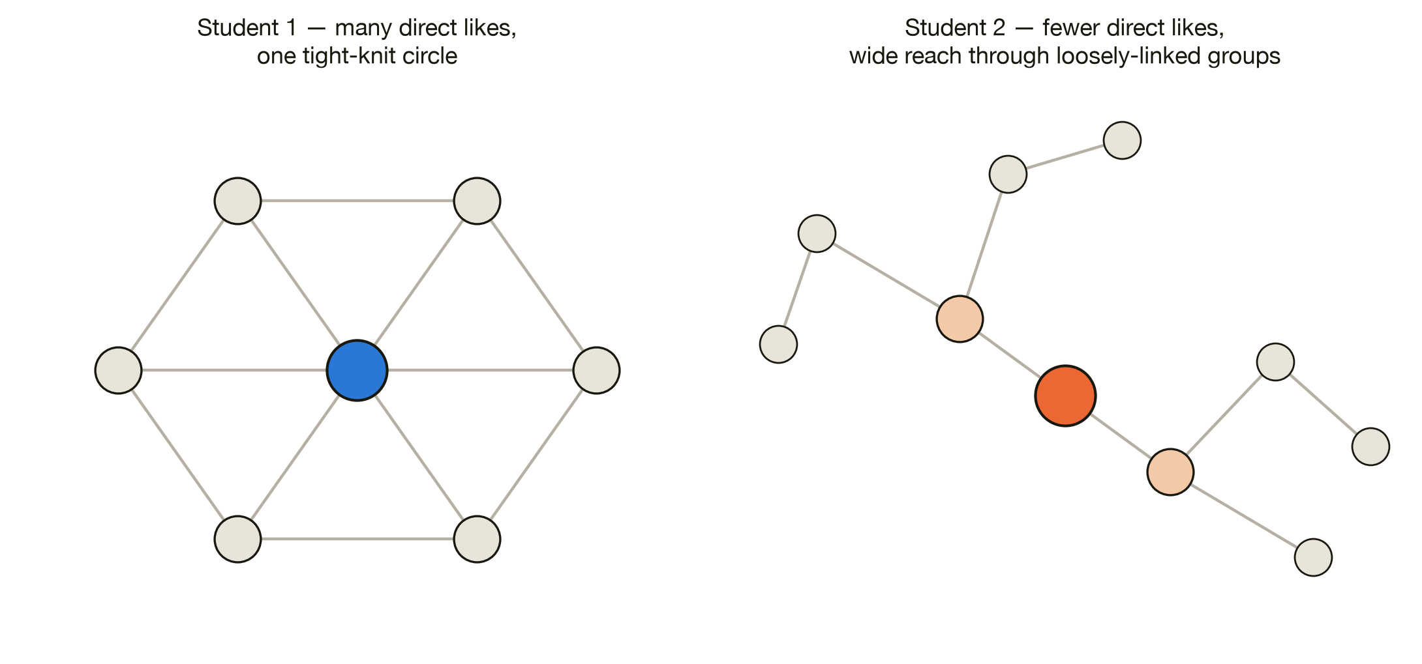
THE PUZZLE
Two students. Same-looking friend groups. Same grades?
Does a student's position in a friendship network affect their grades?
2

Slide 3
WHAT WE ALREADY KNOW · PRIOR WORK
Smirnov & Thurner (2017): the effect is mostly selection
A real, changing “who-likes-who” network of Russian students, matched to GPA.
Students pick friends
with similar GPA
Friend groups end up
GPA-similar
GPA homophily
(what we observe)
Their measure is one number per student — the average GPA of their direct friends.
→ It never asks where that student sits in the wider network.
Two students with the same direct friends score the same — however different those friends' own social worlds are.
3

Slide 4
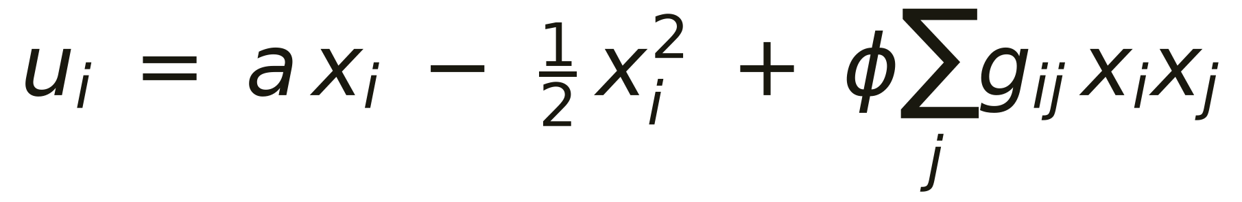
THE MODEL
A model of peer effects in study effort
Ballester, Calvó-Armengol & Zenou (2006) · Calvó-Armengol, Patacchini & Zenou (2009; IZA DP 3859)
Each student i picks study effort xᵢ. Three parts:
• a xᵢ — what you gain from effort
• −½xᵢ² — its rising cost: studying alone has diminishing returns
• φ Σⱼ gᵢⱼ xᵢ xⱼ — the social part: when a friend studies more, your own payoff from studying goes up (φ > 0)
4

Slide 5
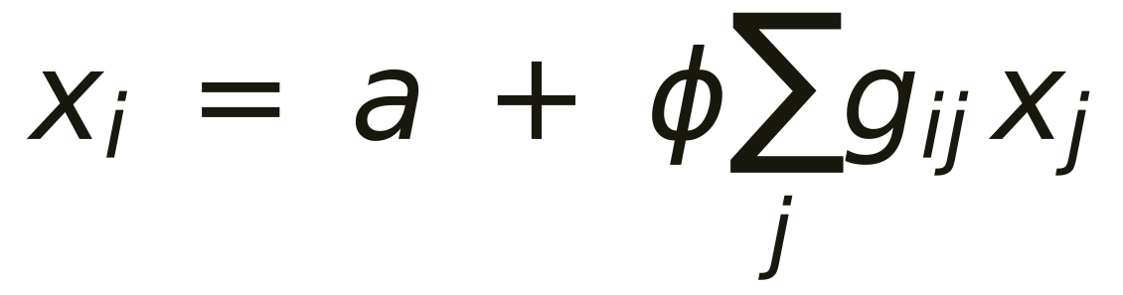
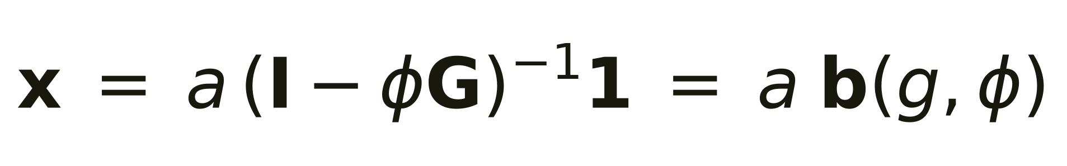
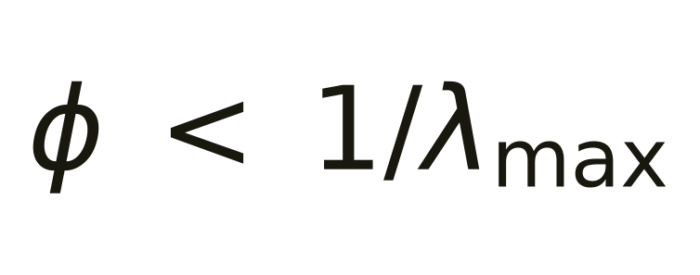
THE MODEL
Everyone best-responds → effort tracks one measure
Best response
study a baseline, plus more when your friends study more
Solve for all students
Valid while
A sharp, falsifiable claim: achievement should track Katz-Bonacich centrality b(g,φ) — not raw popularity, not any other network measure. φ is the model's own parameter, and the one we vary in the data. In the original AddHealth study, a 1-SD rise in centrality raised school performance by about 7% of a SD.
5

Slide 6
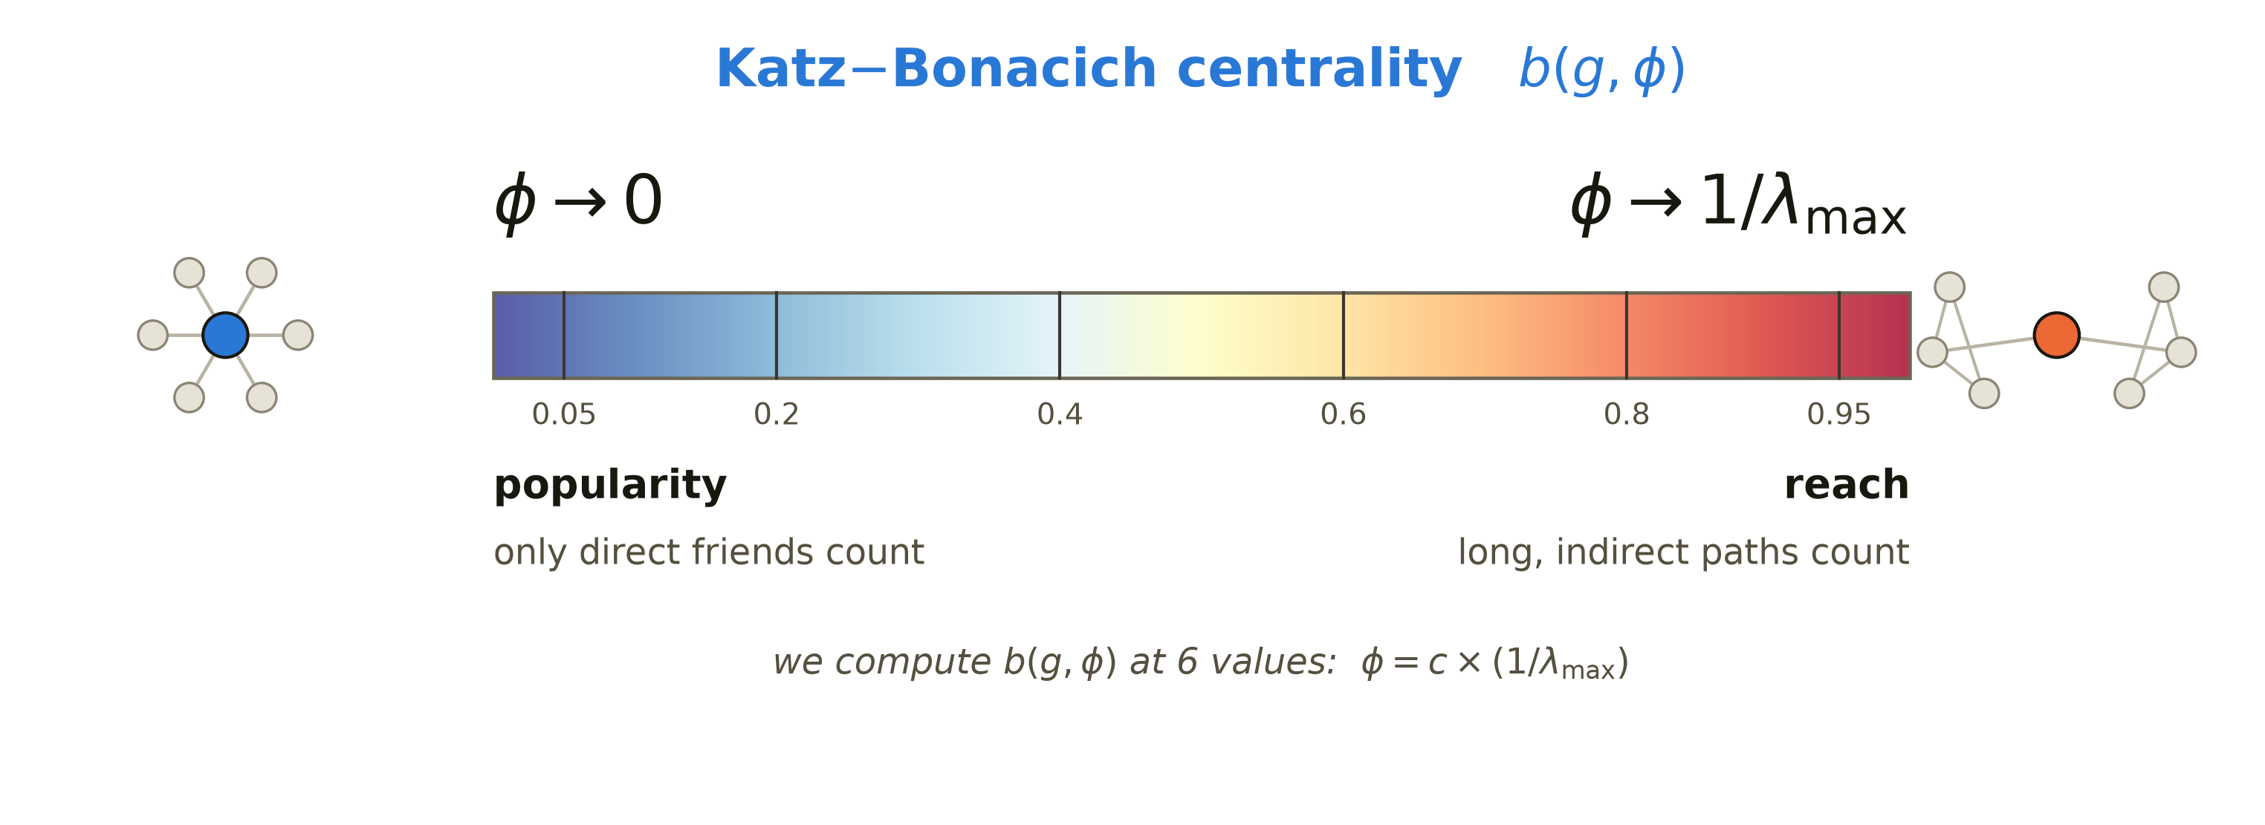
THE KEY IDEA
φ is a dial — from popularity to reach
Turn φ up and the same formula stops asking “how many friends?” and starts asking “where in the network?” — we test GPA against the whole dial.
6

Slide 7
PREDICTIONS
What we expect — and what would prove us wrong
FROM THE MODEL
Katz-Bonacich centrality predicts next-term GPA — even after friend-group GPA and raw degree are controlled. Falsified if it loses significance once degree is in, or if it flips sign along the φ dial.
IF IT PREDICTS — WHICH DIRECTION?
β₁ > 0
β₁ = 0
β₁ < 0
access to help lifts grades
help and time-cost cancel
wide reach eats study time
FROM REPLICATING SMIRNOV & THURNER
• A friend's past GPA won't predict a student's future GPA, once own past GPA is controlled.
• New friendships show a smaller GPA gap than ending ones — a sign of selection.
• Selection is stronger at university than in high school.
7

Slide 8
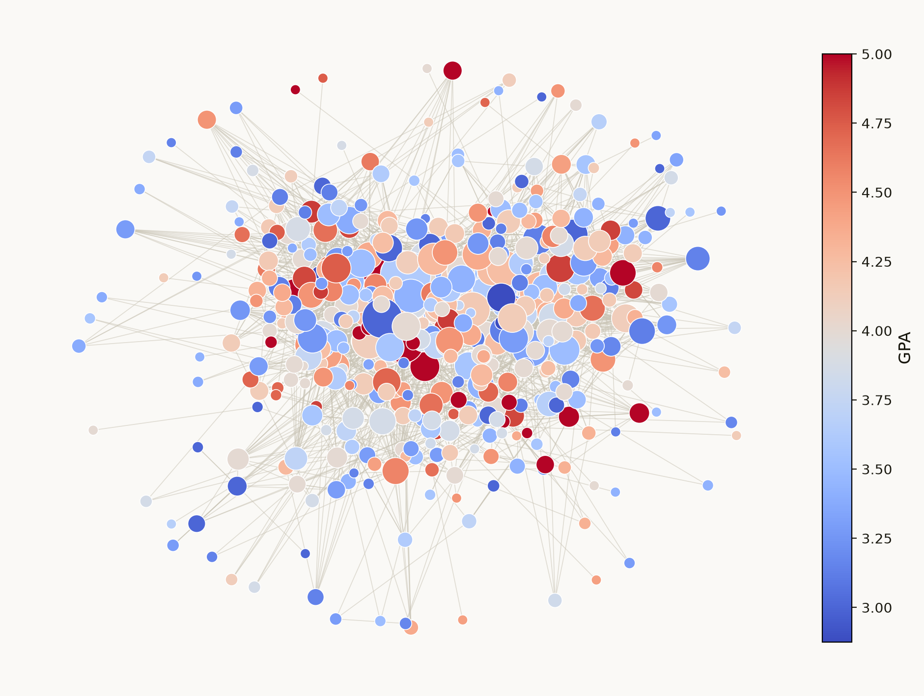
THE DATA
A real, directed friendship network — observed over time
NODES
Students. 655 in high school; 1,200–1,549 per university year.
EDGES
Directed “like” ties. i → j means i liked j at least once in a 3-month window. 2–14 snapshots per group, 38 in total. Only 24–27% are mutual.
ATTRIBUTES
GPA; in/out-degree, Katz-Bonacich, betweenness, eigenvector; school vs. university.
Same dataset as Smirnov & Thurner — our results compare directly with theirs.
8

Slide 9
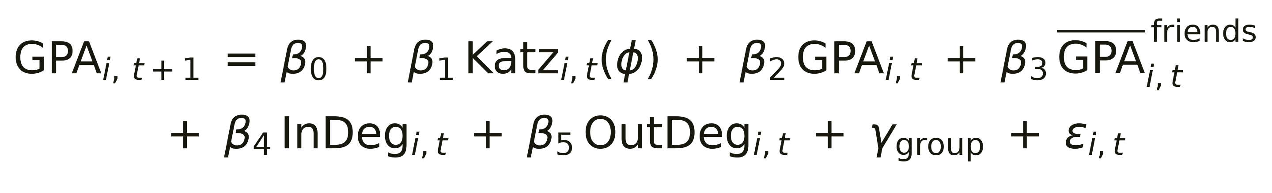
HOW WE'LL GO ABOUT IT
Predict next-term GPA from position — holding the rest fixed
Each control has a job:
• β₃ average friend GPA → β₁ is net of friend-group composition (Smirnov & Thurner's own variable)
• β₄, β₅ raw in / out-degree → β₁ is net of popularity
The real question: does centrality carry anything beyond simply counting friends?
9

Slide 10
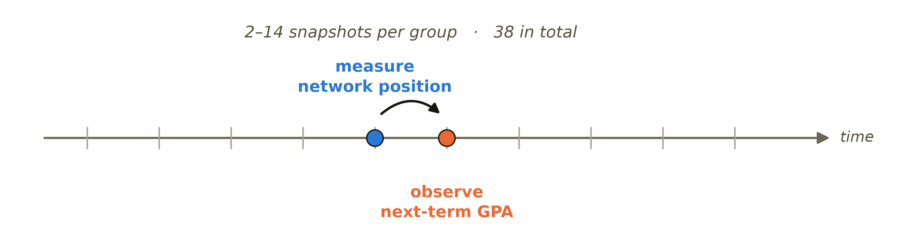
IDENTIFICATION
Which way does the arrow run?
Does position lift grades — or do good grades just attract friends? One snapshot can't tell. Our panel data help three ways:
• Time order — position is measured before the GPA it predicts.
• Past GPA controlled — we compare students at the same current grade.
• Reverse arrow measured directly — does a GPA rise bring new friends? (Smirnov & Thurner's tie-formation check)
So our claim is that position predicts later grades — not that it causes them.
10

Slide 11
OUR PLAN
Three layers of analysis
LAYER 1
LAYER 2
LAYER 3
Replicate
Test the model
Compare
Rebuild Smirnov & Thurner's
selection-vs-influence checks
on the same data
Compute Katz-Bonacich
centrality; test the prediction
across the φ dial
High school vs. university —
does the effect hold across
settings?
One headline test, at φ = 0.85 × (1/λmax), is fixed in advance — so later robustness checks can't be accused of cherry-picking.
Also grounded in: Calvó-Armengol, Patacchini & Zenou (2009) · Giulietti, Vlassopoulos & Zenou (2020) on peer depression
11

Slide 12
Questions?
• Data — Smirnov & Thurner (2017), Harvard Dataverse doi:10.7910/DVN/SZA9YW
• Model — Ballester, Calvó-Armengol & Zenou (2006); Calvó-Armengol, Patacchini & Zenou (2009)
• Full detail — research_brief.pdf
12

