Slide 1
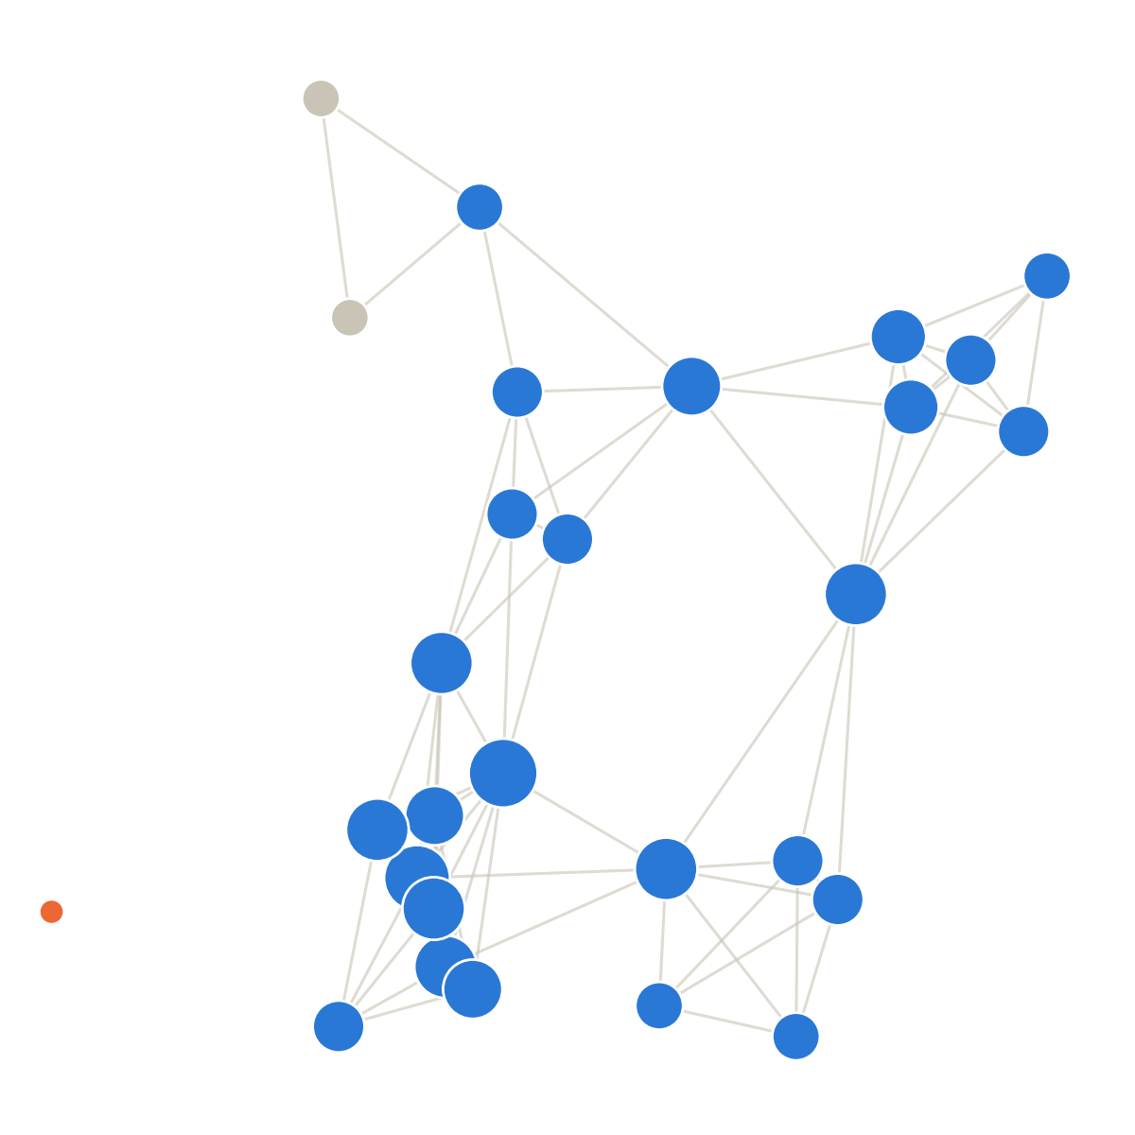
ECC3841 NETWORK ECONOMICS · PRESENTATION 2
Network Position and
Academic Performance
What we found so far — a progress report
Amy Bing · Tingying Huang

Slide 2
WHERE WE LEFT OFF
The plan from last time
Does a student's position in a friendship network predict their grades, on top of popularity and who their direct friends are? The plan: measure Katz-Bonacich centrality, sweep it across φ, and test it against that question.
1
2
3
4
Replicate
Naive test
Planned test
Check + fix
Confirm the data behaves
the way prior work found.
Position alone,
no popularity control.
Add popularity, sweep φ,
pool all 5 groups.
Test the assumptions.
Found one had failed.
This brief reports what running that plan actually found.
2

Slide 3
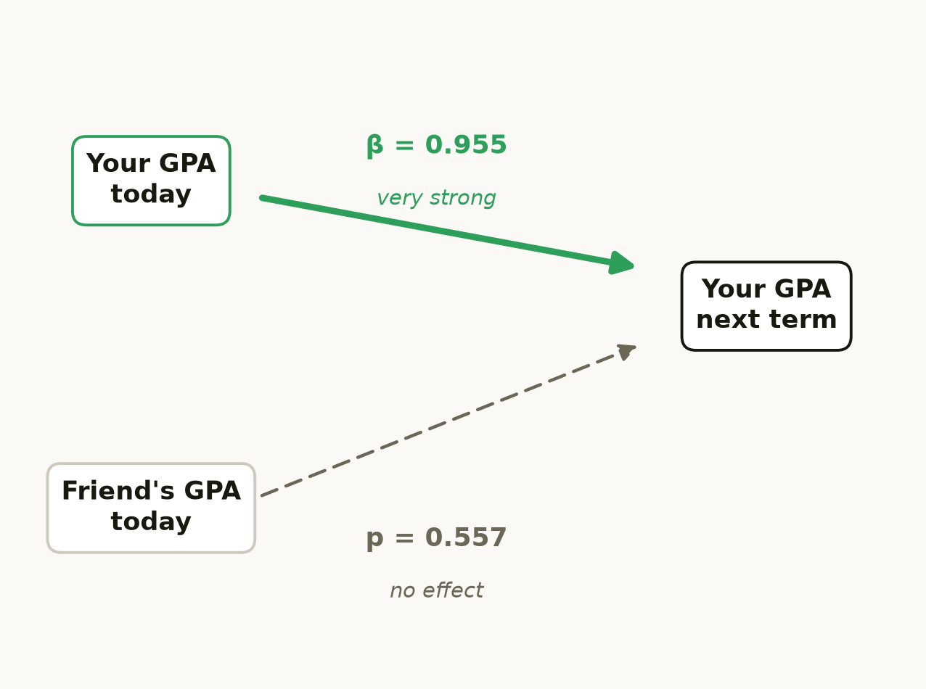
RESULT 1
The replication holds
• A student's own past GPA strongly predicts their next GPA (coefficient 0.955).
• Once that's controlled, a friend's past GPA does not predict your future GPA — not significant (p = 0.557).
• New friendships show a smaller GPA gap than friendships about to end, in the university sample (p < 0.001); same direction in high school, not significant.
Both match Smirnov & Thurner. This is the foundation everything else builds on.
3

Slide 4
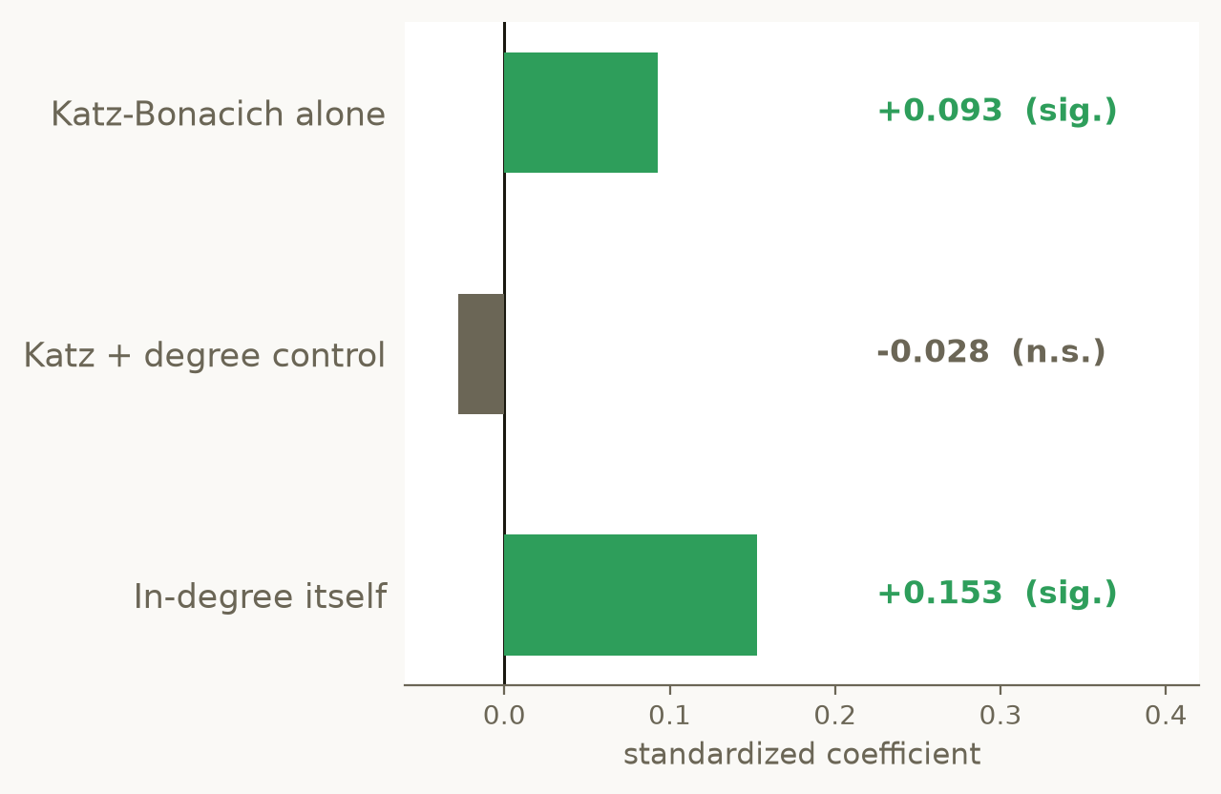
RESULT 2
The naive effect is popularity, relabelled
• Katz-Bonacich alone, net of friend GPA: coefficient +0.093, p < 0.001. Looks like position matters.
• Add raw in-degree and out-degree to the same regression: the coefficient drops to −0.028, p = 0.446 — no longer significant.
• In-degree itself: +0.153, p < 0.001. That's what was driving the naive result.
The naive effect was popularity wearing a different name.
4

Slide 5
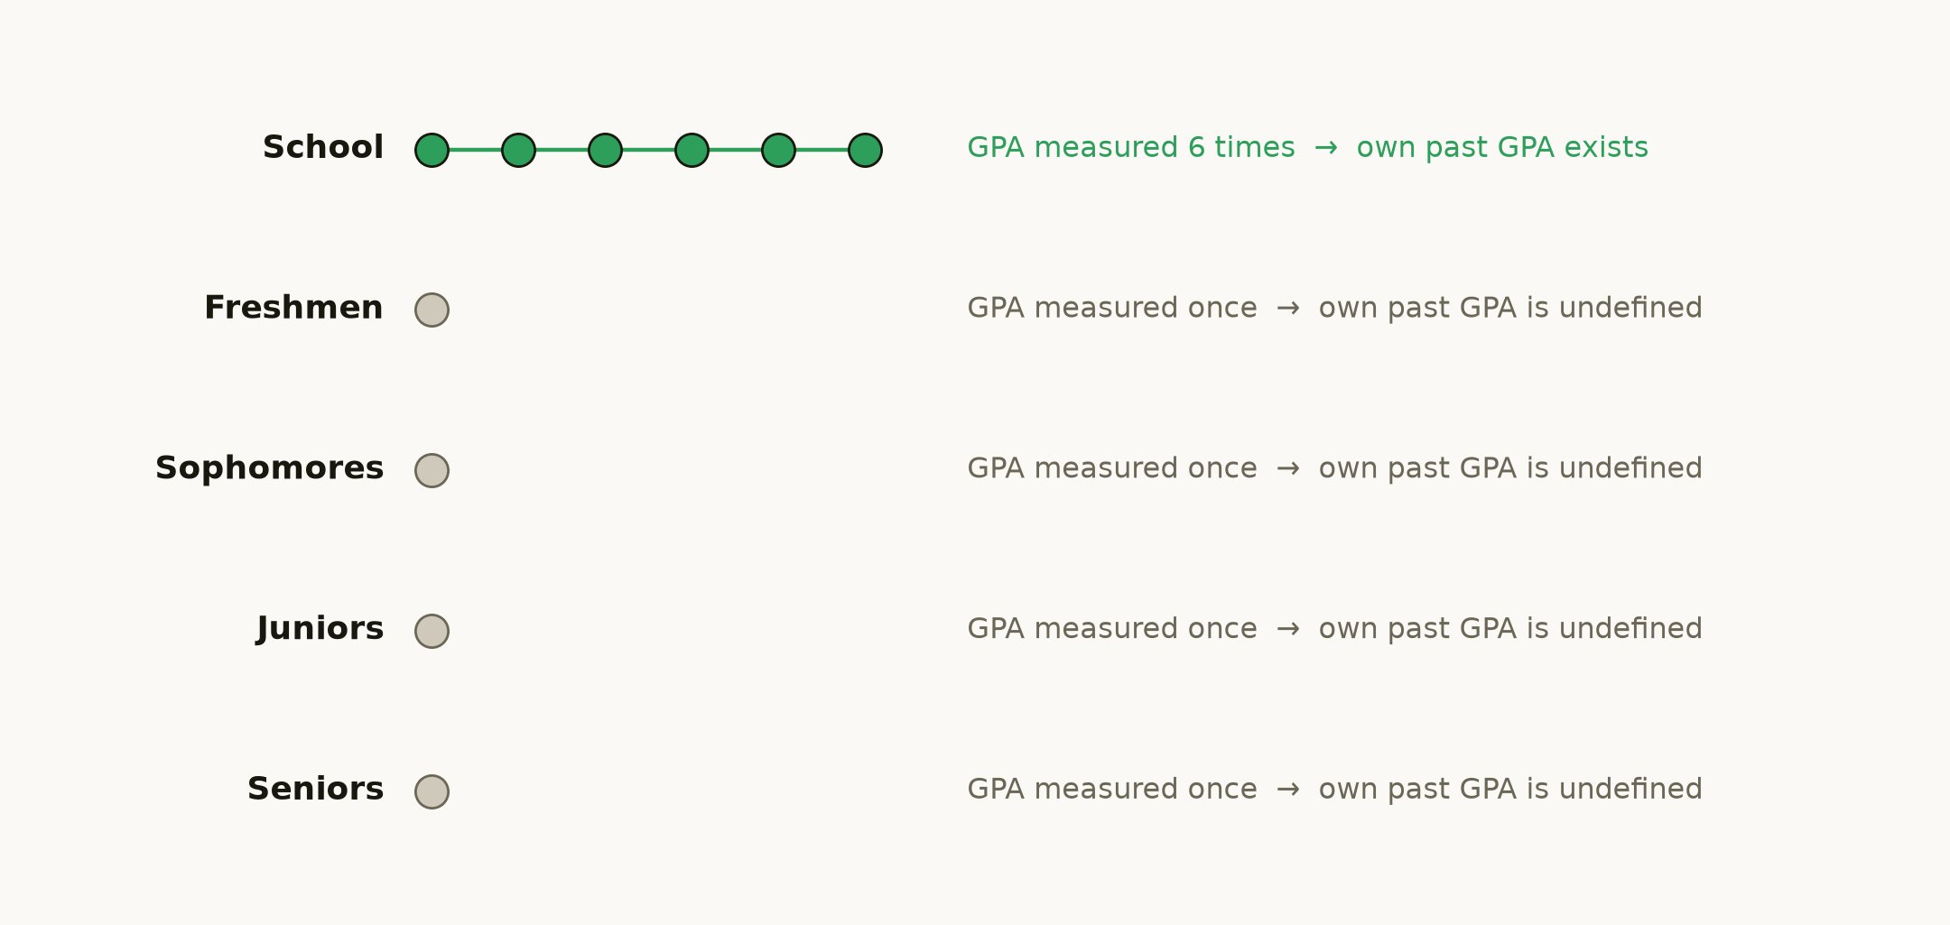
RESULT 3
The planned test, and a gap we found in it
Own past GPA can only be built for the school group — the other 80% of the pooled sample can't have it.
5

Slide 6
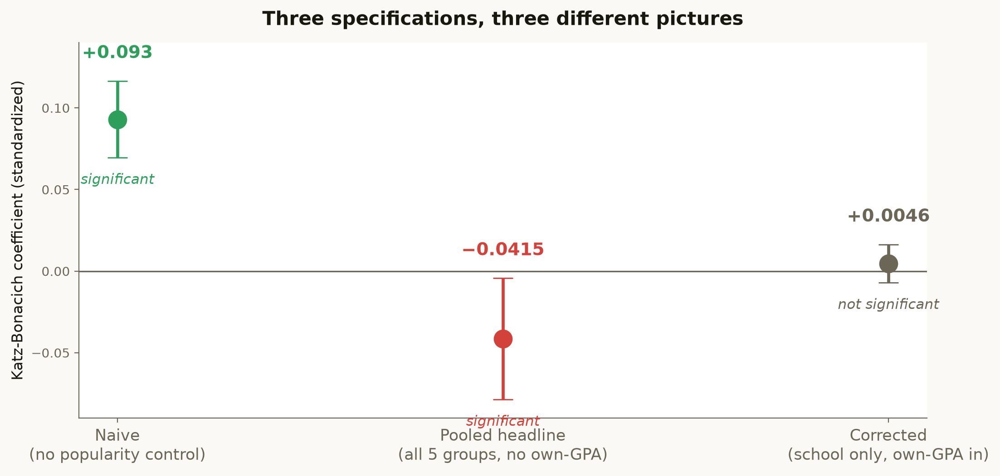
COMPARING THE THREE TESTS
Three specifications, three different pictures
The corrected test — the only one with own past GPA properly controlled — finds nothing.
6

Slide 7
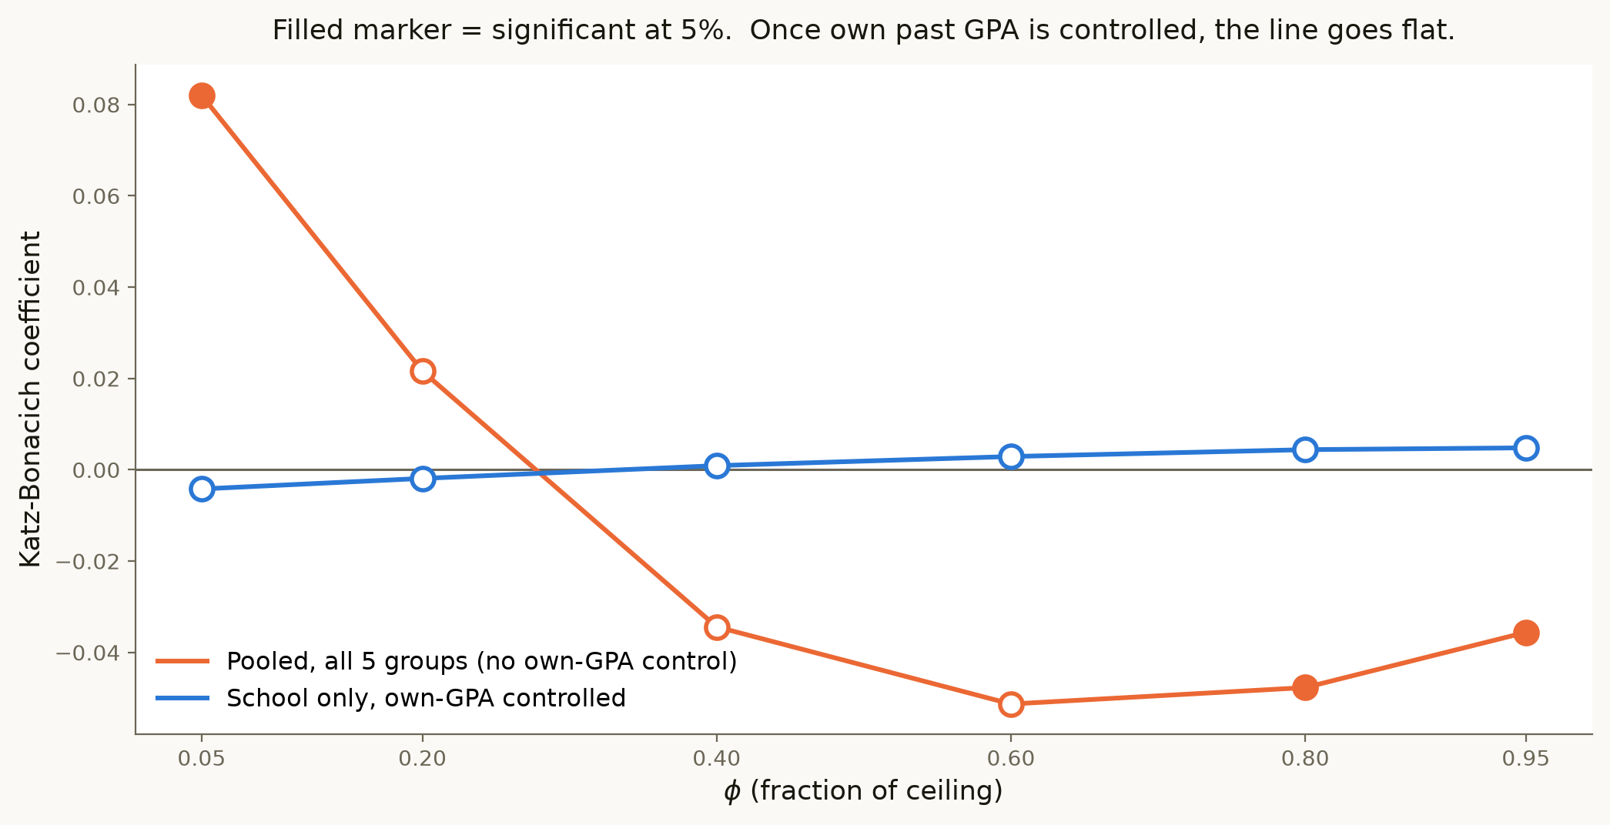
ROBUSTNESS
Checked across the whole φ range, not just one value
Before the fix, the line swings from significantly positive to significantly negative. After it, it's flat.
7

Slide 8
CONCLUSION
What this means
HEADLINE FINDING
Net of popularity, friend GPA, and a student's own past performance, we find no evidence that network position independently predicts grades.
• This is the first time this claim has been tested with a real time lag and an own-performance control — a cross-section could never support that.
• It shows a general risk: pooling groups with different data structures can manufacture a significant coefficient the correctly specified subsample doesn't support.
• It's a decision-relevant answer: interventions built around widening students' network reach aren't supported by this data once the obvious confounds are handled.
8

Slide 9
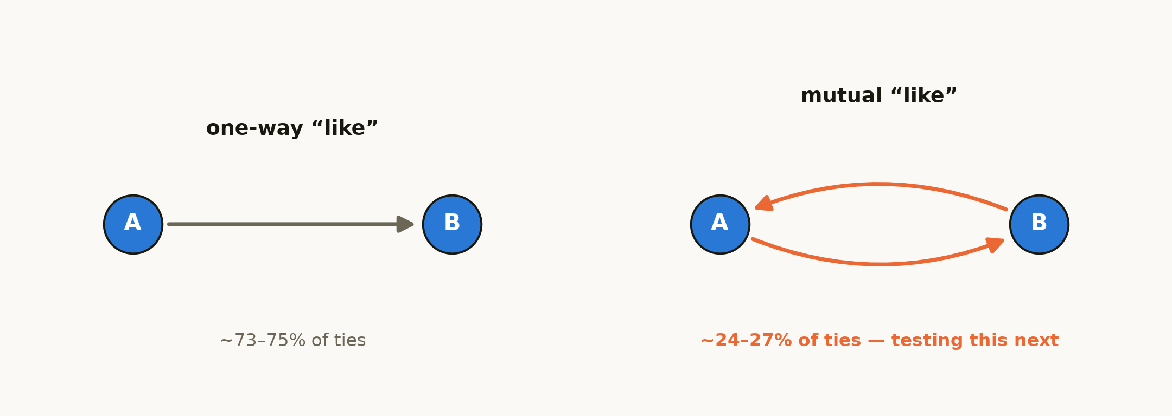
LIMITATIONS AND WHAT'S NEXT
Where this is still open
• The corrected test has n = 2,088 from 535 students — a much wider confidence interval than the pooled test's 36,696.
• It can't be extended to the university cohorts: their GPA is a single measurement, not a time series.
• Betweenness and eigenvector centrality still need to go through the corrected, school-only design.
Next: recompute centrality using only mutually-confirmed ties, shown below.
9

Slide 10
Thank you
Full numbers and setup: research_brief.pdf and progress_brief.pdf.
Questions?
10

