Slide 1
Mental Health Predictions: Leveraging Machine Learning and Socioeconomic Data
Maelice Yamdjieu, Ting-Yu Lin, Vee Tran

Slide 2
Introduction
Objective : Explore relationship between mental health and socioenomic factors.
Dataset: World Data repository.
Data tables: Mental Health Prevalence, GDP, Behavioral Response, Unemployment Rate
Models: Random Forest, SVM, Logistic Regression.
Notes:
This study investigates the intricate relationship between various mental health disorders and socioeconomic factors using a comprehensive dataset from the World Data repository. Key predictors in the analysis include the prevalence of schizophrenia, depressive, bipolar, and eating disorders, as well as GDP per capita and the unemployment rate. The response variable is the prevalence of anxiety disorders, categorized into high and low prevalence based on average values. We employed multiple machine learning models, including Random Forest, Support Vector Machines (SVM), and Logistic Regression, to predict the prevalence of these mental health disorders. Our findings revealed that Random Forest models, after hyperparameter tuning, explained a significant portion of the variance in mental health disorders. SVM models, particularly with linear and polynomial kernels, demonstrated high accuracy in predicting anxiety and eating disorders. Additionally, logistic regression models showed improved prediction accuracy for anxiety and eating disorders after data standardization. These results underscore the substantial impact of socioeconomic factors on mental health and highlight the varying effectiveness of different machine learning models in predicting mental health disorder prevalence.

Slide 3
Data Exploration
Variable selection:
Predictors: Economic indicators and behavior response
Response: Anxiety disorders, Depressive disorders, Eating disorders (high/low prevalence).
Data preprocessing and cleaning:
Combine all tables by using inner join of ‘Country’
Handle missing values: imputation using Singular Value Decomposition (SVD)
Data Splitting:
Split dataset: 80% training, 20% testing.

Slide 4
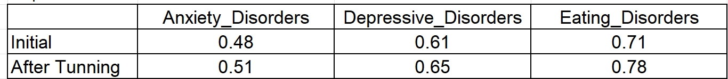
Random Forest
Table: R- squared for predict prevalence of mental health issues

Slide 5
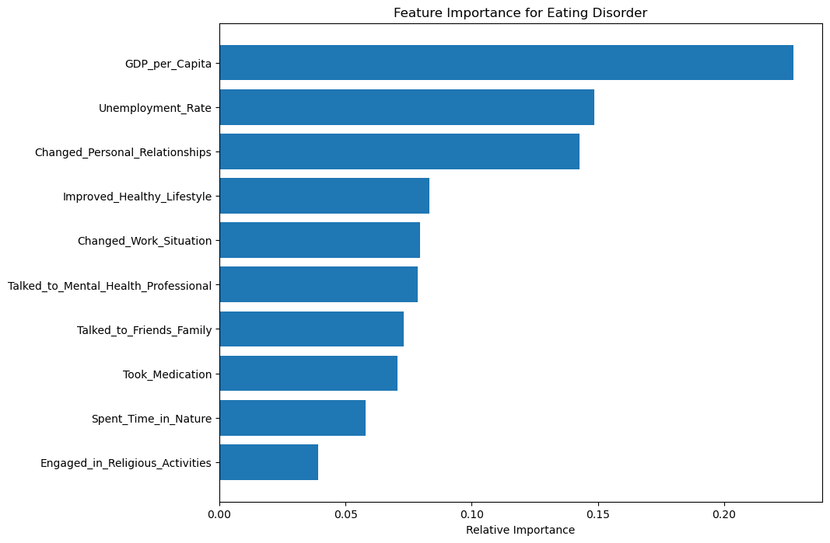
Random Forest
High income and unemployment rate have strong correlate with higher prevalence of mental health issues.

Slide 6
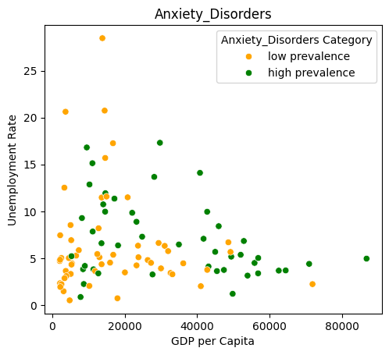
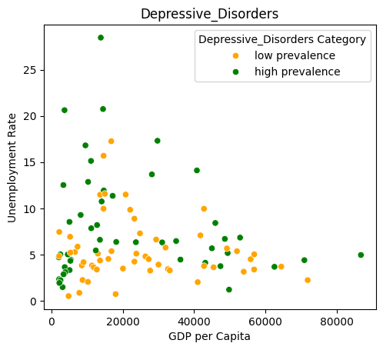
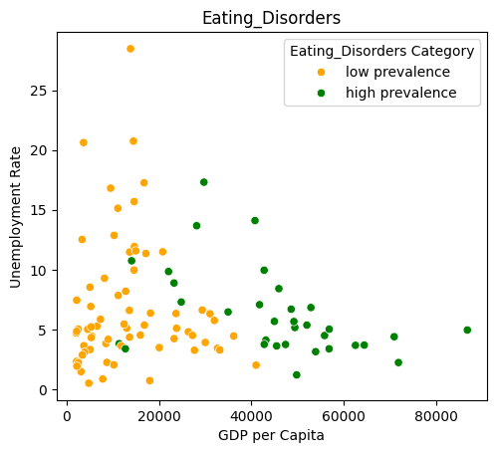
Support Vector Machine & Logistic Regression
Figure 2 Mental Health Issues Classification by GDP and Unemployment Rate

Slide 7
Support Vector Machine & Logistic Regression
Mental issue Model | Anxiety_Disorders | Depressive_Disorders | Eating_Disorders
SVM_linear | 0.6774 | 0.5484 | 0.8387
SVM_RBF | 0.4516 | 0.4594 | 0.6129
SVM_polynomial | 0.6774 | 0.4516 | 0.9032
Logistic regression | 0.7619 | 0.6190 | 1.0000
0.6774
0.5484
0.6774
0.9032
0.7619 | 0.6190 | 1.0000
Table 1 Testing Accuracy with Optimized SVM Model and Logistic Regression Model

Slide 8
Discussion
Increase data samples and include more economic factors to more accurately confirm that the model can predict mental health based on a country's economic condition.
Models in the study could be used to predict regions with high incidences of mental issues, especially eating disorders, to enhance public awareness and prevention education in these areas.

Slide 9
Conclusion
Random Forest models captured significantly GDP and unemployment rate impacts on mental disorders prevalence.
Logistic regression outperformed SVM model.
Valuable insights for addressing mental health challenges globally.

