Slide 1
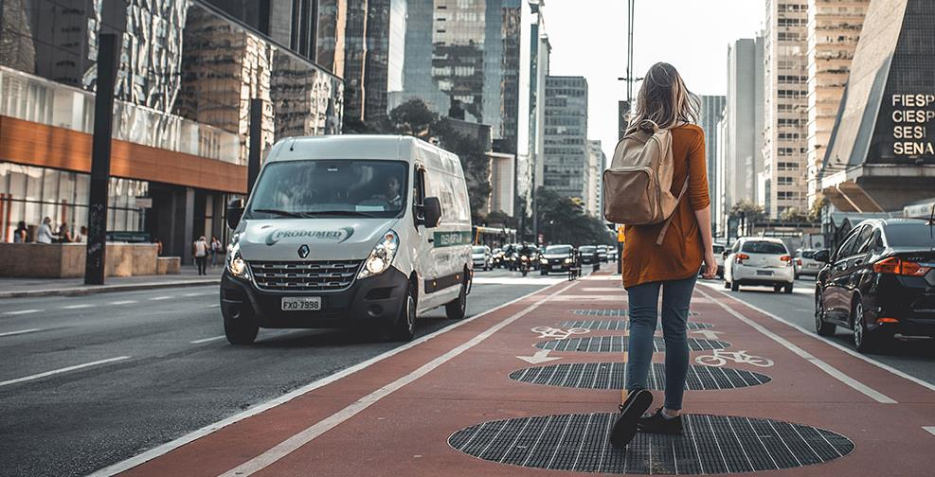
WE-RIDE
The Saturday 9 PM Story.

Slide 2
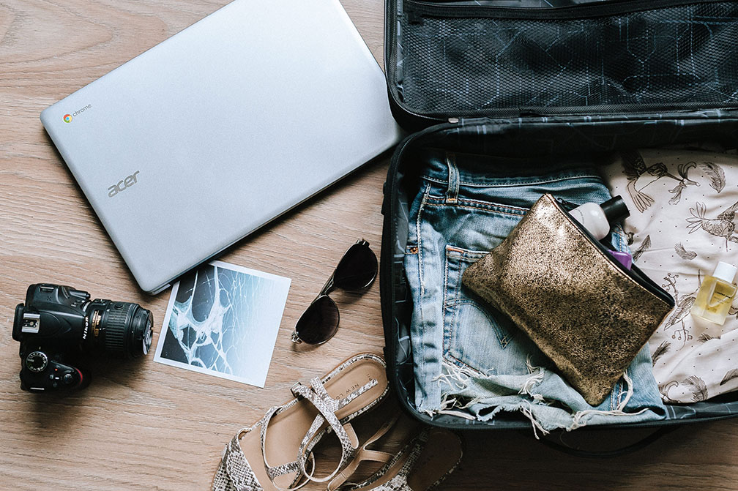
Brief Says; Analyze Fare, Distance, Surge, Traffic, time & Weather

Slide 3
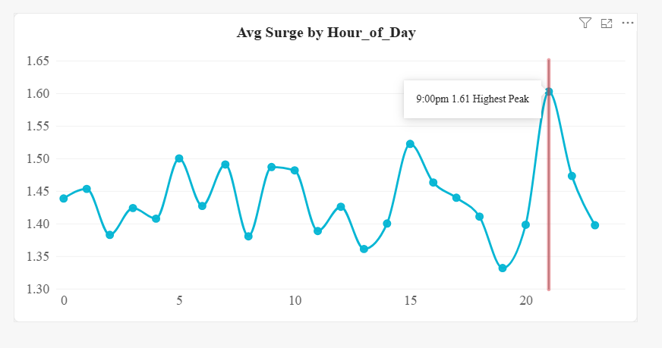
THE PEAK WINDOW
At 19:00 (7 PM), surge drops to 1.33x - the lowest. Drivers just came online for evening shift.
Then at 21:00 (9 PM), it spikes to 1.61x - the HIGHEST of the whole day.
Why 9 PM? That is when parties end, offices close late, and buses stop. Everyone wants We-Ride at once.

Slide 4
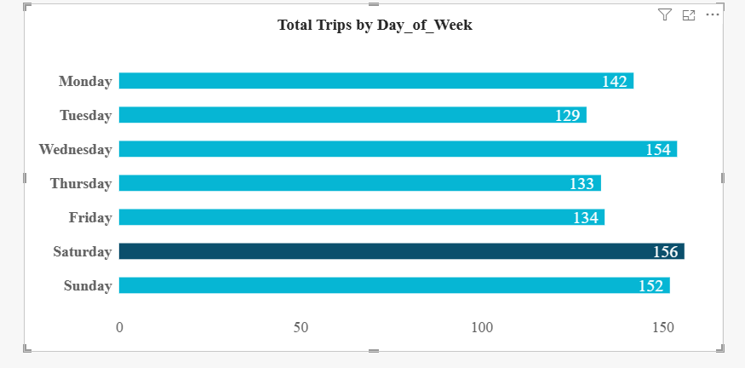

Saturday 9 PM = 1.61x surge vs Daily Avg 1.42x.
This is social travel time. People leaving dinners/parties = demand spike while drivers take breaks.

Slide 5
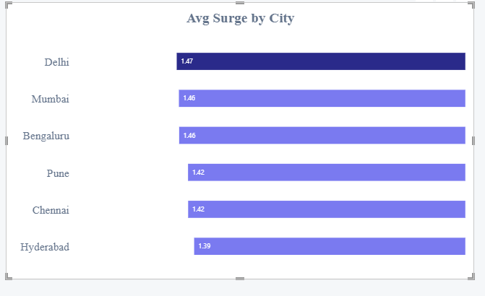
DELHI IS THE MOST EXPENSIVE CITY
Delhi customers don't pay more because they travel farthest (Avg Distance Delhi = 12.3km vs Mumbai 12.8km). They pay more because surge is highest. This is a supply problem, not a distance problem.

Slide 6
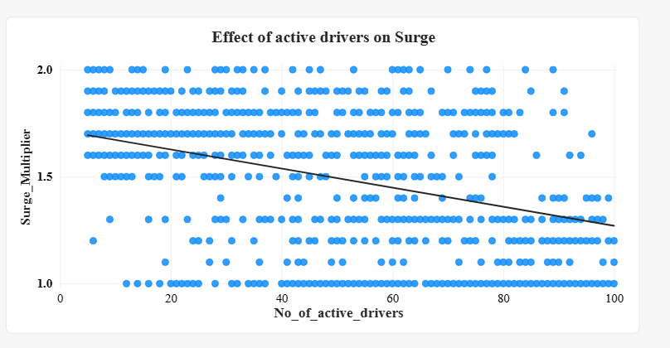
DRIVER SHORTAGE = CONTROLLABLE SURGE

Slide 7
When Active Drivers = 10, Surge = 1.71x. When Active Drivers = 80, Surge = 1.31x.
Difference = 0.40x = Rs 85 per trip. Correlation = -0.62

Slide 8
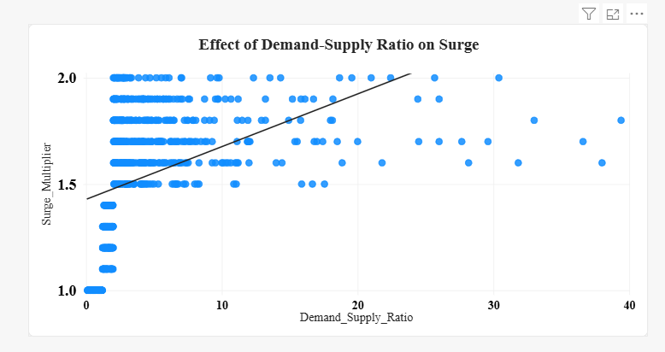
DEMAND-SUPPLY RATIO = STRONGEST SURGE DRIVER
When 1 customer competes for 1 driver, surge = 1.0x
When 20 customers fight for 1 driver, surge = 2.0x. On Saturday 9 PM in Delhi, ratio hits 14.5

Slide 9
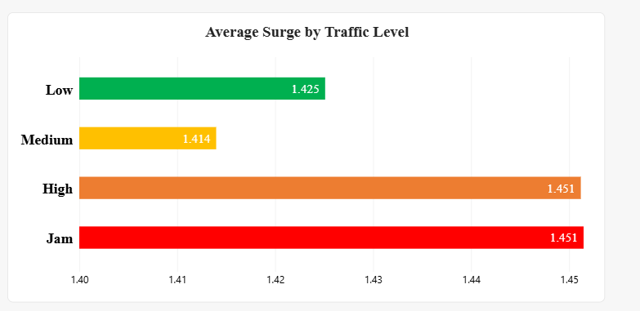
Traffic is Not the Villain
Myth Busted: Traffic Adds Only 2% to Surge
Everyone expected Jam to have huge surge. But Low traffic is @1.42.
Jam is @ 1.45, the difference from Low to Jam is only 2%. If traffic was the cause, Jam would be 2.0x and Low would be 1.0x. But it's not.

Slide 10
THE MISSING PIECE-WEATHER
Dataset Limitation: No Weather Data
Our brief asked for weather analysis. We checked the dataset. No weather column.
If we had weather, Rain + Saturday 9 PM in Delhi, surge would be more than 2.0x.
We-Ride should start tracking weather to test if Rainy days worsen Saturday 9 PM surge in Delhi.

Slide 11
RECOMMENDATIONS
ADD DRIVERS (Cost vs Benefit)
ACTION: Increase Delhi active drivers on Sat 8-11 PM from 35 to 65 (+85%)
COST: 30 drivers x Rs 50 bonus = Rs 1,500 per hour
BENEFIT: Surge 1.61x -> 1.40x, prevents 15 churns. LTV of 15 customers = Rs 60,000
ROI: 40x

Slide 12
INCENTIVIZE DRIVERS - HOW TO GET THEM
Problem: Drivers go offline for dinner at 7-8 PM, exactly right before 9 PM peak demand. This creates artificial shortage.
ACTION 1 - Push Notification at 7:30 PM: "High demand near Connaught Place, Rajiv Chowk. Earn extra Rs 150 tonight! Come online now.
ACTION 2 - Bonus: Rs 50 bonus for completing 3 trips between 8-11 PM in Delhi on Saturday.
Expected Result: +20 drivers back online before 9 PM peak, surge drops by 0.15x immediately.
Why this works: We cannot force drivers, but we can incentivize. This is cheaper than losing customers.

Slide 13
build trust THROUGH transparency
What Data Proves:
Low Traffic = 1.425x surge
Jam Traffic = 1.451x surge
Difference = 0.026x = Only 2% impact
Conclusion: Traffic does NOT cause surge
Actions for We-Ride:
ACTION 1: Pre-Book Feature.
Book before 8 PM, this will lock fare at 1.2x
It gives customer control, and avoids 9 PM peak.
ACTION 2: Show Live Drivers"12 drivers nearby, ETA 3 min
Customer waits instead of canceling
We cannot control distance. But we CAN control supply and honesty.

Slide 14

THANK YOU

