Slide 1
Using-Image-Processing-for-Autonomous-
Illumination-Sensor-Optimization Discussion #1
Supervisor : Prof. Dr. Andreas Pech
By student : Paween Pongsomboon
Frankfurt University of Applied Sciences

Slide 2
Outline
Project overview
Proposal
Questions and suggestions

Slide 3
Project Overview
Objective : Prove that the System(Red Pitaya + Ultrasonic sensor)
can distinguish between person and non-person scenario.
Approach : be able to collect images and data reading
from Red Pitaya at the same time.

Slide 4
Project Overview
Experiment : Two scenarios from the following setup

Slide 5
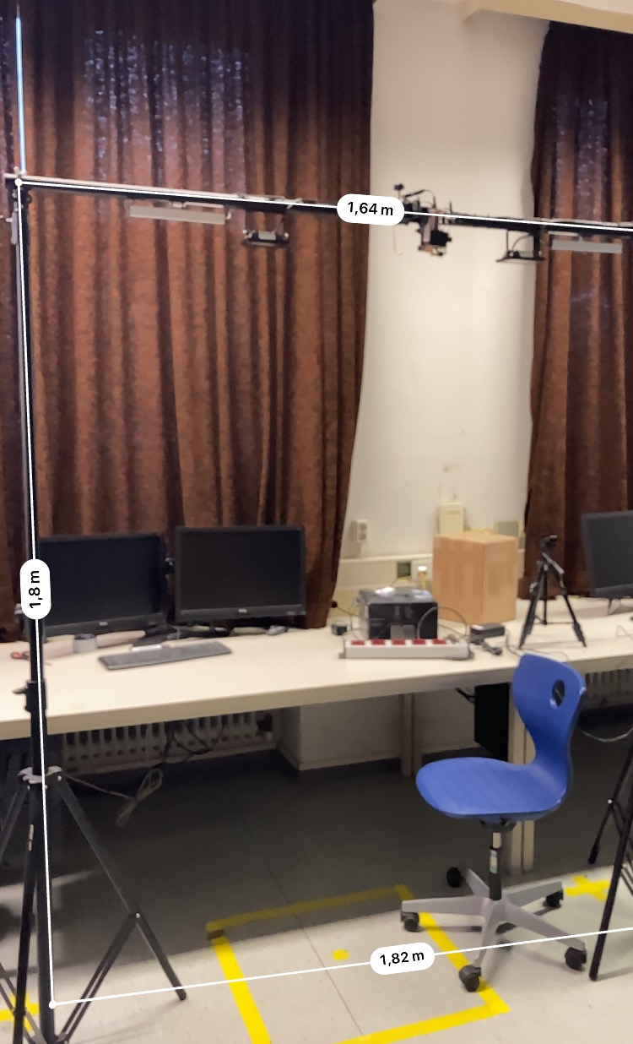
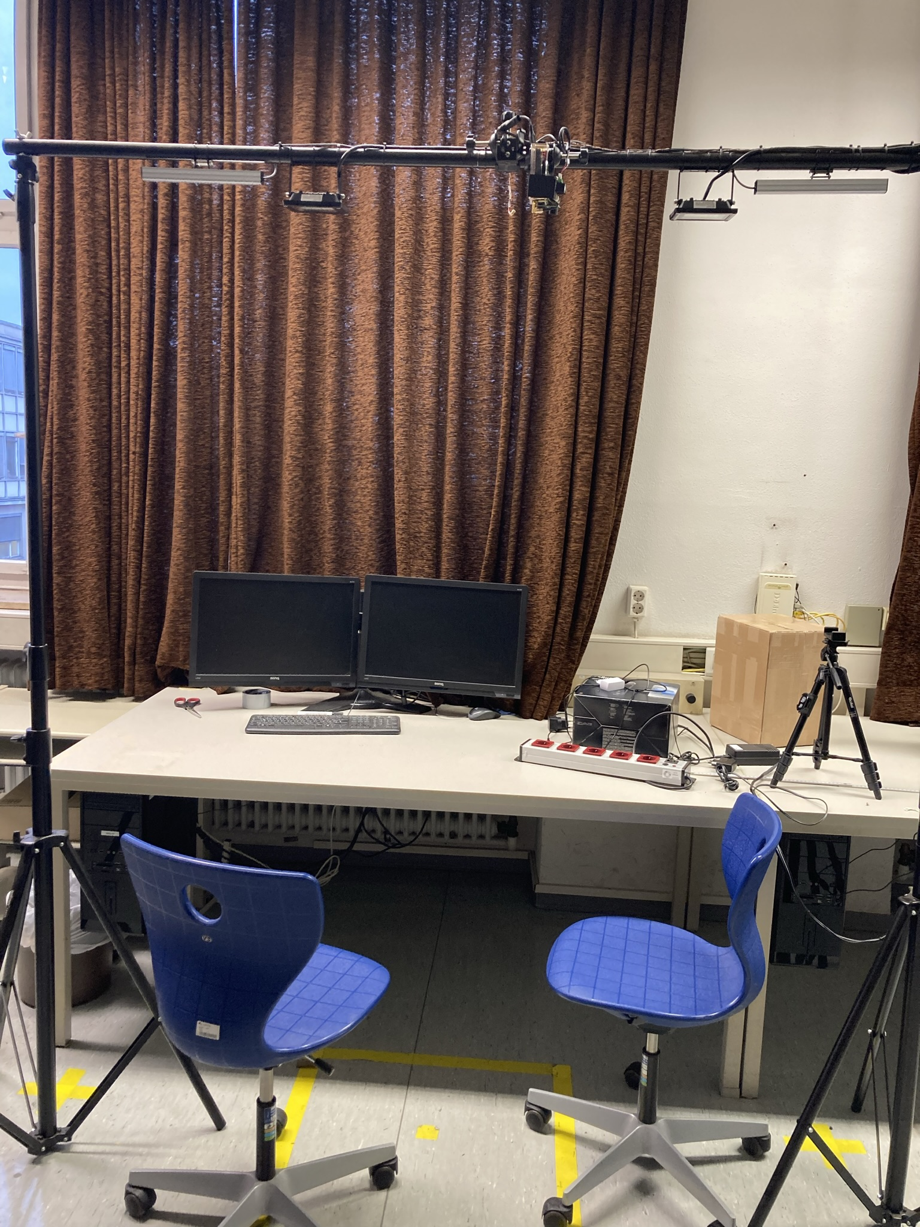
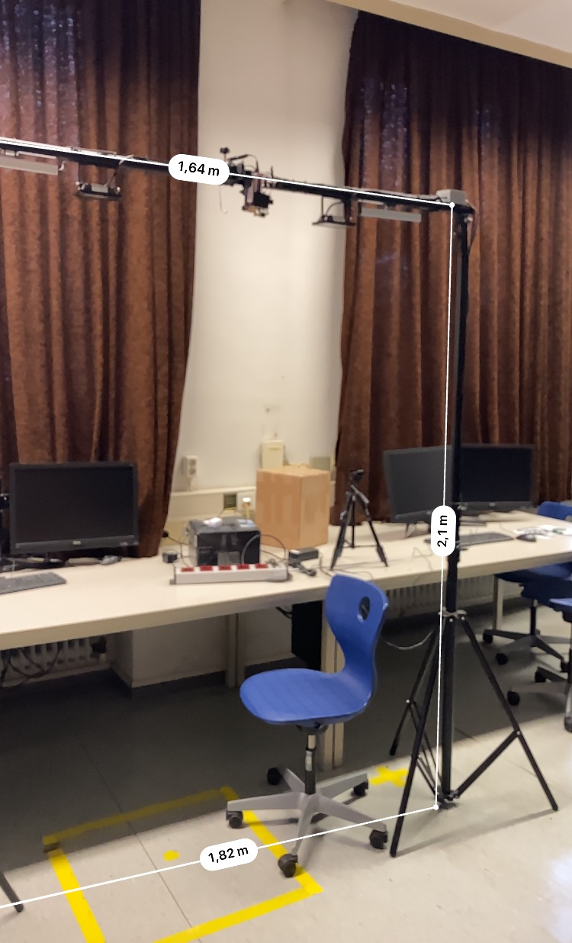
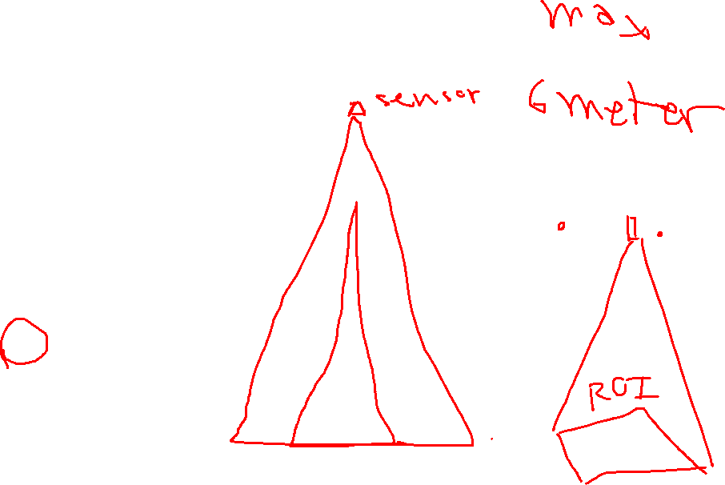
Project Overview
Real Images of Setup

Slide 6
Project Overview
Scenario 1: Empty Seating ( No – person ) condition : no person in the area
Expected result :
Light No. 1 Status | Light No. 2 Status
ON | OFF

Slide 7
Project Overview
Scenario 2: Person detected condition : one or more person in the area
Expected result :
Light No. 1 Status | Light No. 2 Status
OFF | ON

Slide 8

Proposal
A program to retrieve both images and data Reading from Pitaya
At the same time.
System
Ultrasonic sensor
Camera
Red Pitaya
Program
Scenario 1 Folder
(Empty)
Scenario 2 Folder (Person)
Images
Reading Data
Images
Reading Data

Slide 9
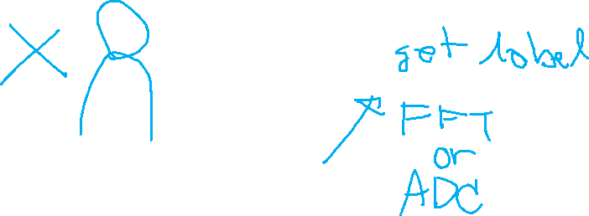
Proposal
An image of a program

Slide 10
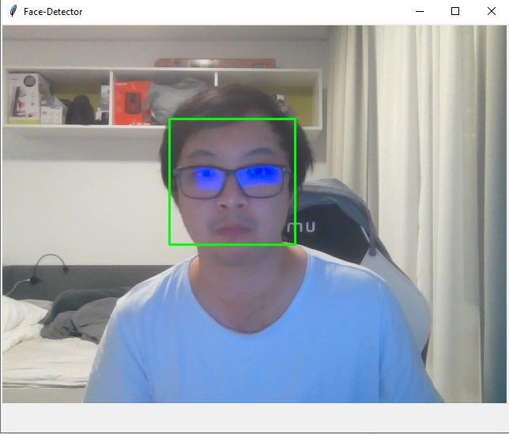
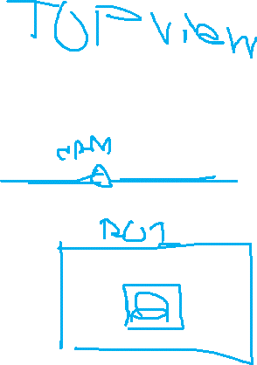
Proposal
Demo program using python and opencv libraries

Slide 11
Questions and suggestions
Need access to some equipment
Computer for experiment ( with a webcam )
Access to Red Pitaya on the platform ( Wifi SSID, password )
How do I turn the light No.1 or No.2 ON and OFF ? Do they turn on
and off automatically using relay or it is controlled by processor?
How large is the data do we require?
Do you have a WIFI in the laboratory? Maybe it is useful to sending
command remotely.

