Slide 1
Using-Image-Processing-for-Autonomous-
Illumination-Sensor-Optimization Discussion #2
Supervisor : Prof. Dr. Andreas Pech
By student : Paween Pongsomboon
Frankfurt University of Applied Sciences

Slide 2
Outline
Update Progress
Problems to solve
Questions and suggestions

Slide 3
Update Progress
Progress (Environment Setup)

Slide 4
Update Progress
Progress (Environment Setup)

Slide 5
Update Progress
Progress (Software)
Software can support
1.) Real-time Detection
2.) Video File Detection
Currently at this stage
BG Subtraction
Blob
Detection
Classified based on Blob
Using Pretrained model
Connected with the program from Redpitaya

Slide 6
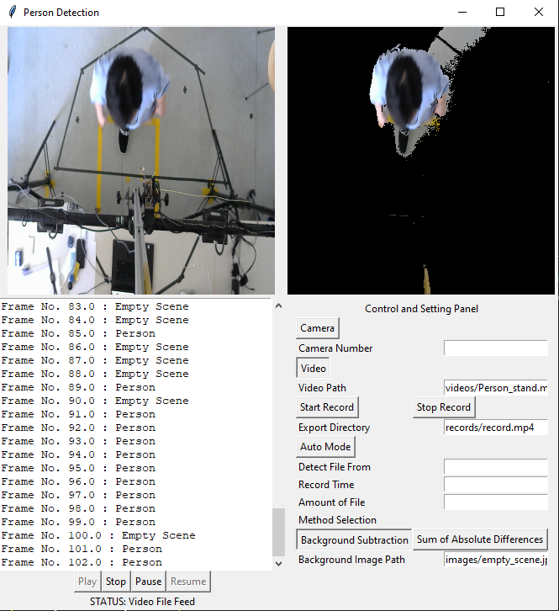
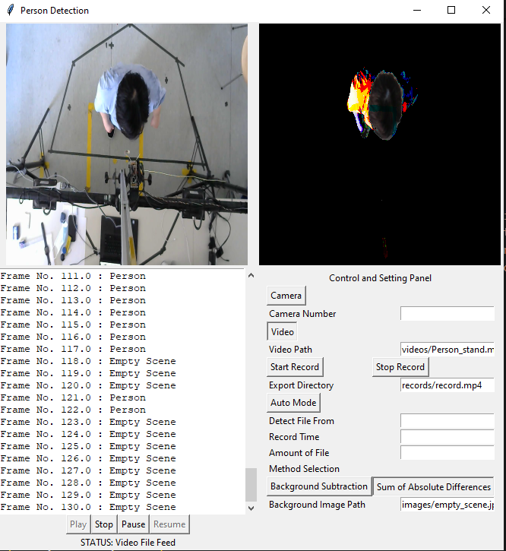
Update Progress
Progress (Software)
BG Subtraction
K Nearest Neighbor (KNN)
Sum of Absolute Difference (SAD)

Slide 7
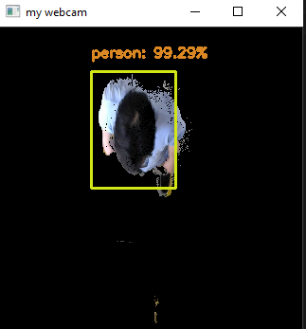

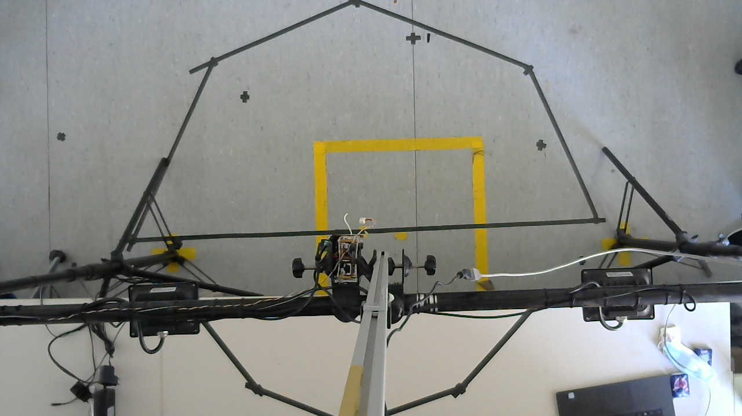
Problems to solve
Problems to solve
When using pre-trained model to classify image, the whole process is getting slower. (SSD_inception)
→ currently researching on how to improve the speed by changing classification method or using another model from another source or use GPU instead of CPU
Classified based on Blob
Using Pretrained model
Fig. 1: Result from classification with SSD_inception
INCOMING
OUTGOING
STAY STILL

Slide 8
Problems to solve
Problems to solve
Once the person stops moving, the foreground detection is getting worse. → Solve with State transition method inside ROI (region of interest)

Slide 9



Problems to solve
Problems to solve
How to connect and synchronise data with program that works with Redpitaya.
→ Use files as medium, count number of total files inside folder which will be the same as data from RedPitaya
Program:Person Detection from Camera
Program:Data from RedPitaya
Detect if there is any file writing in the folder and start recording
Write file into the folder
Parameter: Amount of file needed to be in this folder : (Predetermine) Record time for each file : 10 seconds (Predetermine)
Parameter: Measurement Amount: 100
( 10 seconds)

Slide 10
Problems to solve
Problems to solve
Camera FPS (Frame rate) is 24, but for Redpitaya data one second is 10 measurements. As a result, one measurements = 2.4 frame, but we cannot determine 2.4 frames.
For ex. 1st measurement = Empty, but first frame is ”Empty” and the next one is “Person” and the half of frame cannot be determined.
Data from RedPitaya : 100 64 210 210 … 721 → Person
Frame from Camera : frame 1 → Person
frame 2 → Empty
frame 3 → Empty
Person or Empty?

Slide 11
Questions and suggestions
Q&A

