Slide 1
Using-Image-Processing-for-Autonomous-
Illumination-Sensor-Optimization Discussion #3
Supervisor : Prof. Dr. Andreas Pech
By student : Paween Pongsomboon
Frankfurt University of Applied Sciences

Slide 2
Outline
Update Progress
Problems
Questions and suggestions

Slide 3
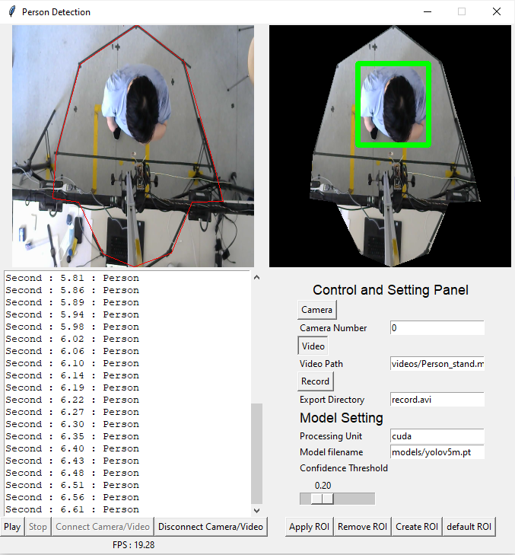
Update Progress
Update Progress
Program can detect person.
Program can record and export prediction result with timestamp.
Program support ROI creation
Program support real-time detection and video.
Detection model parameters adjustable.

Slide 4
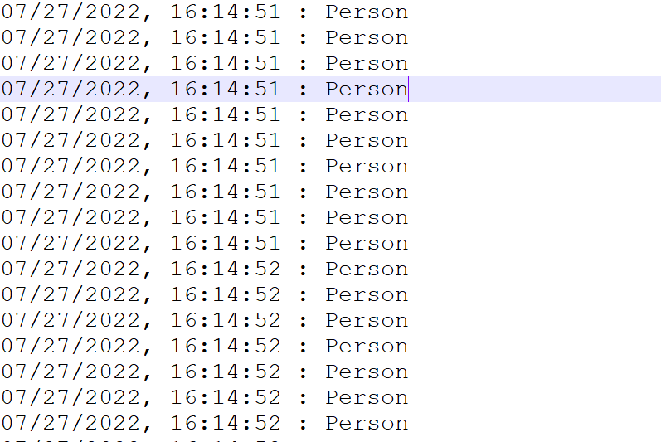
Update Progress
Prediction result with timestamp.

Slide 5





Problems
Overall System
Sync CLK
Sensor
Computer + Camera
Red Pitaya + Ultrasonic Sensor

Slide 6
Problems
Have not been able to synchronise clock between Red Pitaya and external clock (PC).
Have not been able to trigger pulse from ultrasonic sensor.
Sync CLK
Sensor
Red Pitaya + Ultrasonic Sensor

Slide 7
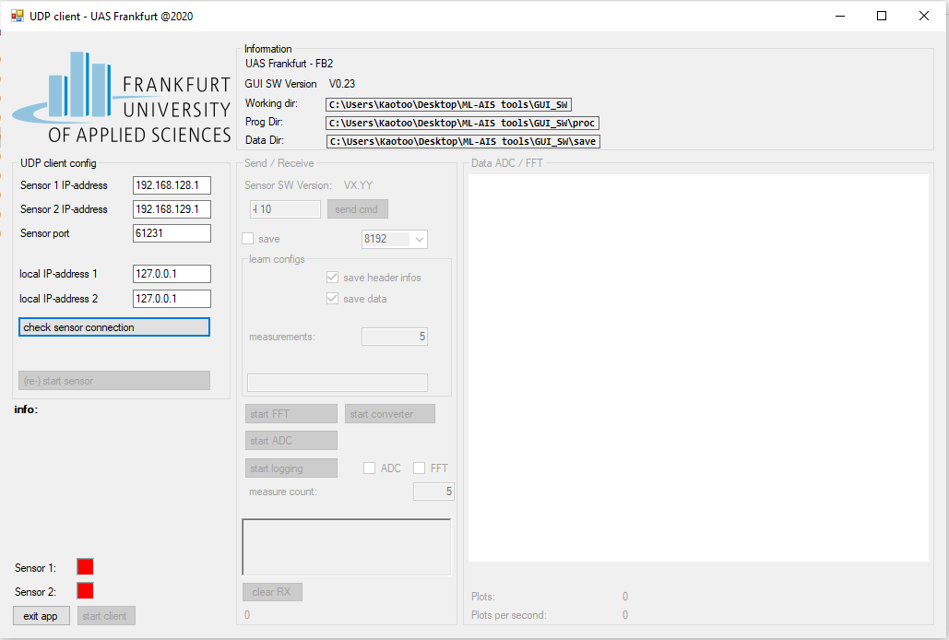
Questions and suggestions
What if we use both program at the same time ?
Prediction Result
Ultrasonic Result

Slide 8
Questions and suggestions
Start program with camera
Prediction Result
Record
Time(s)
Ultrasonic Result
Record
Time(s)
Start program with ultrasonic
< 1s
< 1s
Timestamps : Program with ultrasonic as the following
Timestamp = timestamp from file creation + ( #measurement/10 ) ※ 1s = 10 measurements

Slide 9
Questions and suggestions
Project Report
Master Thesis

