Slide 1
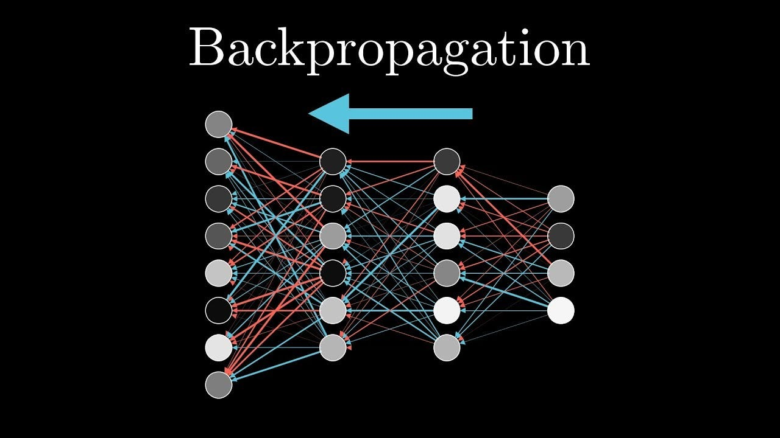
Backpropagation
Het werkpaard van Neurale Netwerken

Slide 2
Dagindeling
Ochtend
Stap voor stap implementatie kruisjes + rondjes: de “uitgeschreven” variant
Middag
Uiteenzetting deep learning & backpropagation

Slide 3




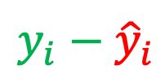

ML model parabool
$$b_{1}$$
$$w_{1}$$
$$x_{i}$$
$$y_{i}−{\hat{y}}_{i}$$
‘error’
$$b_{2}$$
$$w_{2}$$
‘prediction’
$${\hat{y}}_{i}=ReLU\left(w_{1}x_{i}+b_{1}\right)+ReLU\left(w_{2}x_{i}+b_{2}\right)$$
Notes:
Als je interne model kloppende voorspellingen kan doen

Slide 4
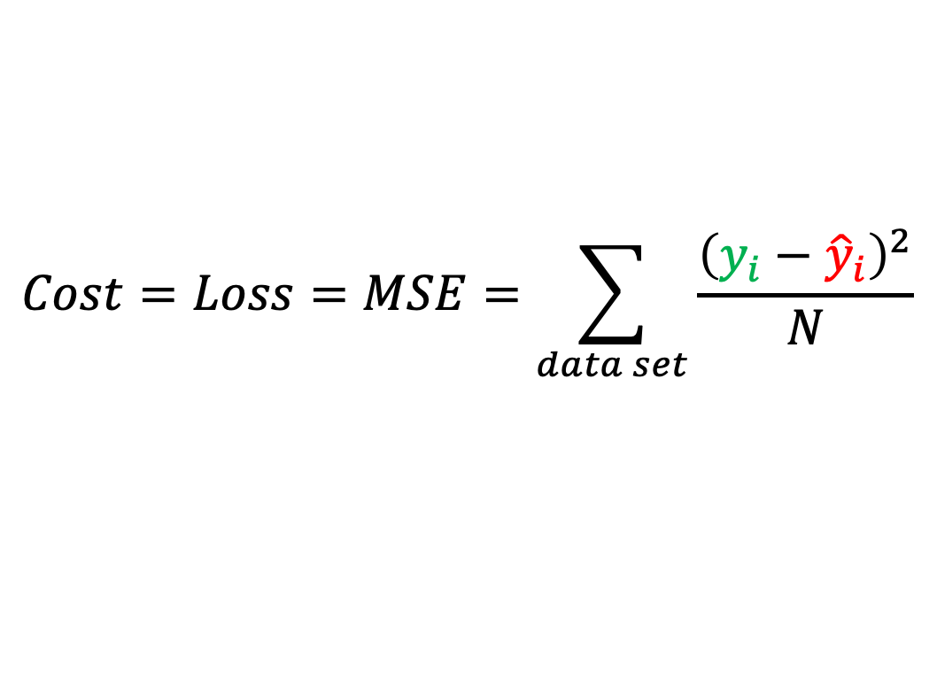
Gradient Descent (1)
$$Cost=Loss=MSE=\sum_{data set}{\frac{{\left(y_{i}−{\hat{y}}_{i}\right)}^{2}}{N}}$$
Ons doel: MSE zo klein mogelijk maken (minimaliseren)

Slide 5
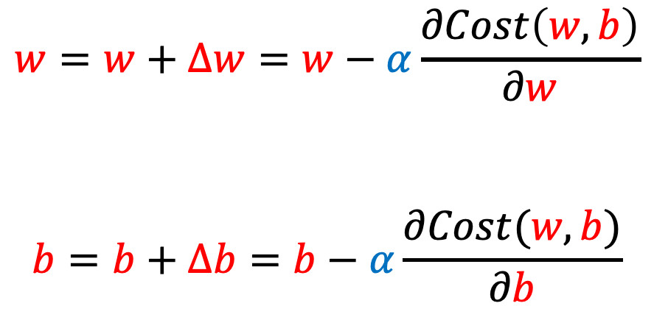
Gradient Descent (2)
$$w=w+∆w=w−α\frac{∂Cost\left(w,b\right)}{∂w}$$
$$b=b+∆b=b−α\frac{∂Cost(w,b)}{∂b}$$
Ons doel: MSE zo klein mogelijk maken (minimaliseren)
Notes:
https://machinelearningcompass.com/machine_learning_math/gradient_descent_for_linear_regression

Slide 6
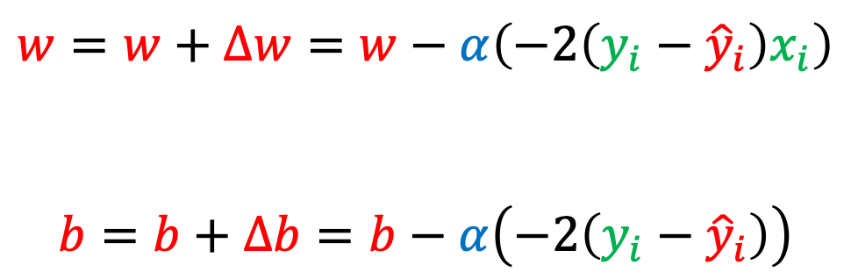
Gradient Descent (3)
$$w=w+∆w=w−α\left(−2\left(y_{i}−{\hat{y}}_{i}\right)x_{i}\right)$$
$$b=b+∆b=b−α\left(−2\left(y_{i}−{\hat{y}}_{i}\right)\right)$$
Ons doel: MSE zo klein mogelijk maken (minimaliseren)
Notes:
https://machinelearningcompass.com/machine_learning_math/gradient_descent_for_linear_regression

Slide 7


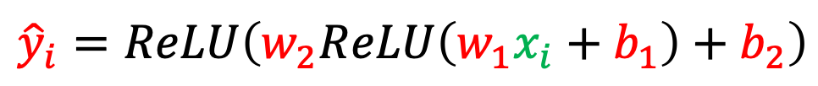







ML model edge detector
$$x_{i}$$
$$z_{1}$$
$$z_{2}$$
$$a_{1}$$
$$a_{2}$$
$$y_{i}−{\hat{y}}_{i}$$
‘error’
$$w_{1}$$
$$b_{1}$$
$$w_{2}$$
$$b_{2}$$
‘prediction’
$${\hat{y}}_{i}=ReLU\left(w_{2}ReLU\left(w_{1}x_{i}+b_{1}\right)+b_{2}\right)$$

Slide 8
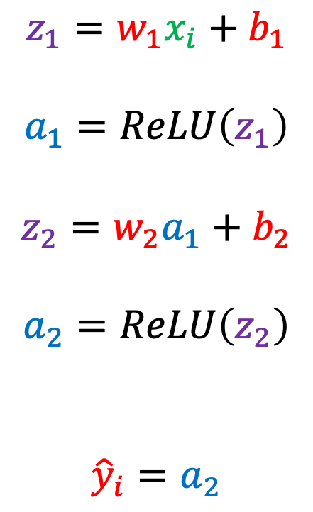
Model term voor term uitgeschreven
$$z_{1}=w_{1}x_{i}+b_{1}$$
$$a_{1}=ReLU\left(z_{1}\right)$$
$$z_{2}=w_{2}a_{1}+b_{2}$$
$$a_{2}=ReLU\left(z_{2}\right)$$
$${\hat{y}}_{i}=a_{2}$$

Slide 9
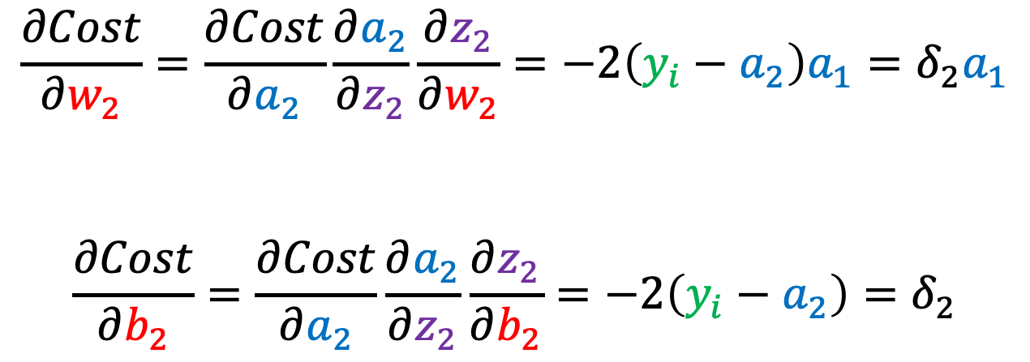
Backpropagation (1)
$$\frac{∂Cost}{∂w_{2}}=\frac{∂Cost}{∂a_{2}}\frac{∂a_{2}}{∂z_{2}}\frac{∂z_{2}}{∂w_{2}}=−2\left(y_{i}−a_{2}\right)a_{1}=δ_{2}a_{1}$$
$$\frac{∂Cost}{∂b_{2}}=\frac{∂Cost}{∂a_{2}}\frac{∂a_{2}}{∂z_{2}}\frac{∂z_{2}}{∂b_{2}}=−2\left(y_{i}−a_{2}\right)=δ_{2}$$

Slide 10
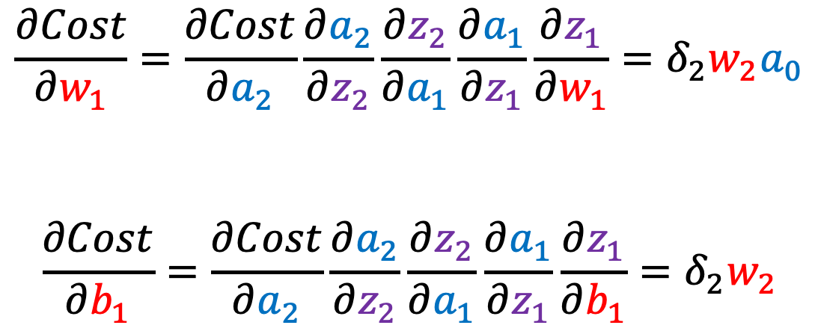
Backpropagation (2)
$$\frac{∂Cost}{∂w_{1}}=\frac{∂Cost}{∂a_{2}}\frac{∂a_{2}}{∂z_{2}}\frac{∂z_{2}}{∂a_{1}}\frac{∂a_{1}}{∂z_{1}}\frac{∂z_{1}}{∂w_{1}}=δ_{2}w_{2}a_{0}$$
$$\frac{∂Cost}{∂b_{1}}=\frac{∂Cost}{∂a_{2}}\frac{∂a_{2}}{∂z_{2}}\frac{∂z_{2}}{∂a_{1}}\frac{∂a_{1}}{∂z_{1}}\frac{∂z_{1}}{∂b_{1}}=δ_{2}w_{2}$$

Slide 11
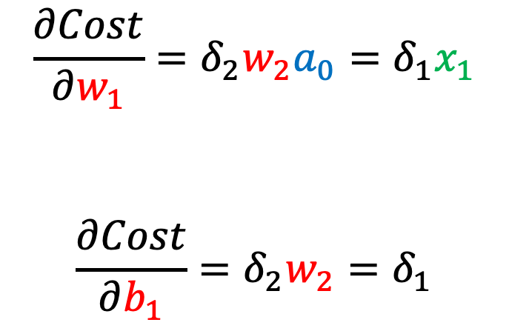
Backpropagation (3)
$$\frac{∂Cost}{∂w_{1}}=δ_{2}w_{2}a_{0}=δ_{1}x_{1}$$
$$\frac{∂Cost}{∂b_{1}}=δ_{2}w_{2}=δ_{1}$$

