Slide 1
Gnuplot&Menu

Slide 2
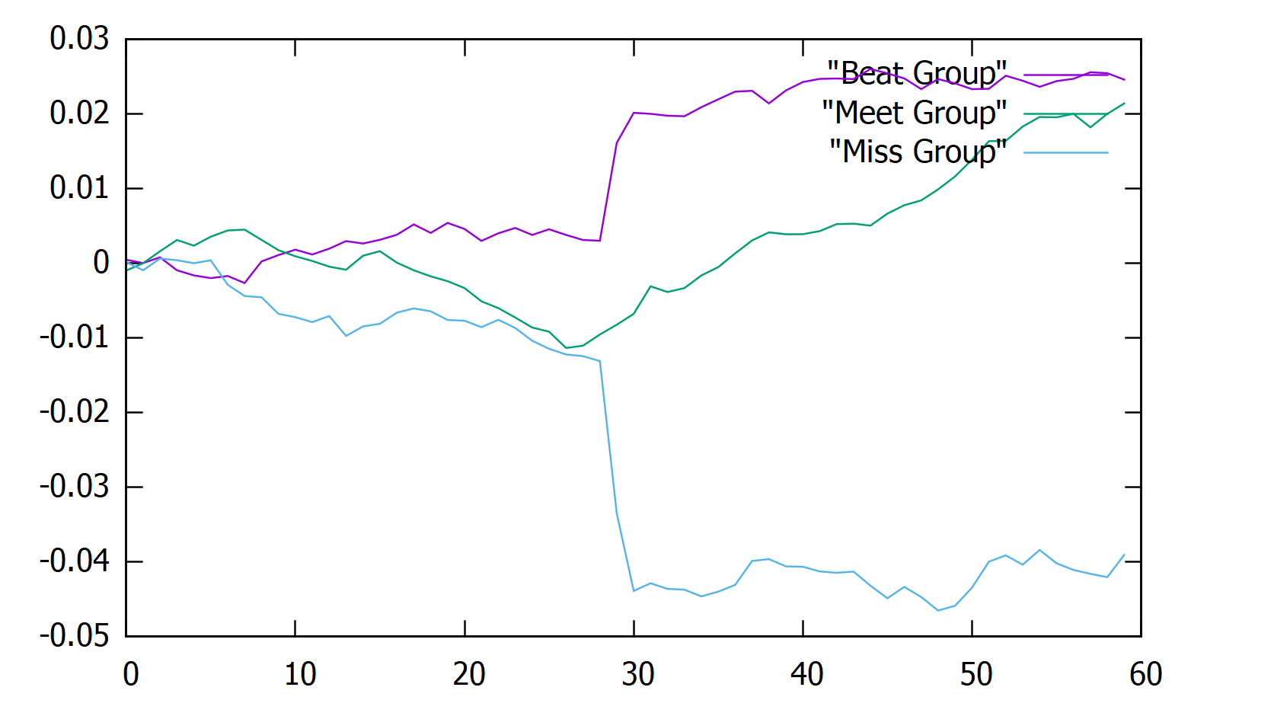

Slide 3
void plotResults(stratify& Beat_, stratify& Meet_, stratify& Miss_) {
vector<double> Beat_CAAR = Beat_.Get_Aver_CAAR();
vector<double> Meet_CAAR = Meet_.Get_Aver_CAAR();
vector<double> Miss_CAAR = Miss_.Get_Aver_CAAR();
//cout << "Debug: "<<Beat_CAAR.size() << endl;

Slide 4
double* xData = (double*)malloc(60 * sizeof(double));
double* yData1 = (double*)malloc(60 * sizeof(double));
double* yData2 = (double*)malloc(60 * sizeof(double));
double* yData3 = (double*)malloc(60 * sizeof(double));

Slide 5
for (int i = 0; i <= 59; i++) {
xData[i] = double(i);
yData1[i] = Beat_CAAR.at(i);
yData2[i] = Meet_CAAR.at(i);
yData3[i] = Miss_CAAR.at(i);
FILE* gnuplotPipe, * tempDataFile;
const char* BeatData = "Beat Group";
const char* MeetData = "Meet Group";
const char* MissData = "Miss Group";
double x1, y1, x2, y2, x3, y3;

Slide 6
Quit=False
If input is invalid
“Invalid input”
Case1:Retrieve historical price data
Case2:Pull info of one stock
Case3:Show AAR, AAR-SD, CAAR and CAAR-SD of one grou
Case4: Draw plot
Case5: Exit
Quit=True
Switch

Slide 7
switch (Response)
{
case '1':
if (PrepareData) { cout << "Historical price data for all stocks retrieved." << endl << endl << endl << endl; break; }
cout << "Retrieving historical price data for all stocks:" << endl;
t0 = clock();
stock_map = WebCrawler.getBloomberg("C:\\Users\\WilliamNG\\Desktop\\2019Q1_new.csv");
GetPriceData(stock_map, SPY500);
cout << "Historical price data for all stocks retrieved; time used: " << setprecision(3) <<
(clock() - t0) * 1.0 / CLOCKS_PER_SEC / 60.0 << " min" << endl << endl;
t0 = clock();
Stratify_Calculate_Bootstrap(stock_map, SPY500, Beat, Meet, Miss);
cout << "AAR and CAAR of all 3 groups calculated; time used: " << setprecision(3) <<
(clock() - t0) * 1.0 / CLOCKS_PER_SEC / 60.0 << " min" << endl << endl << endl << endl;
PrepareData = true;
break;

Slide 8
case '2':
if (!PrepareData) { cout << "Please first retrieve historical price data." << endl << endl << endl << endl; break; }
cout << "Pull information of one stock:" << endl << "Please enter the ticker: ";
cin >> StrInput;
if (stock_map.count(StrInput) > 0)
stock_map[StrInput].PullStockInfo();
else
cout << "Invalid Input: Please re-enter your choice." << endl;
cout << endl << endl << endl;
break;

Slide 9
case '3':
if (!PrepareData) { cout << "Please first retrieve historical price data." << endl << endl << endl << endl; break; }
cout << "Show AAR, AAR-SD, CAAR and CAAR-SD of one group:" << endl << "Please enter Beat, Meet or Miss: ";
cin >> StrInput;
if (StrInput == "Beat")
Beat.PullGroupInfo();
else if (StrInput == "Meet")
Meet.PullGroupInfo();
else if (StrInput == "Miss")
Miss.PullGroupInfo();
else
cout << "Invalid Input: Please re-enter your choice." << endl;
cout << endl << endl << endl;
break;

Slide 10
case '4':
if (!PrepareData) { cout << "Please first retrieve historical price data." << endl << endl << endl << endl; break; }
cout << "Show the CAAR graph of all 3 groups:" << endl << endl;
plotResults(Beat, Meet, Miss);
cout << endl << endl << endl;
break;

