Slide 1
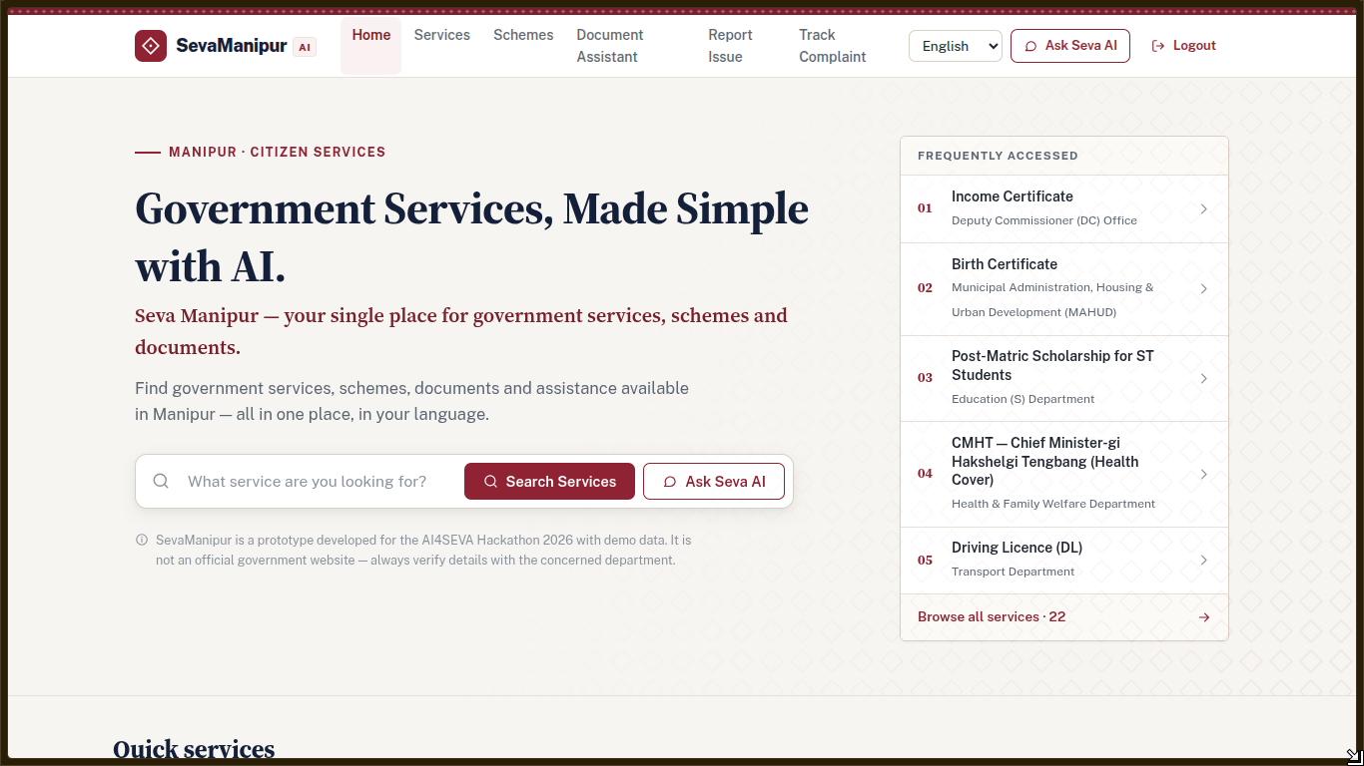
AI4SEVA 2026 · SOCIAL WELFARE · SW-01
Find support.
Know your next step.
SevaManipur AI
SW-01 · Welfare Scheme Navigator
Find possible matches, understand requirements and plan what to do next.
PROFILE → POSSIBLE MATCHES → NEXT STEPS
Prototype developed for the AI4SEVA Hackathon. Not an official Government of Manipur website.
PITCH PRESENTATION
SW-01 · SOCIAL WELFARE
9 OCTOBER 2026
SEVAMANIPUR AI · AI4SEVA 2026 · PROTOTYPE
01 / 06

Slide 2
02 / PROBLEM & SOLUTION
Help citizens move from questions to next steps
THE CITIZEN PROBLEM
“What might fit me?”
“What do I need?”
“What happens next?”
Scheme rules can be hard to find and compare.
Documents and application steps are spread across sources.
People need guidance, while the department makes the final decision.
OUR RESPONSE
Share basics
See possible matches
Plan next steps
01
→
02
→
03
Age · income · work · area
Basic rule checks + reasons
Documents · process · official links
The app offers guidance. The department decides eligibility.
SEVAMANIPUR AI · AI4SEVA 2026 · PROTOTYPE
02 / 06

Slide 3
03 / HOW IT WORKS
Clear rules. Useful explanations. Human decisions.
PROFILE
RULE MATCH
WHY THIS MATCH
NEXT ACTION
Citizen inputs
→
Deterministic checks
→
Explainable result
→
Guided application
Age, occupation,
income and area
Transparent scheme
criteria filters
Show match reasons,
source and caveats
Documents, process
and AI assistance
Basic rule checks
AI explains the catalog
Department decides
The current matcher checks age, work, area and income.
The assistant explains available records and points to listed sources.
A match is not approval. Confirm current rules and application status with the department.
The matcher is a prototype: scheme-specific checks, such as disability or widow status, still need to be added.
SEVAMANIPUR AI · AI4SEVA 2026 · PROTOTYPE
03 / 06

Slide 4
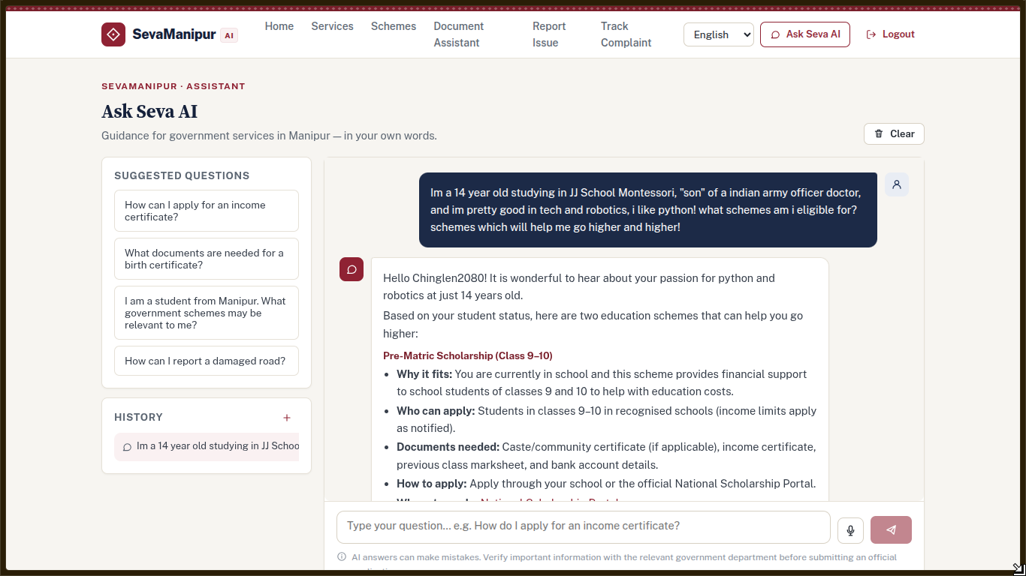
04 / THE PROTOTYPE
What works today — and what needs validation
CURRENT PROTOTYPE
Scheme finder
Seva AI
Basic checks: age, work, area and income
Explains catalog information in a chat
Languages
Live architecture
English, Hindi and Meiteilon controls; translation review remains
Vercel app and APIs; Supabase catalog and signed-in data
DATA STATUS
7 source-linked Social Welfare records are in Supabase; the department must confirm current rules and availability. Other records are samples.
Next: validate the catalog, add scheme-specific rules and test with citizens.
SEVAMANIPUR AI · AI4SEVA 2026 · PROTOTYPE
04 / 06

Slide 5
05 / PILOT & SUSTAINABILITY
A practical pilot needs a trusted owner
PUBLIC VALUE FIRST
SUSTAINABILITY MODEL
Keep scheme discovery and guidance free for citizens.
Content owner
Review schedule
Department reviews rules, sources and links.
Check changes and application status regularly.
Pilot & learn
Protect users
Test whether citizens reach the right next step.
Minimize personal data and review privacy needs.
Fund operations
Expand in stages
Hosting and maintenance need an approved owner and budget.
Add departments after their records are reviewed.
A real service needs an accountable content owner and a regular review cycle.
This is a proposed pilot model; no government partnership or funding is claimed.
SEVAMANIPUR AI · AI4SEVA 2026 · PROTOTYPE
05 / 06

Slide 6
06 / ROLLOUT PLAN
Start with Social Welfare. Expand after review.
A focused entry point
PILOT IN PHASES
Keep state and central schemes clear. Add departments only after checking their information.
01 Verify
02 Pilot
03 Expand
Social Welfare sources + rules
Test with citizens and staff
Add reviewed departments
ALL
MANIPUR
OTHER SCHEMES
Browse full catalog
State schemes
Central / other
Built for careful growth
+ Filter by department
• One catalog with sources and review dates
• Simple matching rules, separate from AI explanations
• Vercel app with Supabase catalog and user data
FIRST DATA DROP
7 Social Welfare records link to official sources; current rules and application status need department confirmation.
SevaManipur AI is a prototype developed for AI4SEVA 2026; not an official government service.
SEVAMANIPUR AI · AI4SEVA 2026 · PROTOTYPE
06 / 06

