Slide 1

Working of Stepper Motor
Introduction to Stepper Motor and Its Applications

Slide 2
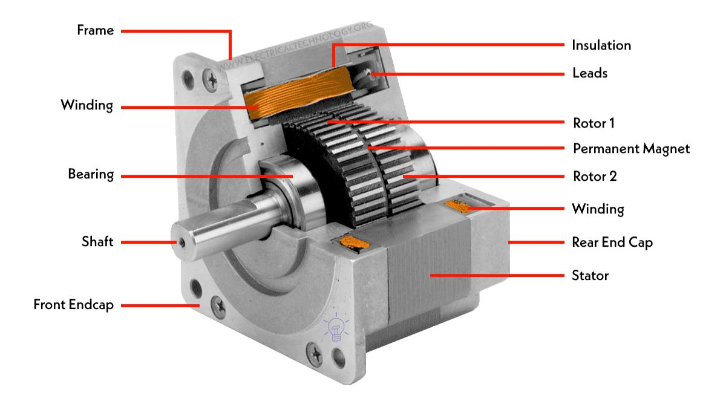
Stepper motor
Source :- https://images.app.goo.gl/fwRzxX67ThweBiKb8

Slide 3
Introduction
A stepper motor is a brushless DC electric motor that moves in discrete steps.
It converts electrical pulses into precise mechanical motion.

Slide 4
Importance of Stepper Motors
✔ High Precision
✔ No Feedback Required
✔ Common in CNC, Robotics, and 3D Printing

Slide 5
Types of Stepper Motors
1. Permanent Magnet Stepper Motor
2. Variable Reluctance Stepper Motor
3. Hybrid Stepper Motor

Slide 6
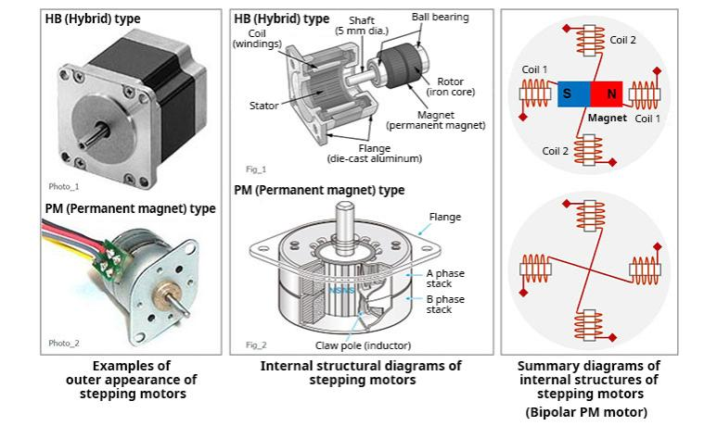
Types
Source :- https://images.app.goo.gl/TT23wtazSFDdP8So6

Slide 7
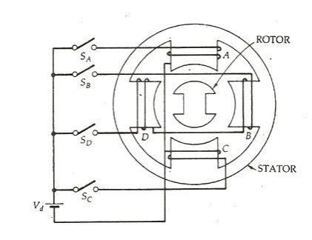
Vr stepper motor
Source :- https://images.app.goo.gl/TeNnZAF41EaSwHYR7

Slide 8
Construction of Stepper Motor
Rotor: Rotating part (magnet/iron core)
Stator: Stationary part with windings
Bearings: Support rotor movement

Slide 9
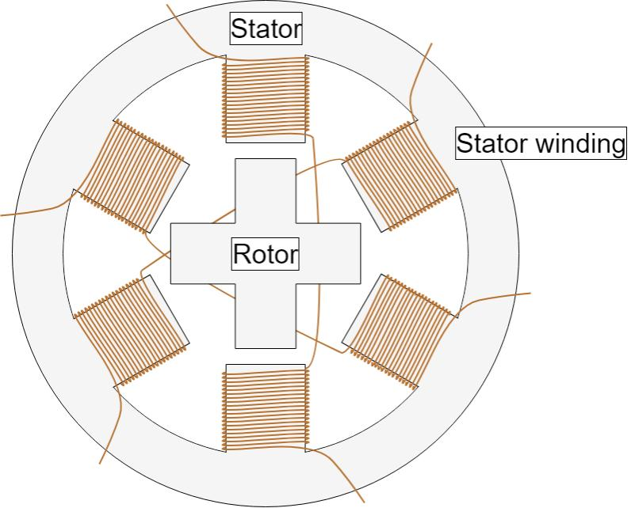
Source :- https://images.app.goo.gl/YsxwevbEG47AqhpEA

Slide 10
Working Principle
Stepper motors move in fixed steps by energizing different coils in sequence.
Pulse signal → Magnetic field changes → Rotor moves.

Slide 11
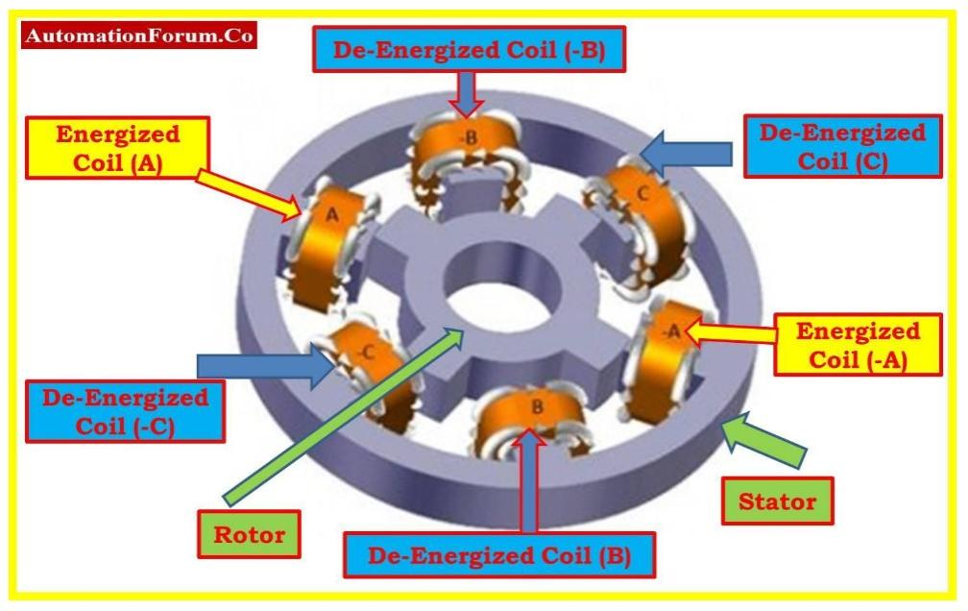
Source :- https://images.app.goo.gl/updWmSp5xSMANRyH8

Slide 12
Stepper Motor Drive Modes
1. Wave Drive
2. Full Step Drive
3. Half Step Drive
4. Microstepping

Slide 13
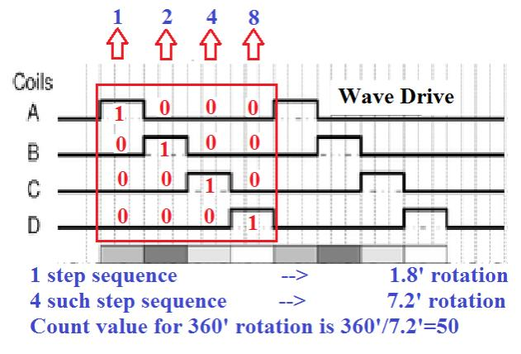
Wave drive
Source :- https://images.app.goo.gl/vdektCKEDVzfEt4c9

Slide 14
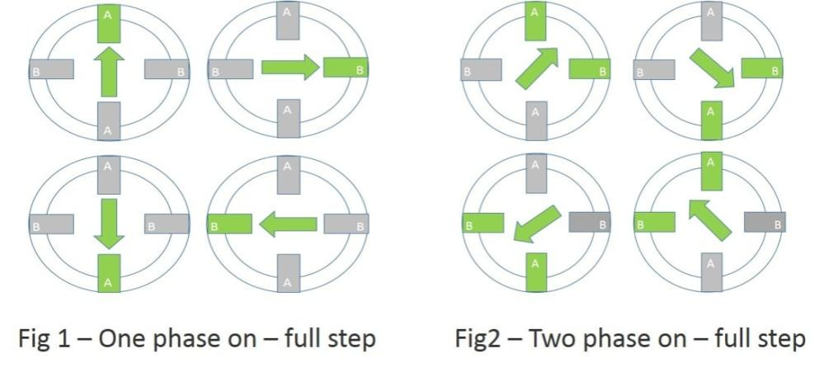
Full step Drive
Source :- https://images.app.goo.gl/ki8fwrrJEVtk4ZHz8

Slide 15
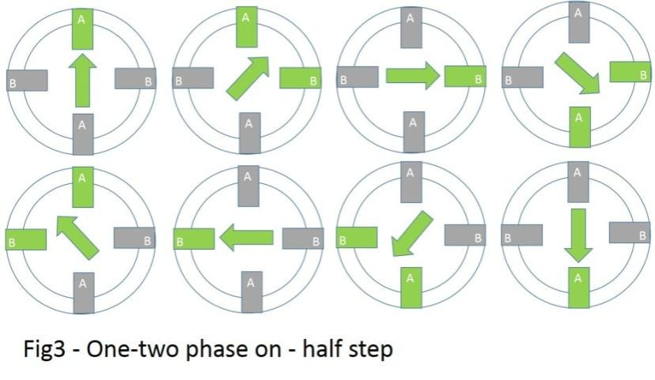
Half step drive
Source :- https://images.app.goo.gl/ki8fwrrJEVtk4ZHz8

Slide 16
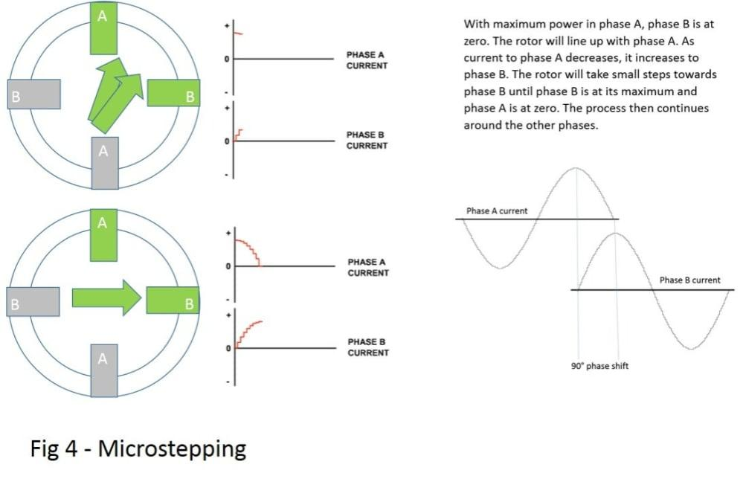
Microsteping
Source :- https://images.app.goo.gl/kj1d1njucL1pWP8BA

Slide 17
Stepper Motor Control
Controlled using microcontrollers like Arduino.
Requires driver circuit (ULN2003, A4988, etc.).

Slide 18
Step Angle Calculation
Formula: θ = 360° / N (steps per revolution)
Example: 200 steps → 1.8° per step

Slide 19
Stepper Motor Driver Circuit
ULN2003 - Unipolar Stepper Motor Driver
A4988 - Bipolar Stepper Motor Driver
H-Bridge Circuit for coil switching

Slide 20
Advantages
✔ Simple design, no brushes
✔ Precise positioning
✔ No feedback required

Slide 21
Disadvantages
✖ Less efficient than DC motors
✖ No torque at high speeds
✖ Requires driver circuits

Slide 22
Applications
✔ CNC Machines
✔ 3D Printers
✔ Robotics
✔ Textile Machines

Slide 23
Stepper Motor vs Servo Motor
Stepper Motor: Open-loop, moderate torque, low speed
Servo Motor: Closed-loop, high torque, high speed

Slide 24
Selection Criteria
✔ Torque Requirement
✔ Step Angle
✔ Voltage & Current Ratings
✔ Environmental Conditions

Slide 25
Future of Stepper Motors
✔ AI & IoT Integration
✔ Energy-efficient stepper motors
✔ Hybrid Stepper Innovations

Slide 26


