Slide 1
Pellet Burner Controller
Hardware Components & Wiring Guide
ESP32 · SH1106 OLED · DS18B20 · MAX6675 · Relays · AC Dimmer · Buttons

Slide 2
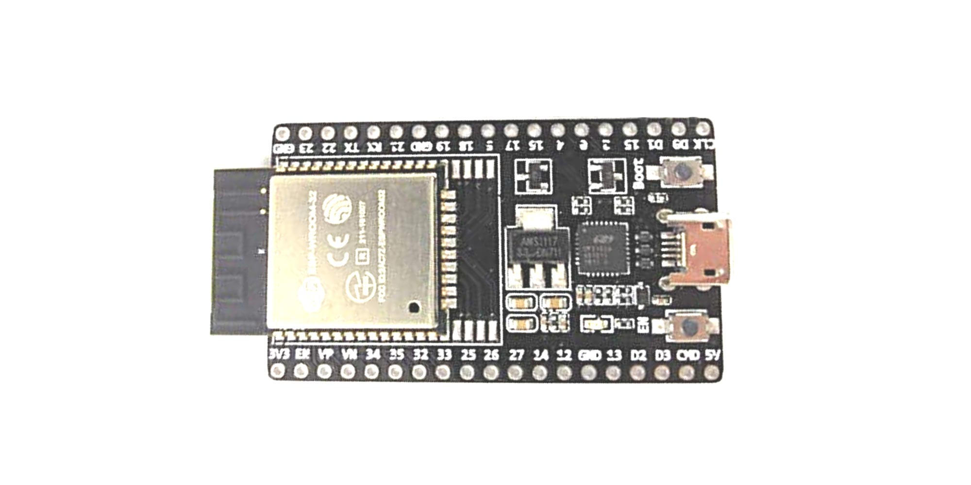
ESP32 DevKit V1 — Main Controller
Key Specifications
Power Supply
• Dual-core Xtensa LX6 @ 240 MHz
• USB 5V during development
• 520 KB SRAM | 4 MB Flash
• VIN pin: 5–12V regulated input
• 802.11 b/g/n WiFi + Bluetooth 4.2
• 3.3V pin: output — do NOT feed 5V
• 3.3 V logic — NOT 5 V tolerant
• Use separate 5V/3A PSU in production
• 30 GPIO pins (several input-only)
• (relay coils draw surge current)
• ADC, DAC, SPI, I2C, UART, PWM
Role in this project
GPIO Pin Assignments
• Main controller — FreeRTOS tasks
• GPIO4 DS18B20 OneWire data
• HTTP web server for settings UI
• GPIO5 MAX6675 SPI CS
• Controls relays and AC dimmer module
• GPIO18 MAX6675 SPI SCK
• Reads DS18B20 and MAX6675 sensors
• GPIO19 MAX6675 SPI MISO
• GPIO21 OLED SDA (I2C)
• Drives OLED display over I2C
• GPIO22 OLED SCL (I2C)
• GPIO25 Relay — Feeder motor
• GPIO26 Dimmer CH2 — Igniter
• GPIO27 Relay — Water pump
• GPIO33 Dimmer CH1 — Blower
• GPIO35 Zero-cross detect (input)
• GPIO13 Button: On/Off
• GPIO14 Button: Emergency stop

Slide 3

SH1106 OLED Display — 1.3" 128×64
Specifications
Wiring to ESP32
• Driver IC: SH1106 (not SSD1306)
• VCC → 3.3V
• Size: 1.3 inch diagonal
• GND → GND
• Resolution: 128 × 64 pixels, monochrome
• SDA → GPIO21
• Interface: I2C (default address 0x3C)
• SCL → GPIO22
• Operating voltage: 3.3V – 5V
Notes
• Library: U8g2 (SH1106 constructor)
• No pull-up resistors needed
• (ESP32 internal pull-ups sufficient)
• I2C address: 0x3C (some boards 0x3D)
Role in this project
• At-a-glance live status without phone/browser:
• • Water temp (DS18B20) and flame temp (MAX6675)
• • Pump / Feeder / Blower state indicators
• • Current state machine state
• • Active operation mode (Standby / Auto / Timer)
• • Error icons (custom bitmap) on fault conditions
Important: SH1106 ≠ SSD1306
• Many cheap 1.3" modules use SH1106.
• U8g2 constructor: U8G2_SH1106_128X64_NONAME

Slide 4
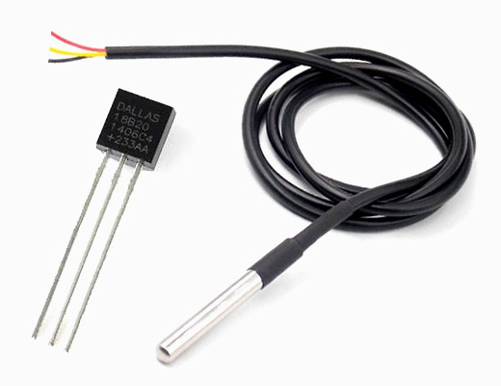
DS18B20 — Water Temperature Sensor
Specifications
Wiring — normal (3-wire) mode
• Protocol: 1-Wire (OneWire)
• VCC (red) → 3.3V
• Range: –55°C to +125°C
• GND (black) → GND
• Accuracy: ±0.5°C (–10°C to +85°C)
• DATA (yellow) → GPIO4
• Resolution: 9–12 bit (configurable)
• 4.7 kΩ pull-up: DATA ↔ 3.3V
• Supply: 3.0V – 5.5V or parasitic (2-wire)
Wiring — parasitic (2-wire) mode
• Multiple sensors per bus (unique 64-bit ROM)
• VCC (red) → GND (tied low)
• Conversion: 94ms (9-bit) to 750ms (12-bit)
• GND (black) → GND
• DATA (yellow) → GPIO4
• 4.7 kΩ pull-up: DATA ↔ 3.3V
Role in this project
• Measures water / boiler temperature
• Used for: pump start/stop hysteresis,
• power level selection (P1/P2/P3),
• economy mode logic,
• target temperature control loop
Recommendation
• Use waterproof stainless steel probe version.
• Route cable away from mains wiring.
• Use 12-bit resolution (0.0625°C steps).

Slide 5
MAX6675 — Flame Thermocouple Module
Specifications
Wiring to ESP32
• Sensor type: K-type thermocouple
• VCC → 3.3V
• Range: 0°C to +1023.75°C
• GND → GND
• Resolution: 0.25°C (12-bit)
• CS → GPIO5
• Interface: SPI (read-only, 3-wire)
• SCK → GPIO18
MAX6675 Module
• Supply: 3.0V – 5.5V
• SO (MISO) → GPIO19
• Cold-junction compensation: internal
K-type thermocouple
• Open thermocouple detection (fault flag)
• Yellow (+) → T+ on module
• Max SPI clock: 4.3 MHz
• Red/White (–) → T– on module
• Tip exposed to flame
Role in this project
• Measures flame / combustion temperature
• Flame detection: above ~100°C = flame on
• Used for: ignition confirmation,
• overheat protection, OLED readout
Notes
• Dedicated SPI bus — no sharing.
• Keep thermocouple wiring short and twisted.
• Bit-15=0 signals open thermocouple fault.
• Use K-type rated to at least 900°C.

Slide 6
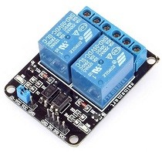
5V Relay Modules — Feeder / Pump
Specifications
• Coil voltage: 5V DC (logic-level trigger)
• Trigger: active LOW (LOW = relay ON)
• Contact rating: 10A @ 250V AC
• Isolation: optocoupler (ESP32 ↔ coil)
• Flyback diode: included on module
• Indicator LED per channel
Note
• Igniter is now on AC dimmer CH2 — not a relay.
• Only 2 relay modules needed for this build.
Feeder Motor
Water Pump
Active LOW wiring note
• IN → GPIO25
• IN → GPIO27
• ESP32 GPIO init HIGH at boot →
• VCC → 5V
• VCC → 5V
• relay stays OFF during reset/startup
• GND → GND
• GND → GND
• LOW = relay ON, HIGH = relay OFF
• COM → AC Live
• COM → AC Live
Safety
• NO → Load
• NO → Load
• All relays default OFF on power-up
• Pellet auger / conveyor
• Circulation pump
• Emergency stop: all GPIOs → HIGH
Decoupling
• 100 nF ceramic cap across VCC/GND
• at each relay module — prevents spikes

Slide 7
2-Channel AC Dimmer — Blower & Igniter
Module: Hipzeepo 2-Channel AC Dimmer
DC logic side — wiring to ESP32
• 3.3V / 5V logic · 110V / 220V AC load
• VCC → 3.3V (or 5V)
• Phase-angle control — variable AC power
• GND → GND bus
Built into the module (no discrete parts needed)
• ZC → GPIO35 (zero-cross, shared output)
• TRIAC × 2 (one per channel)
• DIM1 → GPIO33 (CH1 — blower motor)
• Optocouplers for gate isolation
• DIM2 → GPIO26 (CH2 — igniter soft-start)
Hipzeepo 2-ch Dimmer
• Snubber circuits per channel
AC load side
• Zero-cross detector (shared ZC output)
• CH1 OUT → Blower motor (220V AC)
Control method
• CH2 OUT → Igniter heater (220V AC)
• PWM duty → phase angle → AC power %
• AC IN → Mains L + N (via 5–10A fuse)
• CH1 (blower): 0–100% continuously variable fan speed
Safety
• CH2 (igniter): soft-start ramp 0→100% over 4 s,
• AC side: 230V — HIGH VOLTAGE
• then holds at 100% — limits inrush on cold coil
• Keep AC and DC wiring physically separated
• Fuse live wire before module AC IN

Slide 8
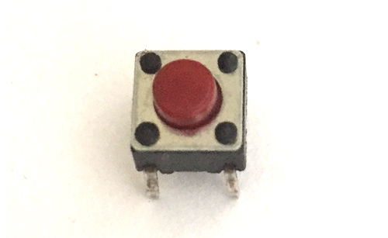
Physical Buttons — On/Off & Emergency Stop
Button type
Button 1 — On / Off
• Momentary normally-open (NO) push button
• GPIO13 ← button ← GND
• Panel-mount, rated for frequent use
• Toggles Standby ↔ previous mode
• On/Off: latching toggle preferred
• (Automatic or Timer)
• E-Stop: momentary (NO) only
Button 2 — Emergency Stop
Wiring (active LOW, internal pull-up)
• GPIO14 ← button ← GND
• One terminal → GPIO pin
• Immediate shutdown — ALL outputs OFF
• Other terminal → GND
• State machine → STANDBY instantly
• ESP32 internal pull-up enabled in firmware
• Does NOT write op_mode to NVS flash
• No external resistors needed
• Button pressed → GPIO reads LOW
• Button released → GPIO reads HIGH
Debounce strategy
• Hardware: 100nF cap from GPIO pin to GND (optional).
• Software: ignore transitions for 50ms after first edge.
• E-Stop: no debounce delay — act on first LOW edge immediately.

Slide 9
Complete Wiring Summary
I2C Bus (GPIO21 SDA, GPIO22 SCL)
SPI Bus (dedicated)
Relay outputs (active LOW)
• SH1106 OLED — addr 0x3C
• MAX6675 thermocouple module
• GPIO25 → Relay IN — Feeder motor
• VCC → 3.3V GND → GND
• CS → GPIO5
• GPIO27 → Relay IN — Water pump
• SDA → GPIO21 SCL → GPIO22
• SCK → GPIO18
• Relay VCC → 5V GND → GND
OneWire Bus (GPIO4)
• MISO → GPIO19
AC Dimmer (2-ch Hipzeepo module)
• DS18B20 water temp sensor
• VCC → 3.3V GND → GND
• GPIO35 ← ZC zero-cross in
• DATA → GPIO4 (4.7kΩ to 3.3V)
Zero-cross detect
• GPIO33 → DIM1 blower speed
• VCC → 3.3V GND → GND
• Signal → GPIO35 (input only)
• GPIO26 → DIM2 igniter on/off
• 3.3V logic, falling edge ISR
Buttons (active LOW, internal pull-up)
Power rails
Safety reminders
• GPIO13 ← On/Off button ← GND
• 3.3V: ESP32 reg → OLED, sensors, dimmer
• Never connect 5V to ESP32 3.3V rail
• GPIO14 ← Emergency Stop button ← GND
• 5V (HLK-PM01): relay VCC, ESP32 VIN
• Dimmer module has built-in optocouplers
• AC 230V: dimmer load side — isolated
• Fuse AC input (5–10A slow blow)
• Do AC wiring last — verify logic first

Slide 10
Pin Reference Table
Component | GPIO | Protocol | Voltage | Notes
SH1106 OLED — SDA | GPIO21 | I2C | 3.3 V | I2C address 0x3C
SH1106 OLED — SCL | GPIO22 | I2C | 3.3 V | 400 kHz fast-mode
DS18B20 DATA | GPIO4 | 1-Wire | 3.3 V | 4.7 kΩ pull-up to 3.3 V
MAX6675 CS | GPIO5 | SPI | 3.3 V | dedicated SPI bus
MAX6675 SCK | GPIO18 | SPI | 3.3 V | max 4.3 MHz
MAX6675 MISO (SO) | GPIO19 | SPI | 3.3 V | read-only from module
Relay — Feeder IN | GPIO25 | GPIO | 3.3 V | active LOW, relay VCC = 5 V
Dimmer CH2 — Igniter | GPIO26 | PWM | 3.3 V | DIM2 on 2-ch AC dimmer module
Relay — Pump IN | GPIO27 | GPIO | 3.3 V | active LOW, relay VCC = 5 V
Dimmer CH1 — Blower | GPIO33 | PWM | 3.3 V | DIM1 on 2-ch AC dimmer module
Zero-cross detect | GPIO35 | GPIO | 3.3 V | input-only pin, falling edge ISR
Button — On/Off | GPIO13 | GPIO | 3.3 V | internal pull-up, active LOW
Button — E-Stop | GPIO14 | GPIO | 3.3 V | internal pull-up, active LOW

