Slide 1

Homing of a Robot

Slide 2


Anusheel Goswami 16-1-6-005
Rajneesh Kashyap 16-1-6-015
Tinkumoni Kalita 16-1-6-024
Under the guidance of
Dr. Koena Mukherjee
In Partial Fulfillment of the Fourth year UG Project Work
Electronics & Instrumentation Department
NIT Silchar, Assam

Slide 3

Contents
Introduction………………………………………………………………………..4
The idea of Homing……………………………………………………………..5-6
Objective………………………………………………………………………...7-8
Literature Survey…………………………………………………………........9-10
Software & Hardware…………………….…………………………………..11-13
Image Detection & Ranging……………………………………………..…...14-16
Contour Detection……………………………………………………….........17-18
Timeline…………………………………………………………………........19-20
Cost Involved………………………………………………………………...21-22
Reference……………………………………………………………….........23-24
The End……………………………………………………………………….....25

Slide 4

Introduction

Slide 5

The idea of Homing

Slide 6
The behavior which enables a robot to return to its initial position (home position) is termed “Homing”.
It is a crucial step for any mobile robot. Before giving any navigational instruction the robot needs to be initialized accurately so that the post processing of the collected data is correct.

Slide 7

Objective

Slide 8
Distance measurement of an object from the camera using OpenCV.
Analyze the object for obstacle avoidance
Static Obstacle
Dynamic Obstacle
Avoiding the obstacle using Potential Energy based concept.
Homing of the Robot for initialization

Slide 9

Literature Survey

Slide 10
S. No. | Ref. No. | Author | Title | Description
01 | 01 | K. Weber S. Venkatesh M. V. Srinivasan | Insect Inspired Robot Homing | The homing algorithm allows a mobile robot to home incrementally by moving in such a way as to gradually reduce the discrepancy between the current view and the view obtained from the home position.
02 | 02 | Antonis A. Argyros Kostas E. Bekris Stelios C. Orphanoudakis Lydia E. Kavraki | Robot Homing by Exploiting Panoramic Vision | The method assumes that the robot tracks visual features in panoramic views of the environment that it acquires as it moves.
03 | 03 | Iwan Ulrich Illah Nourbakhsh | Appearance-Based Obstacle Detection with Monocular Color Vision | Each individual image pixel is classified as belonging either to an obstacle or the ground based on its color appearance. The method uses a single passive color camera, performs in real-time, and provides a binary obstacle image at high resolution.
04 | 04 | Adrian Rosebrock | Image Processing, Tutorials | A website on Image Processing and Computer Vision

Slide 11
Software & Hardware

Slide 12
Software
Python 3.7.5
Libraries:
OpenCV (Open Source Computer Vision)
NumPy
imutils
Xming : Virtual Display
PuTTY : Connection to the RPi using SSH

Slide 13
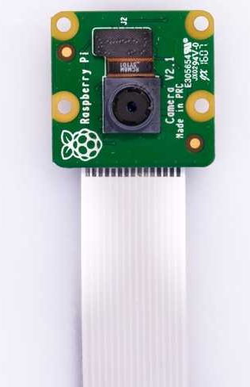
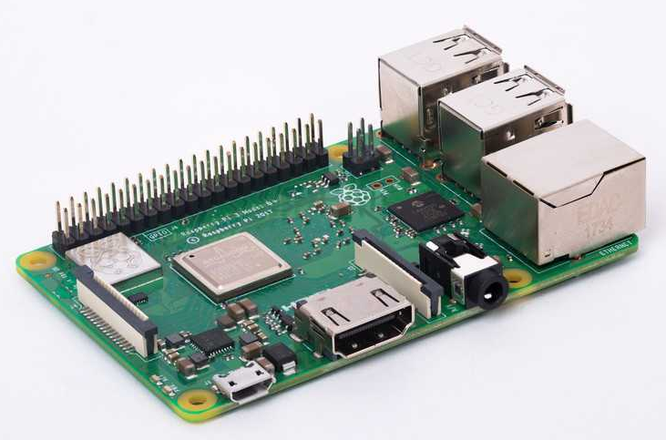
Hardware
Raspberry Pi 3B+
Pi Camera (5 MP)
USB A power supply (5V/2A)
Ethernet cable

Slide 14
Image Detection & Ranging

Slide 15
Ranging involves measuring the distance of an object from the lens of a camera.
This needs calibration of the camera with a sample image of the object which is at a known distance and whose distance needs to be measured from any unknown distance.

Slide 16
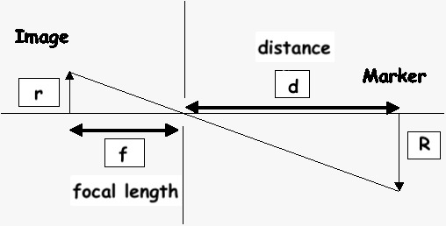
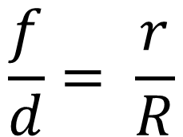
Using similarity of
triangles:
$$\frac{f}{d}= \frac{r}{R}$$
By calculating the focal length from the sample image, our lens will be calibrated for ranging of the same object.

Slide 17
Contour Detection

Slide 18
A raw image is blurred to remove noise and finally, it is converted to a binary image
This image is passed through Canny edge detection which identifies all edges according to local maxima identification
All continuous contours are grabbed
The contour with the maximum area is taken
The width of this contour is the pixel image width, which is the size of the image
From the formula the distance is calculated

Slide 19
Timeline

Slide 20
Finalizing the objective
July - August
Setting up the working environment
August - September
Using a camera to detect object
October - Present
RGB image to binary
Contour identification
Contour detection
Measuring the distance to the object from the image captured

Slide 21
Cost Involved

Slide 22
Raspberry Pi 3B+ = ₹4000
Pi Camera = ₹400

Slide 23
References

Slide 24

K. Weber, S. Venkatesh, M. V. Srinivasan. “Insect Inspired Robot Homing”, Adaptive Behaviour, 1998.
Antonis A. Argyros, Kostas E. Bekris, Stelios C. Orphanoudakis, Lydia E. Kavraki, "Robot Homing by Exploiting Panoramic Vision", Autonomous Robots 19, 2005 Springer Science + Business Media, Inc. Manufactured in The Netherlands, 2005.
Iwan Ulrich, Illah Nourbakhsh, “Appearance-Based Obstacle Detection with Monocular Color Vision”, AAAI-00 Proceedings. Copyright © 2000, AAAI
Adrian Rosebrock, “Image Processing using Python and OpenCV”, https://www.pyimagesearch.com, January 19, 2015.

Slide 25
The End.

