Slide 1

Eye Disease Classification Using Vision Transformer: A Deep Learning Approach
Jayakrishna VuppalapatI - 101163693
Tinku Rao Kotha - 101141777
Praveenkumar Kavali - 101167418
Krishna Prithvi Battula - 101164482

Slide 2
1.⁠ ⁠Project Overview:
The project aims to classify eye diseases using a Vision Transformer (ViT) model.
It involves both training and testing a deep learning model to accurately classify images of eye diseases into their respective categories.

Slide 3
2. Dataset Overview:
Our dataset comprises images of eye diseases categorized into four classes: cataract, diabetic retinopathy, glaucoma, and normal.
Each class represents a specific eye condition, and the dataset is likely used for training and testing to predict the accuracy of each class based on the input.

Slide 4
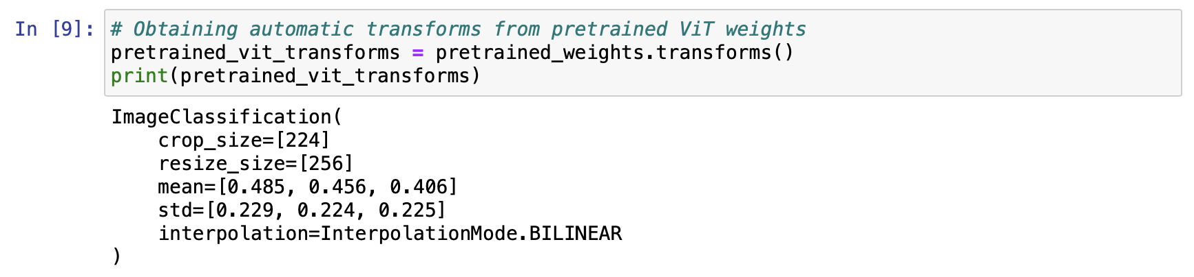
3.⁠ ⁠Data Preprocessing:
The dataset has been divided into training and testing sets, with 80% of the data allocated for training and 20% for testing.
Automatic transformations are applied to the images using pretrained ViT weights.

Slide 5
Data Preprocessing:
Generally automatic transformations are utilized for preprocessing images before feeding them into the Vision Transformer (ViT) model.
These transformations are automatically derived from the pretrained ViT weights.

Slide 6
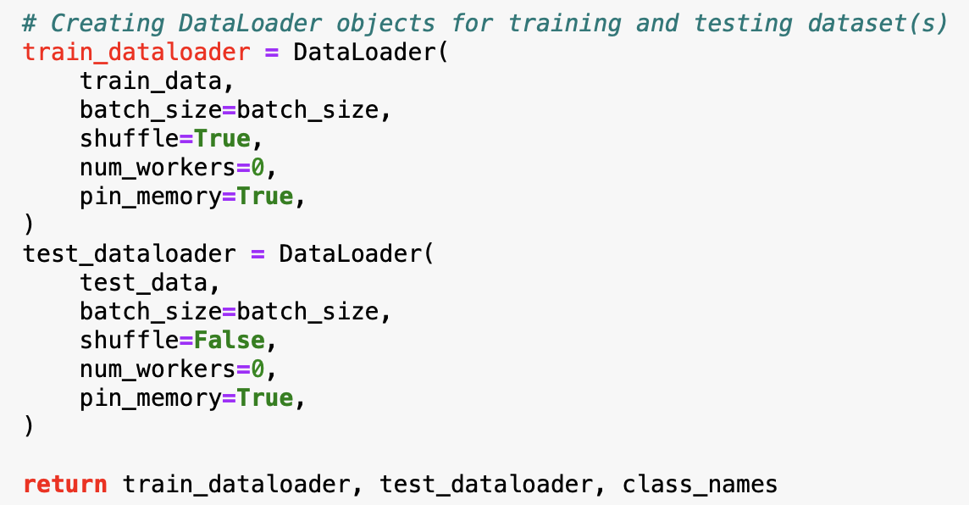
Data Preprocessing:
We created Data loaders to efficiently load and preprocess the images for training and testing.

Slide 7
4.⁠ ⁠About Vision Transformer:
Vision Transformer (ViT) is a deep learning architecture that applies the Transformer model, originally designed for natural language processing, to image recognition tasks.
ViT breaks down images into patches and treats them as sequences of tokens, which are then processed by Transformer layers to capture spatial relationships and features.
The pretrained ViT model used in this project is initialized with default weights and modified for the specific classification task.

Slide 8
5. Why Vision Transformer is better than CNN?
ViT utilizes the Transformer architecture, leveraging its self-attention mechanisms to capture the interconnections between image patches at a global scale.
Unlike CNNs, which have fixed convolutional and pooling layers, ViT is highly flexible and can handle inputs of arbitrary sizes.
ViT operates directly on raw image patches without requiring predefined grid-like structures, allowing it to scale to larger images without significant modifications.

Slide 9
Why Vision Transformer is better than CNN?
ViT typically requires fewer parameters compared to CNNs for similar performance.
ViT has shown strong generalization performance across various vision tasks and datasets, including image classification, object detection, and segmentation.

Slide 10
5.⁠ ⁠Model Building:
Setting Device:
The device variable is determined based on the availability of GPU (cuda) or CPU (cpu). This allows the code to leverage GPU acceleration if available, improving computation speed.

Slide 11
Model Building:
Loading Pretrained Vision Transformer Model:
The model obtains pretrained weights for a Vision Transformer (ViT) model (ViT_B_16 variant) using the models.ViT_B_16_Weights.DEFAULT attribute.
It instantiates a ViT model (vit_b_16) with the pretrained weights and moves the model to the specified device (GPU or CPU) using .to(device).

Slide 12
Model Building:
Freezing Parameters:
The parameters of the ViT model are frozen (requires_grad = False) to prevent them from being updated during training. Only the parameters of the newly added classifier head will be trained.

Slide 13
Model Building:
Finally, we import a function (pred_and_plot_image) for predicting and plotting images.
We also specify image paths for prediction and we iterate over each image, making predictions and plotting the results using the defined class names.

Slide 14
6. Results
The model's architecture and parameters are summarized using the torchinfo library.
The model is trained using an Adam optimizer and cross-entropy loss function over 15 epochs.
Training results, such as accuracy and loss metrics are recorded and analyzed.

Slide 15
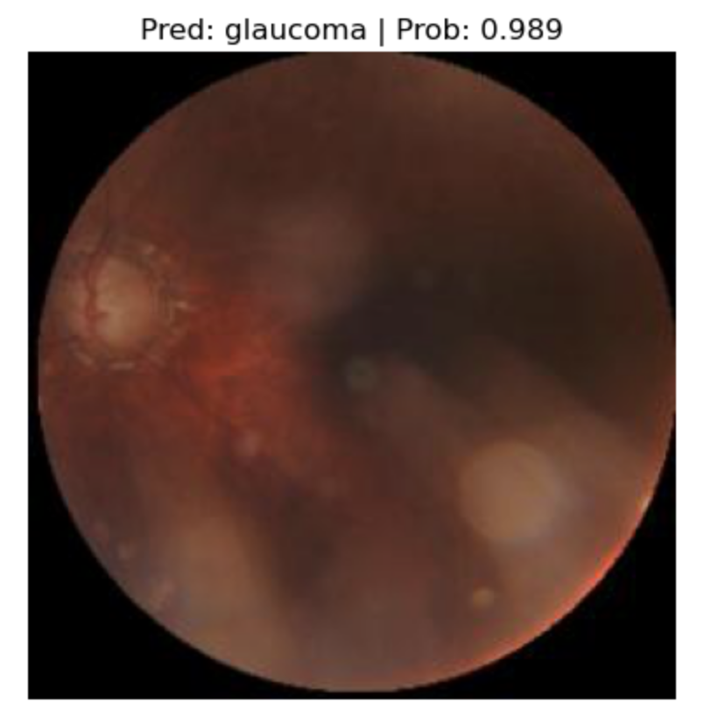
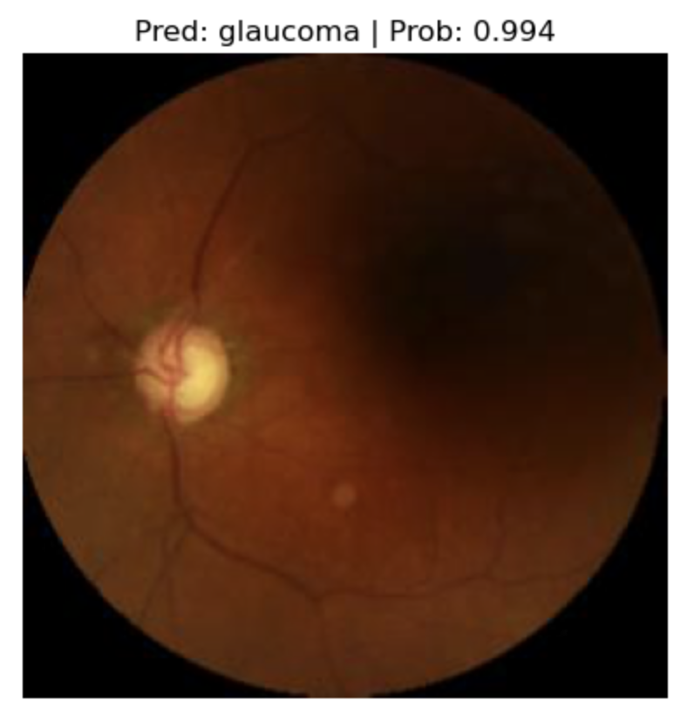
Results

Slide 16
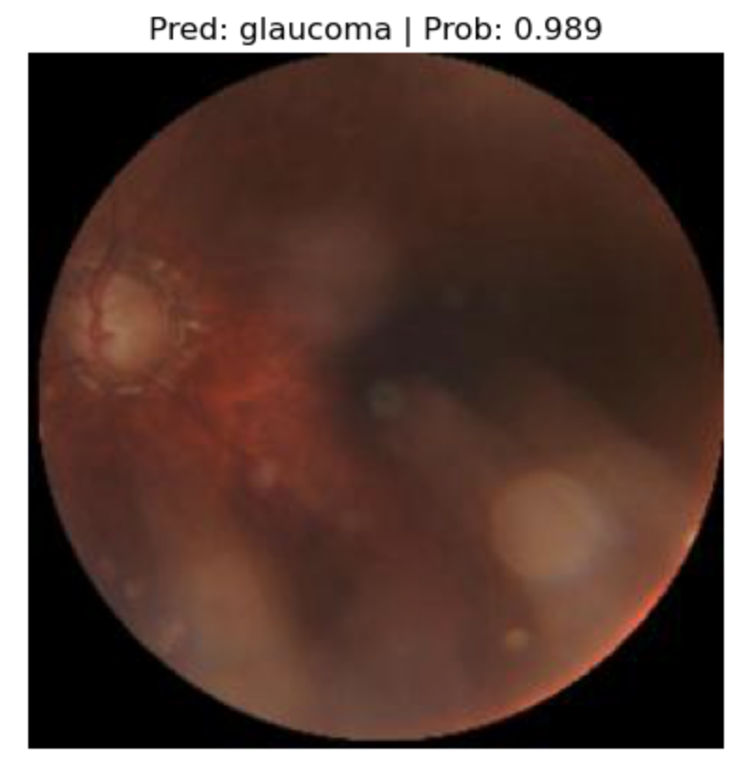
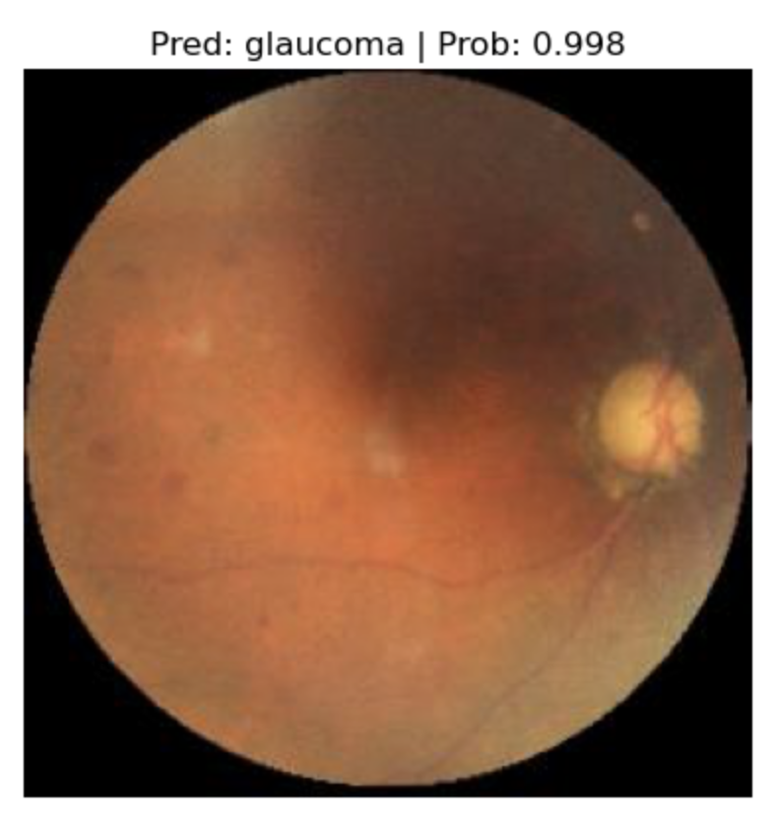
Results

Slide 17
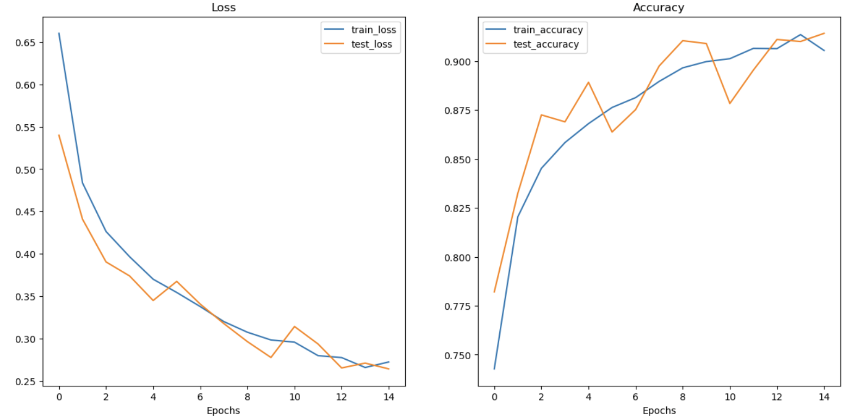
7. Accuracy and Loss Plots

Slide 18
THANK YOU

