Slide 1
Architecting a data layer

Slide 2
Entity Framework
.net api interacting with a variety of relational databases
Encapsulationg EF Code (repositories)
Notes:
Entity Framework,=> geen moeite om databanken aan te spreken
Entitiy framework code encapsuleren
De controller moet niet verantwoordelijk zijn voor de entity framework code

Slide 3
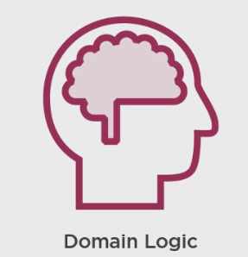
Architectural Starting Point
Most critical part = business problem the software is solving = domain.

Slide 4
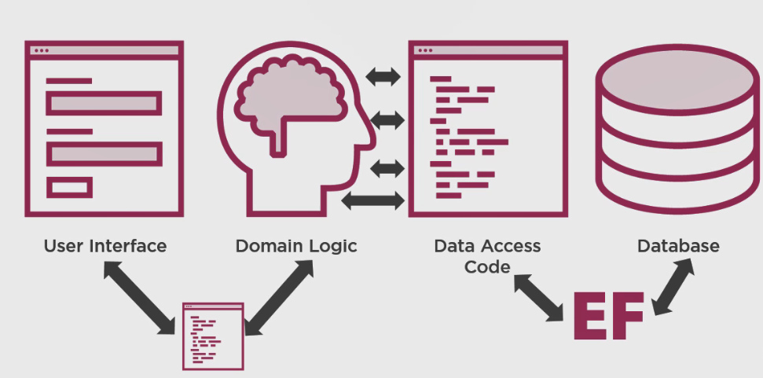
Architectural Starting Point
Notes:
So what does my basic architectural footprint look like? The most critical part of my application is the part which describes the business problem that the software is solving,
I refer to this as a domain. This will be made up of the classes that I use in my software and the business logic that reflect the behaviors and actions that the software needs to perform.
My user interface may communicate directly with this business logic or I might have application services that act as an intermediary between the user interfaces and my core business logic.
Depending on the complexity of my software, the application services may pass my domain classes directly to the user interface or pass up another set of classes that better map to the needs of the user interface.
What about persisting the information? My data is stored in a database, my business logic needs to be able to persist data into that database, and to retrieve data back from it.
Rather than wasting my cycles with a repetitive tasks of writing SQL, spinning up commands and connections studying the scheme of my database, transposing database results into objects, and so on.
Entity framework, or any ORM, can do this work for me.
So in my application architecture it's entity framework that talks directly to the database. Then there's my code, which talks to entity framework to ask it if it would be so kind as to get me some data and to send data back to the database on my behalf.
I don't write this code directly in my business logic, since getting and storing data is not usually the business problem that my software is aiming to solve.
So the code which encapsulates my queries, which I express with entity framework's linked to entities, and my request to store data, that's what becomes the connector between my business logic and the database. And that code then uses the underlying entity framework APIs to perform the interaction's with the database.
The reason I show a number of arrows between my domain logic and my data access code, is to make sure you understand that I'll probably have more than one class that encapsulates the logic I need to talk toentity framework. And I group my data interactions based on which subdomain of the software I'm working in. And as the application gets bigger, then I'm probably separating that logic even further.

Slide 5
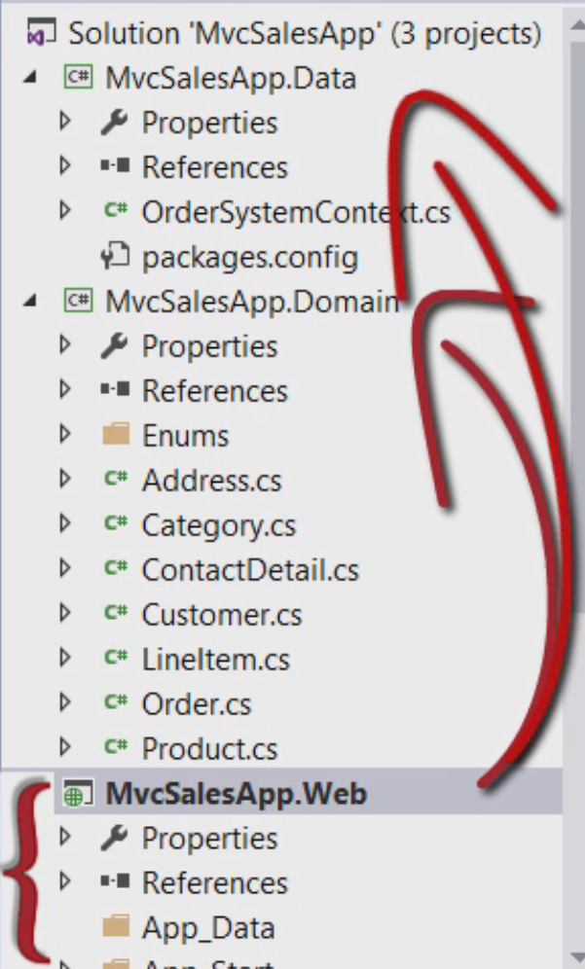
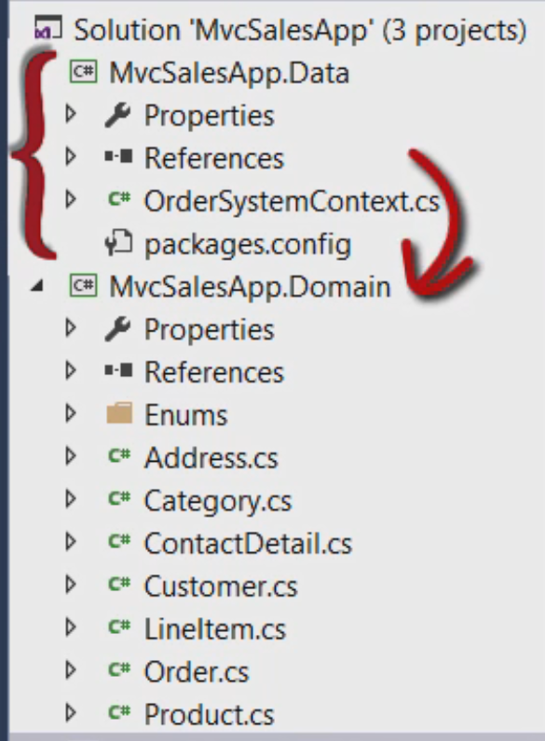
First pass at breaking apart a single project solution
Notes:
Now let's look at the same app, but I've done a first pass of breaking things up into separate projects. All I've done here was move classes around and fix up references.
I put the domain classes into their own project and the entity framework DbContext into its own project.
And that project needed entity framework2.1.1 installed, so I added that package using NuGet. Then it also needed reference to the project with a domain classes and then the web project, which I've renamed, needs references to both the domain and the data projects.
And everything still works, it's still now where I want it, but it's a great first step with very little effort.
Now I can focus on my domain classes and how I want them to behave in isolation of working on the UI views and controllers, although eventually,
those will need to align with any relevant changes I do make to the domain classes. And I can work onshaping my entity data model as a separate problem.

Slide 6
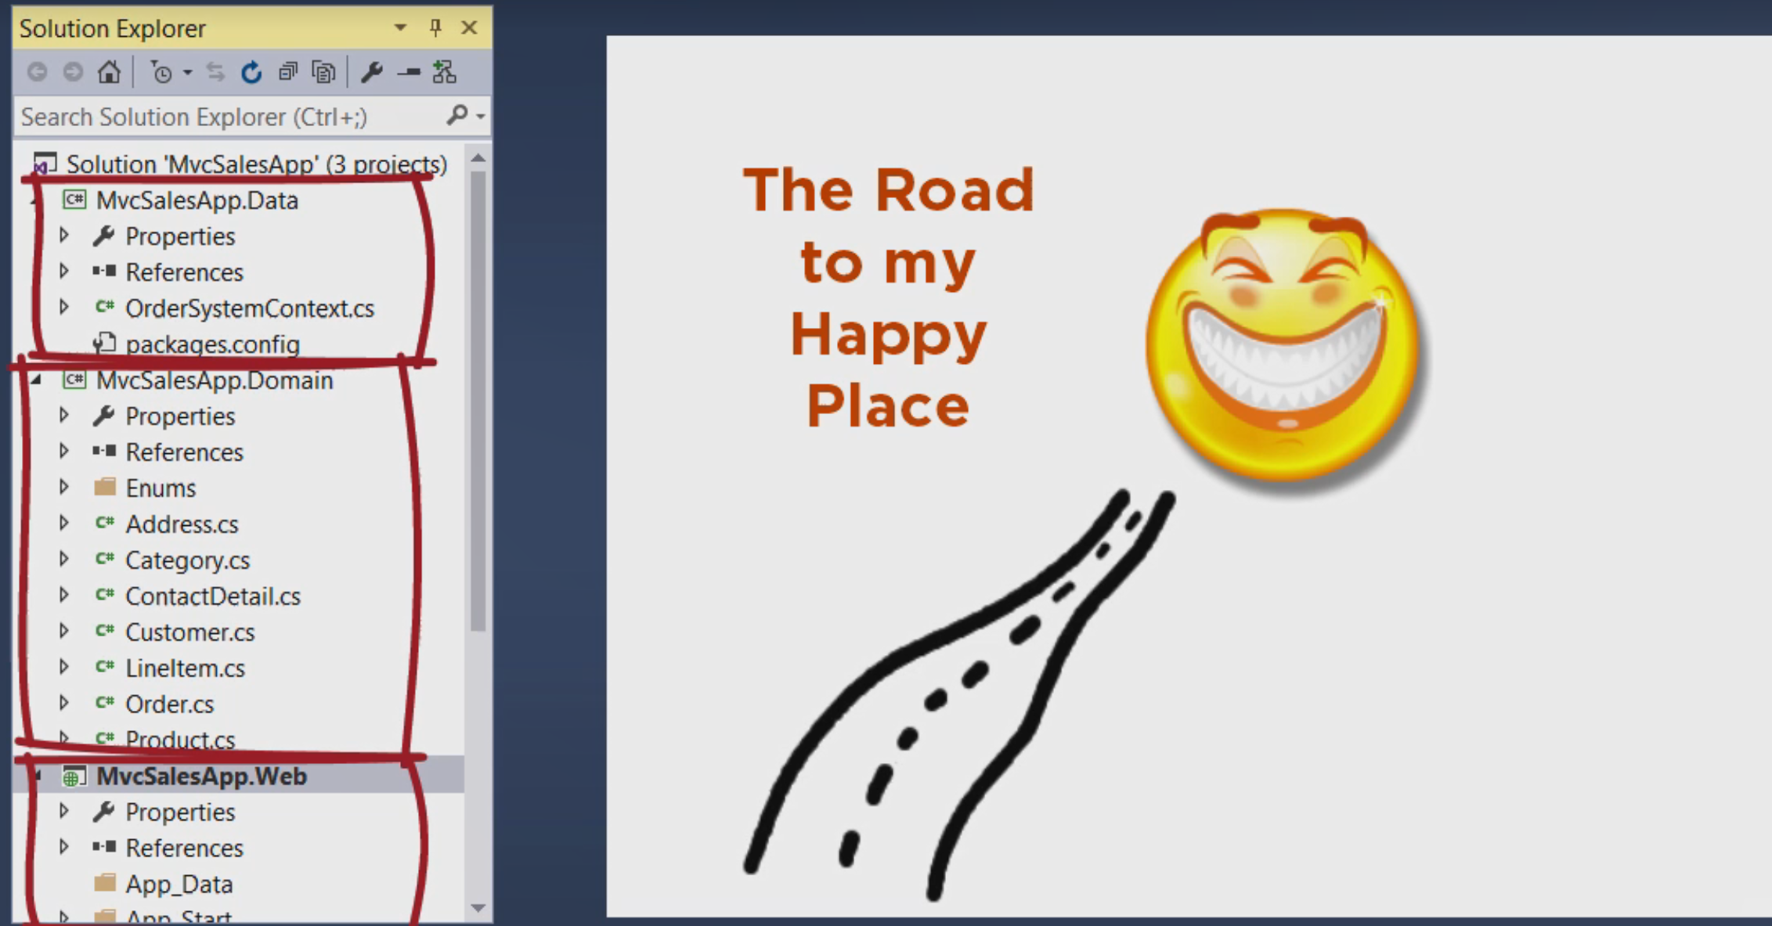
Notes:
I like breaking things apart, because it's so much less confusing and stressful to work on smaller, independent problems,
then to have everything thrown into a single pot and having to deal with a whole kitten caboodle any time you want to have a conversation about or make changes to this code.
So this still works, but there's still a big problem in here that bothers me, the web project is still very much aware of and dependent on entity framework.
In the controller classes I'm writing link to entities queries using the entity framework change tracker API and calling entity frameworks SaveChanges method to push data back to the database.
I don't want my UI to be concerned with the entity framework, nor any developers who are working with the UI, to have to know how to write any framework queries and how entity framework's change tracker works.
So what I prefer is to encapsulate the entity framework logic elsewhere and make simple methods for the author of the controller to call, without having any direct interaction with the entity framework.

Slide 7
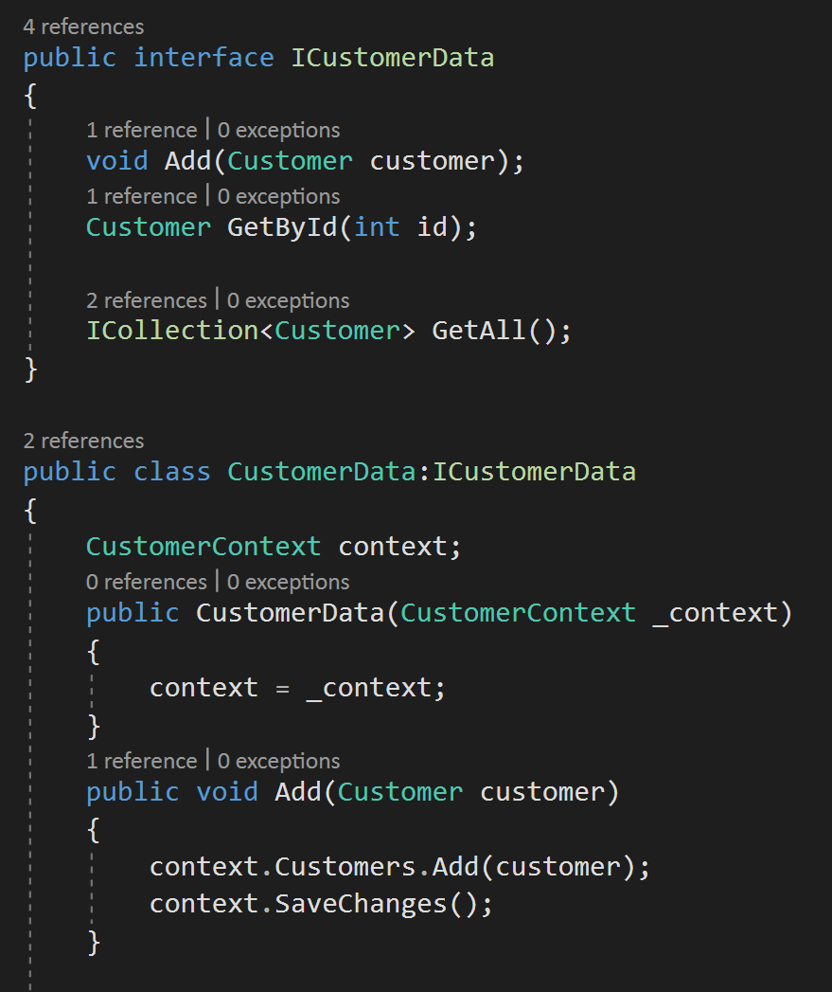
Removing Entity Framework from the UI
Notes:
The next pass of refactoring the solution is to encapsulate the entity framework code so I don't have to call it from the controllers. This allows me to completely remove the entity framework from the UI project.
Even if I were to separate out the controllers from the UI project into their own project, I still want to keep entity framework out of the controllers, for the same reasons I stated earlier.
However, my goal is to remove entity framework from this layer of the application. Encapsulating the entity framework code elsewhere is hardly excessive, I don't need to build something that follows the repository pattern itself just something that provides the functionality I need for my app to get at and to store the data.
My controller doesn't care how customer data works, just that this is the class I'm supposed to work with. I've got simplistic methods, like get all customers, and find customers, add, update, and delete. At this point I'm still using the simple read, add, update, and delete concepts that the MVC template created for me. And I haven't really introduced more intelligent behaviors. Another benefit of this encapsulation is that the web project is no longer dependent on entity framework, nor the entity framework SQL Server provider. Notice that both of those references are gone. It's still uses my data project, but I've simplified the dependencies of the web project. Let's look at the customer data class, it's my own class and I canwrite it however I want. Because my website performs each action per HTTP request, and my DbContext will be disposed immediately, there's no reason to waste resources by engaging entity framework's change tracker. So the queries I've written here use the AsNoTracking method, unlike a classic repository, I'm doing more than just storing in memory objects here. Rather than storing new or updated or deleted objects and then saving them later, I'll just persist my data to the database immediately in each action. A classic repository wouldn't do this, but I'm not following that pattern here. I'm just making sure my logic performs the way I want it to. In fact, it's worth noting that I could change how I want the backend of my website to behave at a later date. But the controller doesn't need to know, it will just continue to say, here's a new customer do whatever it is you do with newcustomers. I should also point out that even with these changes this is still demoware, if you download and run these apps, you'll find that not all of thefunctions are flushed out. For example, all you can do with customers with orders is look at the details, there wasn't any need to make this a fully functioning application just to show you the things I wanted to show you. It's still a good starting place, but I just can't stress enough that it's really important to understand the difference between demoware and your real world software.

Slide 8
Encapsulating in Object-Oriented Programming
A technique for hiding data and implementation of a class providing accessors in the form of public methods and properties

Slide 9
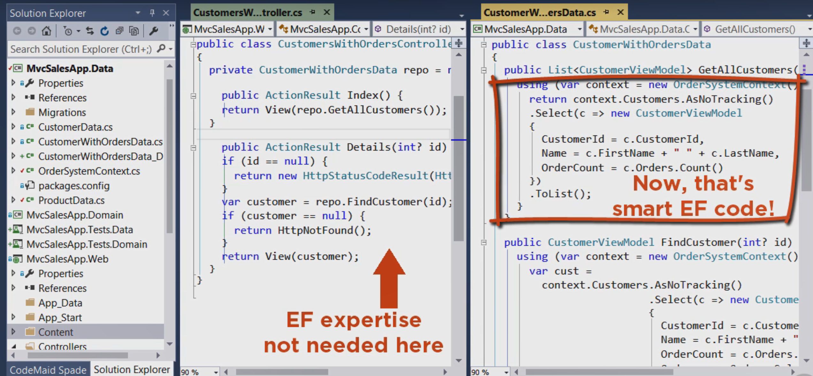
Benefits of encapsulating EF
Notes:
Encapsulation is related to the word capsule, which is a physical means of containment and protection. A pill capsule keeps the medicine together, it also constrains the dosage, and protects it from the atmosphere.
The most commonway of describing encapsulation is that it's a way to protect data and logic implementation by hiding those in a class and then providing public access, or such as getters, setters, and methods that constrain how external code can interact with that data in methods.
Encapsulating your entity framework data access code follows this pillar of OOP. If you want to maintain that code, you know just where to find it, rather than it being randomly scattered within other code throughout your application.
Plus you can protect your software from misuse of entity framework patterns by assigning those classes to be worked on by developers who really understand the ins and outs of entity framework.
And then other developers who come along to work in these classes can learn from the existing code and continue to follow the prescribed patterns. You're essentially building an API of how entity framework should be used in your software.

