Slide 1
Welcome to my presentation Name: Tinny Rani Nath Registrantion: 2020236022 Department of English First year Second Semester

Slide 2
Topic Name
Saving the environment: My suggestions

Slide 3
Outlines
What is happening in recent years?
Consequences
My suggestions
Environment declaration
Conclusion

Slide 4
What is happening?
In recent years, Scientist have been carefully examining the ways we affect the environment.
They found air pollution, deforestation, acid rain and other problems that are dangerous both to earth and our self.

Slide 5
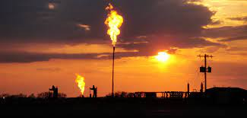
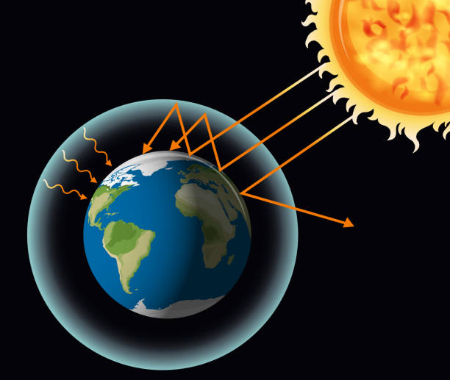
Burning fossil fuels, such as coal, oil and gas, releases carbon dioxide into the atmosphere
We call this The Greenhouse Effect,
because it is similar to how a greenhouse works
by trapping the heat from the sun

Slide 6
Suggestions
Here are some suggestions how to save environment:
Reduce, reuse and recycle
Reduce the use of chemical fertilizer
Conserve water
Use less fossil fuel
Creating awareness
Plant more trees
Reduce pollution
Reduce the use of plastics
Use LED bulbs

Slide 7

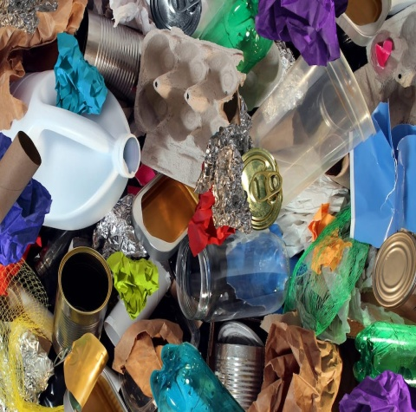
Reuse: We should reuse things when we can.
Don’t use disposable shopping bags.
Instead take a reusable bag
Reduce: It would be better for the environment
if we reduced the amount of things we buy and use.
It would also save us money

Slide 8


Recycle: Help the environment by recycle your waste
Recyclable materials include many kinds of glass, paper,
metal, plastic etc.

Slide 9
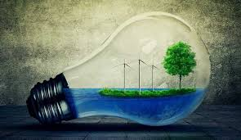
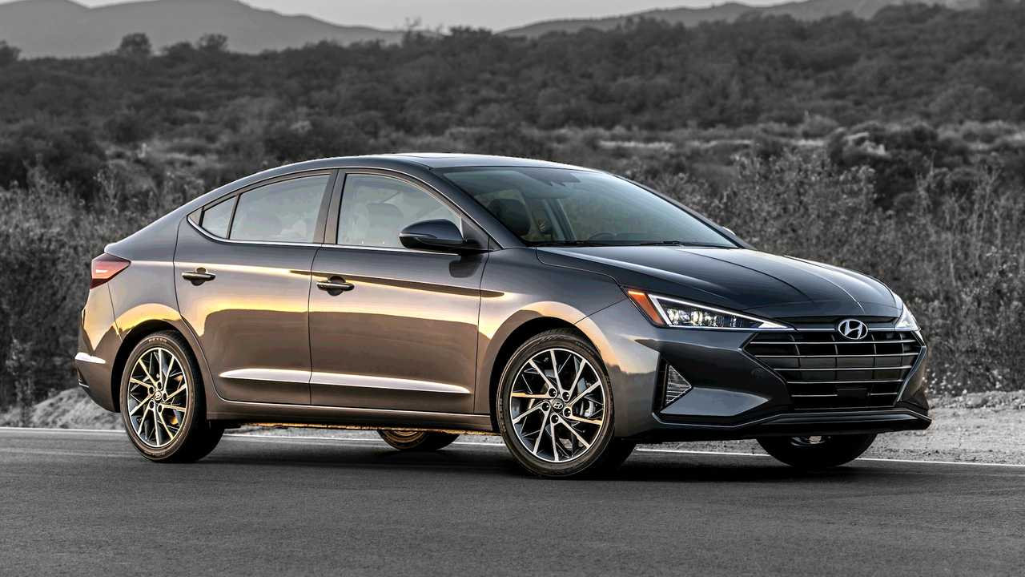
We should use energy saving light bulbs
And we can drive more efficient cars.

Slide 10
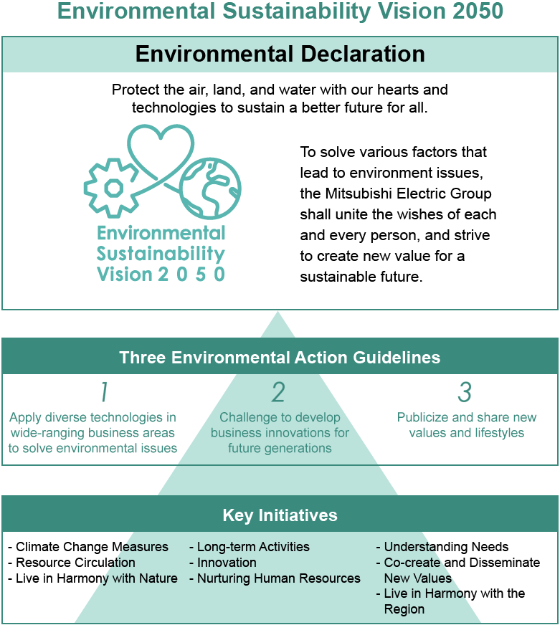
Environment Declaration

Slide 11
Conclusion
A healthy ecosystems provides clean water, purify air, maintain soil, regular the climate, recycle nutrients and provide good food.
Biodiversity is the key indicator of the health of an ecosystem.
Save the environment
Save the life

Slide 12
Thank you

