Slide 1
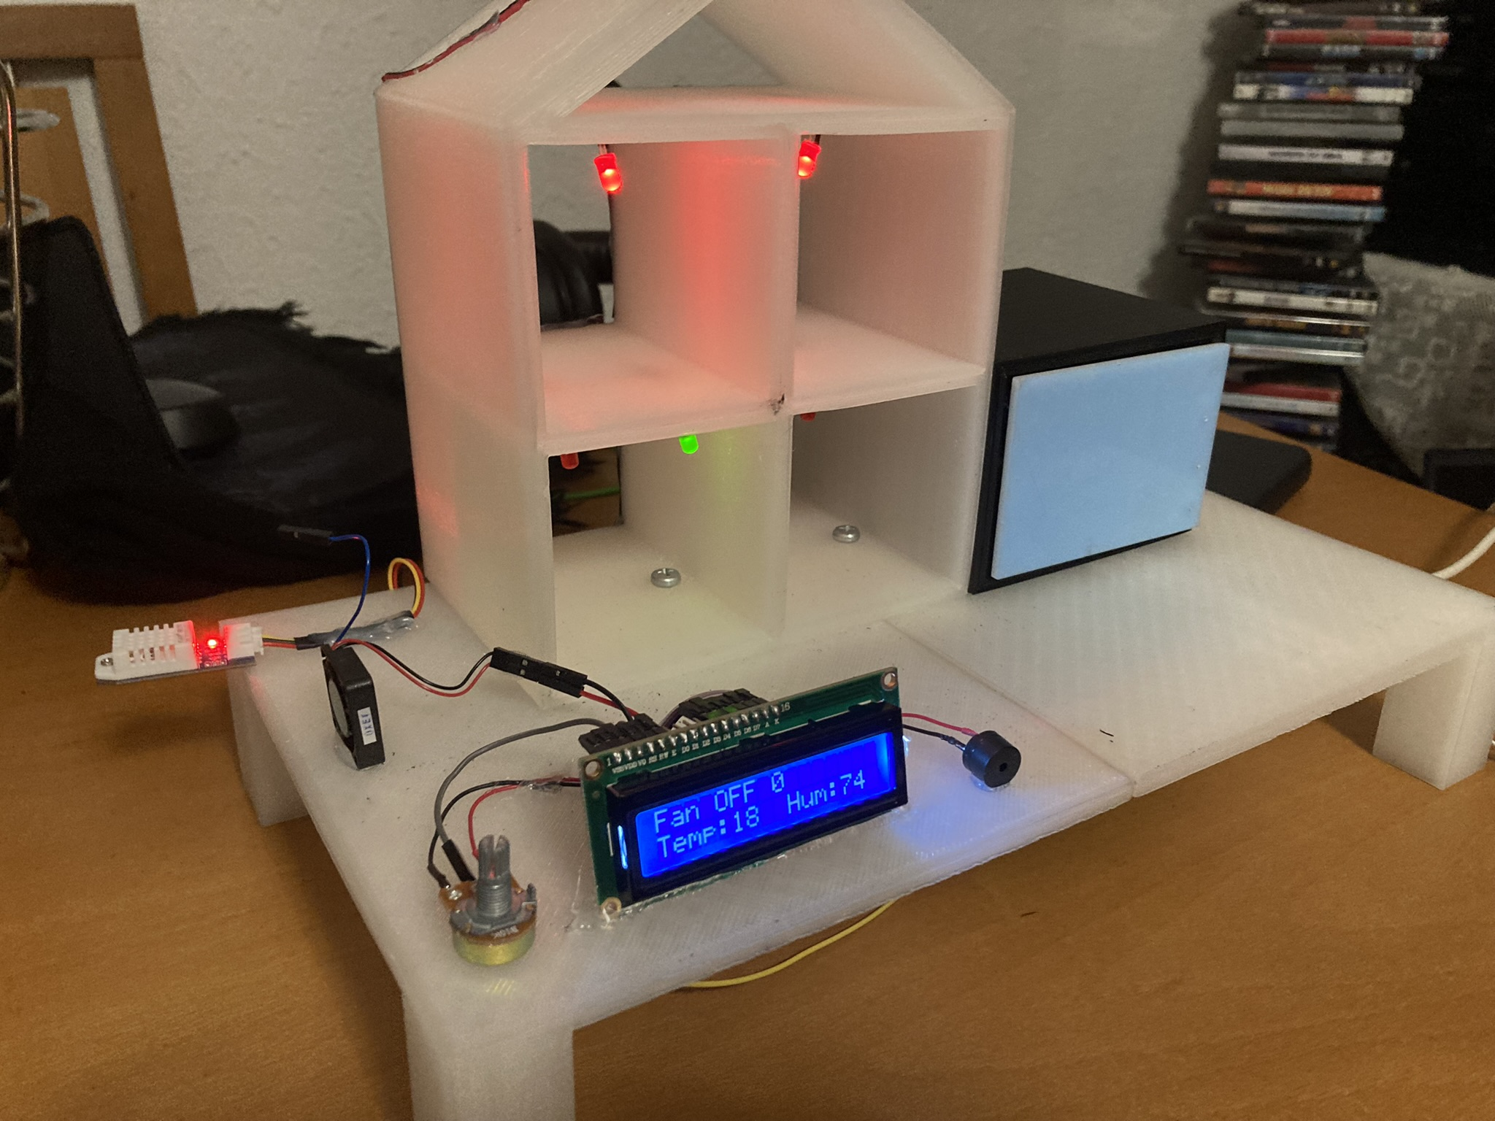
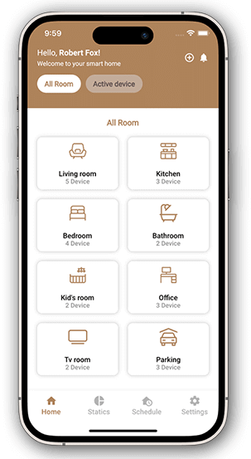
DIY Home Automation
Tiago Oliveira, Francisco Arantes, Luis Ferreira
Degree in Computer Systems Engineering
Supervisors: ESI 3rd year teachers 2023-2024
BACKGROUND
OBJECTIVES
IoT, or the Internet of Things, has emerged as one of the most promising technologies of the 21st century, fundamentally changing the way we interact with the world around us [1].
Its primary goal is to create an environment where objects, devices, and systems are interconnected and capable of autonomously capturing, transmitting, and sharing information.
IoT aims to enhance the quality of life for everyone by optimizing company workflows and fostering innovation. Smart houses, driven by IoT, represent a significant breakthrough in the way we develop and interact with our homes.
In essence, IoT is intended to simulate a residence, demonstrating how easy it is to incorporate this technology into our daily lives.
Develop a model with the aim of simulating a smart house:
Implement a system to control de inside lighting;
Implement a system focused on controlling the environments temperature;
Implement an alarm system with a motion sensor;
Implement a system capable of connecting all together the previous systems;
Control the residence through the mobile application:
Connect the user to his own residence;
Allow the user to check up all of the smart devices (sensors, LEDs (Light-emitting diode) and engine);
Allow the manipulation of every device’s state.
METHODOLOGY
We adopted SCRUM (Sprint, Cycle, Review, Update and Meeting) as our methodology for project management, defining delivery dates and specifying the main roles for each active member of the project [2].
The GIT (Global Information Tracker) platform was chosen to control the various versions of the project during its development [3].
Discord served as the platform for online meetings, and Trello was used to organize and manage various tasks [4].
Visual Studio was employed to create the API (Application programming interface), leveraging its strength as a development tool [5][6].
SQL (Structured Query Language) Server Management Studio was utilized to manage and manipulate data in the database [7].
We used Android Studio for the development of an Android application, which allows users to manage their residence through it [8].
RESULTS AND CONCLUSIONS
BIBLIOGRAPHY
A model home was built to simulate a smart residence , equipped with light, temperature, humidity, and movement sensors (figure 1). ***
https://www.oracle.com/pt/internet-of-things/what-is-iot/
https://www.techtarget.com/searchsoftwarequality/definition/Scrum
https://git-scm.com/book/en/v2/Getting-Started-What-is-Git%3F
https://discord.com/
https://learn.microsoft.com/en-us/visualstudio/get-started/visual-studio-ide?view=vs-2022
https://aws.amazon.com/what-is/api/
https://aws.amazon.com/what-is/sql/
https://developer.android.com/studio/intro
Figure 1: Smart house model
Figure 2: Application model
CONTACTS
Email of Francisco Arantes: a16622@alunos.ipca.pt
Email of Tiago Oliveira: a23504@alunos.ipca.pt
Email of Luis Ferreira: a23516@alunos.ipca.pt

