Slide 1
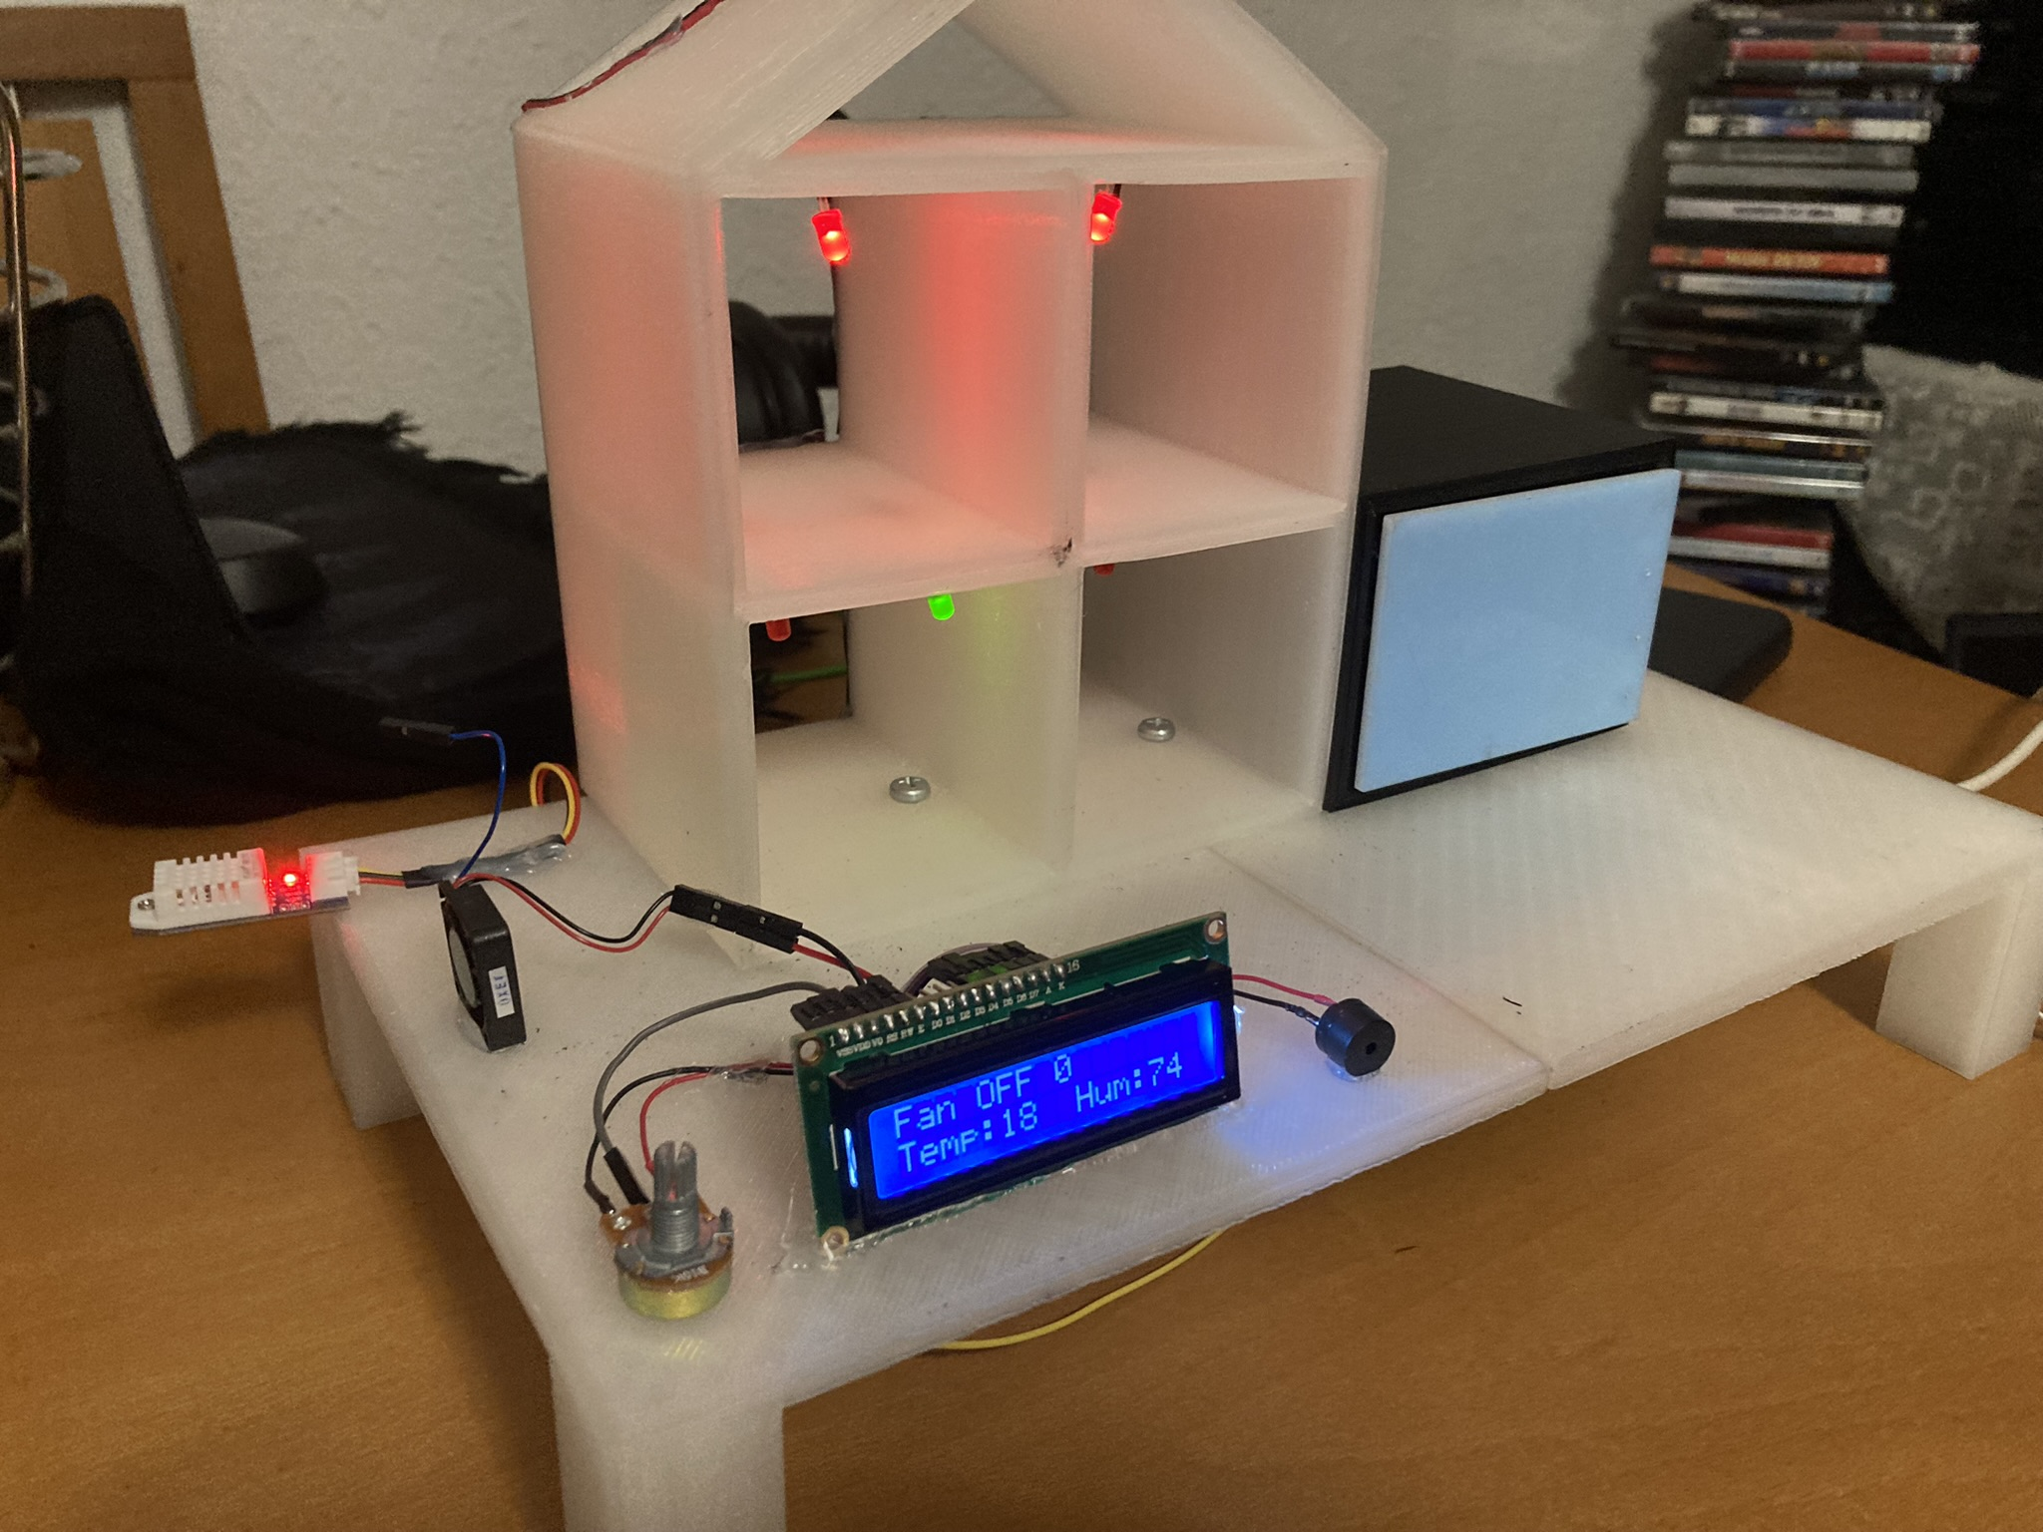
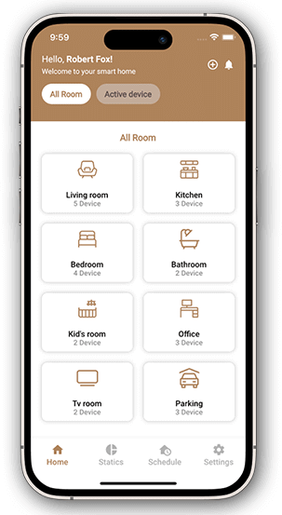
DIY Home Automation
Tiago Oliveira, Francisco Arantes, Luis Ferreira
Degree in Computer Systems Engineering
Supervisors: ESI 3rd year teachers 2023-2024
BACKGROUND
OBJECTIVES
IoT, or the Internet of Things, has emerged as one of the most promising technologies of the 21st century, fundamentally changing the way we interact with the world around us. Its primary goal is to create an environment where objects, devices, and systems are interconnected and capable of autonomously capturing, transmitting, and sharing information.
IoT aims to enhance the quality of life for everyone by optimizing company workflows and fostering innovation. Smart houses, driven by IoT, represent a significant breakthrough in the way we develop and interact with our homes.
In essence, IoT is intended to simulate a residence, demonstrating how easy it is to incorporate this technology into our daily lives.
Develop a model with the aim of simulating a smart house:
Implement a system to control de inside lighting;
Implement a system focused on controlling the environments temperature;
Implement a alarm system with a motion sensor;
Implement a system capable of connecting all of the previous systems;
Control de residence through the mobile App:
Connect the user to his own residence;
Allow the user to check up all of the smart devices (sensors, LEDs and engine);
Allow the manipulation of every device’s state.
METHODOLOGY
We adopted SCRUM as our methodology for project management, defining delivery dates and specifying the main roles for each active member of the project. The GIT platform was chosen to control the various versions of the project during its development. Discord served as the platform for online meetings, and Trello was used to organize and manage various tasks.
Visual Studio was employed to create the API, leveraging its strength as a development tool. SQL Server Management Studio was utilized to manage and manipulate data in the database.
We used Android Studio for the development of an Android app, which allows users to manage their residence through it.
RESULTS AND CONCLUSIONS
BIBLIOGRAPHY
A model home was built to simulate a smart residence, equipped with light, temperature, humidity, and movement sensors, along with an API capable of connecting the Android app and the database.
https://www.crompton.co.in/;
www.researchgate.net
www.asurion.com
https://www.firgelliauto.com/pt-pt
https://www.angi.com/
https://www.taskrabbit.pt/
https://smartify.pt/
https://www.apple.com/home-app/
https://www.home-assistant.io/
https://sonoff.tech/
https://home.google.com/welcome/
https://www.se.com/ww/en/
https://aminhacasadigital.pt/
CONTACTS
Email1: a16622@alunos.ipca.pt
Email2: a23504@alunos.ipca.pt
Email3: a23516@alunos.ipca.pt

