Slide 1
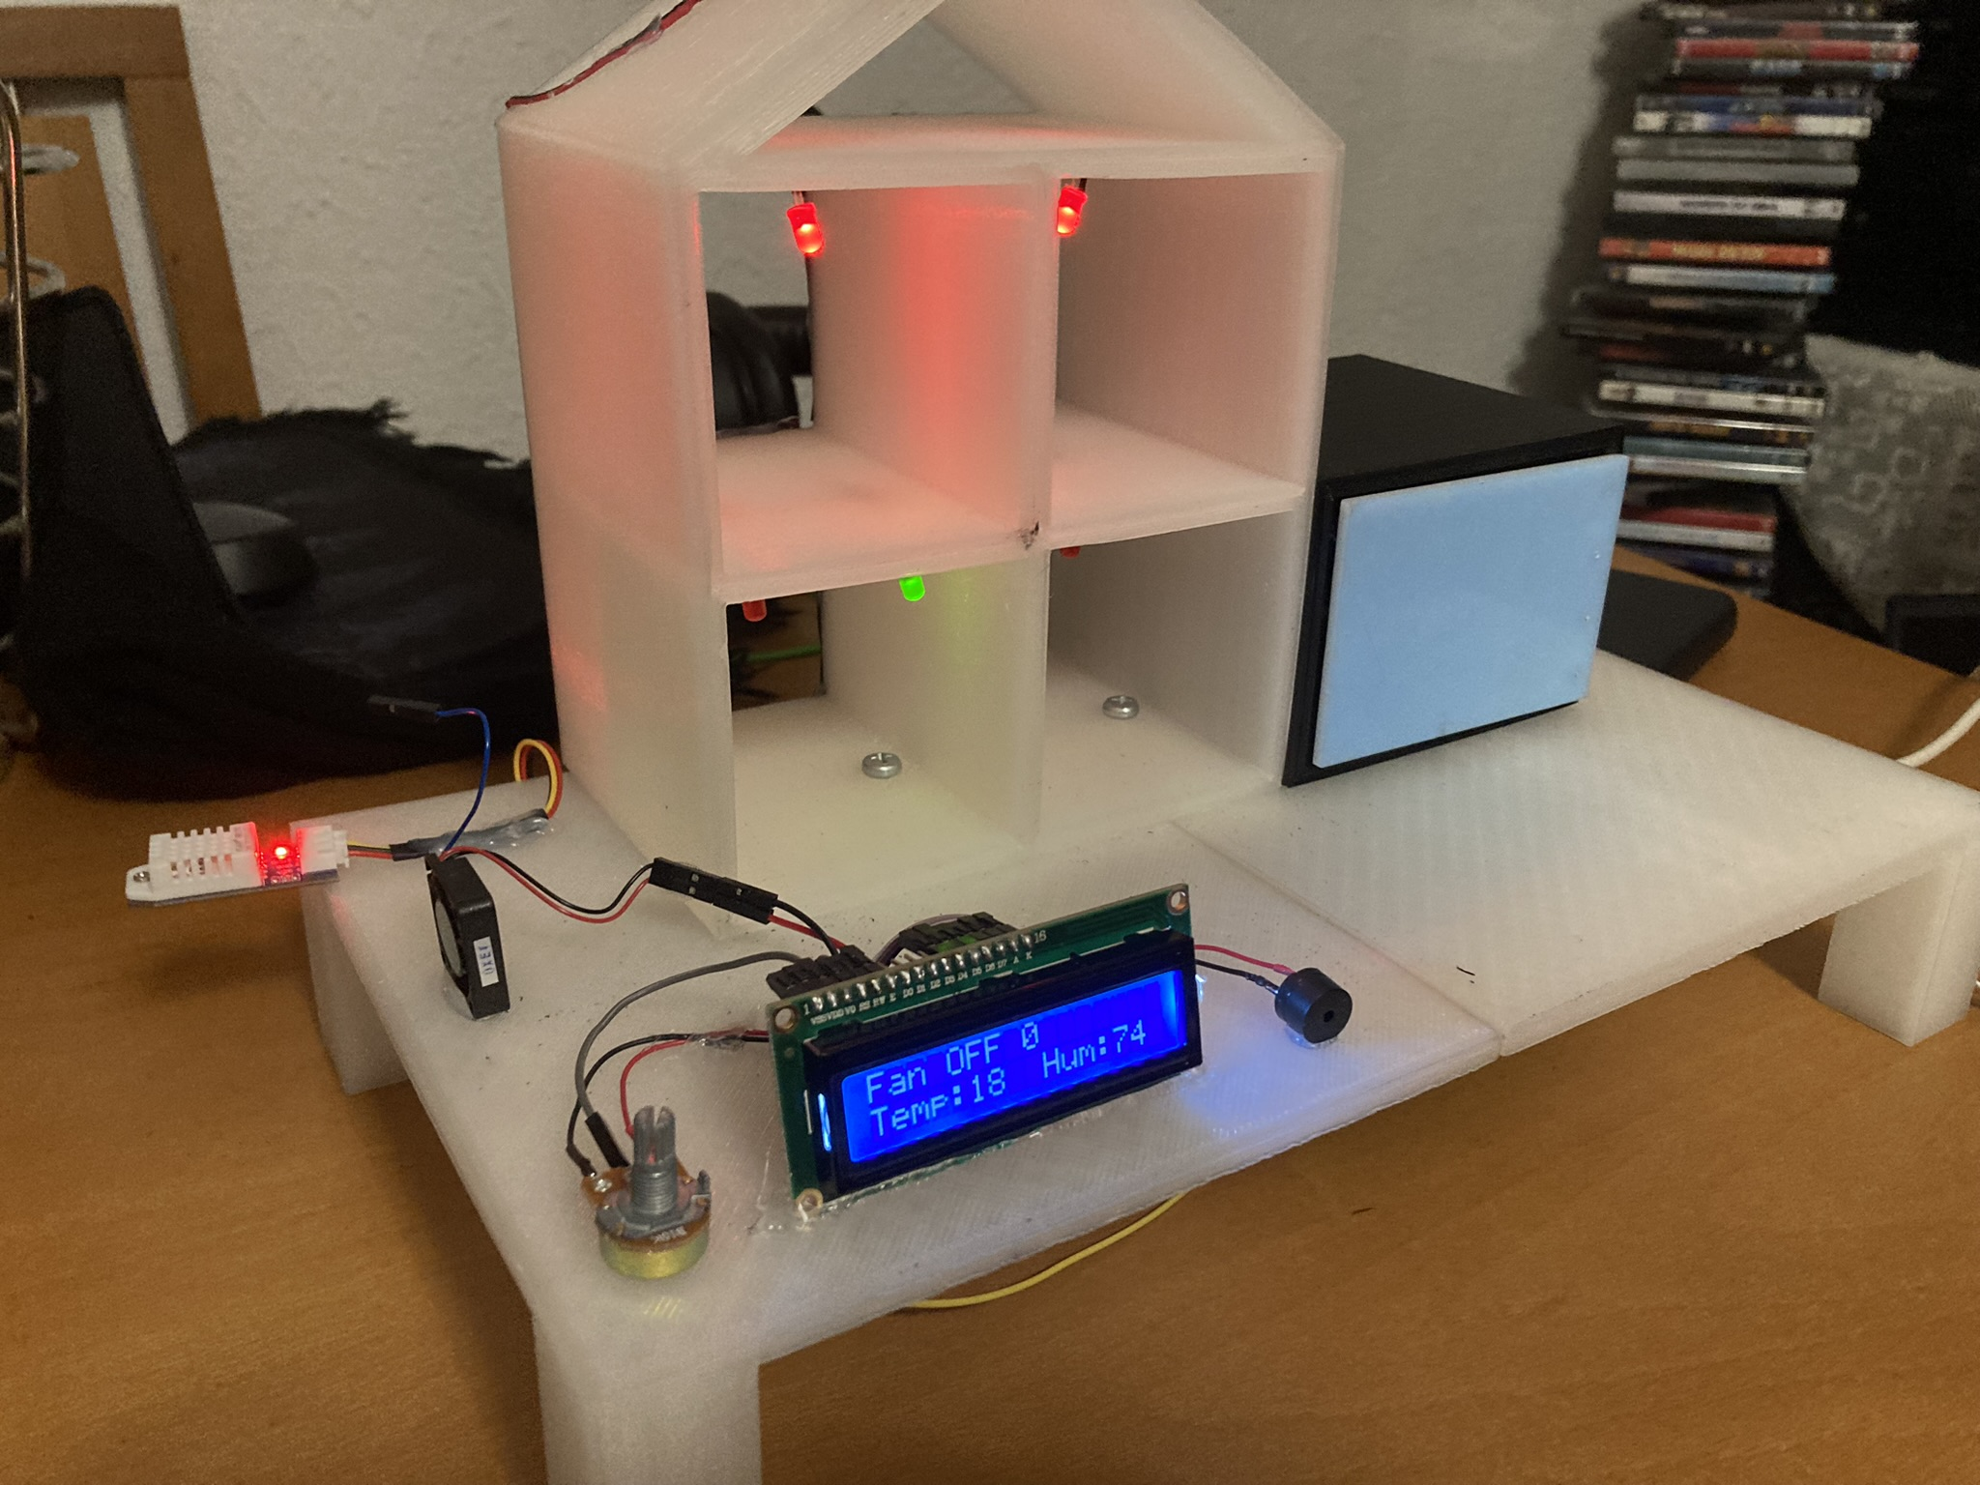
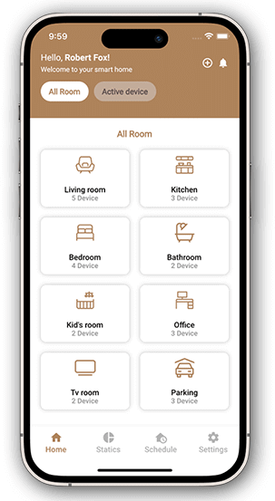
DIY Home Automation
Tiago Oliveira, Francisco Arantes, Luis Ferreira
Degree in Computer Systems Engineering
Supervisors: Patricia Leite, Paulo Macedo and Nuno Mendes
BACKGROUND
OBJECTIVES
IoT, or the Internet of Things, has emerged as one of the most promising technologies of the 21st century, fundamentally changing the way we interact with the world around us. Its primary goal is to create an environment where objects, devices, and systems are interconnected and capable of autonomously capturing, transmitting, and sharing information. IoT aims to enhance the quality of life for everyone by optimizing company workflows and fostering innovation [1].
Smart houses, driven by IoT, represent a significant breakthrough in the way we develop and interact with our homes. In essence, IoT is intended to simulate a residence, demonstrating how easy it is to incorporate this technology into our daily lives. Contemporary smart homes seamlessly integrate IoT through dedicated mobile applications, serving as user-friendly interfaces for effortless interaction with smart house features via smartphones. Essentially, these mobile applications play a pivotal role in establishing a direct and user-friendly interface with the intricate IoT infrastructure embedded in contemporary smart homes, marking a significant leap in home automation technology [2].
Develop a model with the aim of simulating a smart house:
Implement a system to control de inside lighting;
Implement a system focused on controlling the environments temperature;
Implement an alarm system with a motion sensor;
Implement a system capable of connecting all together the previous systems;
Control the residence through the mobile application:
Connect the user to his own residence;
Allow the user to check up all of the smart devices (sensors, LEDs (Light-emitting diode) and engine);
Allow the manipulation of every device’s state.
METHODOLOGY
We adopted SCRUM (Sprint, Cycle, Review, Update and Meeting) as our methodology for project management, defining delivery dates and specifying the main roles for each active member of the project [3].
The GIT (Global Information Tracker) platform was chosen to control the various versions of the project during its development [4].
Discord served as the platform for online meetings, and Trello was used to organize and manage various tasks.
Visual Studio was employed to create the API (Application programming interface), leveraging its strength as a development tool [5][6].
SQL (Structured Query Language) Server Management Studio was utilized to manage and manipulate data in the database [7].
We used Android Studio for the development of an Android application, which allows users to manage their residence through it [8].
The Arduino IDE (Integrated Development Environment) is an open-source software platform used for programming Arduino boards. We utilized it to program the systems integrated into our model [9].
RESULTS AND CONCLUSIONS
BIBLIOGRAPHY
In summary, our project created a model home simulating a smart residence with light, temperature, humidity, and movement sensors. It featured LEDs, an LCD display, and a servo motor for garage door simulation (Figure 1). An Android application was developed to facilitate control of the residence through a mobile application where the user is capable of connect to is own residence and manipulate the state of his own devices (Figure 2). In conclusion, our project successfully brought to life a model home that emulates the functionalities of a smart residence.
What Is the Internet of Things (IoT)? (n.d.). Oracle. https://www.oracle.com/en/internet-of-things/what-is-iot
Aliza Vigderman, & Gabe Turner. (2024, January 3). What Is Home Automation and How Does It Work? Security.Org. https://www.security.org/home-automation/
Ben Lutkevich. (2021, October). What is Scrum? https://www.techtarget.com/searchsoftwarequality/definition/Scrum
Getting Started - What is Git? (n.d.). Git--Fast-Version-Control. https://git-scm.com/book/en/v2/Getting-Started-What-is-Git%3F
What is the Visual Studio IDE? (2023, October 24). Microsoft Learn. https://learn.microsoft.com/en-us/visualstudio/get-started/visual-studio-ide?view=vs-2022
What is a API? – Explanation about Application Programming Interfaces. (n.d.). AWS. https://aws.amazon.com/en/what-is/api/
What is SQL? (Structured Query Language) ? (n.d.). AWS. https://aws.amazon.com/en/what-is/sql/
Meet Android Studio. (2023, December 13). Android Developers. https://developer.android.com/studio/intro?hl=en
Liam Aljundi. (2024, January 4). Using the Arduino Software (IDE). Arduino Documentation. https://docs.arduino.cc/learn/starting-guide/the-arduino-software-ide
Figure 1: Smart house model
Figure 2: Application model
CONTACTS
Email of Tiago Oliveira: a23504@alunos.ipca.pt
Email of Francisco Arantes: a16622@alunos.ipca.pt
Email of Luis Ferreira: a23516@alunos.ipca.pt

