Slide 1

The Devout
Name: Francis James
Age: 56
Technology: Family Desktop computer, Cell phone
Tasks: Find a way to request prayer intentions. Find information about a spiritual retreat. Learn about the order and their founderess.
“I heard about this monastery in western Missouri, I hope that they will say a prayer for my extended family.”

Slide 2

The Discerning
Name: Mary Williams
Age: 17
Technology: Cell phone, school issued chromebook
Tasks: Find information about the order’s particular beliefs. When are there opportunities to view what being a religious is like. Arrange a retreat to view things up close.
“I’ve always had an interest in being a nun, maybe this order will suit me.”

Slide 3
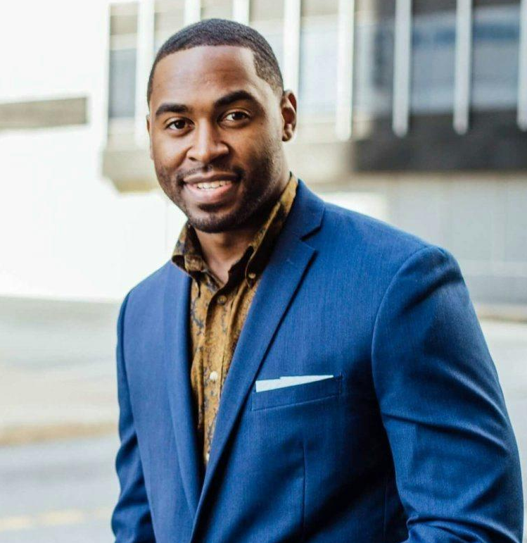
The Curious
Name: Jaime Tanner
Age: 23
Technology: Cell phone, Laptop, Ipad
Tasks: Find out about the order. What services do they offer? How do they sustain themselves? Can I make a donation as a form of alms?
“I help the church where I can, maybe this will be a good place to donate.”

